Slide 1
PHY 712 Electrodynamics
9-9:50 AM MWF Olin 103
Plan for Lecture 27:
Finish Chap. 11 and begin Chap. 14
Electromagnetic field transformations & corresponding analysis using Liénard-Wiechert potentials for constant velocity sources
Radiation by moving charged particles

Slide 2
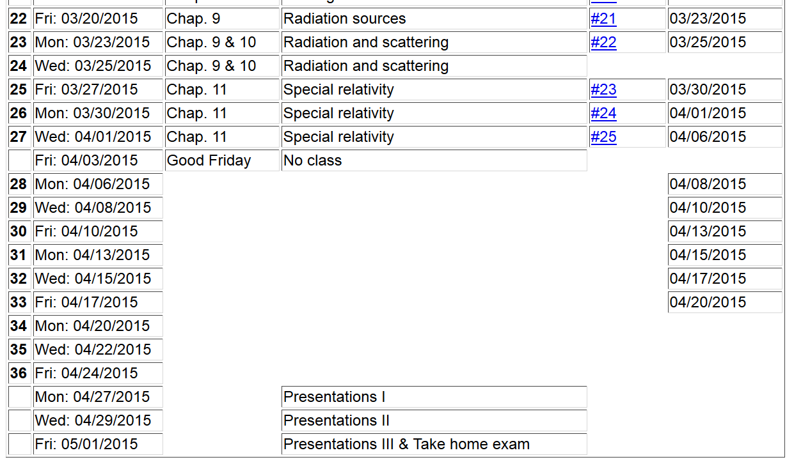

Slide 4
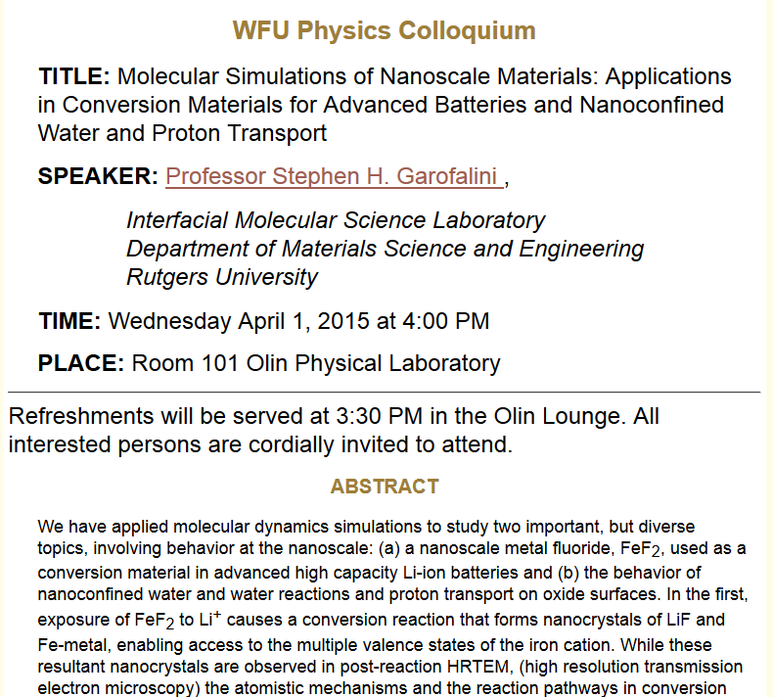

Slide 5
Inverse transformation of field strength tensor

Slide 6
Example:
y
y’
v
b
q
x
x’
z
z’

Slide 7
Example:
y
y’
v
b
q
x
x’
z
z’

Slide 8
Example:
y
y’
v
b
q
x
x’
z
z’
Expression in terms of consistent coordinates

Slide 9
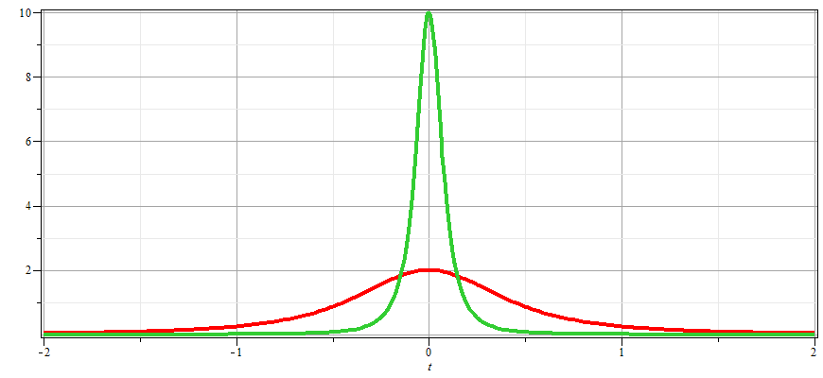
γ_{v}=10
γ_{v}=2

Slide 10
Examination of this system from the viewpoint of the
the Liènard-Wiechert potentials –(Gaussian units)

Slide 11
Examination of this system from the viewpoint of the
the Liènard-Wiechert potentials –(Gaussian units)

Slide 12
Some details

Slide 13
Some details continued:

Slide 14
Radiation from a moving charged particle
z
r-R_{q}(t)
q
r
R_{q}(t)
y
x

Slide 15
Liénard-Wiechert fields (cgs Gaussian units):

Slide 16
Electric field far from source:

Slide 17
Poynting vector:

Slide 18
Power radiated

Slide 19
Radiation from a moving charged particle
z
.
v
r-R_{q}(t_{r})=R
q
Θ
r
R_{q}(t)
y
x

Slide 20
Radiation power in non-relativistic case -- continued

