Slide 1
PHY 712 Electrodynamics
9-9:50 AM MWF Olin 103
Plan for Lecture 29:
Continue reading Chap. 14 – Synchrotron radiation
Radiation from electron synchrotron devices
Radiation from astronomical objects in circular orbits

Slide 2
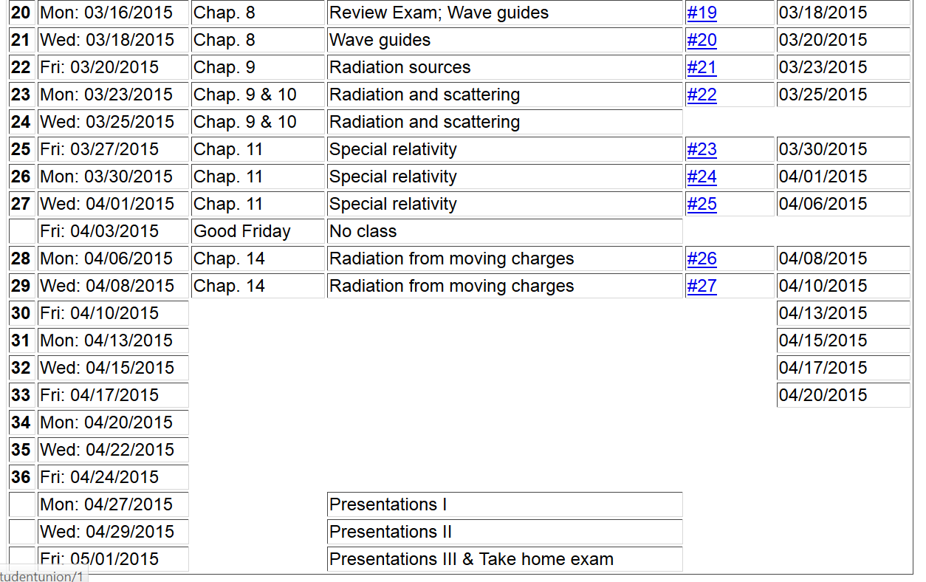

Slide 5
Radiation from charged particle in circular path
z
r
.
Power distribution for circular acceleration
θ
β
y
β
x

Slide 6
Spectral composition of electromagnetic radiation -- continued

Slide 7
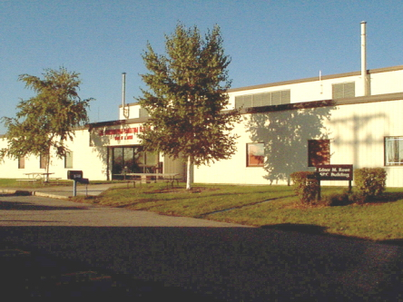
Synchrotron radiation light source installations
Synchrotron radiation center in Madison, Wisconsin
E_{c}=0.5 GeV and 1 GeV; λ_{c} = 20 Å and 10 Å
http://www.src.wisc.edu/

Slide 8
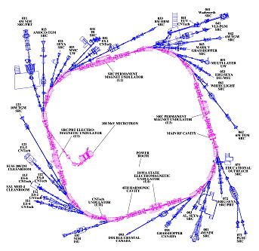
SRC – “Aladdin” --
Madison
Wisconsin

Slide 9
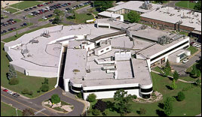
Brookhaven National Laboratory – National Light Source
E_{c}=0.6 GeV; λ_{c} = 20 Å
http://www.bnl.gov/ps/

Slide 10
z
r
.
θ
β
y
β
Top view:
x
ρ
y
x

Slide 11
z
r
.
θ
β
y
β
x

Slide 12
z
r
.
θ
β
y
β
x

Slide 14
Some details:
Modified Bessel functions
Exponential factor

Slide 15
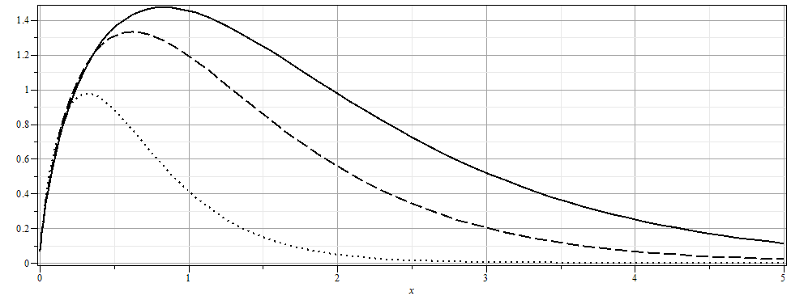

Slide 16
The second example of synchroton radiation comes from a distant charged particle moving in a circular trajectory such that the spectrum represents a superposition of light generated over many complete circles. In this case, there is an interference effect which results in the spectrum consisting
of discrete multiples of v/ρ. For this case we need to reconsider the analysis. There is a very convenient Bessel function identity of the form:

Slide 17
Astronomical synchrotron radiation -- continued:

Slide 18
Astronomical synchrotron radiation -- continued:
In both of the expressions, the sum over m includes both negative and positive values. However, only the positive values of ω and therefore positive values of m are of interest. Using the identity: the
result becomes:
These results were derived by Julian Schwinger (Phys. Rev. 75, 1912-1925 (1949)). The discrete case is similar to the result quoted in Problem 14.15 in Jackson's text. For information on man-made synchrotron sources, the following web page is useful: http://www.als.lbl.gov/als/synchrotron_sources.html.

