Slide 1
PHY 712 Electrodynamics
9-9:50 AM MWF Olin 103
Plan for Lecture 30:
Finish reading Chap. 14 –
Radiation from charged particles
Review of synchrotron radiation
Free electron laser
Thompson and Compton scattering

Slide 2
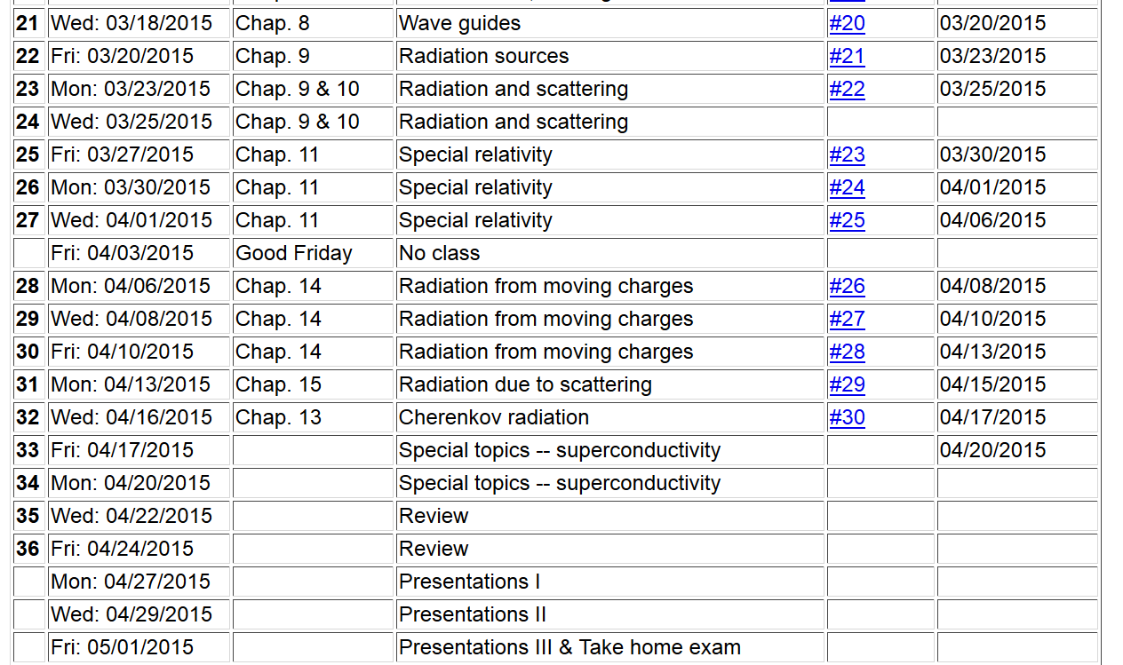

Slide 3
Radiation from a moving charged particle
z
r-R_{q}(t)
q
r
R_{q}(t)
y
x

Slide 4
Liénard-Wiechert fields (cgs Gaussian units):

Slide 5
Electric and magnetic fields far from source:

Slide 6
Poynting vector:

Slide 7
Spectral composition of electromagnetic radiation

Slide 8
Spectral composition of electromagnetic radiation -- continued

Slide 9
z
Example for circular motion:
r
.
θ
β
y
β
Top view:
x
ρ
y
x

Slide 10
z
r
.
θ
β
y
β
x

Slide 11
Synchrotron radiation geometry –
using modified Bessel functions
Exponential factor

Slide 12
Spectral form of synchrotron radiation in this case:

Slide 13
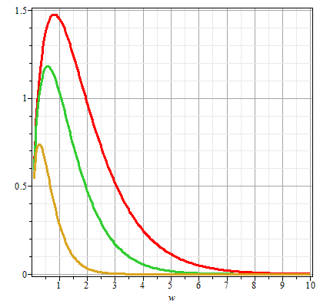
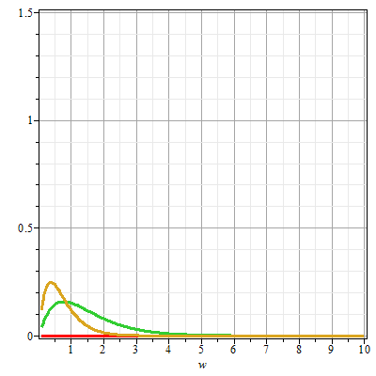
Plots of the intensity function for synchrotron radiation
γθ=0
γθ=0.5
γθ=1
γθ=1
γθ=0.5
ω/ω_{c}
ω/ω_{c}

Slide 14
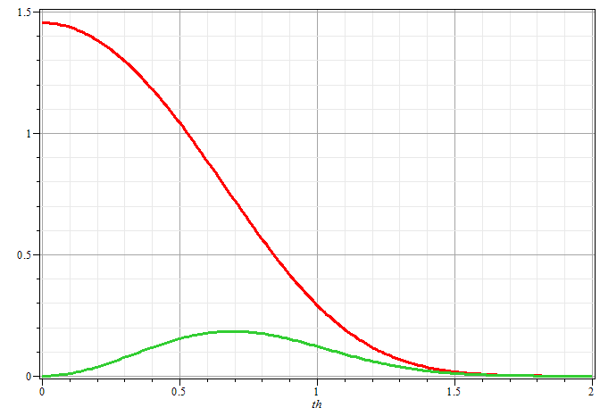
Plots of the intensity function for synchrotron radiation
ω/ω_{c}=1
γθ

Slide 15
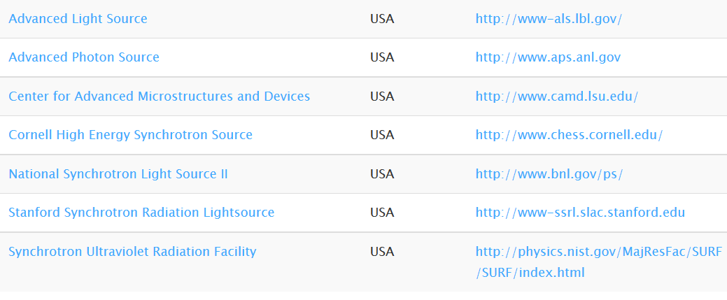
Synchrotron facilities in USA
http://www.lightsources.org/regions

Slide 16
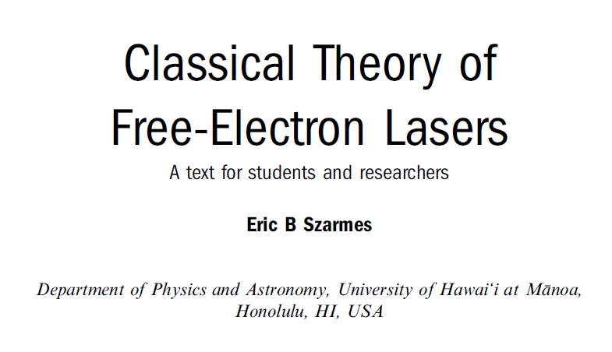
Free electron laser
Reference:

Slide 17
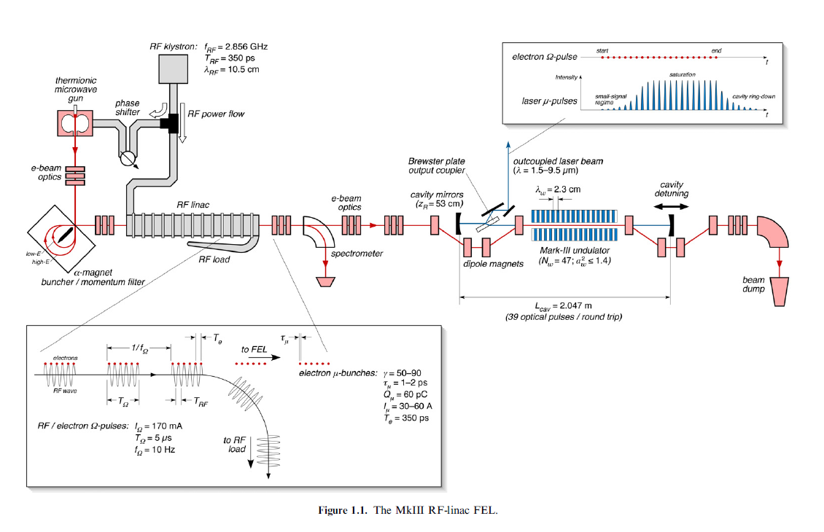

Slide 18
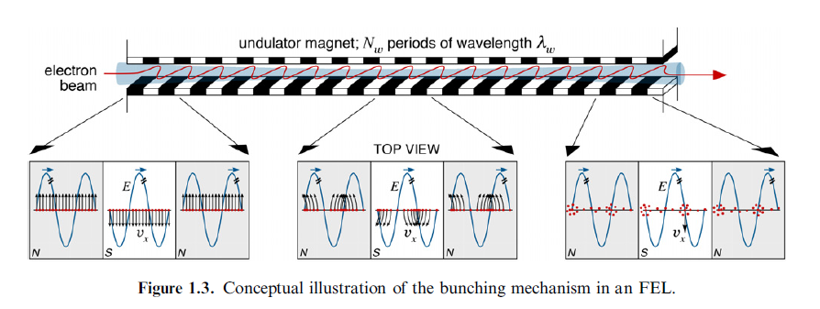
Electron emission in periodic magnet

Slide 19
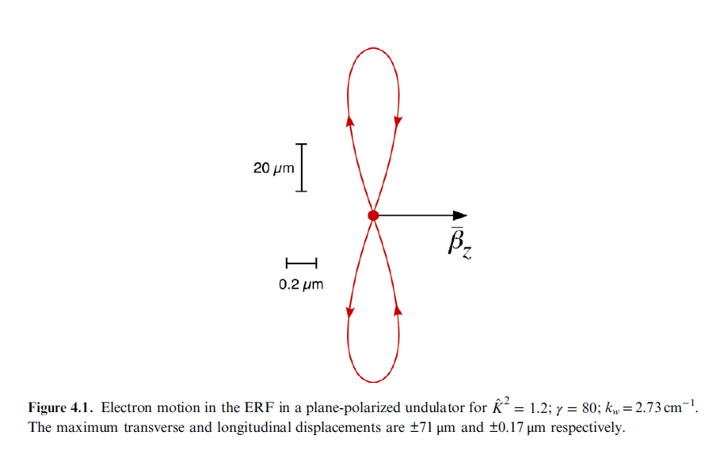
Electron trajectory near magnetic in undulator viewed in the electron rest frame (ERF)

Slide 20
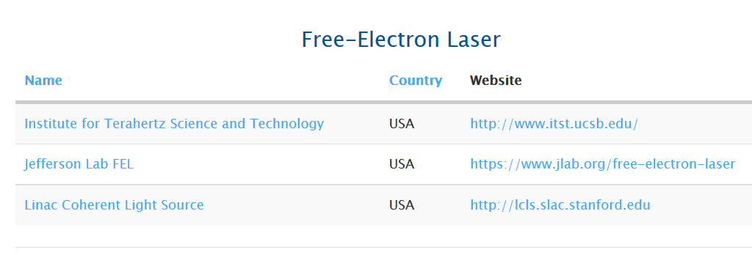

Slide 21
Some details of scattering of electromagnetic waves incident on a particle of charge q and mass m_{q}
r
k₀
θ
ε₂
ε₀
φ
ε₁

Slide 22
Thompson scattering – non relativistic approximation

Slide 23
Thompson scattering – non relativistic approximation -- continued
r
k₀
θ
ε₂
ε₀
φ
ε₁

Slide 24
Thompson scattering – non relativistic approximation -- continued
Scattered light may be polarized parallel to incident field or polarized with an angle θ so that the time and polarization averaged cross section is given by:
This formula is appropriate in the X-ray scattering of electrons or soft γ-ray scattering of protons

Slide 25
Thompson scattering – relativistic and quantum modifications
p_{q}
incident photon
α
p
θ
p’
scattered
photon
04/08/2013
25

Slide 26
Thompson scattering – relativistic and quantum modifications
p_{q}
incident photon
α
p
θ
p’
scattered
photon

