Slide 1
PHY 712 Electrodynamics
9-9:50 AM MWF Olin 103
Plan for Lecture 31:
Start reading Chap. 15 –
Radiation from collisions of charged particles
Overview
X-ray tube
Radiation from Rutherford scattering
Continuum models (Chap. 13)

Slide 2
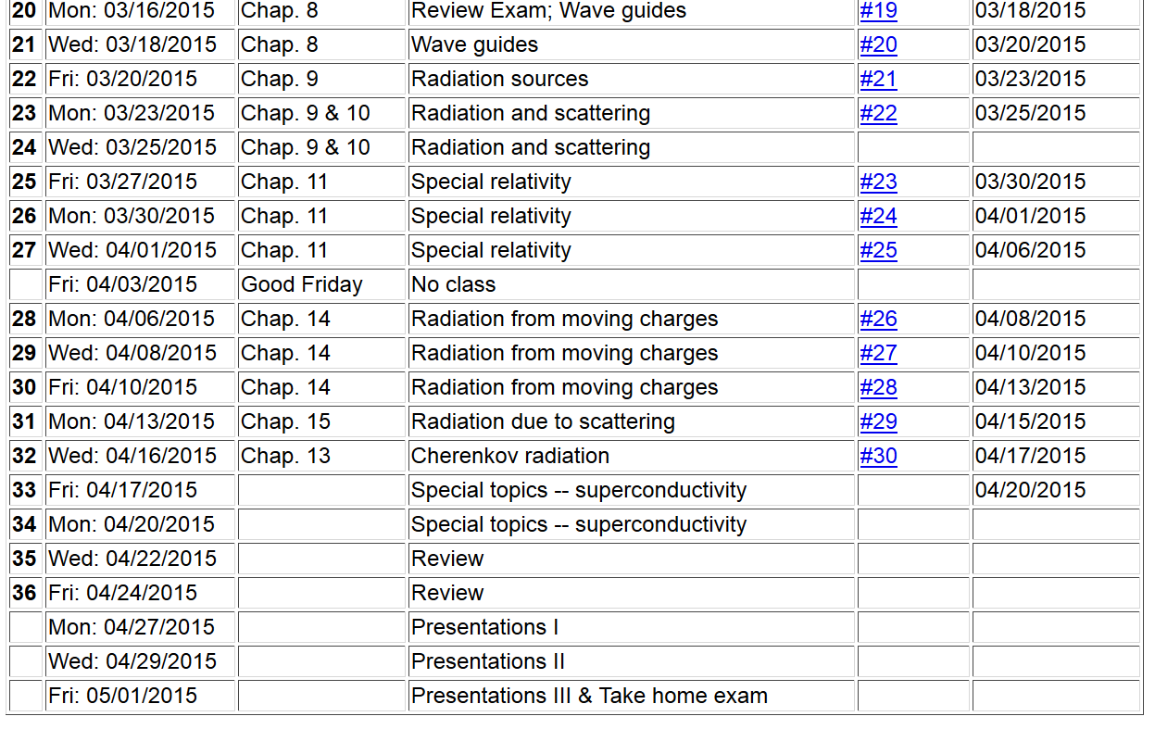

Slide 3
Generation of X-rays in a Coolidge tube
https://www.orau.org/ptp/collection/xraytubescoolidge/coolidgeinformation.htm

Slide 4
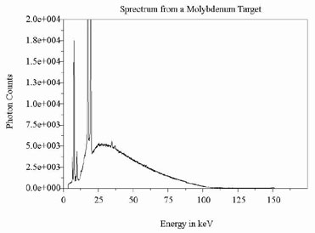
http://www.ndt-ed.org/EducationResources/CommunityCollege/Radiography/Physics/xrays.htm
Quantum effects – due to the release of core electrons

Slide 5
Radiation during collisions
β
r
θ
β(t)
β(t+Δt)
φ
Δβ

Slide 6
Radiation during collisions -- continued

Slide 7
Radiation during collisions -- continued
β
r
θ
φ
Δβ
polarization in r and β plane
polarization perpendicular to r and β plane

Slide 8
Some details:
β
r
θ
φ
Δβ

Slide 9
z
Radiation during collisions -- continued
β
r
θ
y
φ
Δβ
x

Slide 10
Estimation of Δβ
q
Δβ
q
β(t)
β(t+Δt)
mass of particle having charge q

Slide 11
Estimation of Δβ -- for the case of Rutherford scattering
q
Δβ
q
β(t)
β(t+Δt)
Ze
p’
θ’
Q
p

Slide 12
Case of Rutherford scattering -- continued
q
p(t+Δt)
θ’
Q
Ze
p(t)

Slide 13
Case of Rutherford scattering -- continued
q
p(t+Δt)
θ’
Q
Ze
p(t)

Slide 14
Comment on frequency dependence --

Slide 15
λ= “fudge factor” of order unity

Slide 16
Electromagnetic effects in energy loss processes (see Chap. 13 of Jackson)
Again consider Rutherford scattering – now of a neucleus (or alpha particle ze incident on an electron –e in rest frame of electron:
ze
p(t+Δt)
θ’
Q
-e
p(t)

Slide 17
Energy loss continued
minimum energy transfer

Slide 18
Energy loss continued
Refining this result, Bethe and Fermi noticed that the analysis lacked consideration of the effects of electromagnetic fields. Representing the colliding electrons in terms of a dielectric function ε(ω) and the energetic partical of charge ze in terms of the charge and current density:

Slide 19
Energy loss continued

