Slide 1
PHY 712 Electrodynamics
9-9:50 AM MWF Olin 103
Plan for Lecture 32:
Special Topics in Electrodynamics:
Cherenkov radiation
References: Jackson Chapter 13.4
Zangwill Chapter 23.7
Smith Chapter 6.4

Slide 2
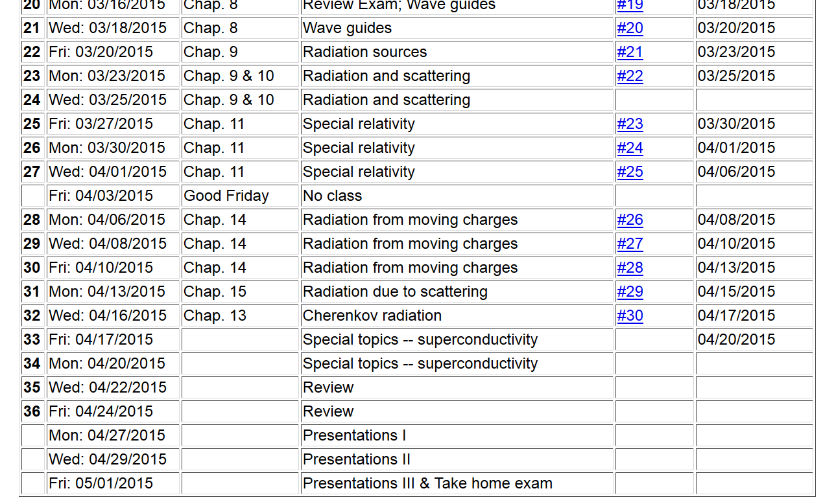

Slide 4
References for notes: Glenn S. Smith, An Introduction to Electromagnetic Radiation (Cambridge UP, 1997), Andrew Zangwill, Modern Electrodynamics (Cambridge UP, 2013)
Cherenkov radiation
Discovered ~1930; bluish light emitted by energetic charged particles traveling within dielectric materials
θ_{c}
q

Slide 5
R_{q}(t)
q

Slide 6
Liénard-Wiechert potential solutions:

Slide 7
r
R(t)
R(t_{r})
vt_{r}
vt

Slide 8
r
R(t)
R(t_{r})
θ(t)
vt_{r}
vt

Slide 9
r
Liénard-Wiechert potentials:
R(t)
R(t_{r})
θ(t)
vt_{r}
vt

Slide 10
Physical fields for β_{n} > 1
r
R(t)
R(t_{r})
θ(t)
vt_{r}
vt

Slide 11
Physical fields for β > 1

Slide 12
Intermediate steps:

Slide 13
Some details: Cherenkov radiation observed near the angle θ_{c} at time t=t_{C}+Δt
c_{n}(t-t_{r})
vt_{r1}
vt_{r2}
vt_{r3}
vt_{r4}
vt_{C}

Slide 14
Some details: Cherenkov radiation observed near the angle θ_{c}
r
R_{c}
R(Δt)
θ_{C}=θ(0)
θ(Δt)
vt_{C}

Slide 15
Cherenkov radiation observed near the angle θ_{c} -- continued
r
R_{C}
R(Δt)
θ_{C}=θ(0)
θ(Δt)
vt

Slide 16
Cherenkov radiation observed near the angle θ_{c} -- continued

Slide 17
Cherenkov radiation observed near the angle θ_{c} -- continued

Slide 18
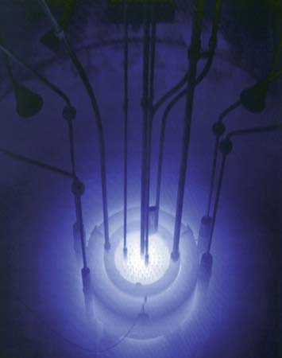
Cherenkov radiation emitted by the core of the Reed Research Reactor located at Reed College in Portland, Oregon, U.S.
Cherenkov radiation. Photograph. Encyclopædia Britannica Online. Web. 12 Apr. 2013. http://www.britannica.com/EBchecked/media/174732

