Slide 1
PHY 712 Electrodynamics
9-9:50 AM MWF Olin 103
Plan for Lecture 33:
Special Topics in Electrodynamics:
Electromagnetic aspects of superconductivity

Slide 2
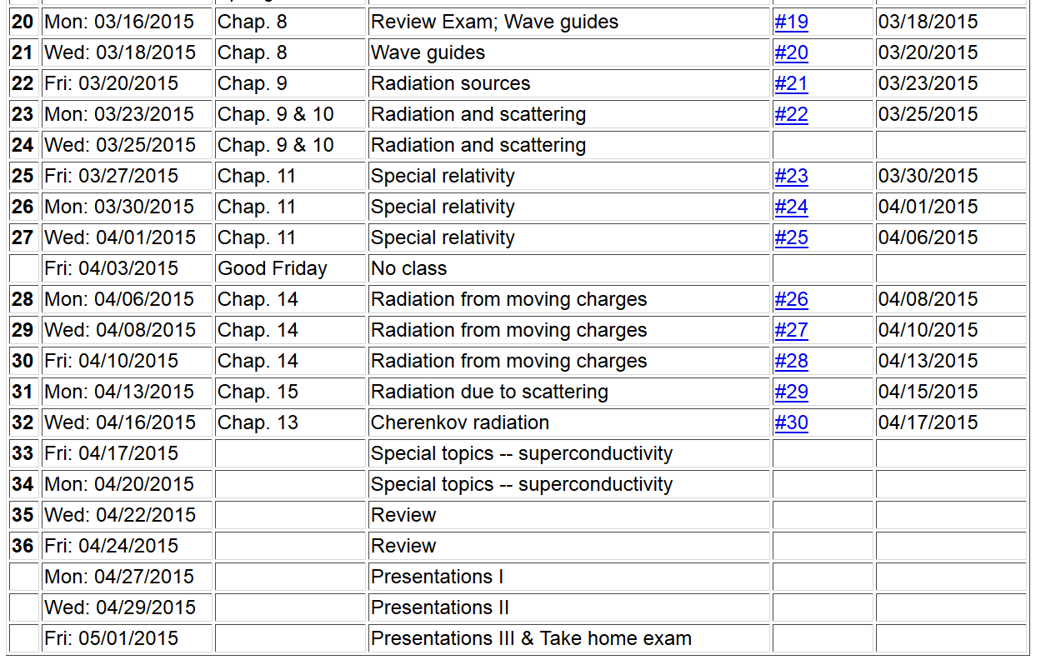

Slide 3
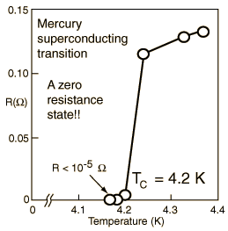
Special topic: Electromagnetic properties of superconductors
Ref:D. Teplitz, editor, Electromagnetism – paths to research,
Plenum Press (1982); Chapter 1 written by Brian Schwartz and Sonia Frota-Pessoa
History:
1908 H. Kamerlingh Onnes successfully liquified He
1911 H. Kamerlingh Onnes discovered that Hg at 4.2 K has vanishing resistance
1957 Theory of superconductivity by Bardeen, Cooper, and Schrieffer

Slide 4
Some phenomenological theories < 1957

Slide 5
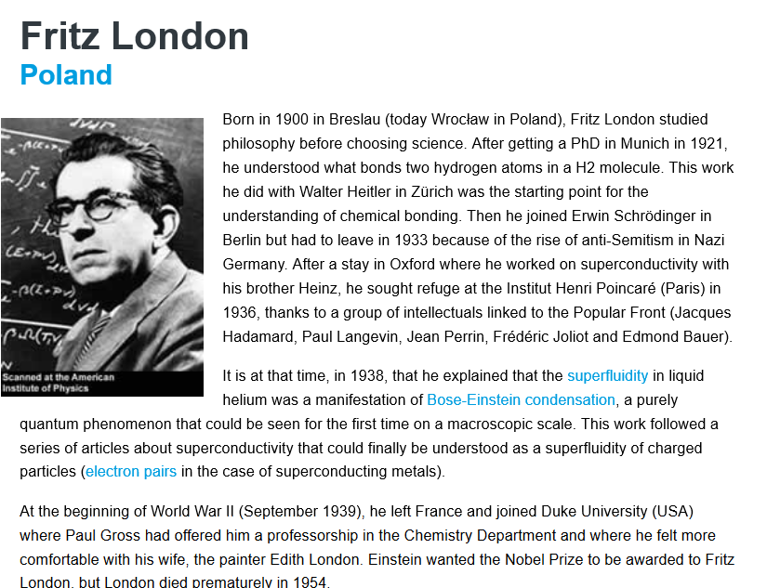

Slide 6
Some phenomenological theories < 1957

Slide 7
London model – continued

Slide 8
London model – continued
λ_{L}
x

Slide 9
Magnetization field

Slide 10
Magnetization field (for “type I” superconductor)
B
H
H_{C}
-4πM
H
H_{C}
G_{S}-G_{N}
H_{C}
H

Slide 11
Behavior of superconducting material – exclusion of magnetic field according to the London model
λ_{L}
x

Slide 12
Examples of type I superconductors
http://hyperphysics.phy-astr.gsu.edu/hbase/tables/supcon.html#c1

Slide 13
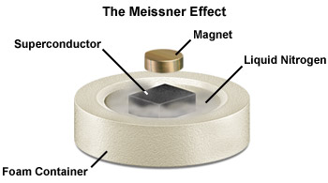

Slide 14
Josephson junction -- tunneling current between two superconductors
d
x
B_{z}

Slide 15
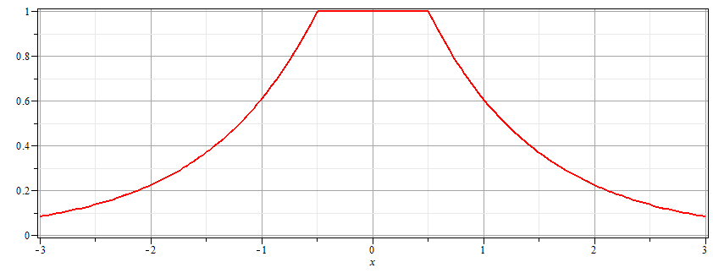
Josephson junction -- continued
Supercon left
Junction
Supercon right
B_{z}
d

Slide 16
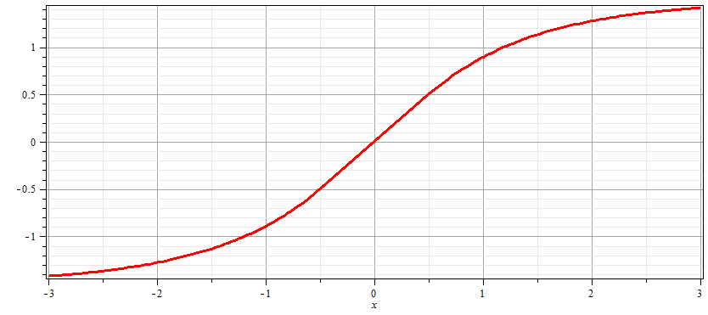
Josephson junction -- continued
Supercon left
Junction
Supercon right
A_{y}
d

Slide 17
Josephson junction -- continued
d
L
R
x

Slide 18
Josephson junction -- continued

Slide 19
Josephson junction -- continued
J_{L}
J_{R}
J_{T}
L
R
x

Slide 20
Josephson junction -- continued
J_{L}
J_{R}
J_{T}
L
R
x

Slide 21
Josephson junction -- continued
J_{L}
J_{R}
J_{T}
L
R
x

Slide 22
Josephson junction -- continued
J_{L}
J_{R}
J_{T}
L
R
x

Slide 23
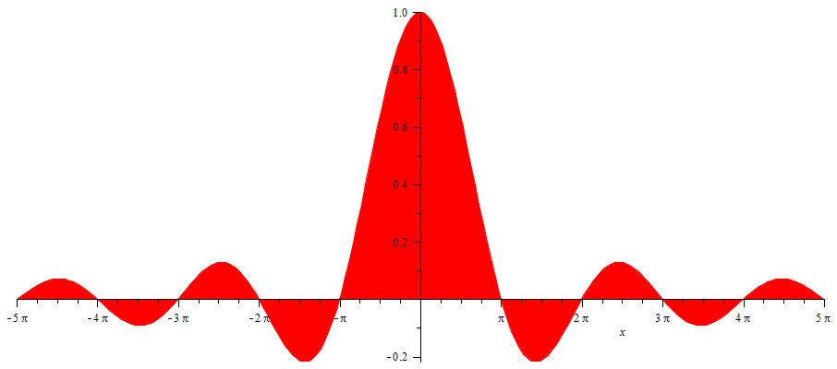
Josephson junction -- continued
SQUID =superconducting quantum interference device
I_{T}
Φ/Φ₀
Note: This very sensitive “SQUID” technology has been used in scanning probe techniques. See for example, J. R. Kirtley, Rep. Prog. Physics 73, 126501 (2010).

Slide 24
