Slide 1
PHY 712 Electrodynamics
9-9:50 AM MWF Olin 103
Plan for Lecture 34:
Special Topics in Electrodynamics:
Electromagnetic aspects of superconductivity
London equations
Tunneling between two superconductors

Slide 2
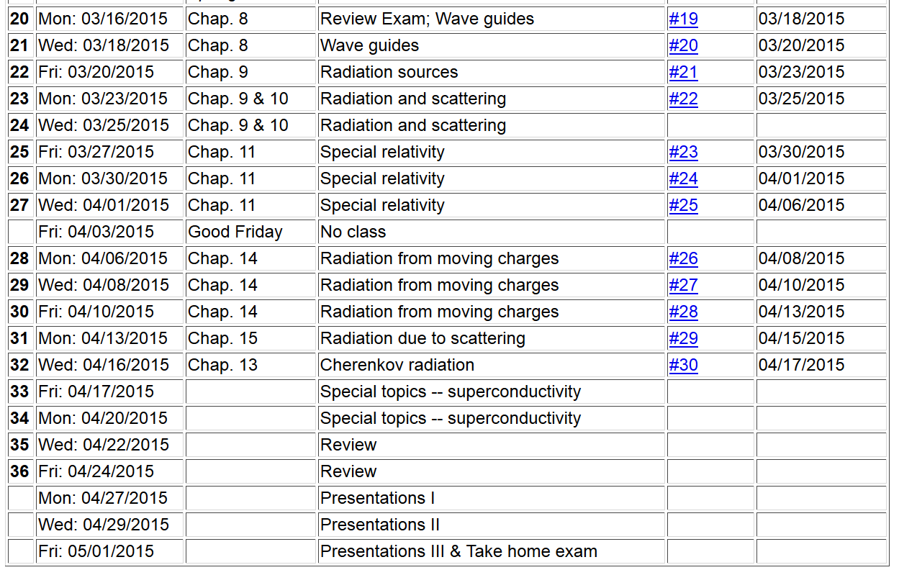

Slide 3
London model of superconducting state

Slide 4
London model, continued

Slide 5
London model – continued

Slide 6
Behavior of superconducting material – exclusion of magnetic field according to the London model
λ_{L}
x

Slide 7
Magnetization field
(At T=0K)

Slide 8
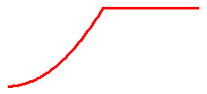
Magnetization field (for “type I” superconductor at T=0K)
B
H
H_{C}
-4πM
H
H_{C}
G_{S}-G_{N}
H_{C}
H

Slide 9
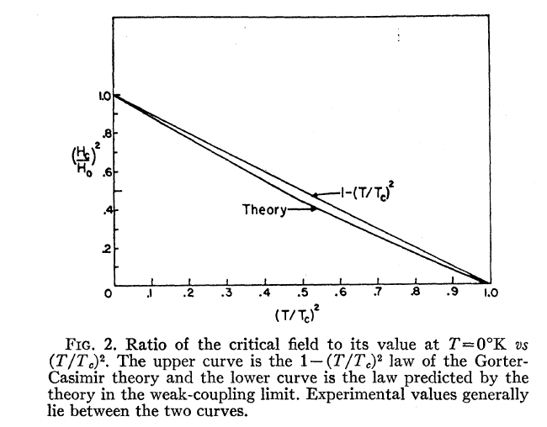
Temperature dependence of critical field
From PR 108, 1175 (1957)
Bardeen, Cooper, and Schrieffer, “Theory of Superconductivity”
characteristic phonon energy
density of electron states at E_{F}
attraction potential between electron pairs

Slide 10
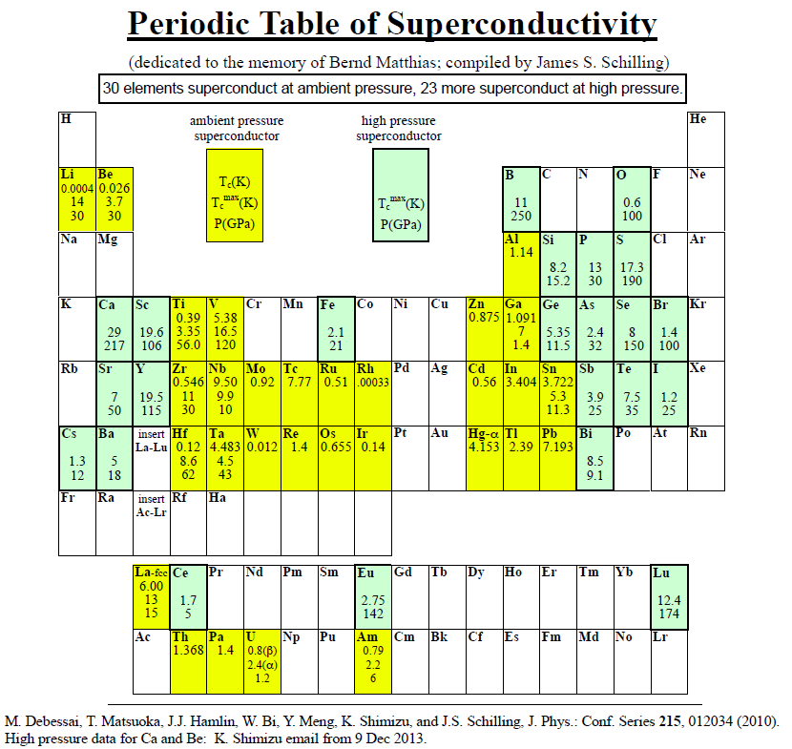
Type I elemental superconductors
http://wuphys.wustl.edu/~jss/NewPeriodicTable.pdf

Slide 11
Quantization of current flux associated with the superconducting state (Ref: Ashcroft and Mermin, Solid State Physics)

Slide 12
Quantization of current flux associated with the superconducting state -- continued
Suppose a superconducting material has a cylindrical void. Evaluate the integral of the current in a closed path within the superconductor containing the void.
dl
Such “vortex” fields can exist within type II superconductors.

Slide 13
Josephson junction -- tunneling current between two superconductors (Ref. Teplitz, Electromagnetism (1982))
d
x
B_{z}

Slide 14
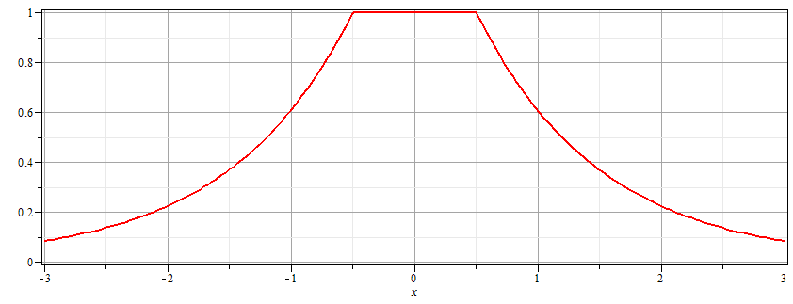
Josephson junction -- continued
Supercon left
Junction
Supercon right
B_{z}
d

Slide 15
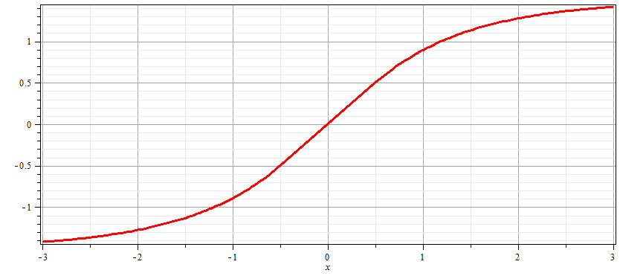
Josephson junction -- continued
Supercon left
Junction
Supercon right
A_{y}
d

Slide 16
Josephson junction -- continued
d
L
R
x
Coupling parameter

Slide 17
Josephson junction -- continued

Slide 18
Josephson junction -- continued
J_{L}
J_{R}
J_{T}
L
R
x

Slide 19
Josephson junction -- continued
J_{L}
J_{R}
J_{T}
L
R
x

Slide 20
Josephson junction -- continued
J_{L}
J_{R}
J_{T}
L
R
x

Slide 21
Josephson junction -- continued
J_{L}
J_{R}
J_{T}
L
R
x

Slide 22
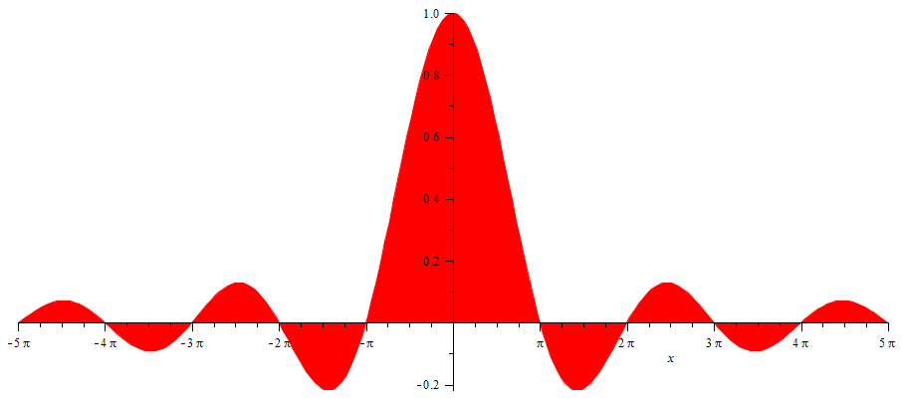
Josephson junction -- continued
SQUID =superconducting quantum interference device
I_{T}
Φ/Φ₀
Note: This very sensitive “SQUID” technology has been used in scanning probe techniques. See for example, J. R. Kirtley, Rep. Prog. Physics 73, 126501 (2010).

Slide 23
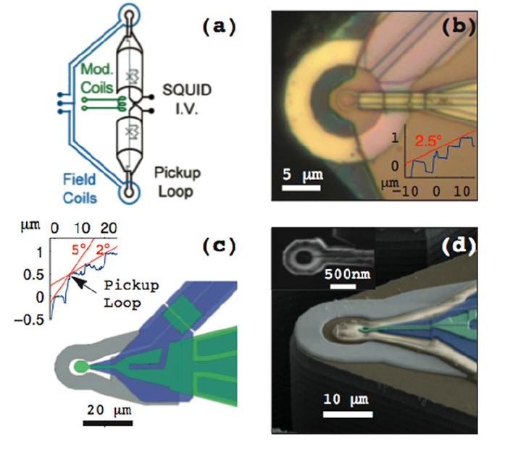
Scanning SQIUD microscopy
Ref. J. R. Kirtley, Rep. Prog. Phys. 73 126501 (2010)

Slide 24
