Slide 1
PHY 712 Electrodynamics
9-9:50 AM MWF Olin 103
Plan for Lecture 35:
    Review Part I:
    Problem solving examples
    (mainly from Chapters 7 & 9)

Slide 2
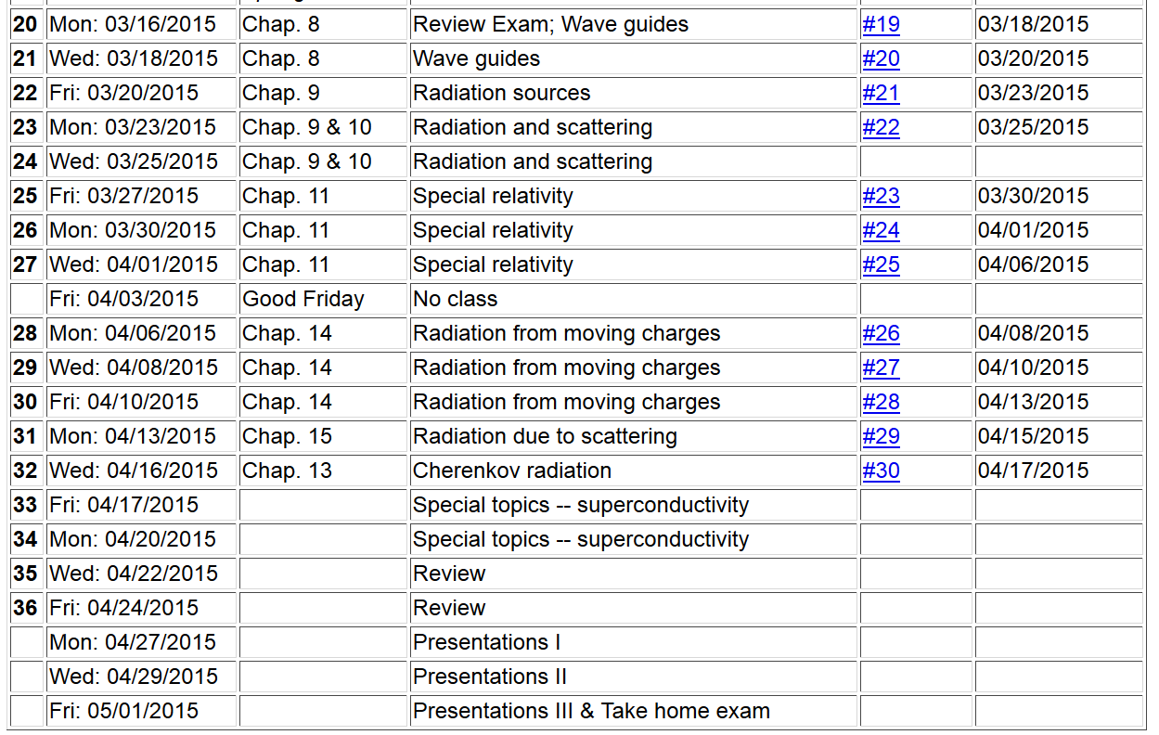

Slide 3


Slide 4
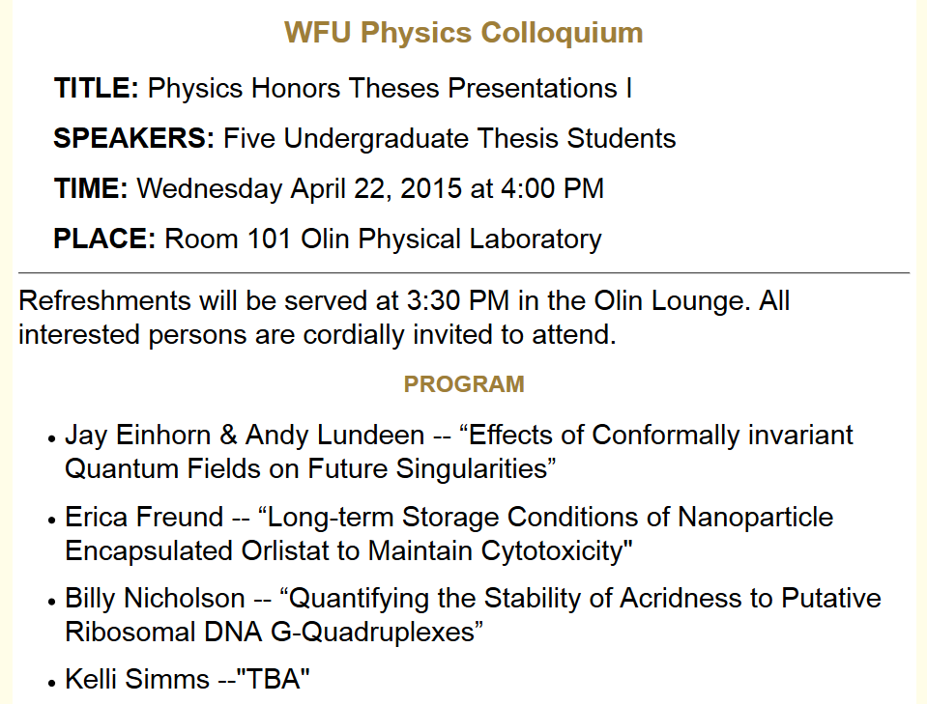

Slide 5
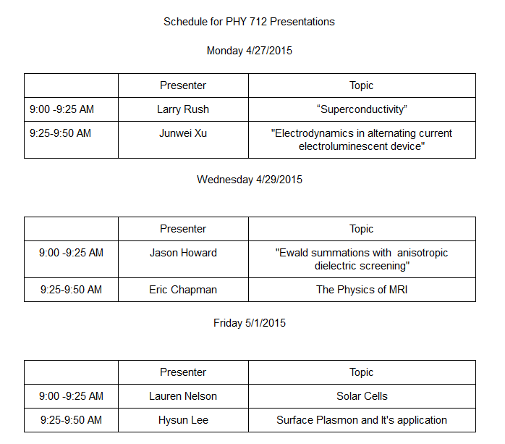

Slide 6
Review topic – analytic properties of dielectric function
Material from Chapter 7 in Jackson
The displacement field D is related to the electric field E
Kramers-Kronig transform – for dielectric function:

Slide 7
Drude model dielectric function:

Slide 8
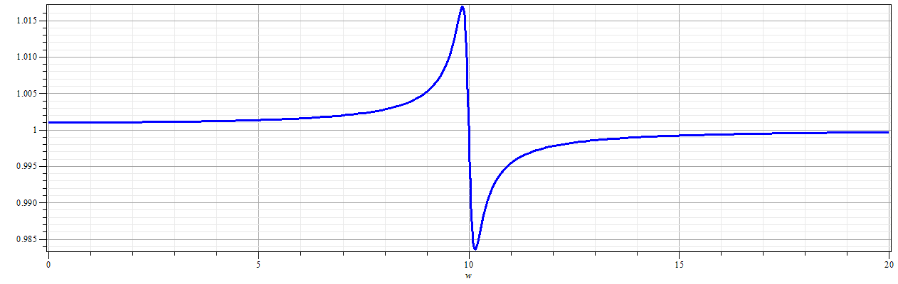
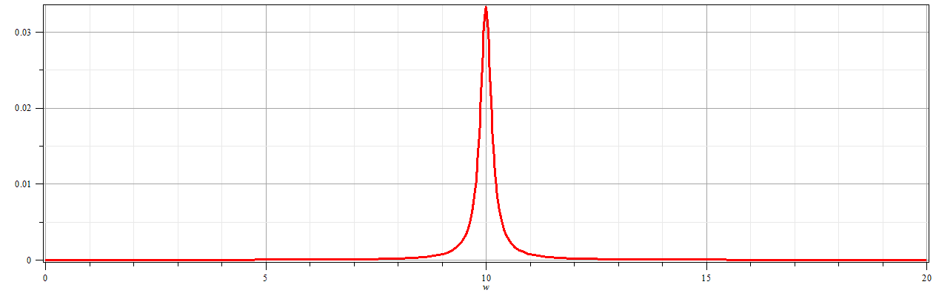
Drude model dielectric function:

Slide 9
Practical evaluation of Kramers-Kronig relation

Slide 10
Practical evaluation of Kramers-Kronig relation

Slide 11
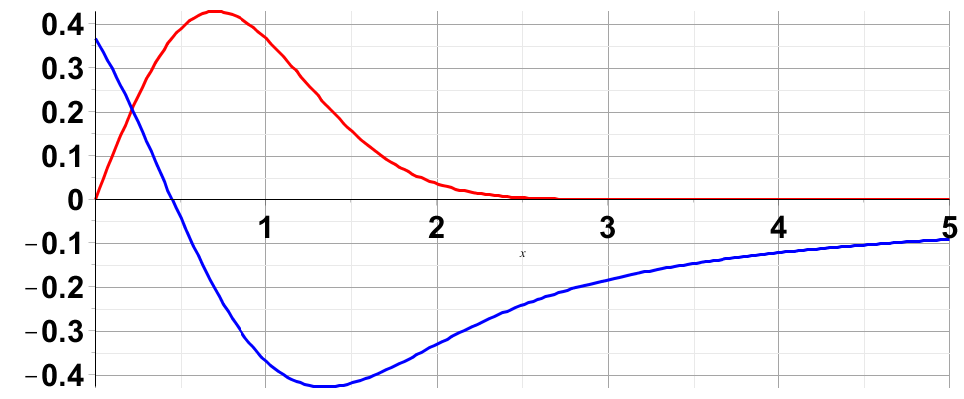
Evaluation of singular integral numerically:

Slide 12
Review of reflection and refraction
Consider the normal incidence case; 3 media
n₁
n₂
n₃
E₀
E_{2T}
E_{3T}
E_{1R}
E_{2R}

Slide 13
Review of reflection and refraction -- continued
Consider the normal incidence case; 3 media
n₁
n₂
n₃
E₀
E_{2T}
E_{3T}
E_{1R}
E_{2R}
d
Note that in this steady-state formulation, we must match the tangential components of the E and H fields at each boundary

Slide 14
Review of reflection and refraction -- continued
Consider the normal incidence case; 3 media
n₁
n₂
n₃
E₀
E_{2T}
E_{3T}
E_{1R}
E_{2R}
d

Slide 15
Review of reflection and refraction -- continued
Consider the normal incidence case; 3 media
n₁
n₂
n₃
E₀
E_{2T}
E_{3T}
E_{1R}
E_{2R}
d

Slide 16
Review of reflection and refraction -- continued
n₁
n₂
n₃
E₀
E_{2T}
E_{3T}
E_{1R}
E_{2R}
d

Slide 17
Review of reflection and refraction -- continued
n₁
n₂
n₃
E₀
E_{2T}
E_{3T}
E_{1R}
E_{2R}
d

Slide 18
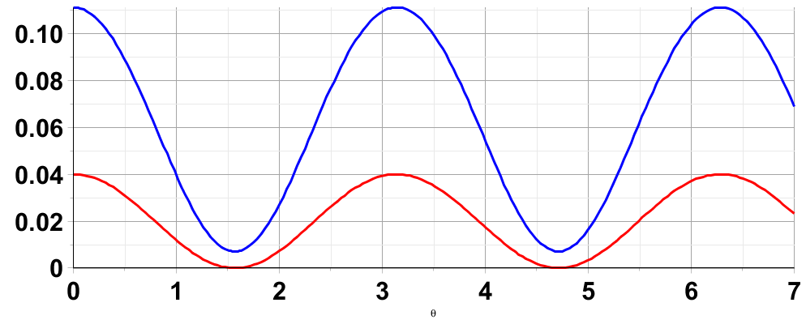
Review of reflection and refraction -- continued
n₁
n₂
n₃
E₀
E_{2T}
E_{3T}
E_{1R}
E_{2R}
d
n₁=1
n₂=1.3
n₃=2.0
n₁=1
n₂=1.224
n₃=1.5

Slide 19
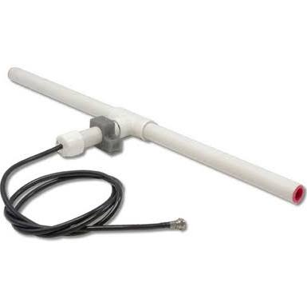
r
Review of radiation from antenna
z
Linear center-fed antenna
θ
d/2

Slide 20
Linear center-fed antenna continued

Slide 21
Linear center-fed antenna continued

Slide 22
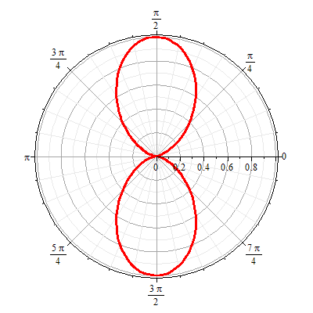
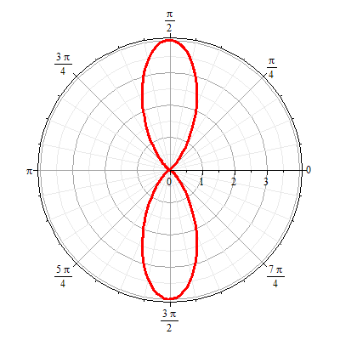
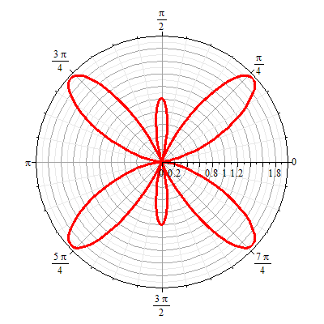
Linear center-fed antenna continued
Radiation patterns kd=mπ:
m=1 m=2 m=3

Slide 23
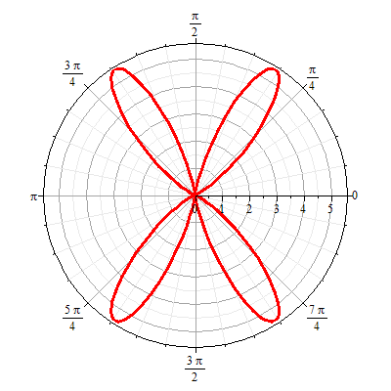
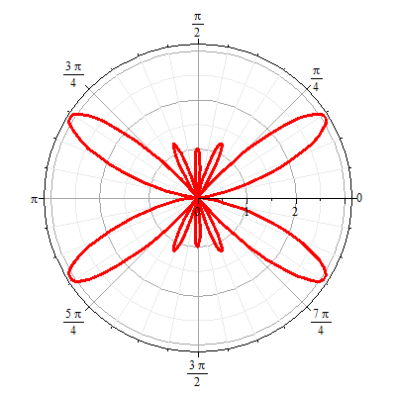
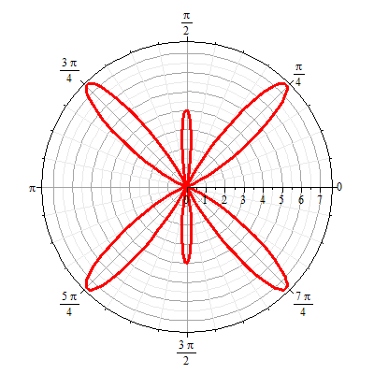
Linear center-fed antenna continued
Radiation patterns kd=mπ:
m=4 m=5 m=6

Slide 24
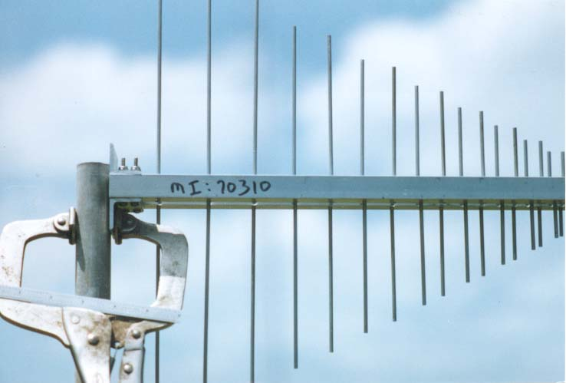
Antenna arrays
http://www.tennadyne.com/company.htm
z
a
φ
r
x

Slide 25
z
Antenna arrays
a
φ
r
z’’
x

Slide 26
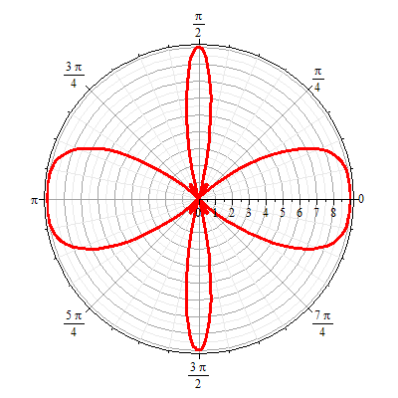
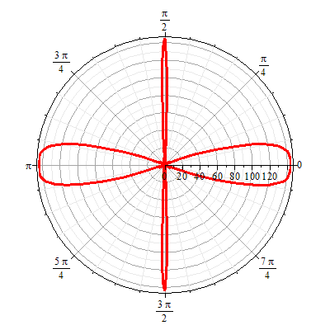
Antenna arrays
N=3
N=12
φ

