Slide 1
PHY 712 Electrodynamics
9-9:50 AM MWF Olin 103
Plan for Lecture 36:
    Review Part II:
      Further comment of Kramers-Kronig transform
      Some equations for top of your head
      Example problems
      Course evaluation forms

Slide 2
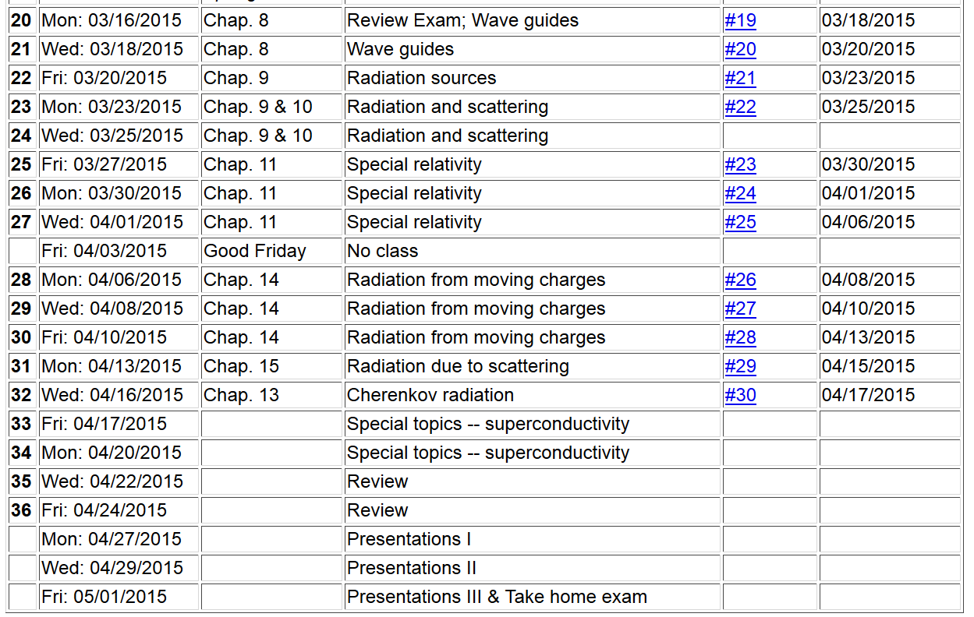

Slide 3
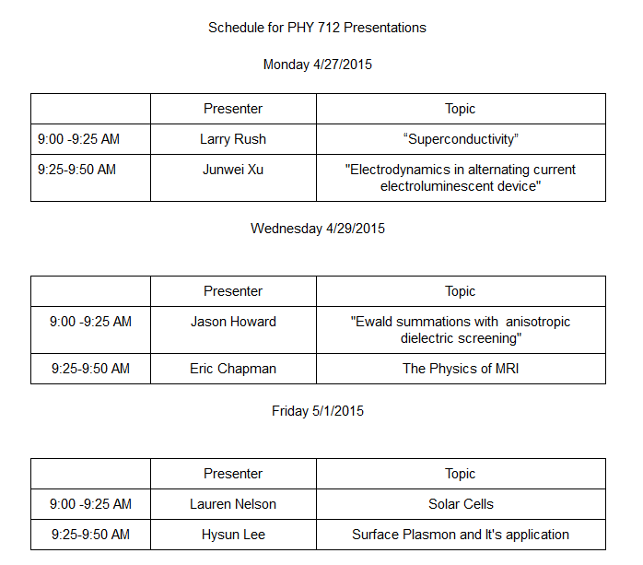

Slide 4
Review topic – analytic properties of dielectric function
Material from Chapter 7 in Jackson
The displacement field D is related to the electric field E
Kramers-Kronig transform – for dielectric function:

Slide 5
Practical evaluation of Kramers-Kronig relation

Slide 6
Practical evaluation of Kramers-Kronig relation

Slide 7
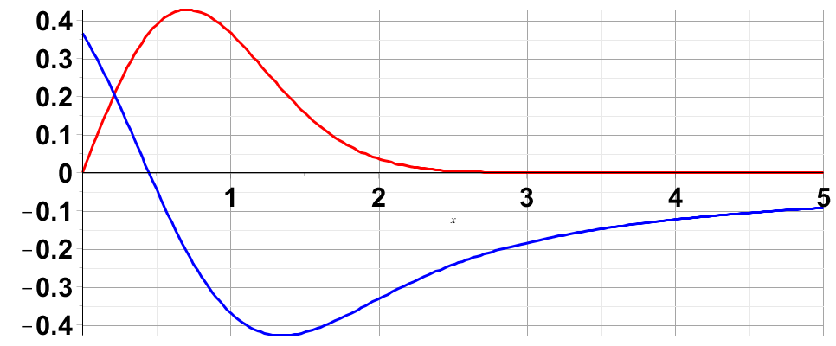
Evaluation of singular integral numerically:

Slide 8
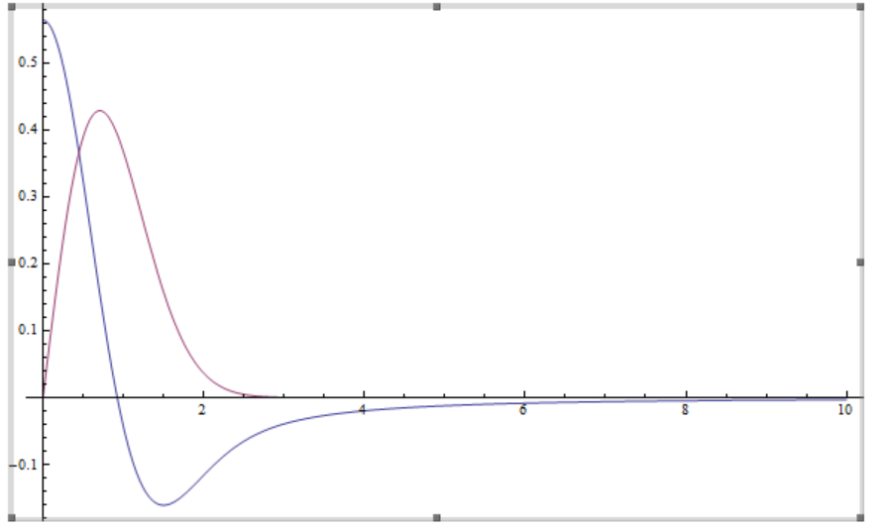
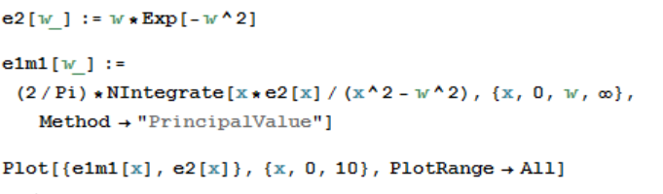
Evaluation of Kramer’s Kronig transform using Mathematica (with help from Professor Cook)

Slide 9
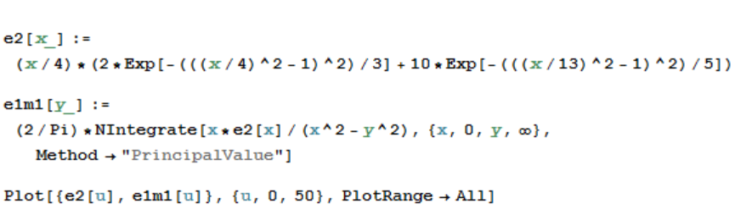
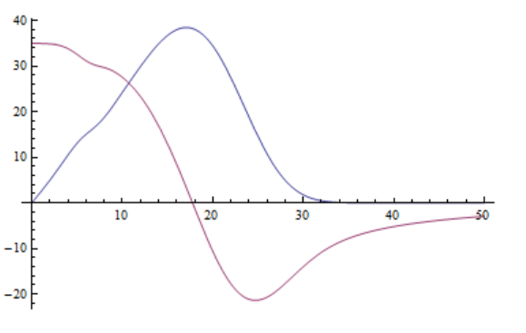
Another example

Slide 10
Some equations worth remembering --

Slide 11
Maxwell’s equations

Slide 12
Maxwell’s equations

Slide 13
Maxwell’s equations

Slide 14
Energy and power (SI units)

Slide 18
In your “bag” of tricks:
  Direct (analytic or numerical) solution of differential equations
  Solution by expanding in appropriate orthogonal functions
  Green’s function techniques

Slide 19
How to choose most effective solution method --
  In general, Green’s functions methods work well when source is contained in a finite region of space

Slide 21
Electromagnetic waves from time harmonic sources

Slide 22
Electromagnetic waves from time harmonic sources – continued:

Slide 23
Electromagnetic waves from time harmonic sources – continued:

Slide 24
Radiation from a moving charged particle
z
.
v
r-R_{q}(t_{r})=R
q
Θ
r
R_{q}(t)
y
x

Slide 25
Liènard-Wiechert potentials –(Gaussian units)

Slide 26
Example:
  Problem 15.2 in Jackson:
  A nonrelativistic particle of charge e and mass m collides with a fixed, smooth, hard sphere of radius R. Assuming that the collision is elastic, show that in the dipole approximation (neglecting retardation effects) the classical differential cross section for the emission of photons per unit solid angle per unit energy interval is:
  where θ is measured relative to the incident direction.

Slide 27
r
v’
θ
v

Slide 28
Low frequency radiation from charged particle during a collision
as analyzed by Eq. 15.2 :

