Slide 1
PHY 752 Electrodynamics
11-11:50 AM MWF Olin 107
Plan for Lecture 1:
Reading: Chapters 1-2 in Marder’s text
Course structure and expectations
Crystal structures
Real and reciprocal space lattice vectors
Some examples
Point symmetry properties
Introduction to group theory

Slide 2
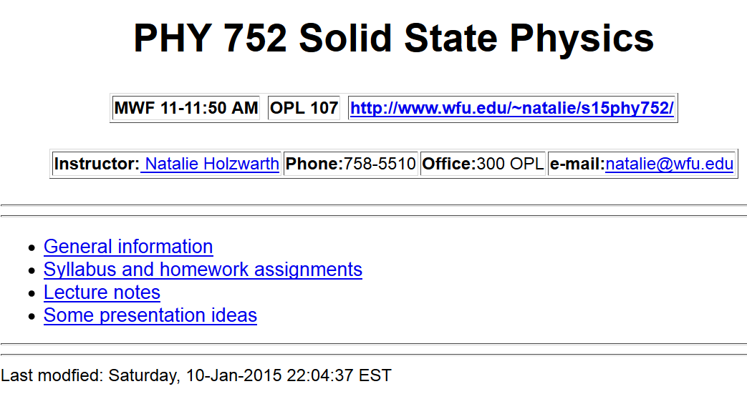
http://users.wfu.edu/natalie/s15phy752/

Slide 3
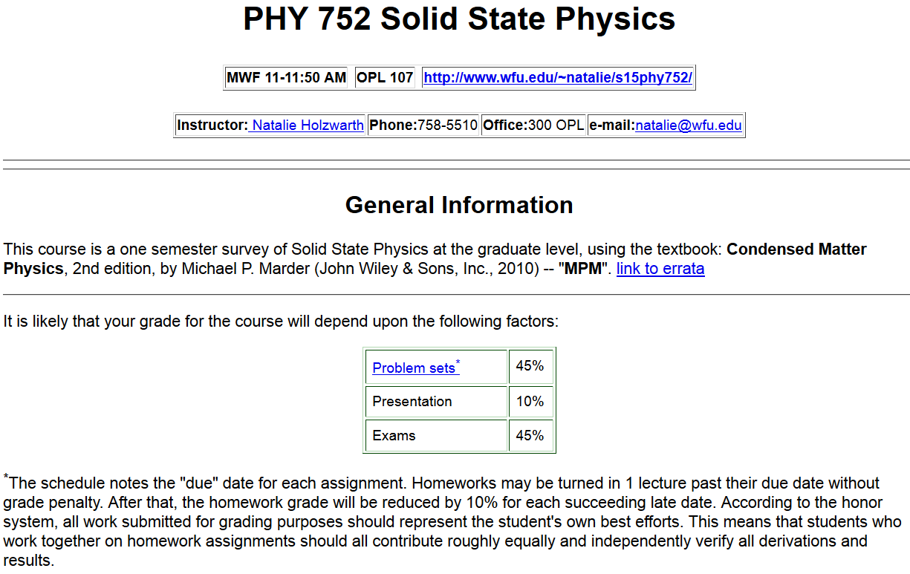

Slide 4
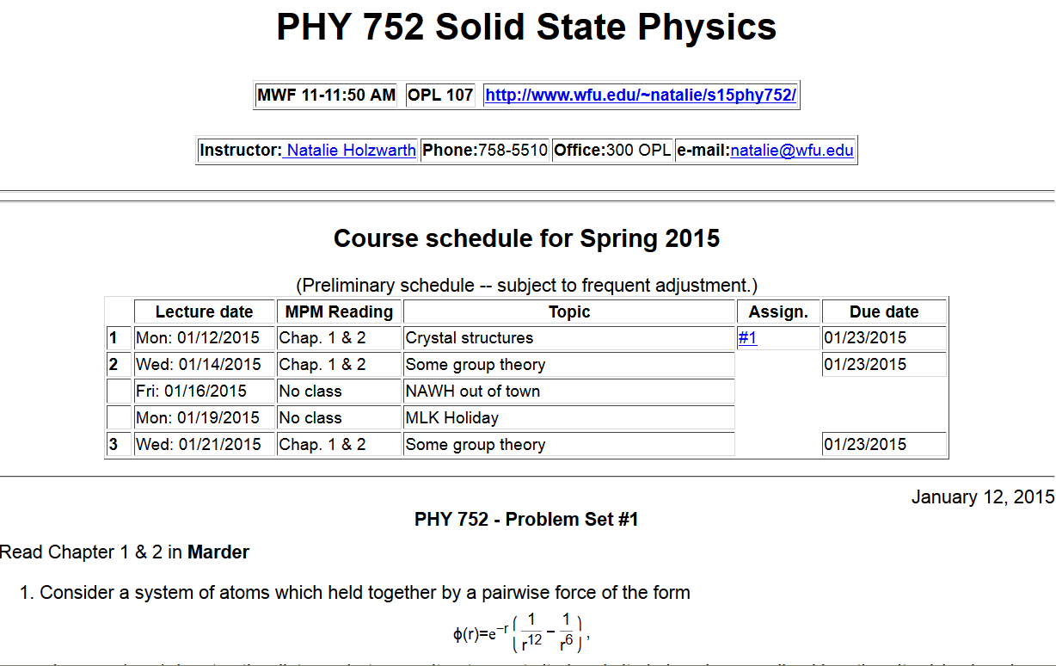

Slide 5
Course syllabus:
In the formal portion of the course, the following topics are usually covered:
Crystalline structures
Translation vectors and reciprocal lattice vectors
Symmetry properties of crystals; brief introduction to group theory analysis
Brief survey of common structures and their properties
X-ray and neutron scattering analysis of crystals
Electronic structure analysis
Simple model examples
Linear combinations of atomic orbital analyses
Hartree-Fock approximations
Density functional formalism
Numerical approximations and methods
Surfaces and interfaces
Relationship of interface and bulk properties
Low energy electron diffraction analysis
Scanning probe analysis of surfaces
Defects and disorder effects

Slide 6
Course syllabus continued:
Depending on time available the following additional formal topics are often covered:
Mechanical properties of solids
Cohesive properties
Deformation properties
Vibrational modes
Dislocations and cracks
Electronic transport in solids
Semi-classical approximations and comparison with experiment
Optical properties in solids
Magnetic properties of solids
➔ Feedback on topics choice appreciated.

Slide 7
Introduction to crystalline solids
An ideal crystal fills all space
Limited possibilities for crystalline forms –
Only 14 Bravais lattices
Only 32 crystallographic point groups
Only 230 distinct crystallographic structures
Quantitative descriptions of crystals in terms of lattice translations vectors and basis vectors
Use of group theory in the study of crystal structures

Slide 8
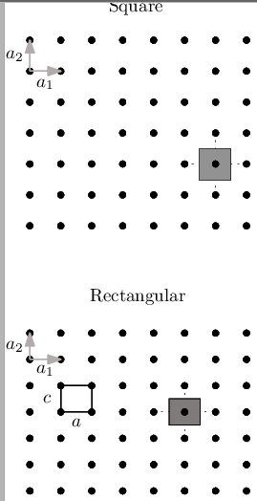
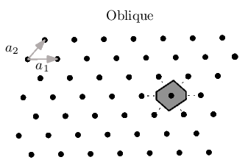
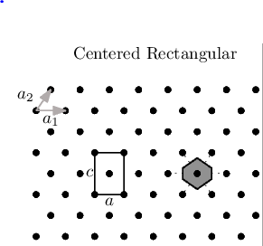
Two-dimensional crystals

Slide 9
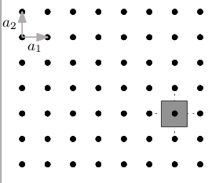
Some details –
square lattice example

Slide 10
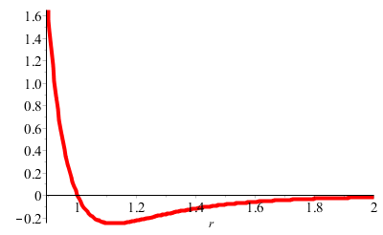
Energy associated with crystal configuration
Simple pair potential models
r

Slide 11
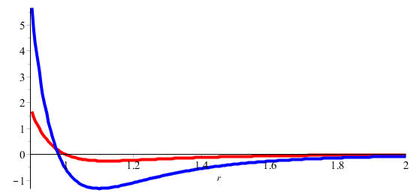
Energy of square lattice
E(a)
Note: This is the energy per atom assuming all atoms are identical.

Slide 12
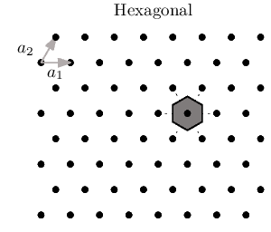
Two-dimensional crystals -- continued

Slide 13
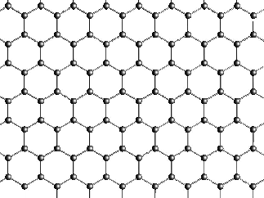
Two-dimensional crystals -- continued
Honeycomb lattice (graphene sheet)
Example of lattice with a “basis”

Slide 14
Honeycomb lattice (graphene sheet)
a

Slide 15
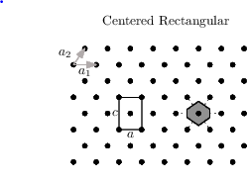
“Conventional” versus “Primitive” unit cell

Slide 16
Wigner-Seitz cell
Note that primitive cell and Wigner-Seitz cell have the same volume.

Slide 17
Generalization to 3-dimensions
basis vector
Bravais lattice

Slide 18
From
http://web.mit.edu/6.730

Slide 19
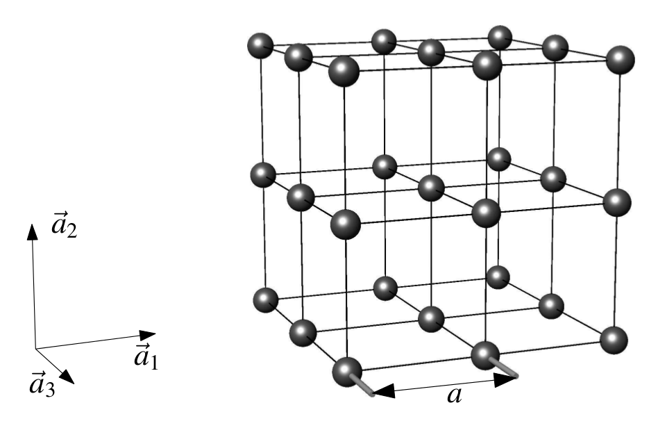
Simple cubic lattice:

Slide 20
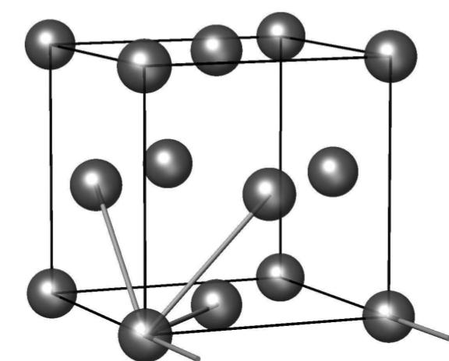
Face-centered cubic lattice

Slide 21
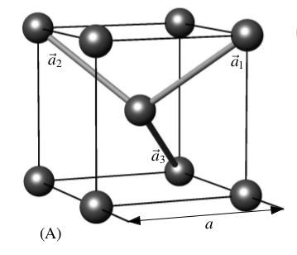
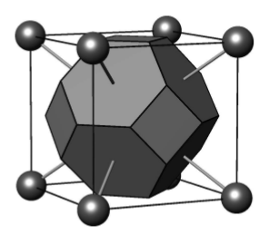
Body centered cubic lattice
Wigner-Seitz cell

