Slide 1
PHY 752 Solid State Physics
11-11:50 AM MWF Olin 107
Plan for Lecture 10:
Reading: Chapter 10.3-10.4 in MPM; Survey of some electronic structures
Metals
Insulators
Semiconductors and semimetals

Slide 2
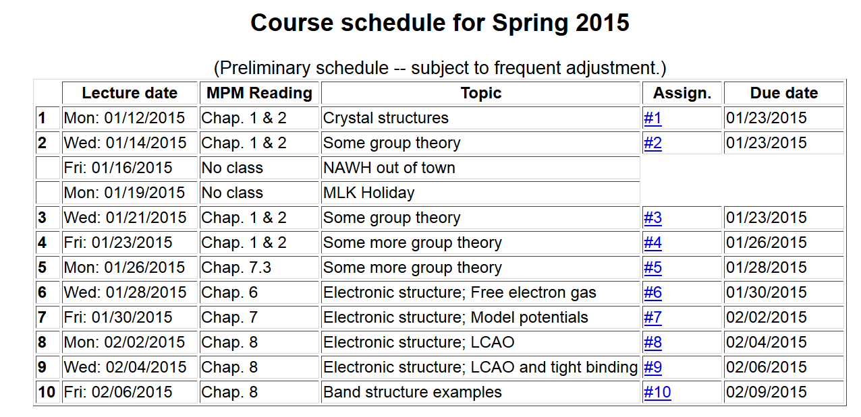

Slide 3
What can you learn from a electronic band diagram?
Metal or insulator?
Band width
Optical properties
Transport properties

Slide 4
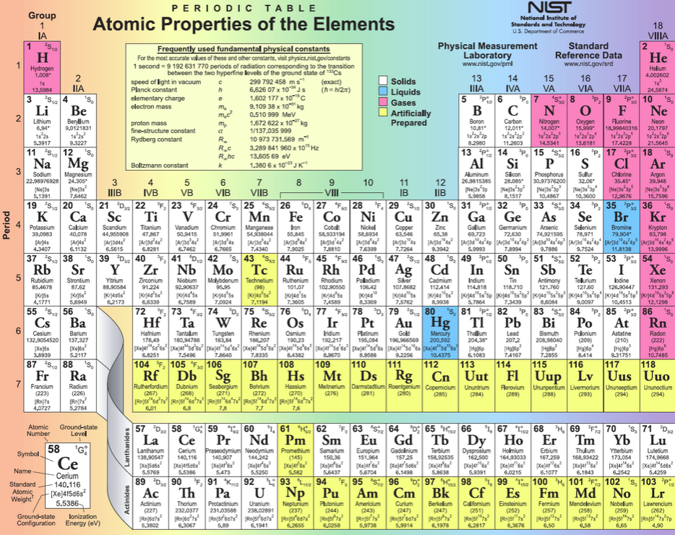

Slide 5
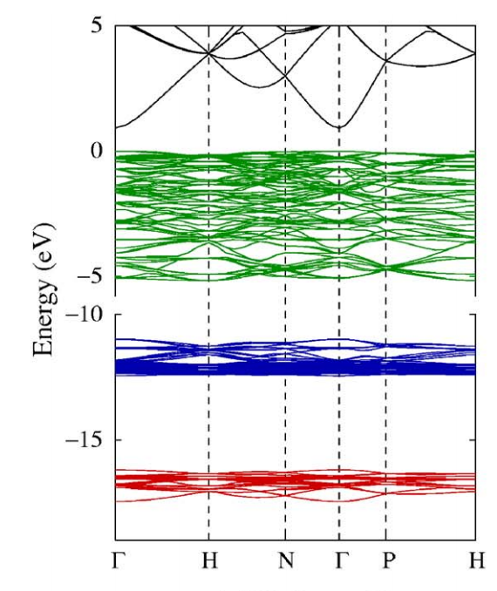
Spaghetti diagram of In₂O₃ from reference:
PRB 75, 153205 (2007)

Slide 6
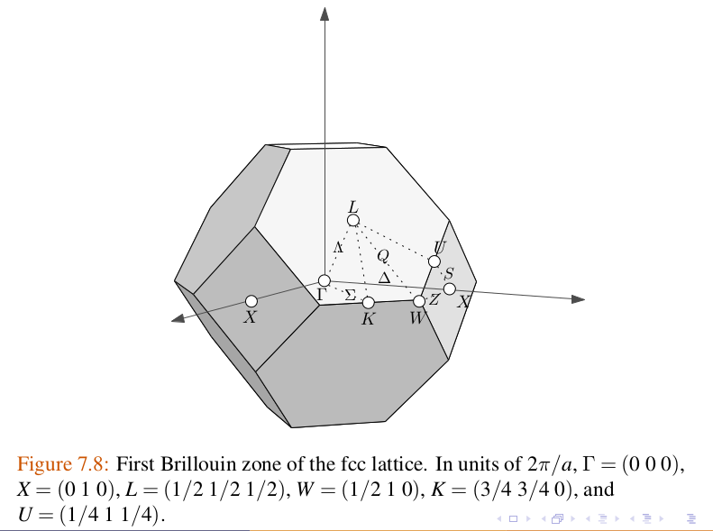
Guide to k-points – fcc lattice

Slide 7
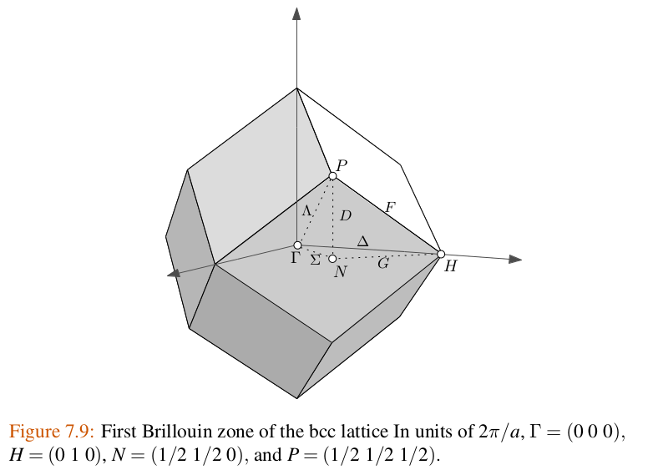
Guide to k-points – bcc lattice

Slide 8
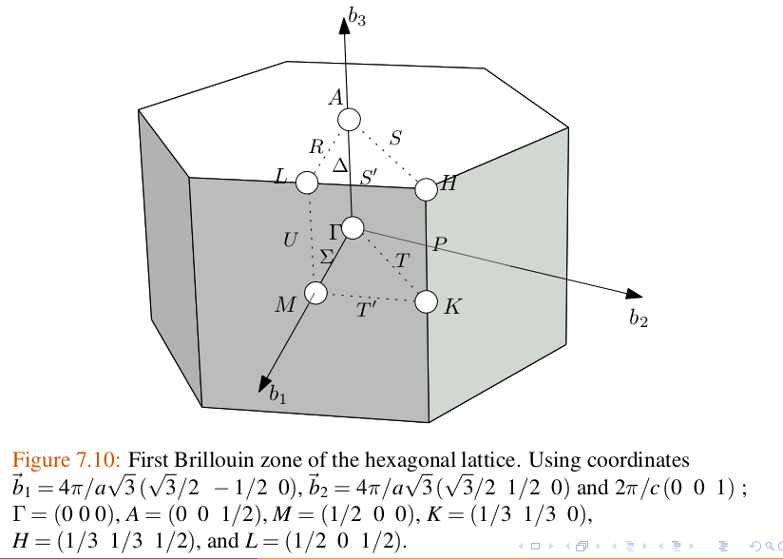
Guide to k-points – hcp lattice

Slide 9
Comments on energy scale
In principle, the zero of energy is TOTALLY arbitrary
It is common to set the zero of energy at the top of the valence band for insulators and at the Fermi level for conductors

Slide 10
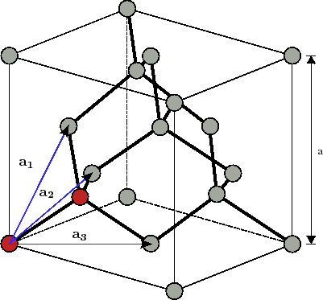
Diamond lattice (2 C atoms per unit cell)

Slide 11
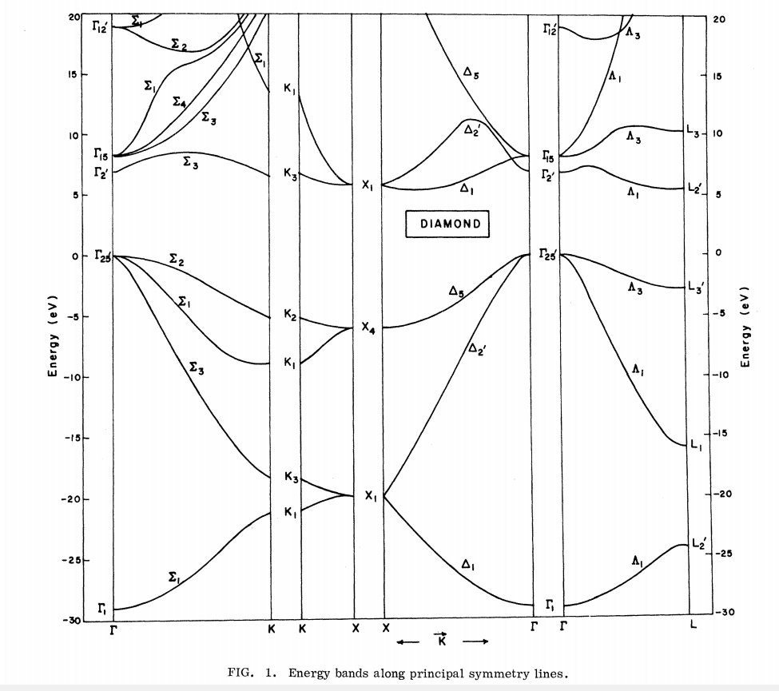
Ref. PRB 2, 2054 (1970)
Note: Valence bands must accommodate 8 valence electrons from two C 1s²2s²2p² atoms per unit cell

Slide 12
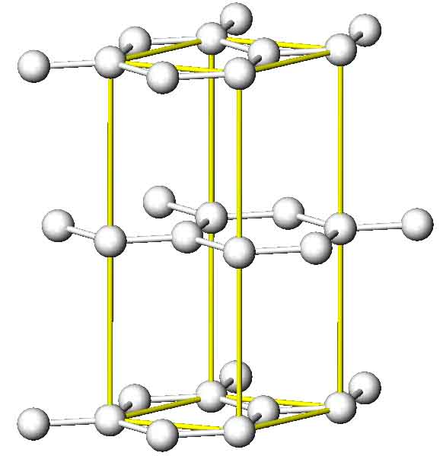
Crystal structure of graphite (4 atoms per unit cell)

Slide 13
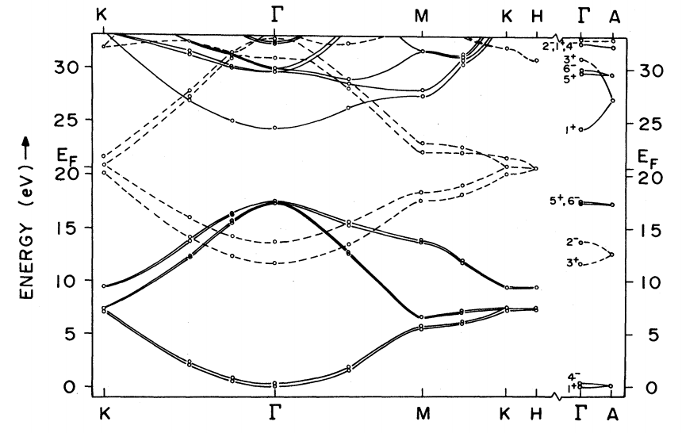
Note: Valence bands must accommodate 16 valence electrons from four C 1s²2s²2p² atoms per unit cell
Ref. PRB 26, 5382 (1982)
Band diagram for graphite

Slide 14
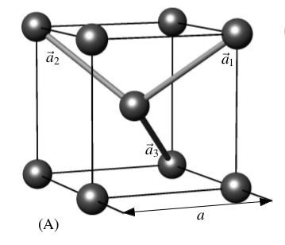
Body centered cubic structure (1 atom per unit cell)

Slide 15
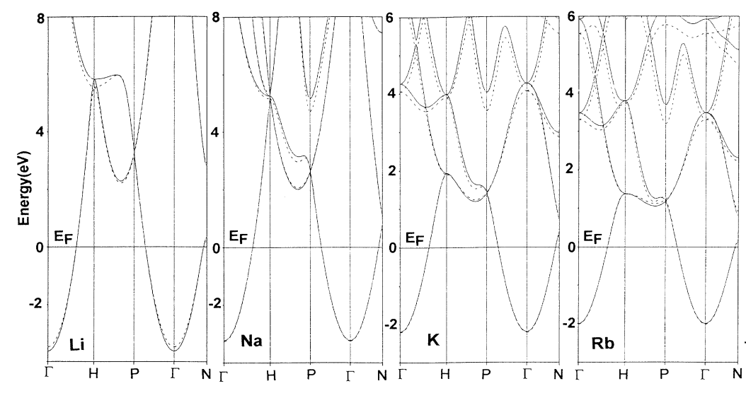
Ref: PRB 52, 17153 (1995)
Electronic structure of some bcc alkali metals; 1 valence electron from one ns¹ atom per unit cell

Slide 16
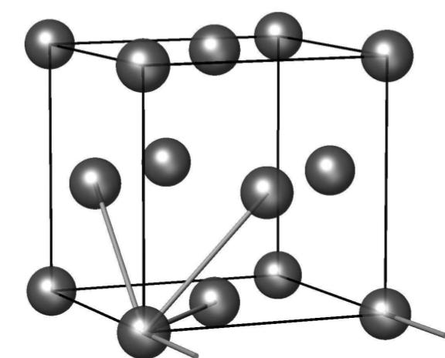
Face centered cubic structure (1 atom per unit cell)
a₁
a₂
a₃
a

Slide 17
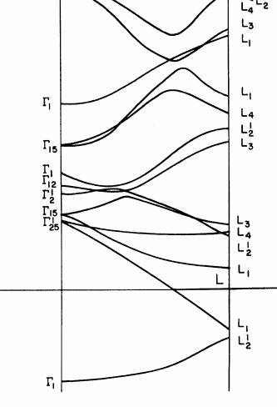
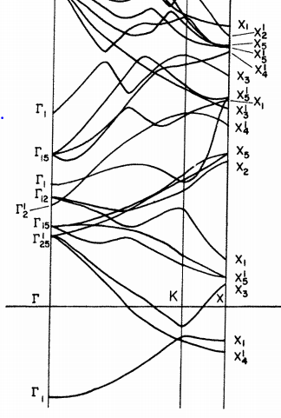
Ref. PRB 2, 3013 (1970) Electronic structure of fcc Al
Note: Valence bands must accommodate 3 valence electrons from one Al 3s²3p¹ atom per unit cell

Slide 18
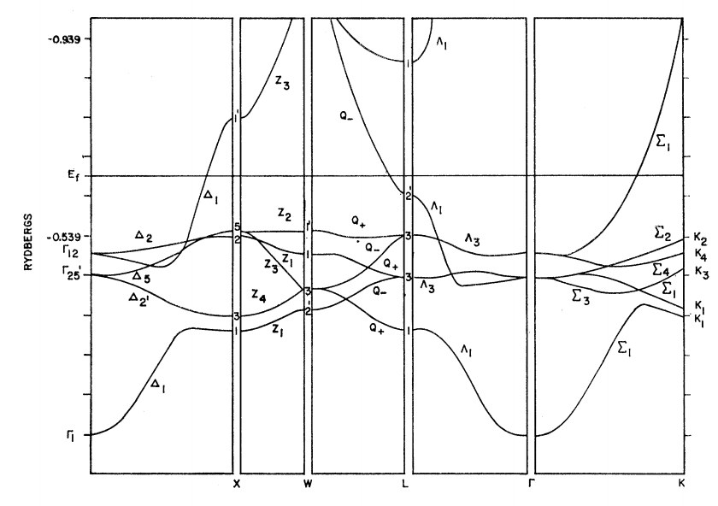
Note: Valence bands must accommodate 11 valence electrons from one Cu 3d¹⁰4s¹ atoms per unit cell
Ref. PR 129, 138 (1963)

Slide 19
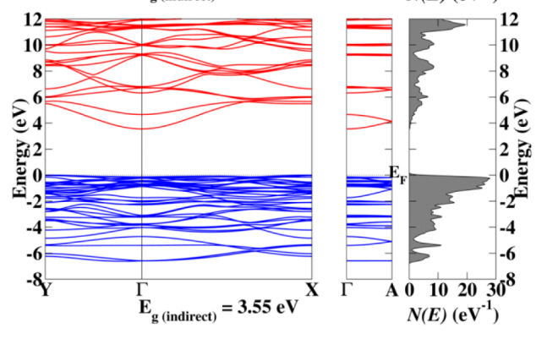
Electronic structure of
Li₂SnO₃
Note: Valence bands must accommodate 72 valence electrons from 8 Li 2s¹ , 4 Sn 5s²5p², and 12 O 2p⁴ atoms per unit cell

Slide 20
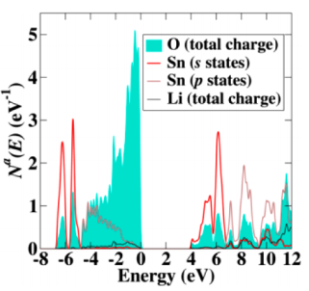
Partial density of states for Li₂SnO₃

Slide 21
Tight binding model of graphene π bands
(more conventional notation than Lect. 8.)
a

