Slide 1
PHY 752 Solid State Physics
11-11:50 AM MWF Olin 107
Plan for Lecture 12:
Reading: Chapter 9 in MPM
Approximations to the
many electron problem -- continued
Density functional theory
Exchange energy and potential for jellium

Slide 2
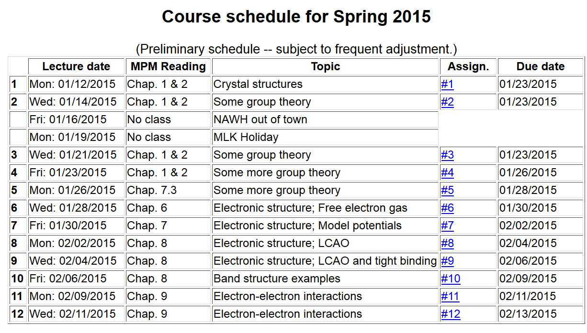
Note: Take-home exam scheduled for the week of March 2nd.

Slide 4
Density functional theory
Describes the relationship between the many electron problem and independent electron treatments.
Proof of theorm
Estimates of F[n].

Slide 5
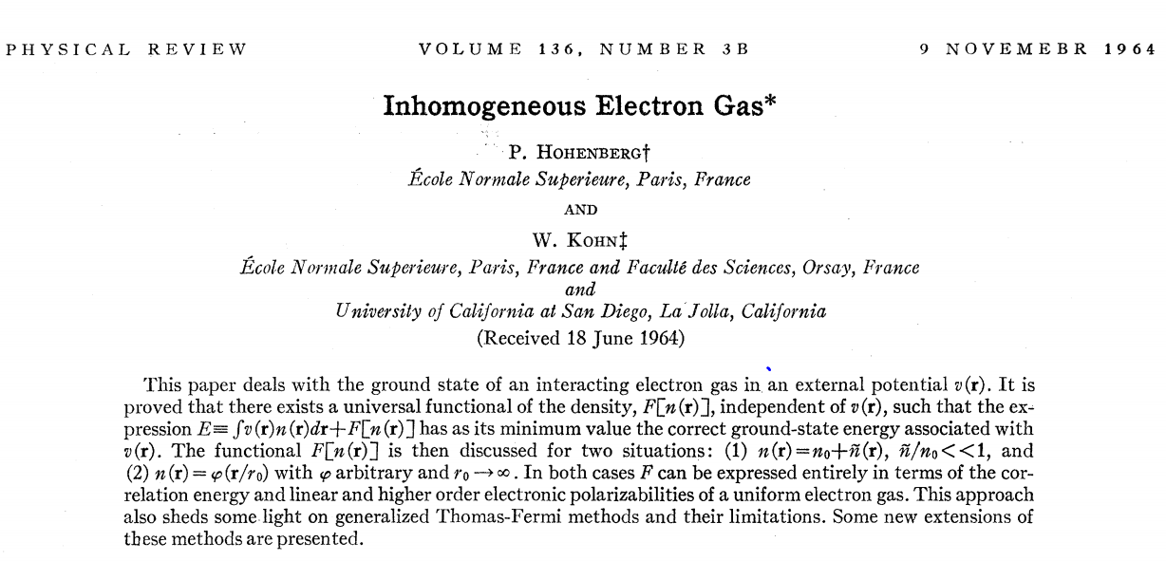
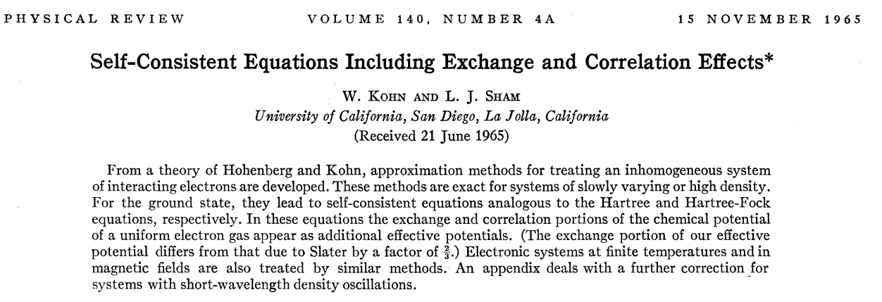
Density functional theory -- continued

Slide 6
Hohenberg and Kohn: formal proof of basic theorem
Kinetic energy
External potential
Coulomb interaction

Slide 7
Theorem: The density n(r) of the ground state of the system is a unique functional of the external potential v(r).
Proof: Consider two Hamiltonians H and H’ differing only by external potentials v and v’.

Slide 8
We can also show:

Slide 9
The theorem implies that the ground state energy E can be considered as a functional of the density n(r)
Thus, the determination of the ground state energy E is transformed into a minimization of the functional with respect to the density n(r), transforming a many particle minimization into a single particle minimization.
In practice, the functional form of F[n] is not known.

Slide 10
Determination of F[n] for jellium

Slide 11
Determination of F[n] for jellium -- continued

Slide 12
Determination of F[n] for jellium – continued
Exchange contribution within Hartree-Fock approximation

Slide 13
Summary of results for jellium:
General forms
Special for jellium

Slide 14
Variational equations

Slide 15
Summary of Kohn-Sham equations:
For jellium; exchange only

