Slide 1
PHY 752 Solid State Physics
11-11:50 AM MWF Olin 107
Plan for Lecture 13:
Reading: Chapter 9 in MPM
Density functional theory
Thomas-Fermi theory
Some practical considerations of density functional theory

Slide 2
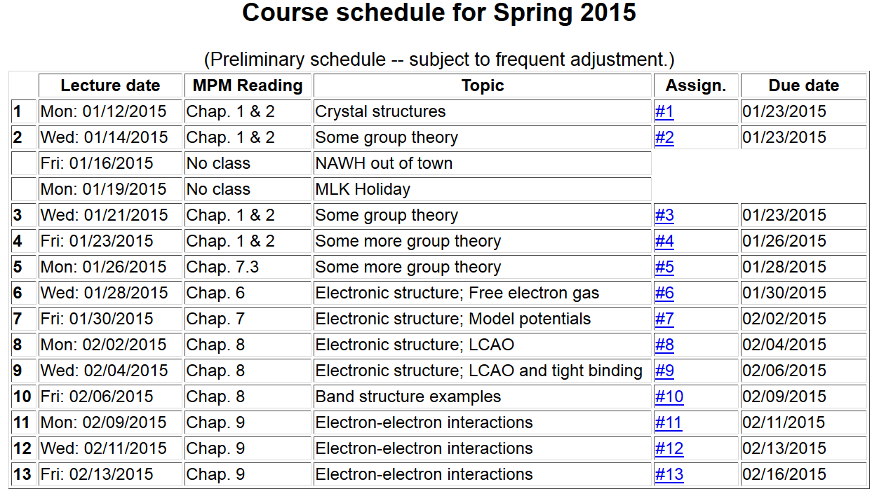
Note: Take-home exam scheduled for the week of March 2nd.

Slide 3
Summary of results for expressing the electronic energy in terms of the density:
General forms
Special for jellium

Slide 4
Jellium extension
i
Local potential at site i
i
j
k
l

Slide 5
Explicit density functional based on extended jellium model

Slide 6
Thomas-Fermi theory
Thomas, Proc. Cambridge Phil. Soc. 23, 542 (1927) Fermi, Z. Physik 48, 73 (1928)

Slide 7
Fermi-Thomas-Dirac equation:
i
j
k
l

Slide 8
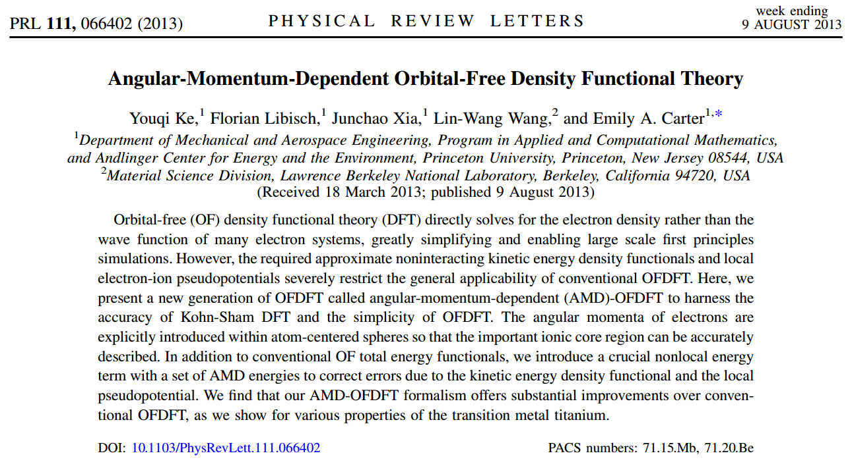
Unfortunately, Thomas-Fermi theory predicts that atoms never bind into molecules.
Modern extensions – Orbital Free DFT

Slide 9
Kohn-Sham formulation of density functional theory

Slide 10
Self-consistent solution

Slide 11
Kohn-Sham formulation of density functional theory
Results of self-consistent calculations
Some remaining issues
Theory for E_{exc}[n] still underdevelopment
This formalism does not access excited states
Strongly correlated electron systems are not well approximated

Slide 12
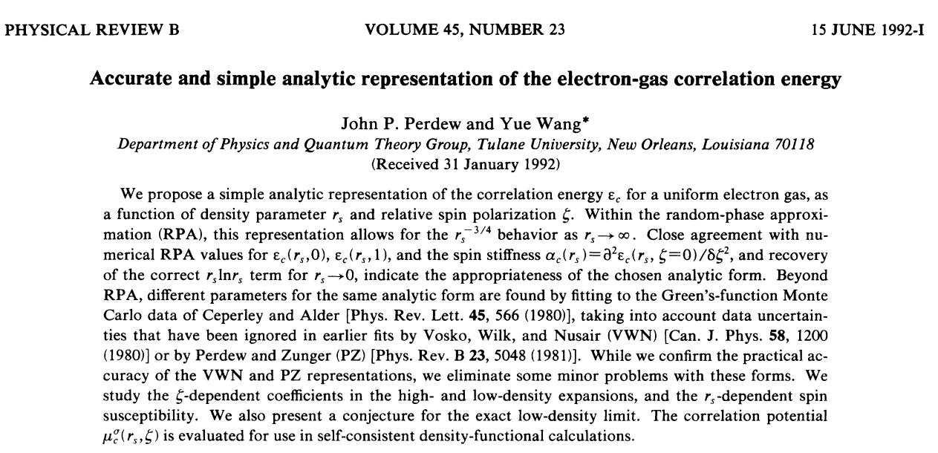
Examples of E_{exc} -- Local Density Approximation (LDA)

Slide 13
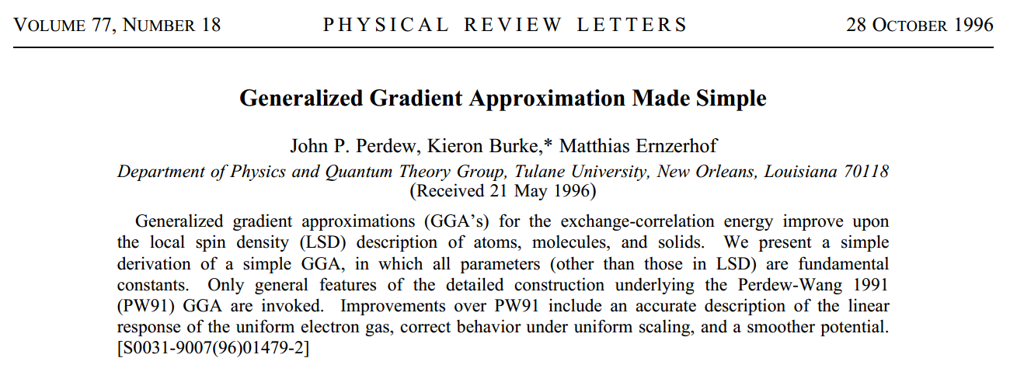
Examples of E_{exc} -- Generalized Gradient Approximation (GGA)

Slide 14
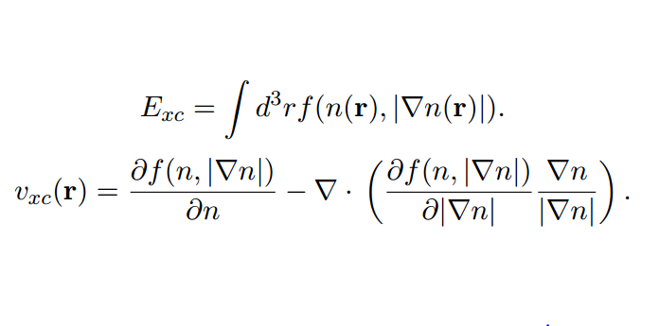
Some details of the Generalized Gradient Approximation

Slide 15
Comparison of LDA and GGA binding energy curves

Slide 16
LDA vs GGA performance wrt normal modes of vibration
A: B. N. Mavrin et al, J. Exp. Theor. Phys. 96,53 (2003); B: F. Harbach and F. Fischer, Phys. Status Solidi B 66, 237 (1974) – room temp. C: Ref. B at liquid nitrogen temp.; D: L. Popović et al, J. Raman Spectrosc. 34,77 (2003).

