Slide 1
PHY 752 Solid State Physics
11-11:50 AM MWF Olin 107
Plan for Lecture 14:
Reading: Chapter 10 in MPM
Numerical Realizations of Density functional theory
Electronic structure of atoms
Integration of the radial equations
Frozen core approximation

Slide 2
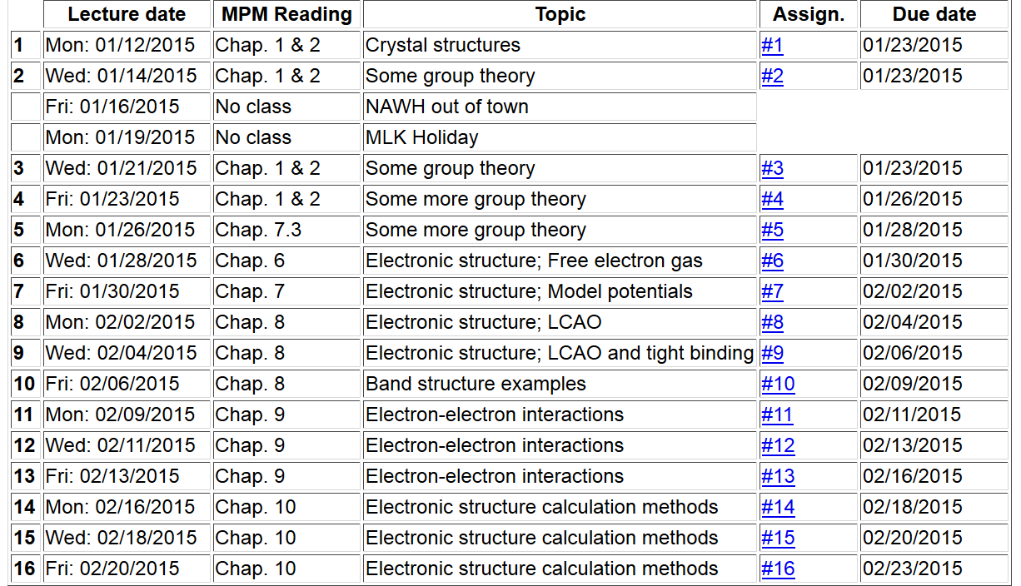
Note: Take-home exam scheduled for the week of March 2nd.

Slide 3
Numerical methods for solving the Kohn-Sham equations

Slide 4
Numerical methods for solving the Kohn-Sham equations
Self-consistent solution

Slide 5
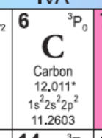
Numerical methods for solving the Kohn-Sham equations –
Consider the case of a single atom, choosing the coordinate system at the center of the nucleus. We will further assume that the atom is spherically symmetric, averaging over the multiplet configurations.

Slide 6
Kohn-Sham equations for spherical atom

Slide 7
Kohn-Sham equations for spherical atom -- continued

Slide 8
Kohn-Sham equations for spherical atom -- continued

Slide 9
Kohn-Sham equations for spherical atom -- continued
Notes on numerical integration of differential equations

Slide 10
Digression on numerical integration
Numerical results from second-order approximation:
 | N=4 | N=8 | Exact
ν=1 | 9.54915028 | 9.7697954 | 9.869604404
ν=2 | 34.54915031 | 37.9008002 | 39.47841762
Numerical results from Numerov approximation:
 | N=4 | Exact
ν=1 | 9.863097625 | 9.869604404
ν=2 | 39.04581620 | 39.47841762

