Slide 1
PHY 752 Solid State Physics
11-11:50 AM MWF Olin 107
Plan for Lecture 15:
Reading: Chapter 10 in MPM
Numerical Realizations of Density functional theory
Electronic structure of atoms
Integration of the radial equations
Frozen core approximation
Extension of formalism to multi-center analysis

Slide 2
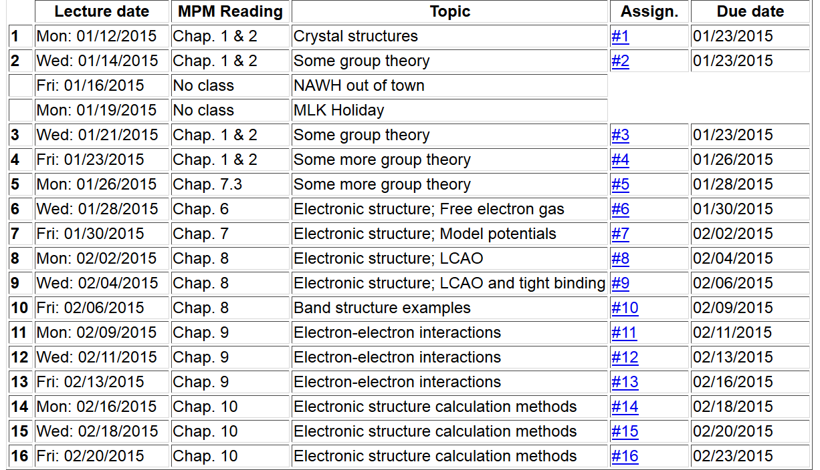
Note: Take-home exam scheduled for the week of March 2nd.

Slide 4
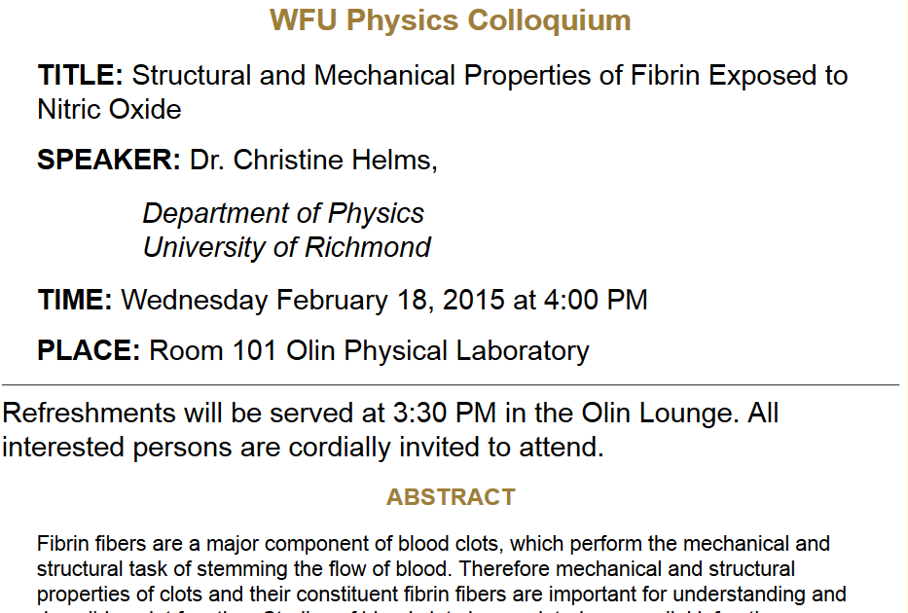

Slide 5
Kohn-Sham equations for spherical atom

Slide 6
Numerical methods for solving the Kohn-Sham equations
Self-consistent solution

Slide 7
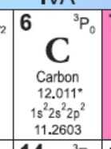
Example for carbon

Slide 8
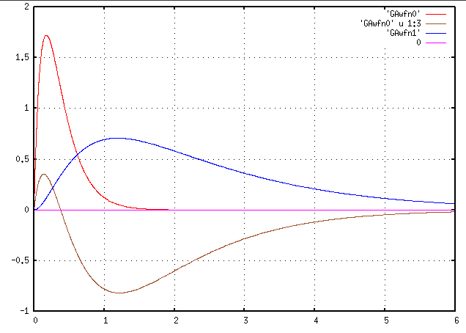
Results for carbon
1s
2p
P_{nl}(r)
2s
r (Bohr)

Slide 9
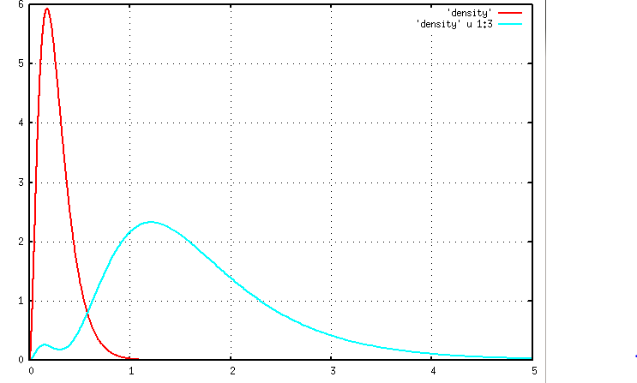
n_{core}(r)
n r²/4π
n_{val}(r)
r (Bohr)

Slide 10
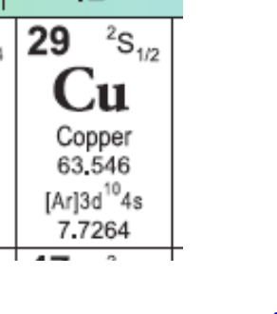
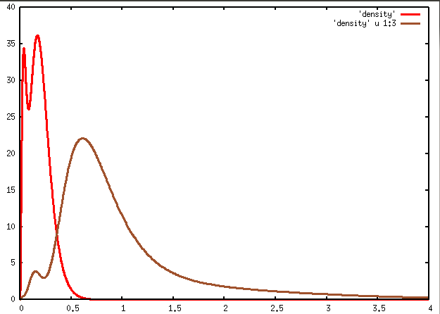
Example for Cu
1s²2s²2p⁶3s²3p⁶3d¹⁰4s¹
n_{core}(r)
n r²/4π
n_{vale}(r)
r (Bohr)

Slide 11
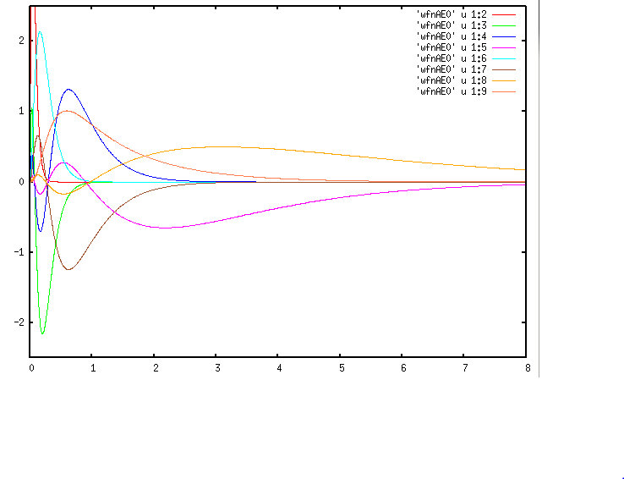
Results for Copper
3s
3d
4p
P_{nl}(r)
4s
3p
r (Bohr)

Slide 12
Frozen core approximation
Example for Cu
1s²2s²2p⁶3s²3p⁶3d¹⁰4s¹
n_{core}(r)
n r²/4π
n_{vale}(r)
r (Bohr)

Slide 13
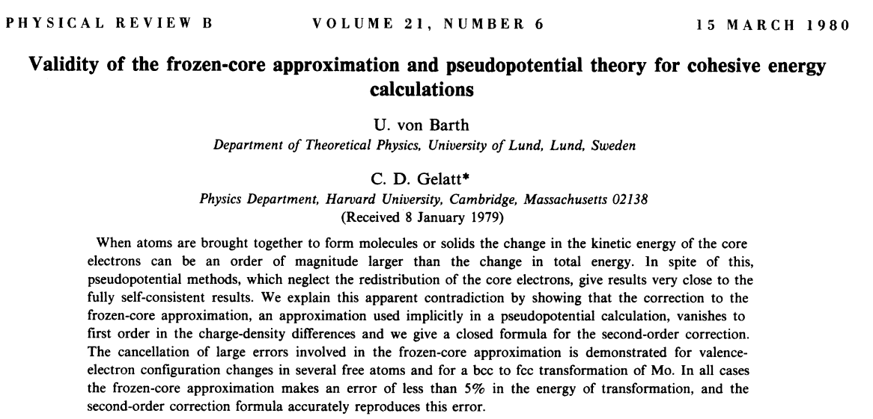
Systematic study of frozen core approximation in DFT
http://journals.aps.org/prb/abstract/10.1103/PhysRevB.21.2222

Slide 14
Variational relations for DFT in frozencore approximation (Kohn-Sham formulation)

Slide 15
Practical solution to Kohn-Sham equations for single particle orbitals:

Slide 16
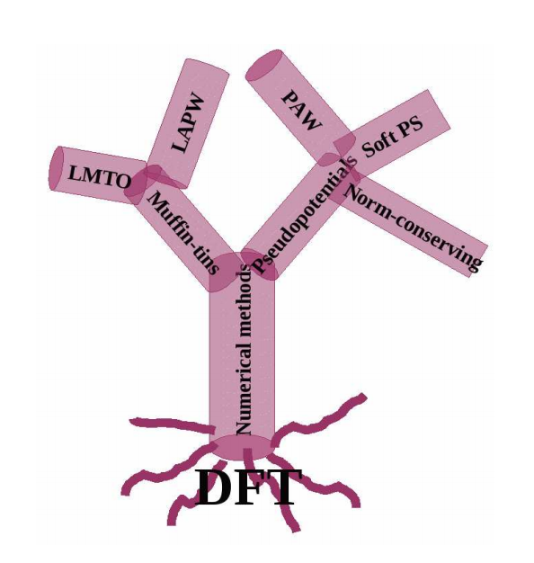
Practical solution of Kohn-Sham equations in solids

Slide 17
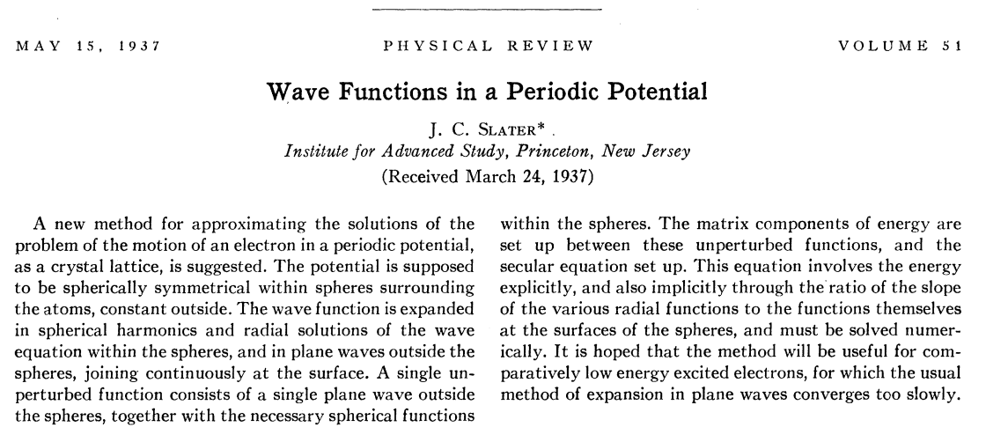
Muffin tin potential construction
http://journals.aps.org/pr/abstract/10.1103/PhysRev.51.846
Augmented Plane Wave (APW) approximation

Slide 18
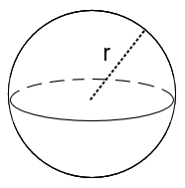
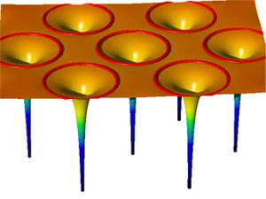
Muffin tin potential construction
http://www.jara.org/de/research/jara-hpc/forschung/details/simlab-ai/performance-modeling-for-linear-algebra-in-fleur/

Slide 19
Muffin tin model continued:
Problems with APW and KKR Green’s function schemes
Difficult numerically to find Kohn-Sham energies ε_{i}
Potential form unrealistic especially for covalent materials
➔Linearized equations – O. K. Andersen
http://journals.aps.org/prb/abstract/10.1103/PhysRevB.12.3060

Slide 20
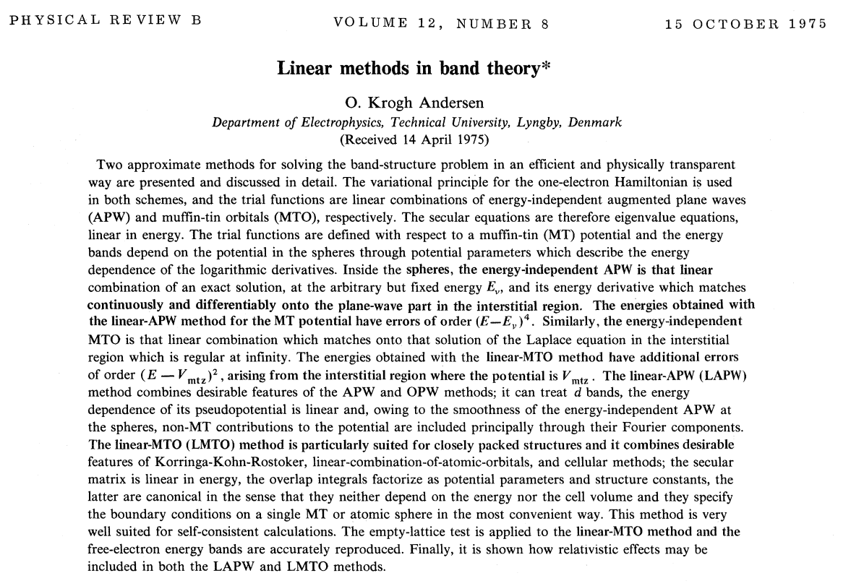

Slide 21
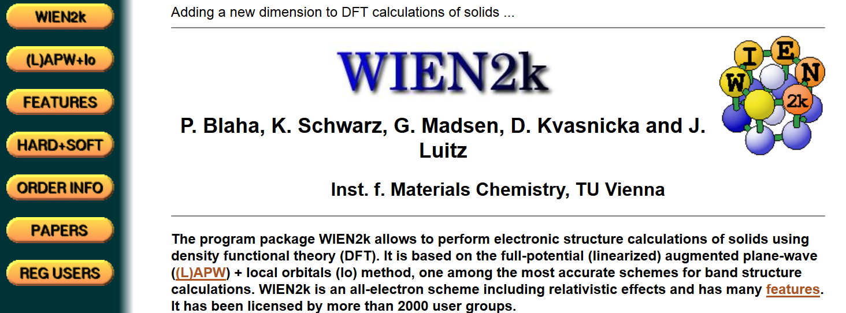
Modern software based on LAPW method --
http://www.wien2k.at/

Slide 22
http://elk.sourceforge.net/
http://exciting-code.org/

