Slide 1
PHY 752 Solid State Physics
11-11:50 AM MWF Olin 107
Plan for Lecture 16:
Reading: Chapter 10 in MPM
Numerical Realizations of Density functional theory
Running graphatom code for spherical atoms
Introduction to pseudopotentials
Projector Augmented Wave (PAW) approximation

Slide 2
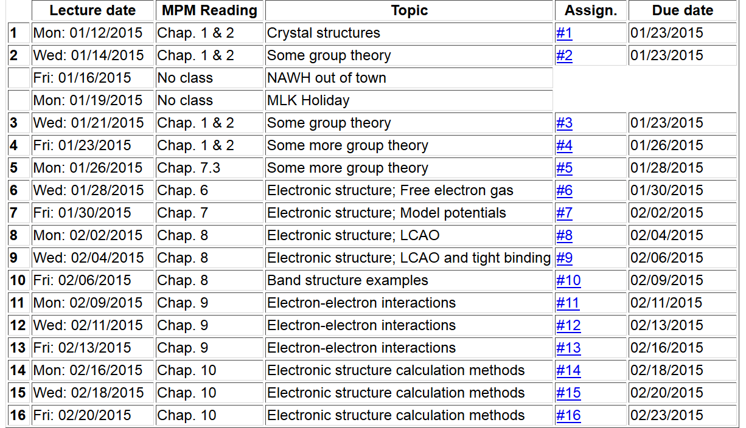
Note: Take-home exam scheduled for the week of March 2nd.

Slide 3
Some comments on using the cluster
Necessary software on your laptop:
A terminal emulator. For windows this means Virtual Box or Putty
If you use Putty, you will also need a graphics emulator such as Xming
http://sourceforge.net/projects/xming/

Slide 4
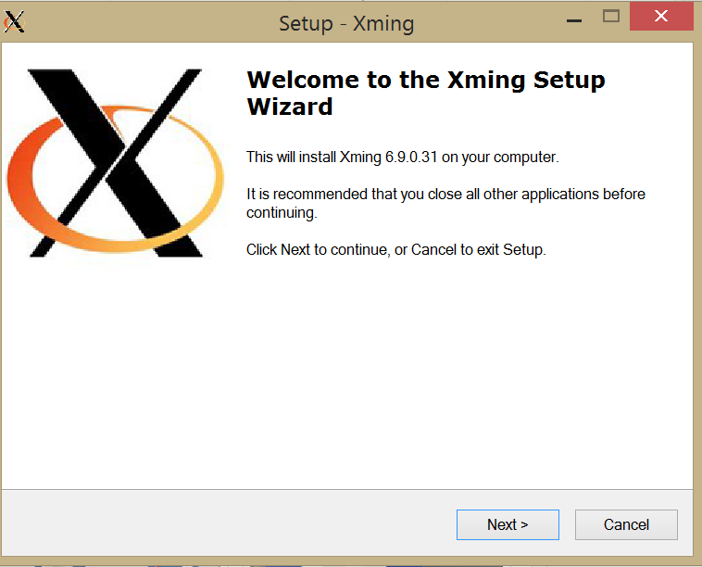
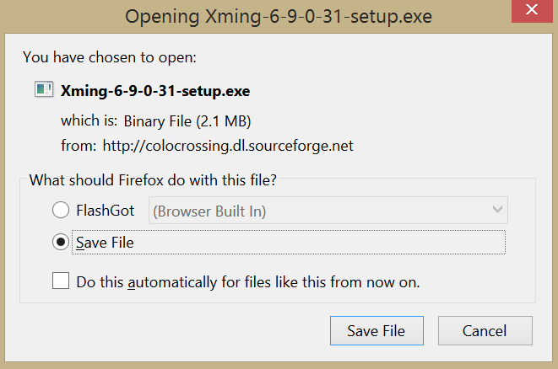
When you run Putty to access the cluster, Xming should be running in background.

Slide 5
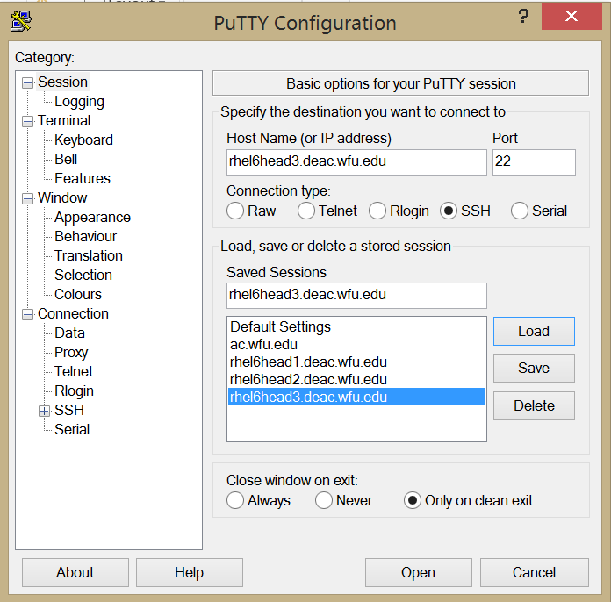
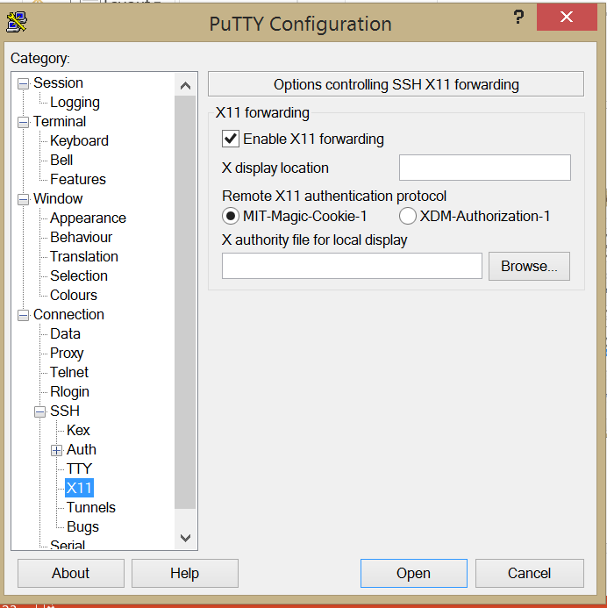

Slide 6
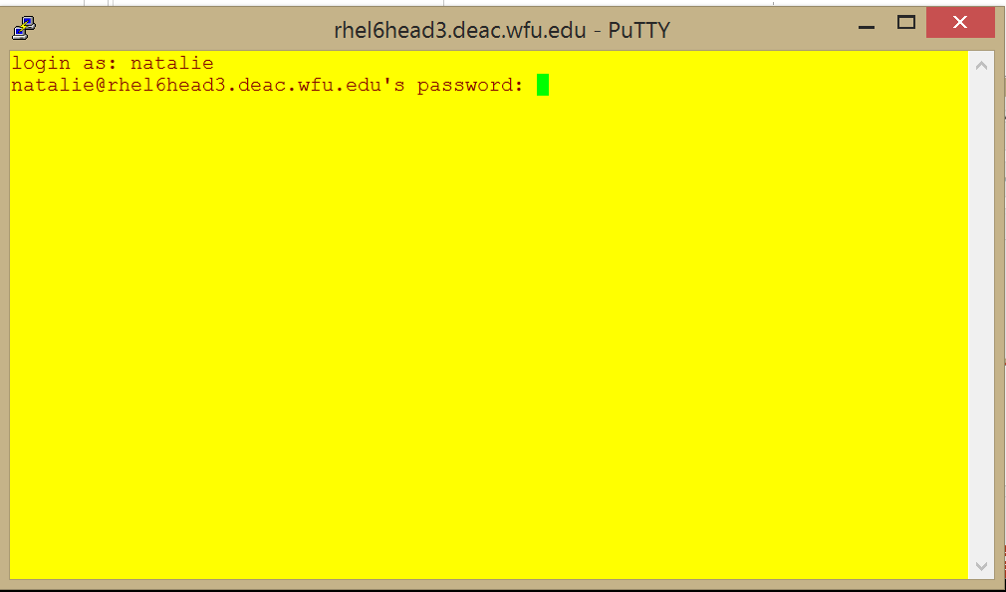

Slide 7
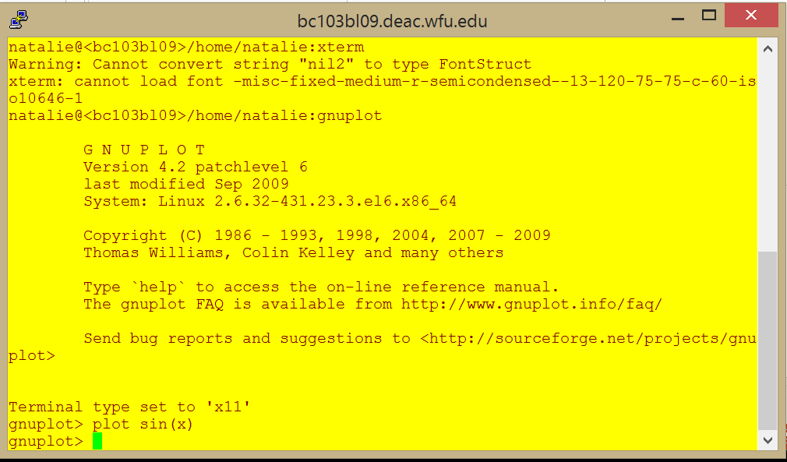

Slide 8
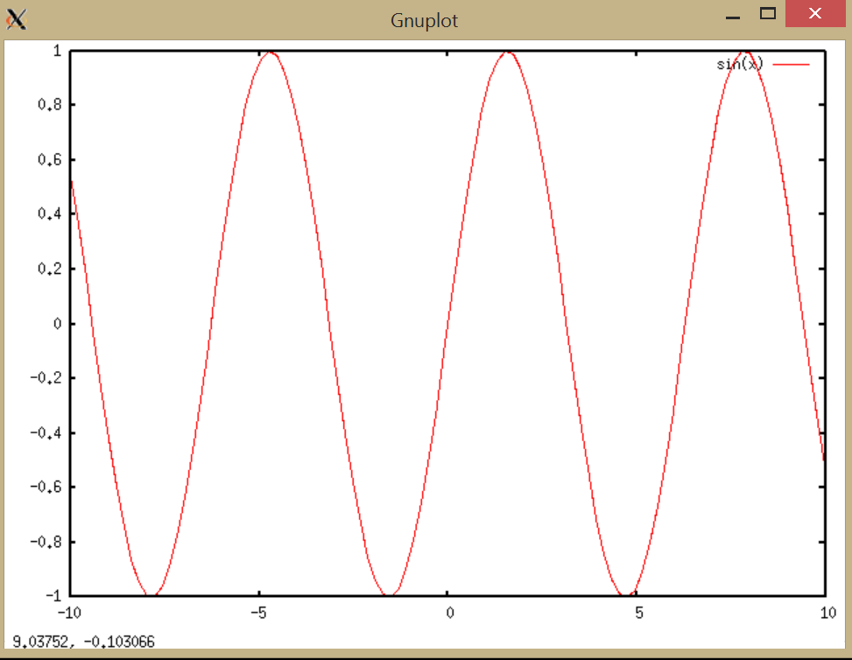

Slide 9
If this is the first time using the cluster – you may which to:
In your home directory (/home/login)
cp /home/natalie/EL6/Coursematerials/s15phy752/setups/.tcshrc .
source .tcshrc
Course datafiles
/wfurc1/classes/phy752/login
To do the graphatom homework, do the following:
cd /wfurc1/classes/phy752/login
/wfurc1/classes/phy752/natalie: mkdir C
/wfurc1/classes/phy752/natalie: cd C
/wfurc1/classes/phy752/natalie/C: gedit C.in
/wfurc1/classes/phy752/natalie/C: \
~natalie/EL6/Coursematerials/s15phy752/pgms/rungraphatom <C.in>&out&

Slide 10
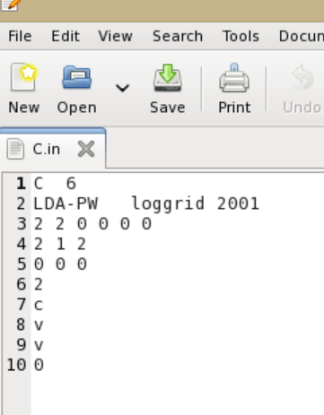
C.In file content
Atomic symbol & number
Exchange-correl. Type & grid info
Maximum n for l=1,2,3,4…..
n l occ corrected configuration
End configuration changes
Flag for frozencore setting
End program

Slide 11
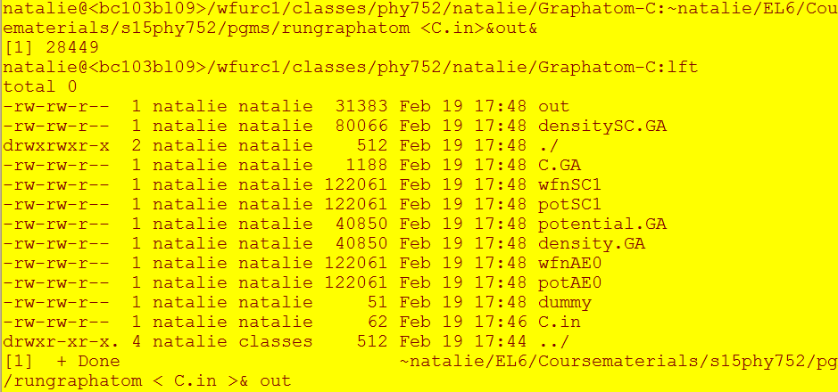

Slide 12
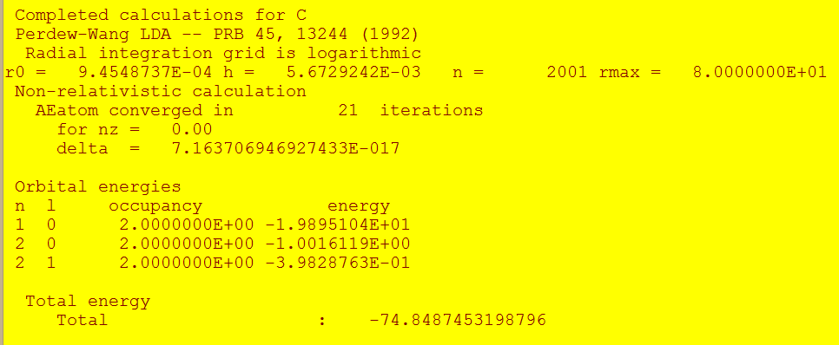
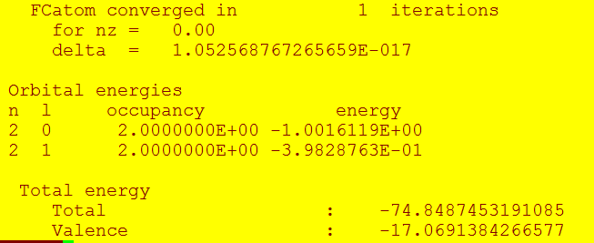

Slide 13
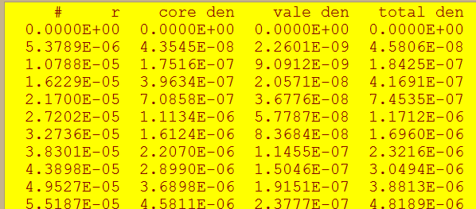
Some output --
densitySC.GA:
wfnAE0:
r 1s 2s 2p

Slide 14
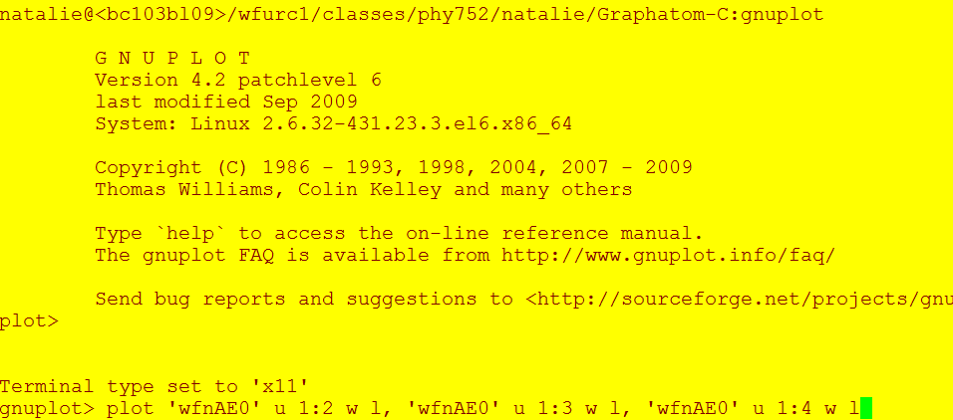
Plotting results with gnuplot:

Slide 15
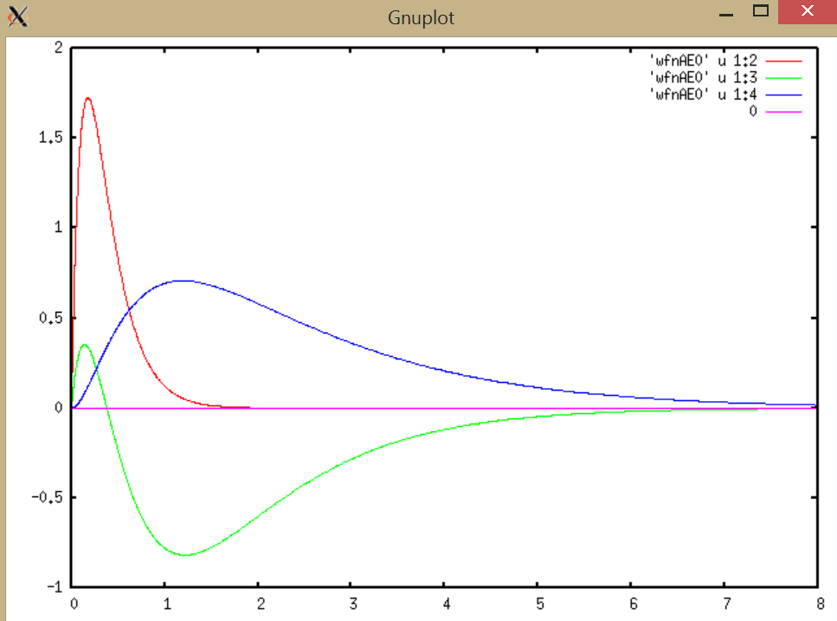
plot [0:8] 'wfnAE0' u 1:2 w l, 'wfnAE0' u 1:3 w l, 'wfnAE0' u 1:4 w l,0

Slide 16
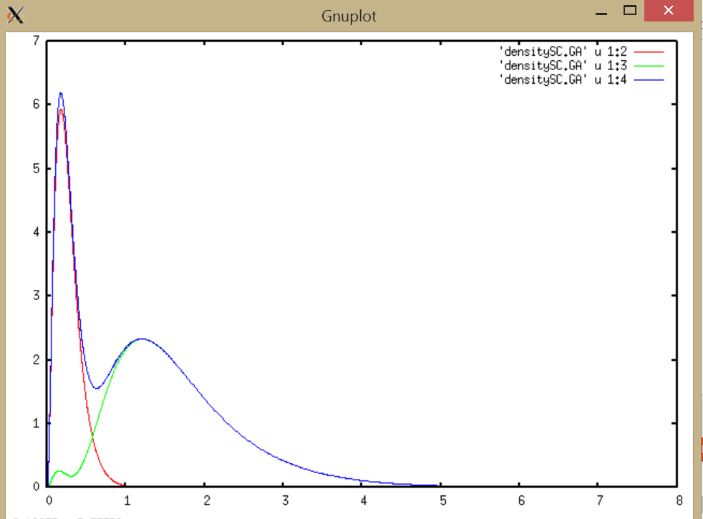
plot [0:8] 'densitySC.GA' u 1:2 w l, 'densitySC.GA' u 1:3 w l, 'densitySC.GA' u 1:4 w l

Slide 17
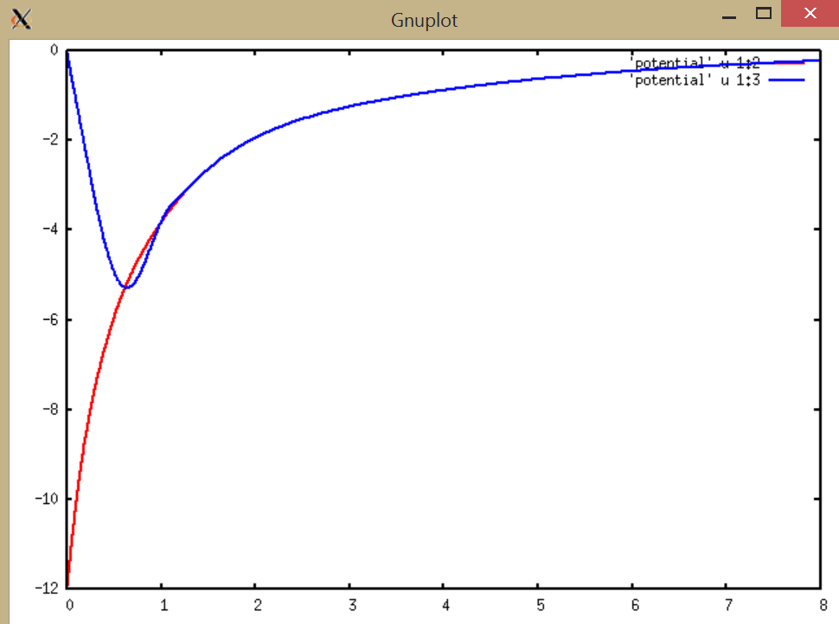
Local pseudopotential for C
rV(r) (Bohr * Ry
Self-consistent full potential for C
r (Bohr)

Slide 18
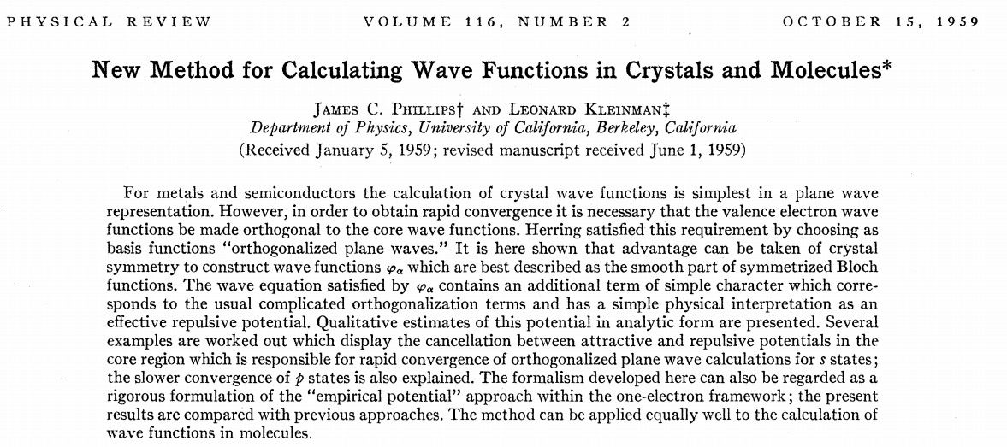
Motivation/justification for pseudopotential formalism

Slide 19
Projector Augmented Wave method – quick summary

Slide 20
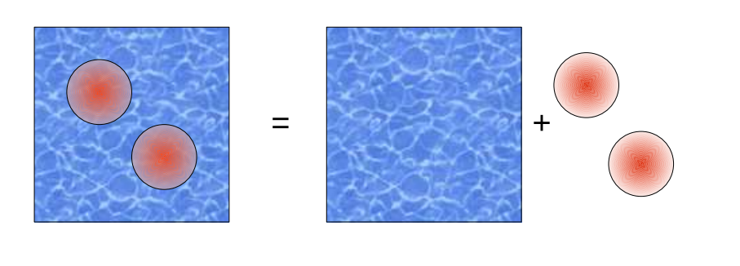
PAW representation of Kohn-Sham orbitals
Evaluation of the energy of the system

Slide 21
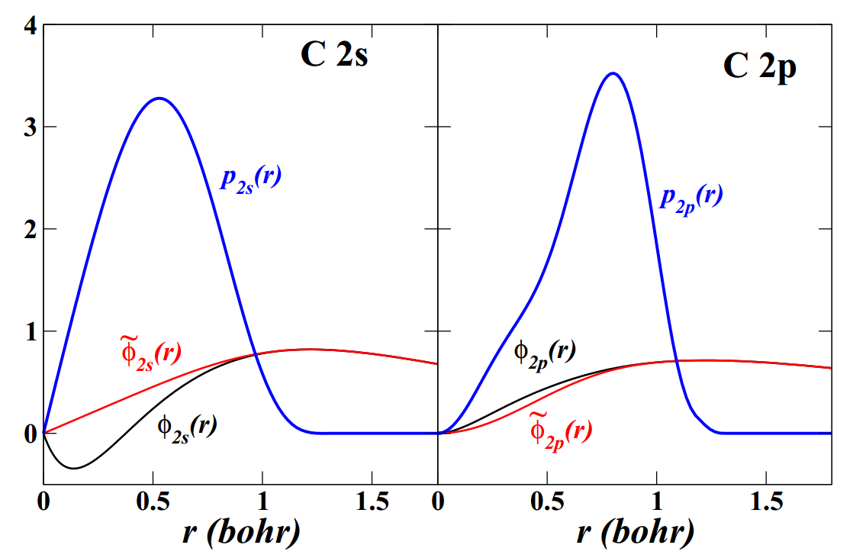
Example of atomic basis and projector functions

Slide 22
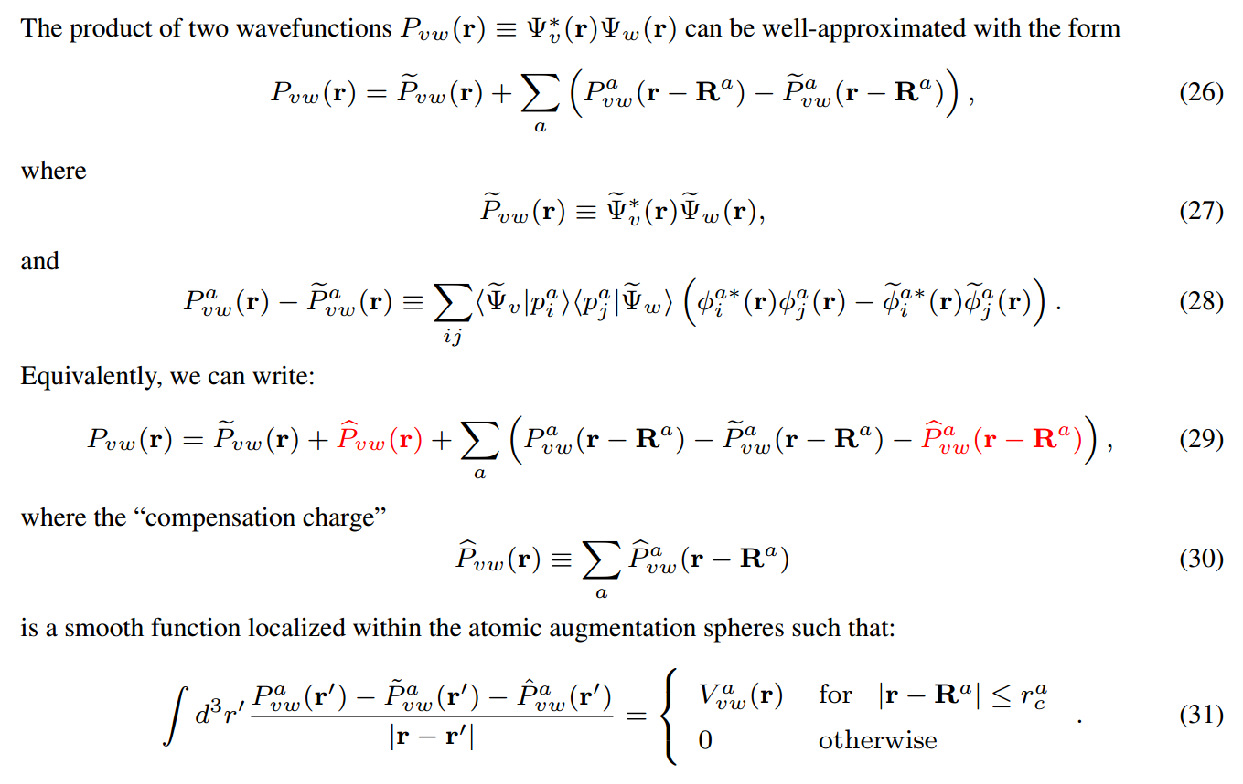
Clever secret of PAW method; partitioning of planewave and one center contributions

