Slide 1
PHY 752 Solid State Physics
11-11:50 AM MWF Olin 107
Plan for Lecture 17:
Reading: Chapter 10 in MPM
Ingredients of electronic structure calculations
Plane wave basis sets
Evaluation of matrix elements
Construction of pseudopotentials

Slide 2
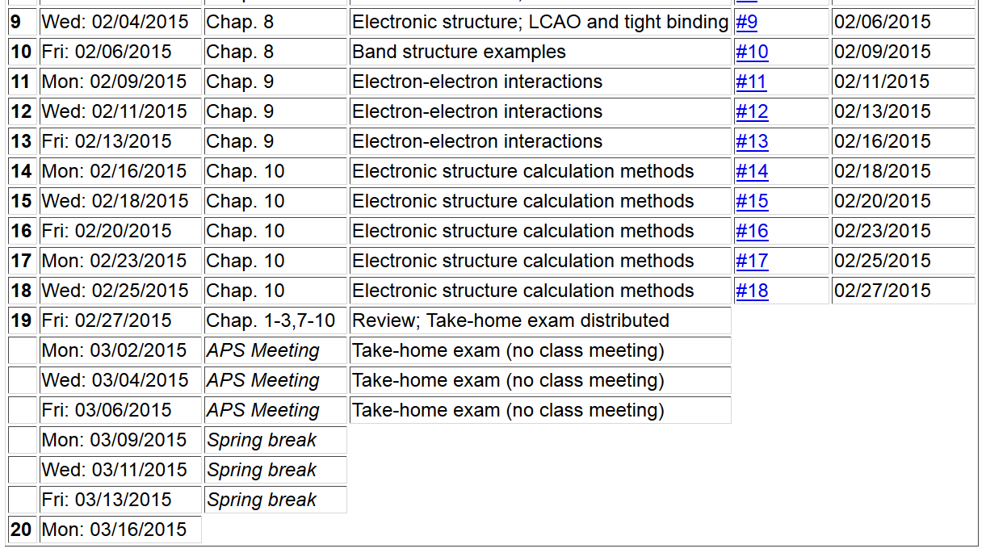

Slide 3
Some practical considerations in electronic structure calculations

Slide 4
Kohn-Sham equations (assuming “local” potential)

Slide 5
Digression on evaluation of the Fourier transform of the effective potential

Slide 6
Digression on evaluation of the Fourier transform of the effective potential

Slide 7
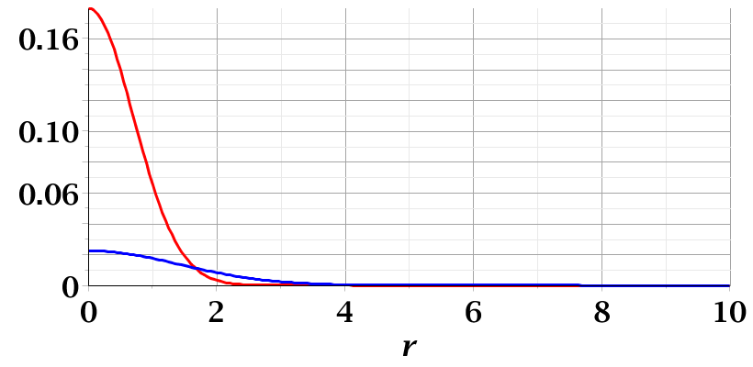
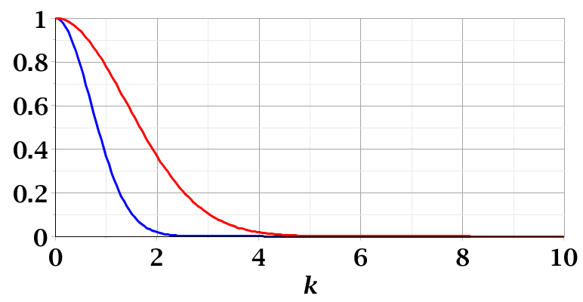
Examples of convergence of Fourier transforms:

Slide 8
Convergence of plane wave expansions

Slide 9
Some practical tricks
Fourier space representation of density can be determined by inverse FFT

Slide 10
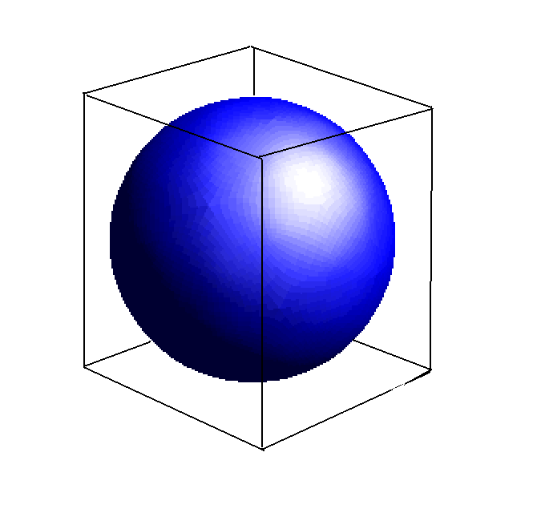
FFT grid size
Enclosing parallelepiped

Slide 11
FFT equations http://www.fftw.org/

Slide 12
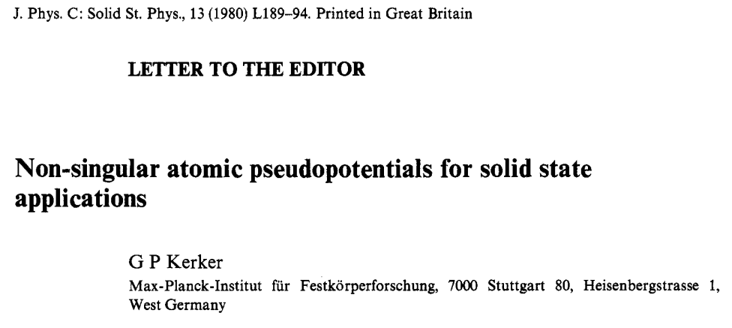
How can we construct a pseudopotential?
Norm-conserving pseudopotentials

Slide 13
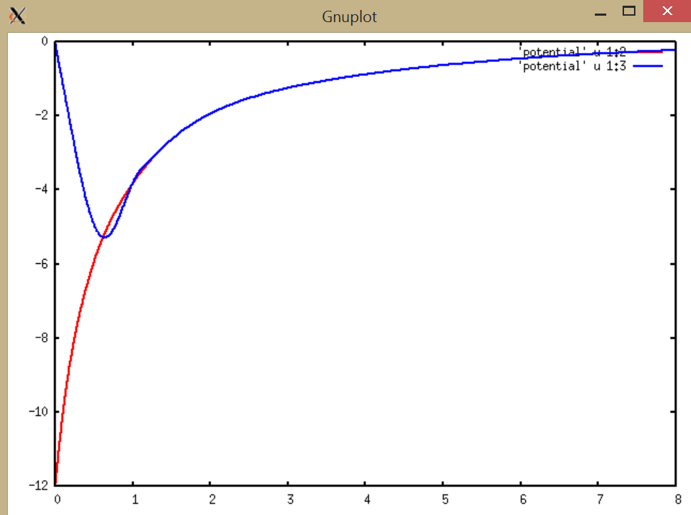
Local pseudopotential for C
rV(r) (Bohr * Ry
Self-consistent full potential for C
r (Bohr)

Slide 14
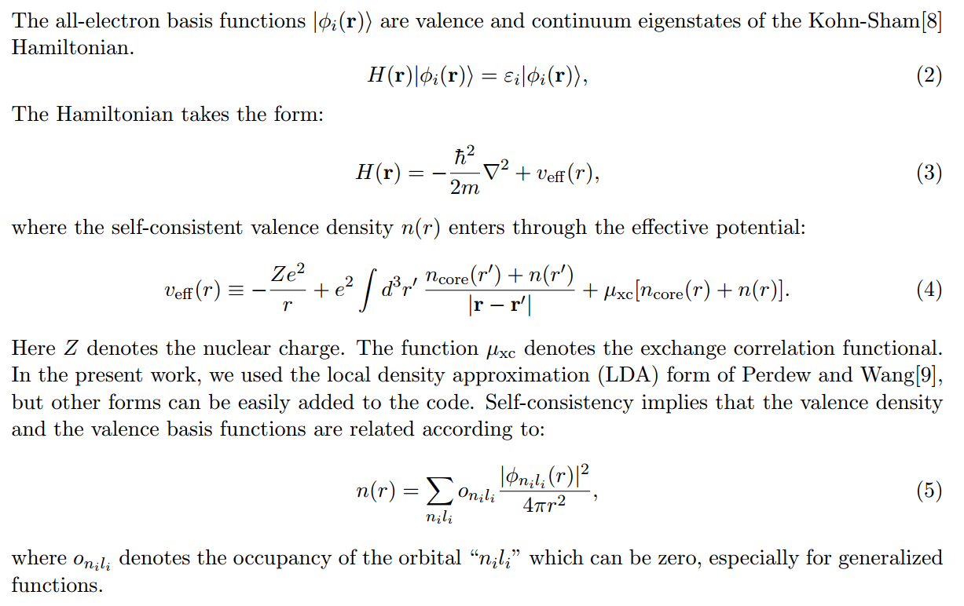
Construction methods used in ATOMPAW code

Slide 15
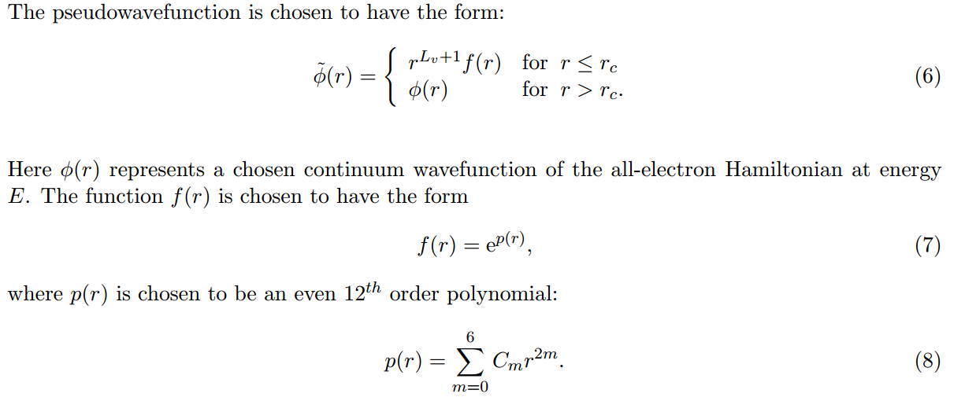

Slide 16
Properties of pseudopotential and corresponding pseudo-wavefunctions
➔Correct logarithmic derivatives at energy E and at nearby energies

Slide 17
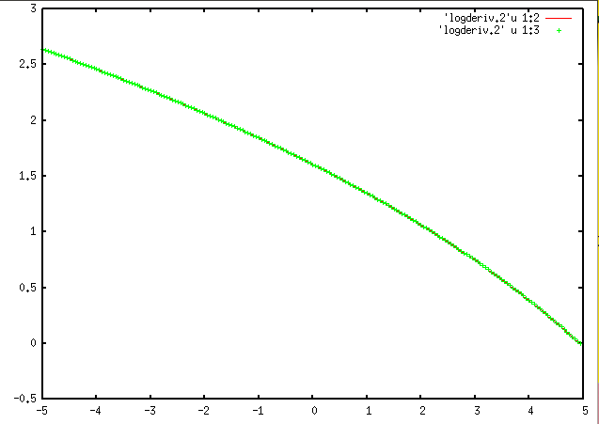
L[P]
E (Ry)
Construction energy

Slide 18
The construction ensures that
➔PS and AE have same log derivatives near E
➔What about other partial waves? (Non-local contributions to pseudopotential)

