Slide 1
PHY 752 Solid State Physics
11-11:50 AM MWF Olin 107
Plan for Lecture 18:
Reading: Chapter 10 in MPM
Ingredients of electronic structure calculations
Construction of and testing of pseudopotentials

Slide 2
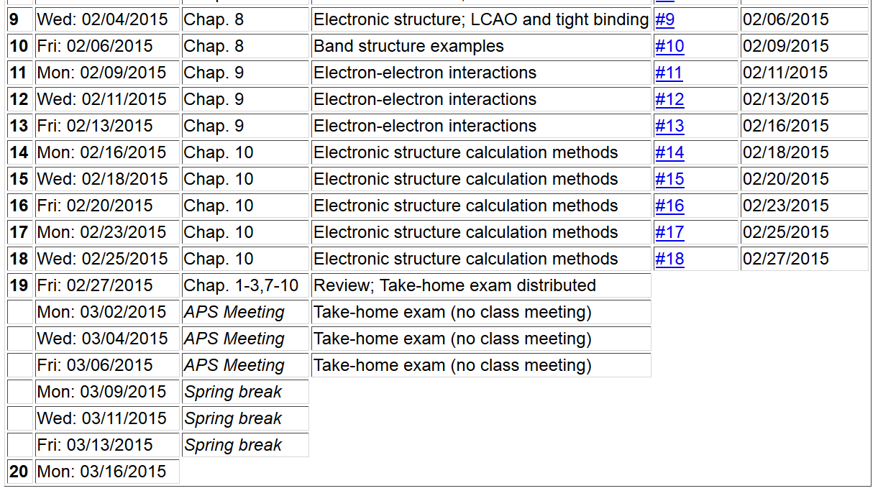

Slide 4
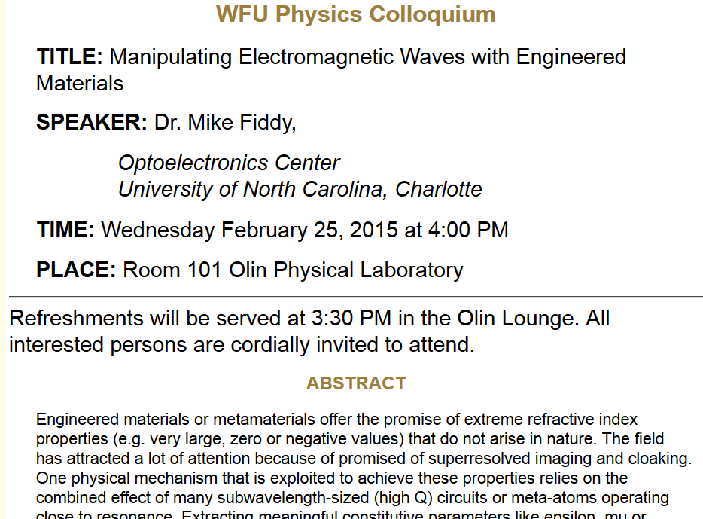

Slide 5
Construction of pseudopotential with PAW formalism
pseudo wavefunction
atom centered basis functions
projector function

Slide 7
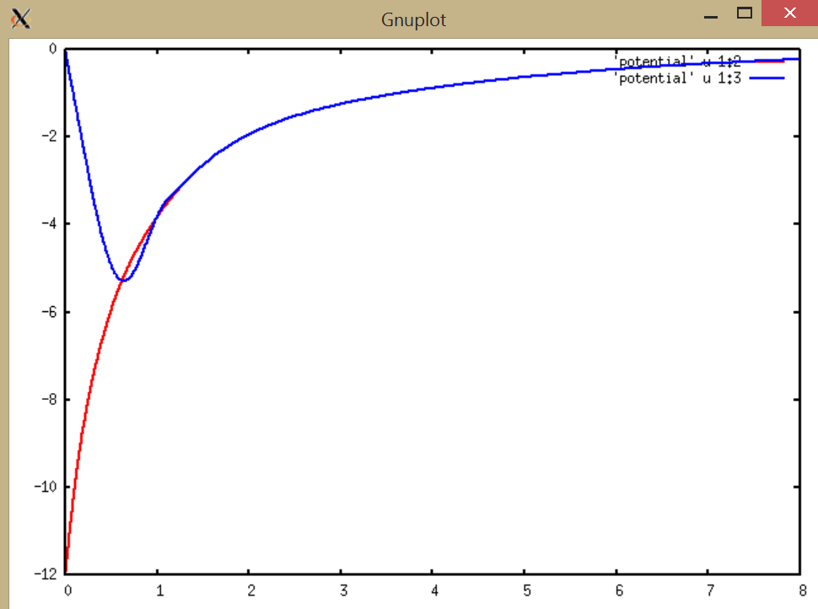
Example for C
rV(r) (Bohr * Ry
r (Bohr)

Slide 8
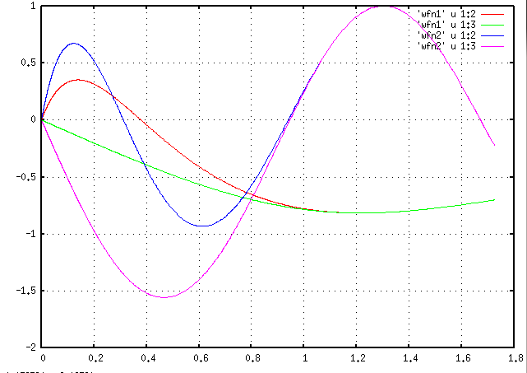
Construction of atom centered basis and projector functions:
r_{c}
r

Slide 9
Construction of atom centered basis and projector functions – continued (scheme developed by David Vanderbilt for ultra-soft pseudopotentials; for each l channel at at time):

Slide 10
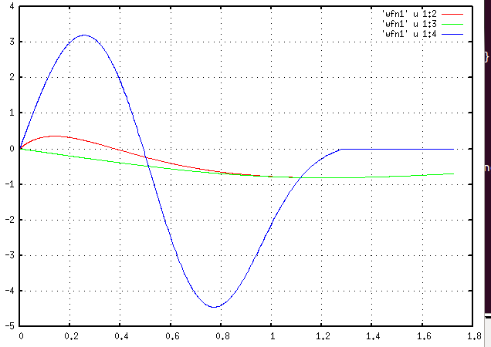
Example for C
r

Slide 11
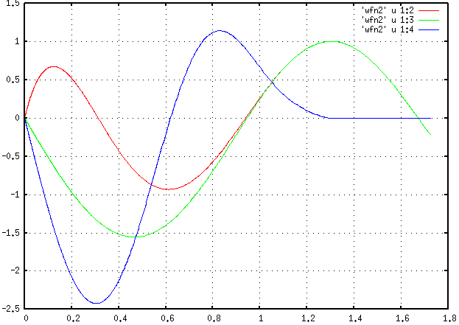
Example for C -- continued

Slide 12
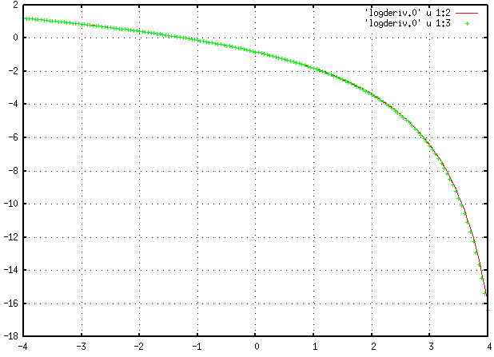
Example for C -- continued
log derivatives for l=0
E

Slide 13
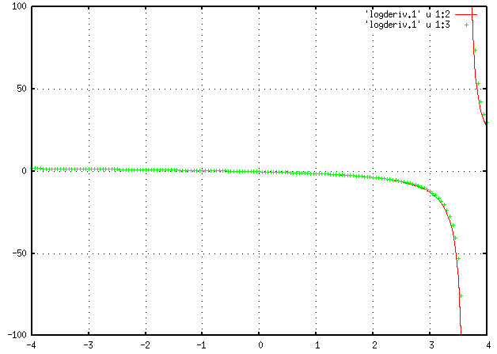
Example for C -- continued
log derivatives for l=1
E

Slide 14
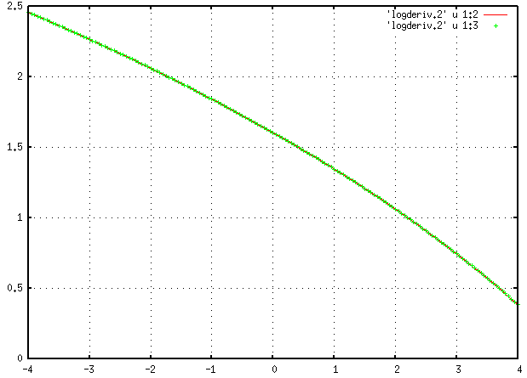
Example for C -- continued
log derivatives for l=2
E

Slide 15
Instructions for running atompaw pgm
Log into cluster
cd /wfurc1/classes/phy752/login
mkdir [directory name]
cd [directory name]
cp /wfurc1/classes/phys752/natalie/Examples/Atompaw-C/C.in [atom].in
gedit [atom].in
~natalie/EL6/Coursematerials/s15phy752/pgms/runatompaw<C.in>&out&
Output:
wfn1, wfn2, ….. for each basis and projector function
logderiv.0, logderiv.1, logderiv.2 … for each l channel
[atom] lists energies and basis functions
input files for QE, abinit, etc.

Slide 16
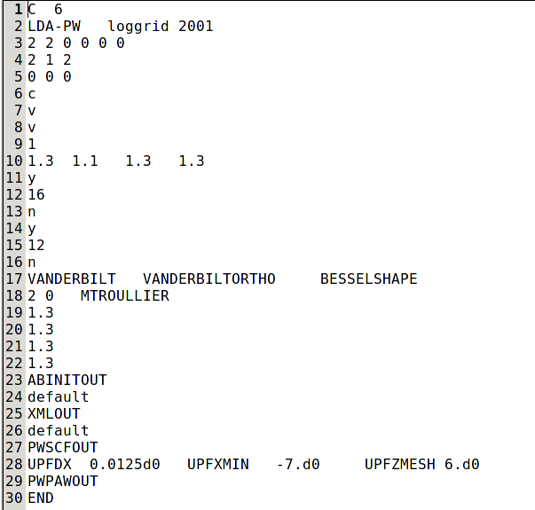
input file for atompaw
same as in graphatom
set core (c) and valence (v)
maximum l for projectors
r_{c} values (bohr units)
add basis states
options for local potential
matching radius for pseudo basis functions
inputs for electronic structure codes

