Slide 1
PHY 752 Solid State Physics
11-11:50 AM MWF Olin 107
Plan for Lecture 19:
Review of Chapters 1-10
Brief review
Discussion of some HW problems
Distribute exam

Slide 2
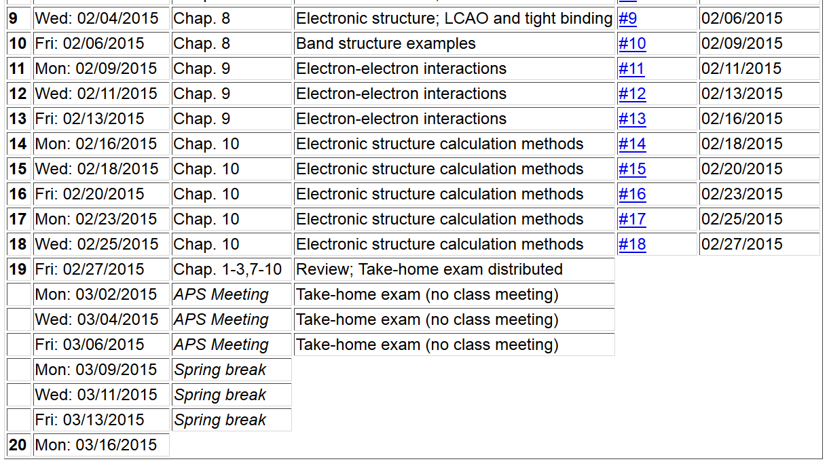

Slide 3
Introduction to crystalline solids
An ideal crystal fills all space
Limited possibilities for crystalline forms –
Only 14 Bravais lattices
Only 32 crystallographic point groups
Only 230 distinct crystallographic structures
Review

Slide 4
Specification of an atom within the lattice
basis vector
Bravais lattice

Slide 5
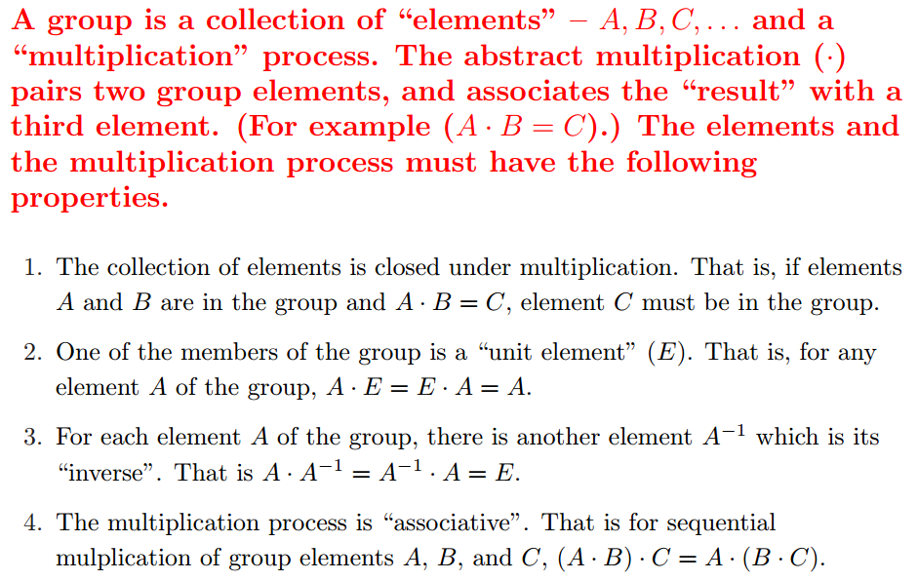
Short digression on abstract group theory
What is group theory ?

Slide 6
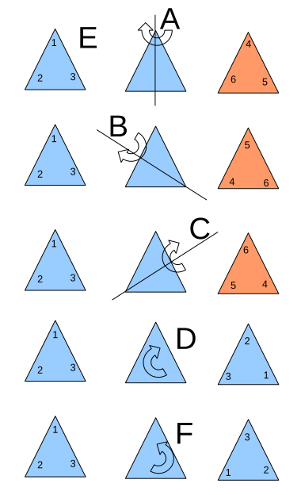
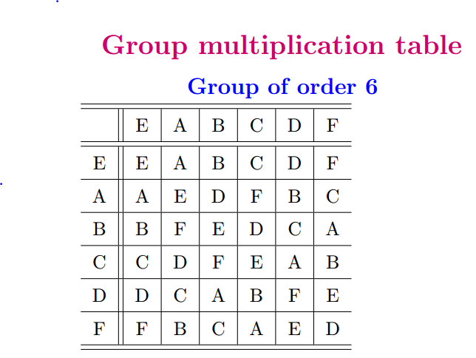
Example of a 6-member group E,A,B,C,D,F,G

Slide 7
Check on group properties:
Closed; multiplication table uniquely generates group members.
Unit element included.
Each element has inverse.
Multiplication process is associative.
Definitions
Subgroup: members of larger group which have the property of a group
Class: members of a group which are generated by the construction

Slide 8
Group theory – some comments
The elements of the group may be abstract; in general, we will use them to describe symmetry properties of our system
Representations of a group

Slide 9
Example:

Slide 10
Example:

Slide 11
The great orthogonality theorem

Slide 12
Simplified analysis in terms of the “characters” of the representations
Character orthogonality theorem
Note that all members of a class have the same
character for any given representation i.

Slide 13
Summary of relationships between the characters and classes of a group which follow from the great orthogonality theorem
These results also imply that the number of classes is the same as the number of characters in a group.

Slide 14
Character table for this group:
 | E | A,B,C | D,F
χ¹ | 1 | 1 | 1
χ² | 1 | -1 | 1
χ³ | 2 | 0 | -1
Use of character table for analyzing matrix elements:

Slide 15
Matrix element example -- continued
Initial
state
Operator
Final
state

Slide 16
Use of character table analysis in crystal field splitting
Question: What happens to a spherical atom when placed in a crystal?
The group which describes the general rotations in 3-dimensions has an infinite number of members, but an important representation of this group is the matrix which rotates to coordinate system about the origin R, transforming

Slide 17
Analysis of the 3-dimensional rotation group -- continued

Slide 18
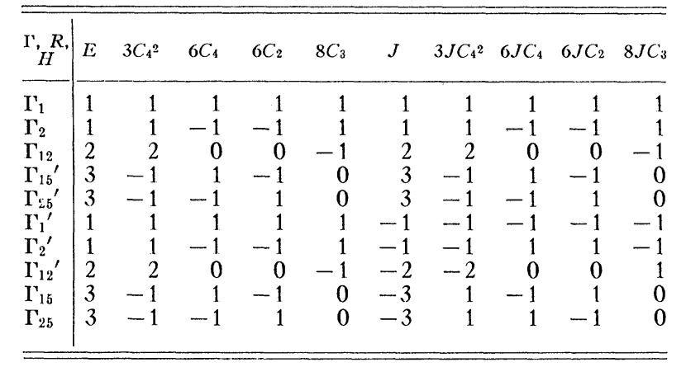
Γ₁
l=0 1 1 1 1 1 1 1 1 1 1
l=1 3 -1 1 -1 0 -3 1 -1 1 0
l=2 5 1 -1 1 -1 5 1 -1 1 -1
Γ₁₅
Γ₁₂+Γ_{25’}

Slide 19
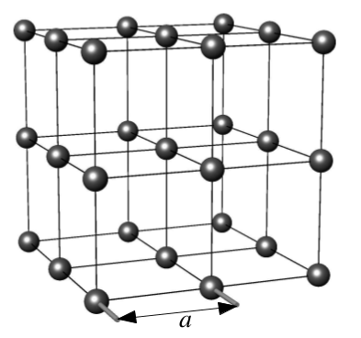
Linear combinations of atomic orbitals (LCAO) methods for analyzing electronic structure
Rª
periodic function
lattice translation
basis vector

Slide 20
LCAO methods -- continued – Slater-Koster analysis

Slide 21
Example
β
β
β
β
β
β

