Slide 1
PHY 752 Electrodynamics
9-9:50 AM MWF Olin 107
Plan for Lecture 2:
Reading: Chapter 1 & 2 in MPM;
Crystal structures and brief introduction to group theory
Survey of crystal structures
Elements of symmetry
Some ideas of group theory

Slide 2
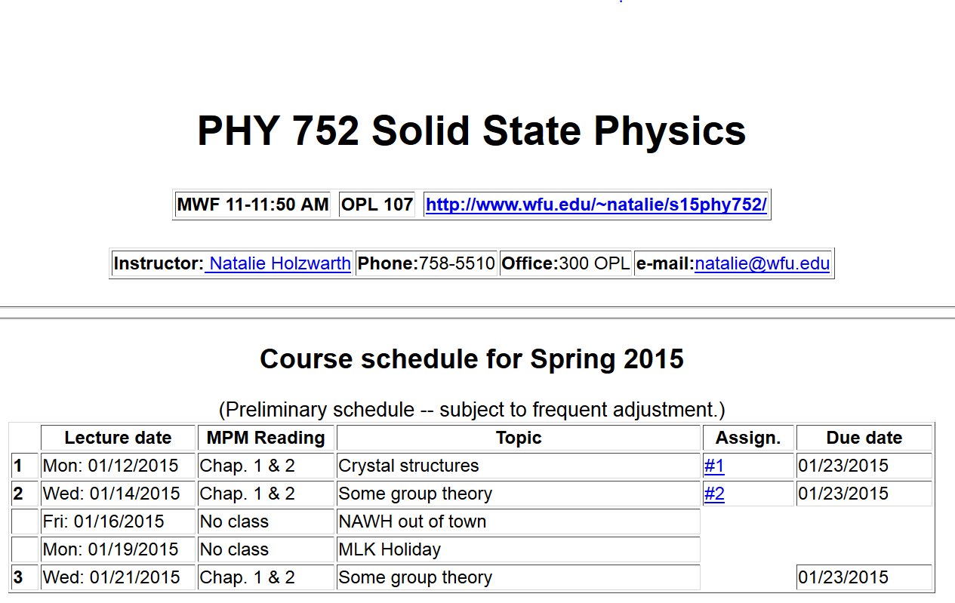

Slide 4
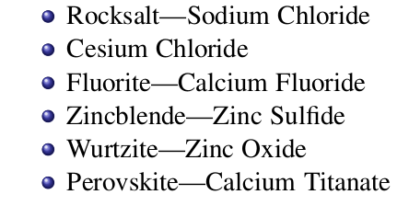
Some common crystal forms found in nature
Note: Materials from Marder used in preparing this lecture.

Slide 5
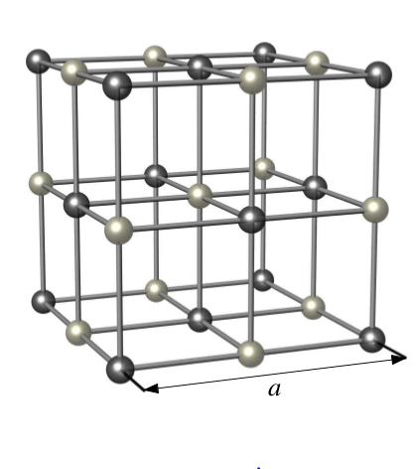
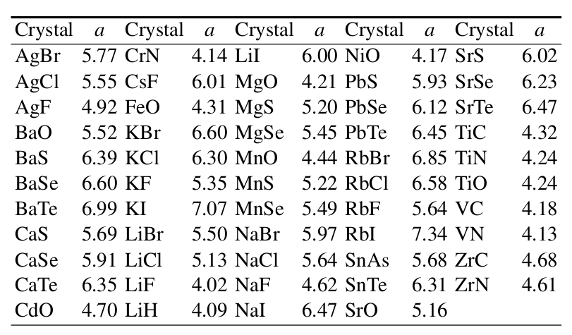
NaCl
Example materials
Face-centered-cubic with basis

Slide 6
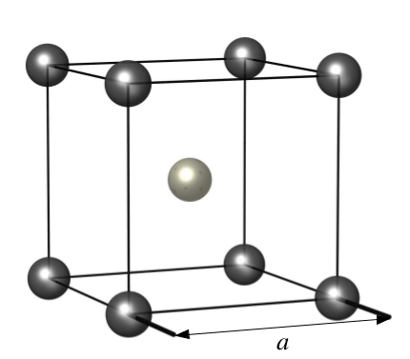
CsCl
Example materials
Simple cubic structure with basis

Slide 7
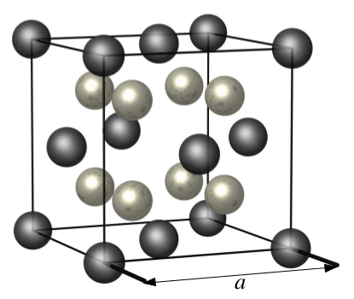
CaF₂
Example materials
Face-centered-cubic with basis

Slide 8
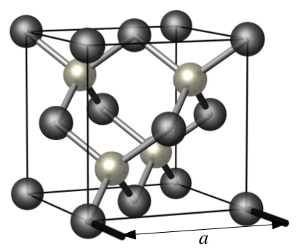
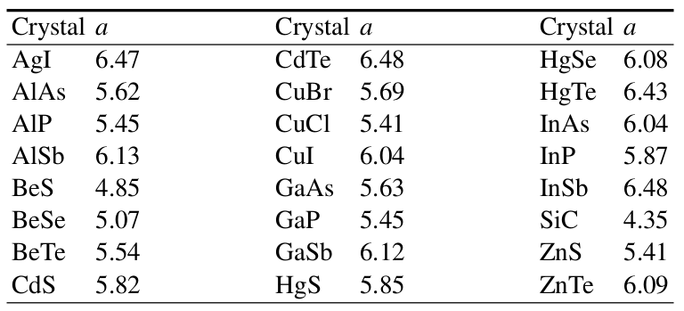
Zincblende
Example materials
Face-centered-cubic with basis

Slide 9
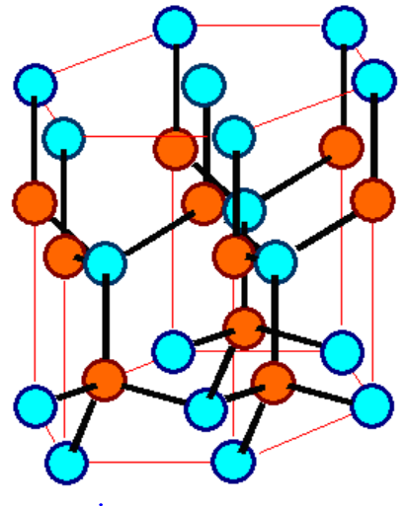
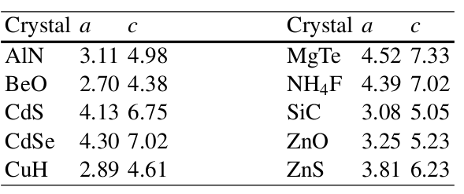
ZnS - Wurtzite
Example materials
Hexagonal structure with basis

Slide 10
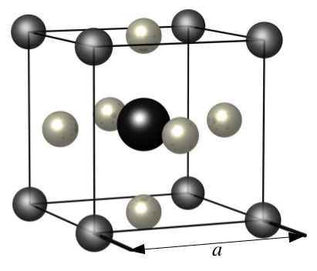
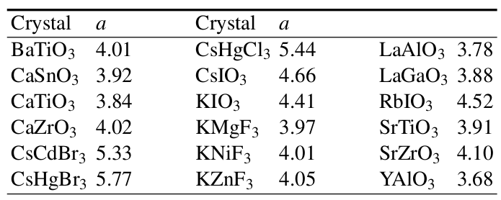
Perovskite
Example materials
Cubic lattice with basis

Slide 11
Systemization of crystal forms
14 Bravais lattices
32 Point groups
230 Space groups
Short digression on abstract group theory
What is group theory ?
What is it doing in the course ?

Slide 12
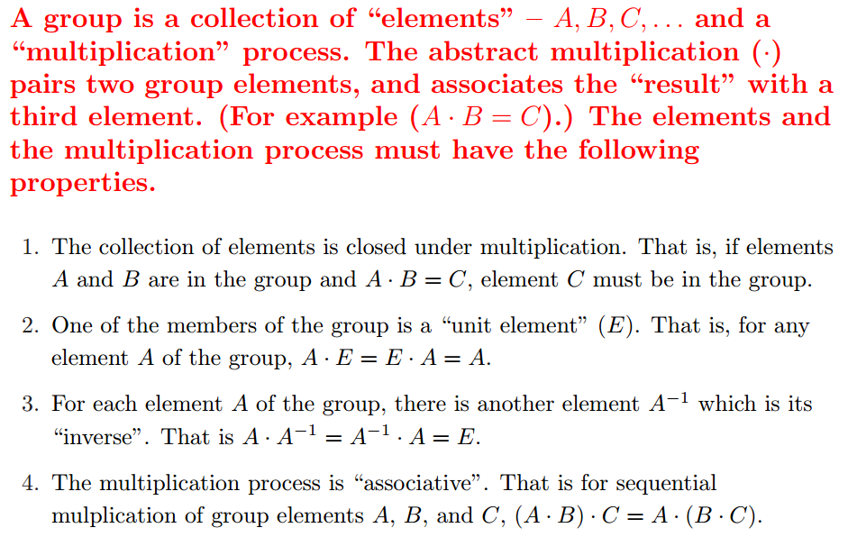
Short digression on abstract group theory
What is group theory ?

Slide 13
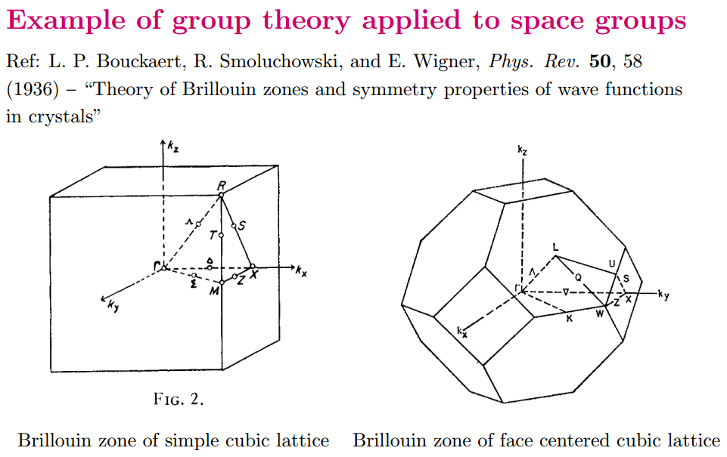
Short digression on abstract group theory
What is group theory doing in a solid state physics class?

Slide 14
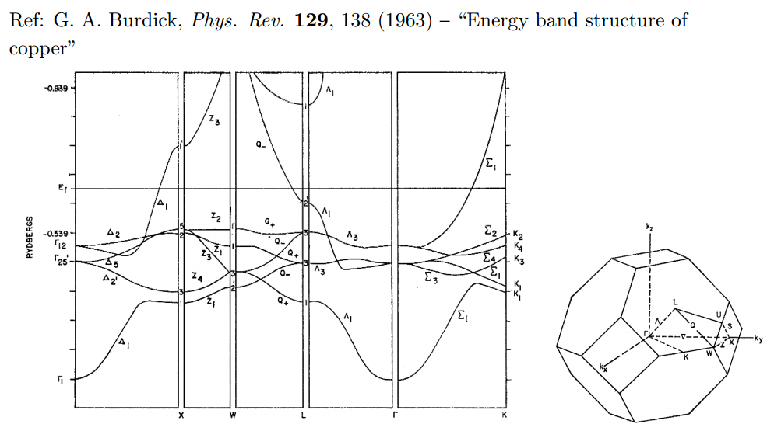
Example of space group theory in band structure analysis

Slide 19
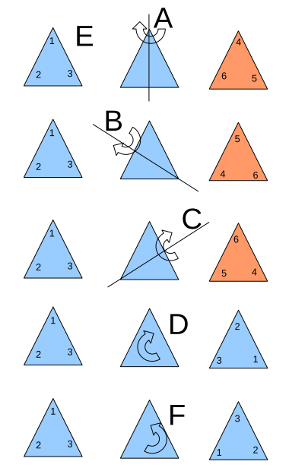
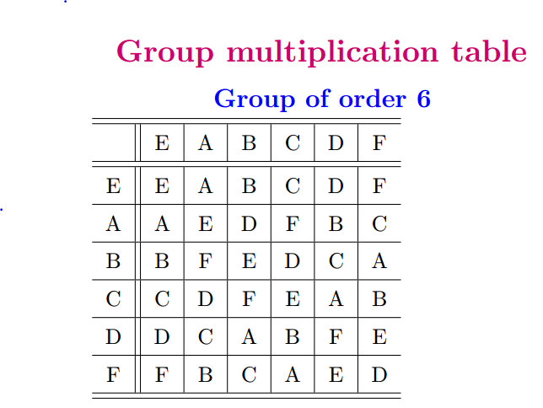
Example of a 6-member group E,A,B,C,D,F,G

Slide 20
Check on group properties:
Closed; multiplication table uniquely generates group members.
Unit element included.
Each element has inverse.
Multiplication process is associative.
Definitions
Subgroup: members of larger group which have the property of a group
Class: members of a group which are generated by the construction

