Slide 1
PHY 752 Solid State Physics
11-11:50 AM MWF Olin 107
Plan for Lecture 20:
Discussion of Mid-Term Exam
Course topics
Electronic transport (Marder Chapter 16-18)

Slide 2
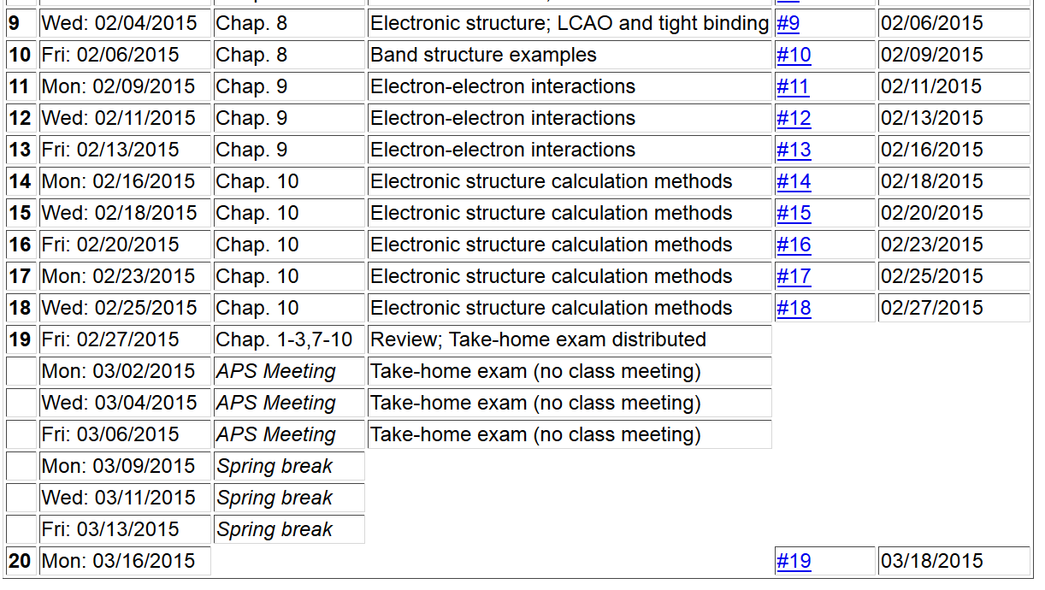

Slide 3
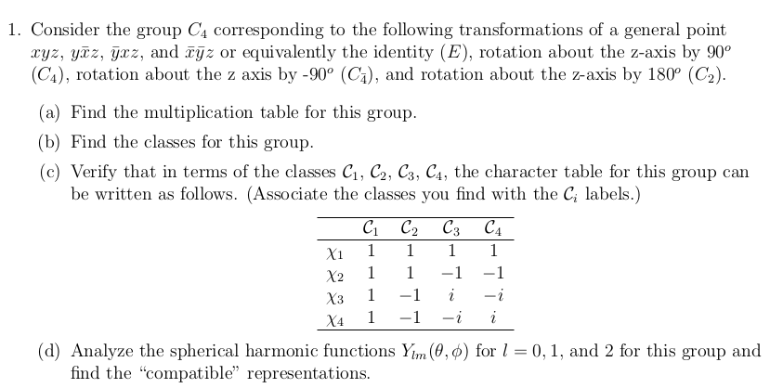

Slide 4
Group multiplication table:
Note that group is abelian.

Slide 5
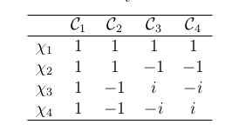
θ 0 180 90 -90
l=0 1 1 1 1
l=1 3 -1 1 1
l=2 5 1 -1 -1

Slide 6
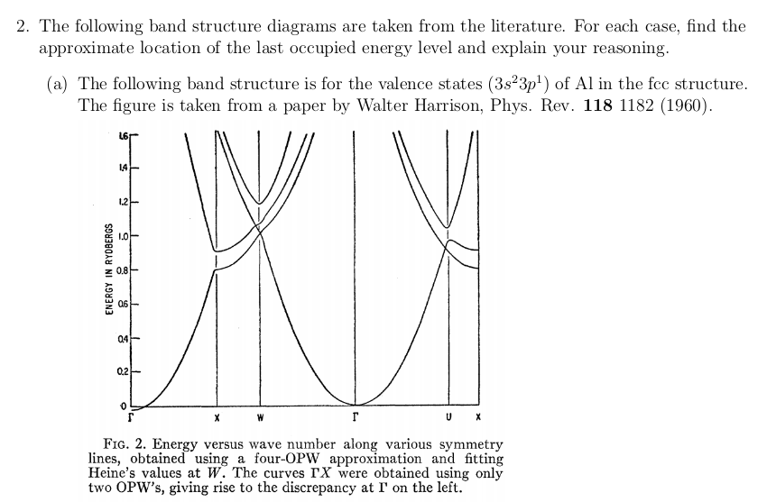
Need to accommodate 3 electrons; 1.5 bands

Slide 7
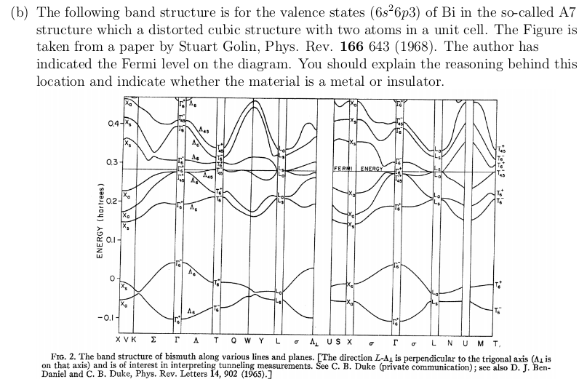
Need to accommodate 10 electrons; 5 bands

Slide 8
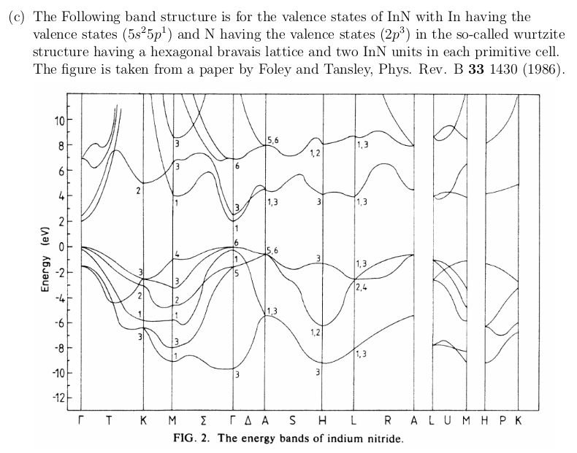
Need to accommodate 12 electrons; 6 bands

Slide 9
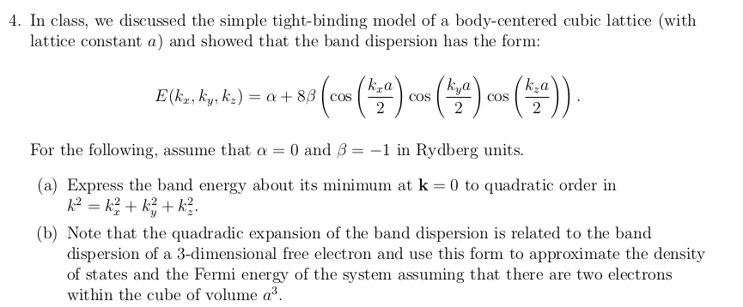

Slide 11
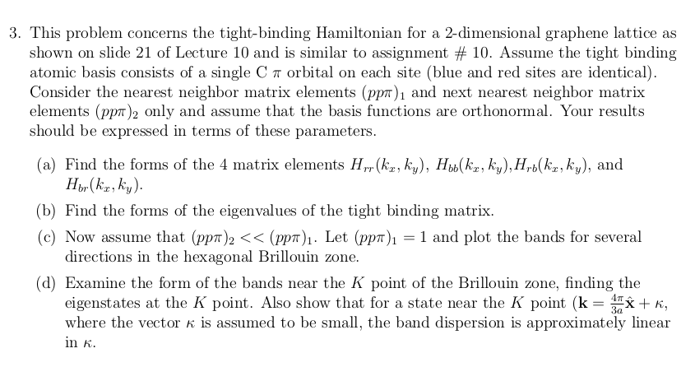

Slide 12
Tight binding model of graphene π bands
(more conventional notation than Lect. 8.)
a

Slide 13
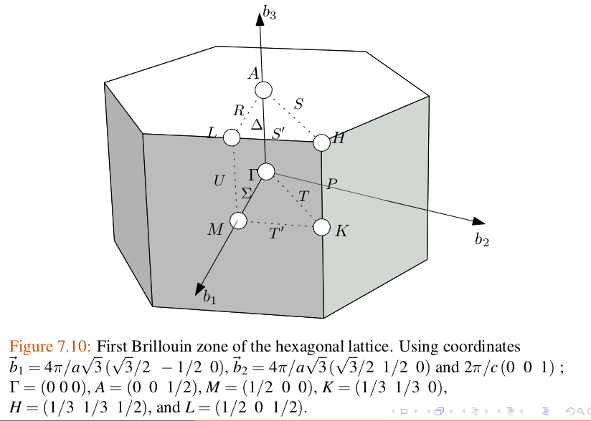
Guide to k-points – hcp lattice

Slide 14
a

Slide 15
a

Slide 18
Tentative plan for topics
Chapter 16-18 Electronic transport
Chapter 20-23 Optical properties
Chapter 26 Hubbard model
Chapter 19 Surfaces
Chapter 16: Dynamics of Bloch Electrons

