Slide 1
PHY 752 Solid State Physics
11-11:50 AM MWF Olin 107
Plan for Lecture 21:
Electronic transport (Marder Chapter 16-18)
Electron velocity
Effective mass
Semi-classical equations of motion
Note: Some of these slides contain material from Marder’s
lectures

Slide 2
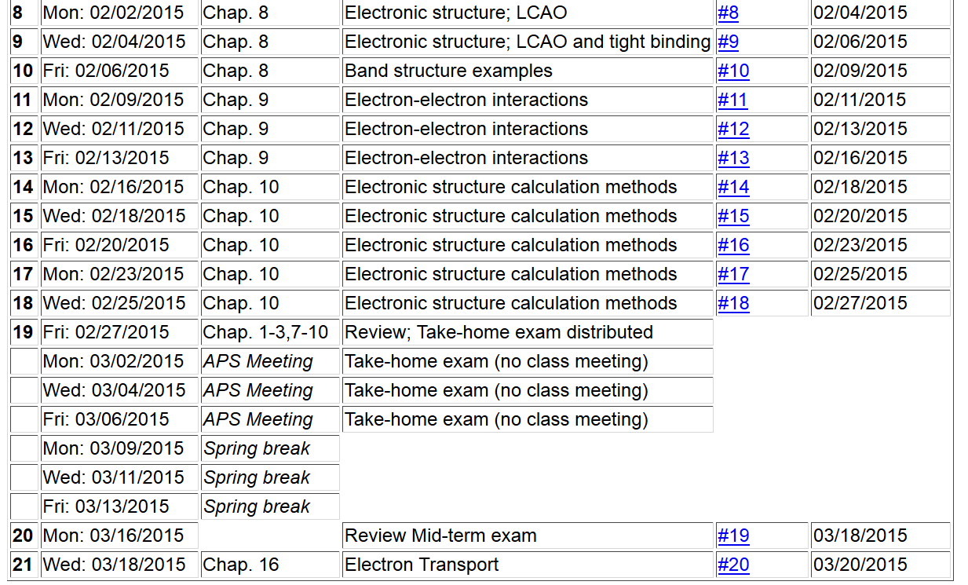

Slide 5
Electron transport for Bloch electrons --
local potential of electron
electron mass

Slide 7
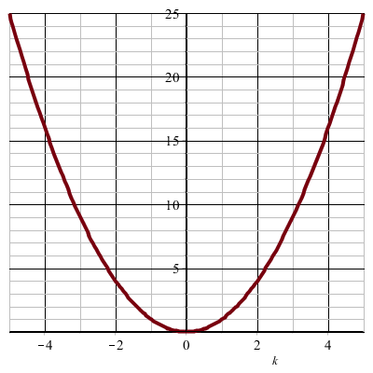
Electron velocity -- continued
E_{k}
k

Slide 8
Effective mass

Slide 9
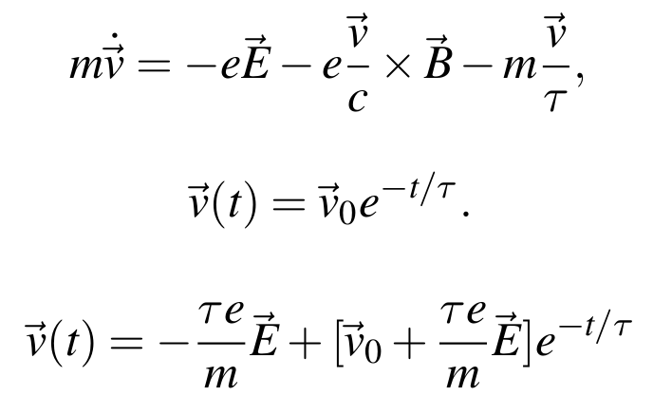
Semi-classical treatment of electron motion in presence of electric field E and magnetic field B:
relaxation time
For E=0, B=0
For B=0

Slide 10
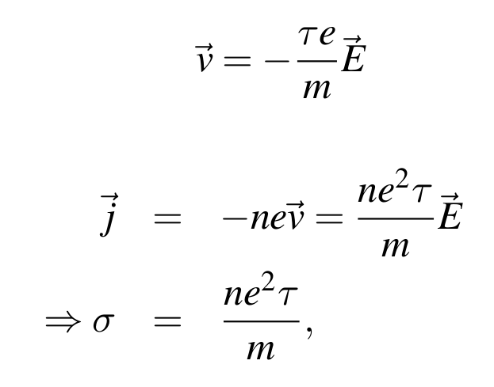
Effects of electric field -- continued
Steady state response:
σ

Slide 11
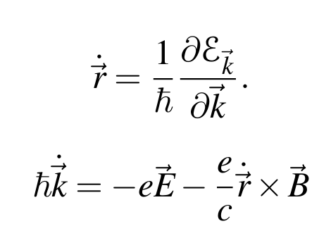
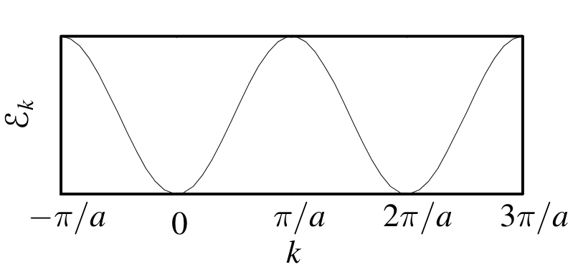
Naïve treatment of semi-classical dynamics
Example with one-dimensional tight-binding band

Slide 12
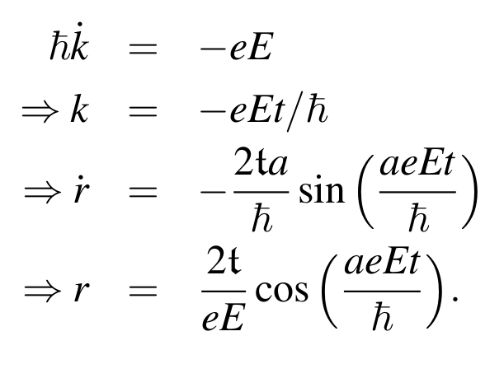
unphysical!
Part of the problem is that the electric field is incompatible with the periodic boundary conditions

Slide 13
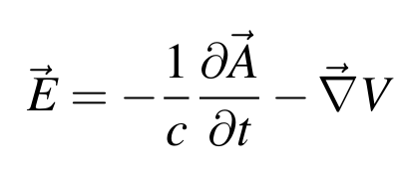
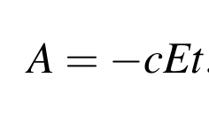
Alternative treatment of electric field –
Note that:
Hamiltonian:
Let:

Slide 14
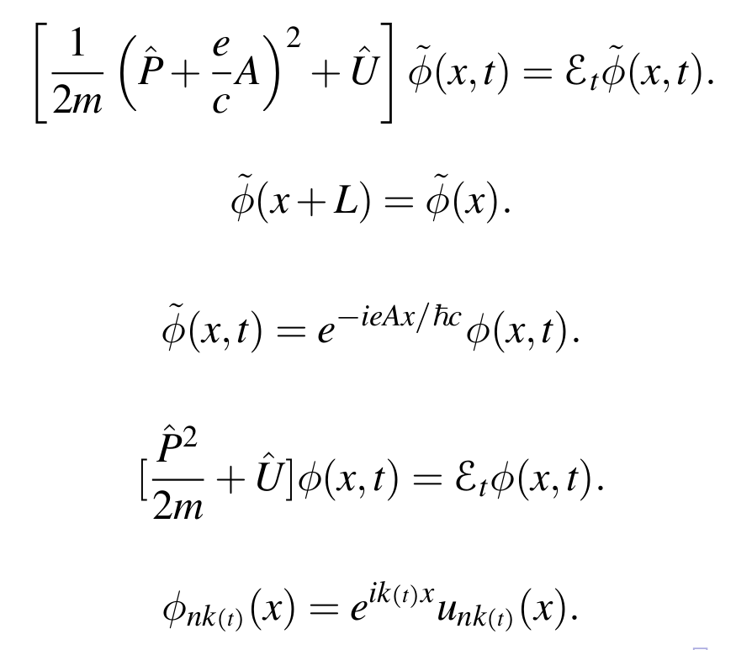
Alternative treatment of electric field – continued

Slide 15
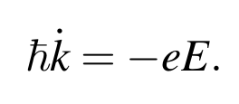
Some additional relationships:
It follows that:
“Houston” functions:

Slide 16
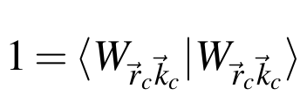
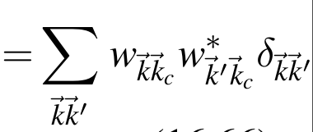
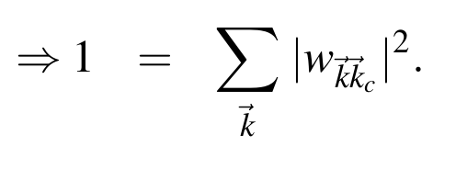
Better justification in terms of wave packets

Slide 17
