Slide 1
PHY 752 Solid State Physics
11-11:50 AM MWF Olin 107
Plan for Lecture 22:
Electronic transport (Marder Chapter 16-18)
Comments on properties of Bloch waves
Semi-classical equations of electron motion
Note: Some of these slides contain material from Marder’s
lectures; acknowledge helpful discussions with Prof. Kerr

Slide 2
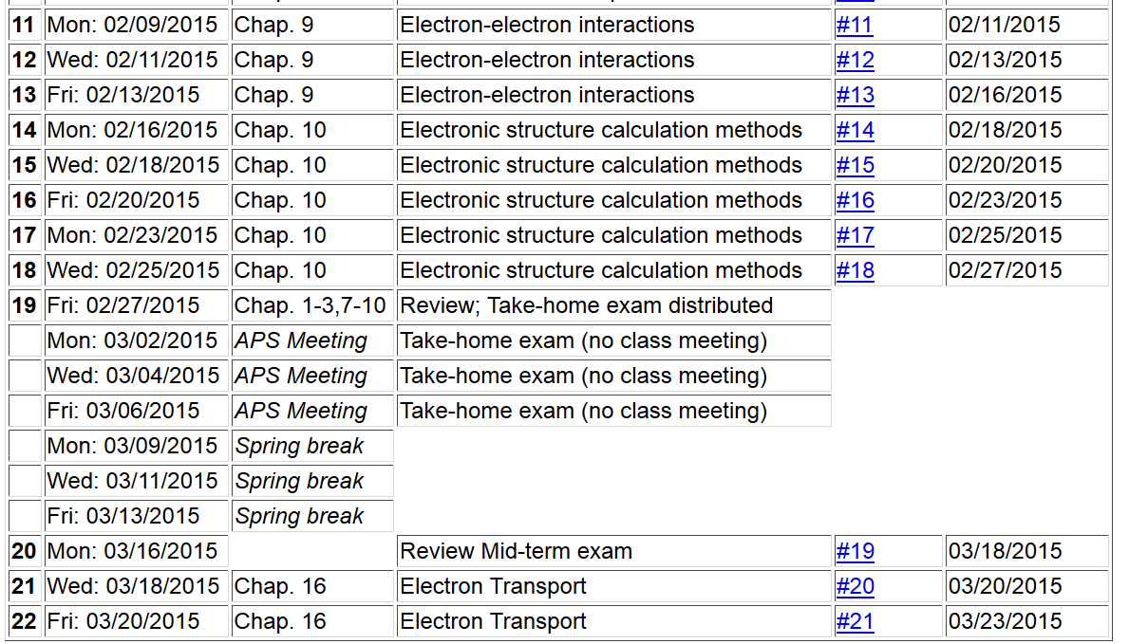

Slide 3
Reminder –
End of term presentations
Please choose topics by March 30th

Slide 4
Electron transport for Bloch electrons --
band index

Slide 5
Properties of periodic part of Bloch wavefunction
(See Chapter 8)

Slide 6
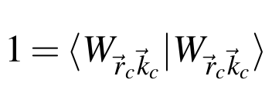
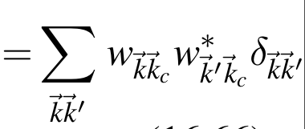
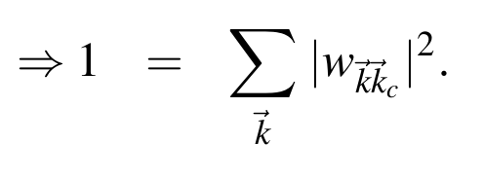
Semi classical analysis of electrons in terms of of wave packets
Consider a wave packet centered in space at the point r_{c} and dominated by wavevector k_{c}

Slide 7
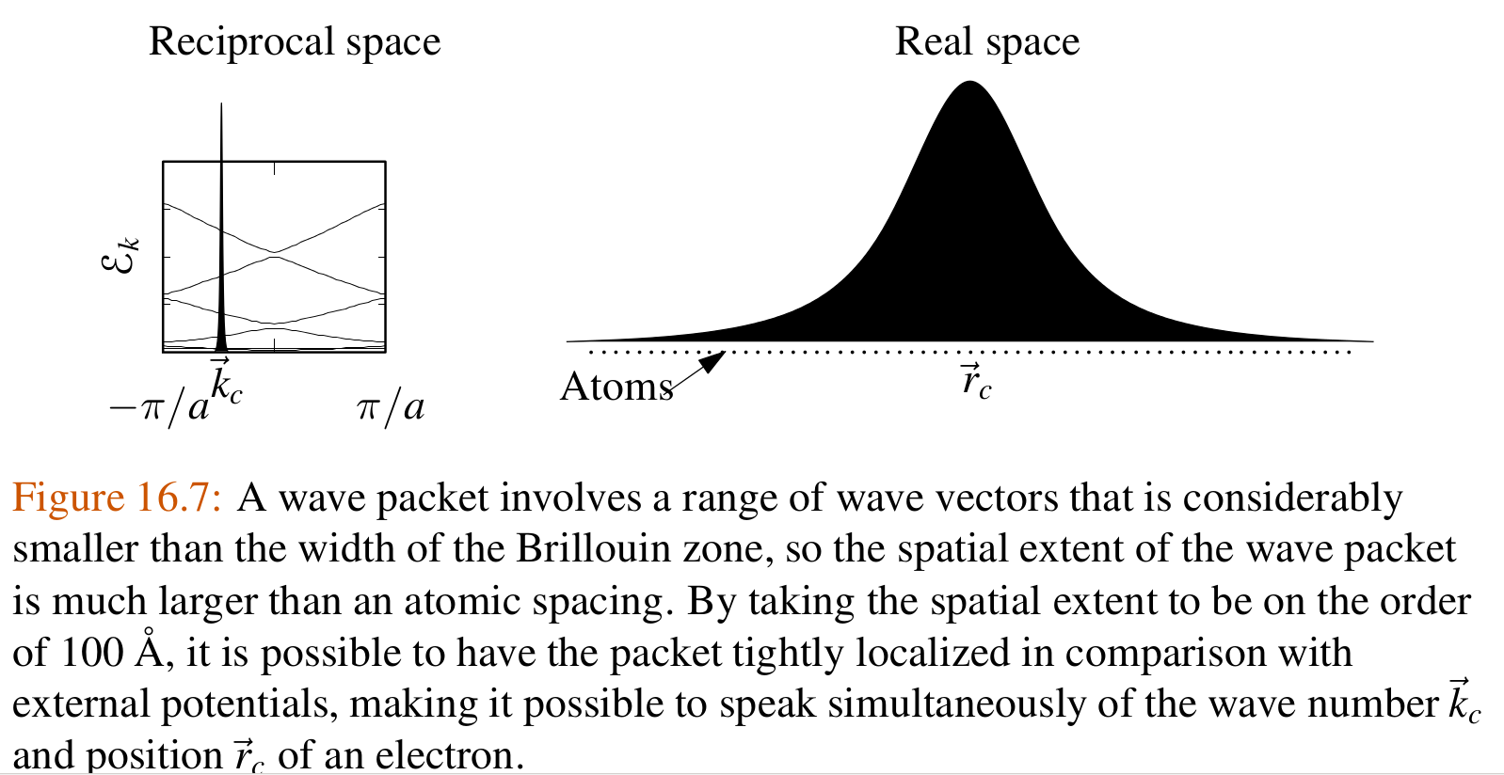
Also see: G. Sundaram and Q. Niu, PRB 59, 14915 (1999)

Slide 8
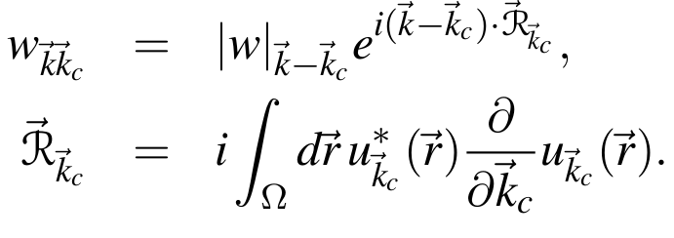
Semi classical analysis of electrons in terms of of wave packets
Note: We are considering a single band
The weight function w must be constructed for the special localization of the wave packet
where

Slide 9
Check localization of wave packet:
Integrate k’ by parts:

Slide 10
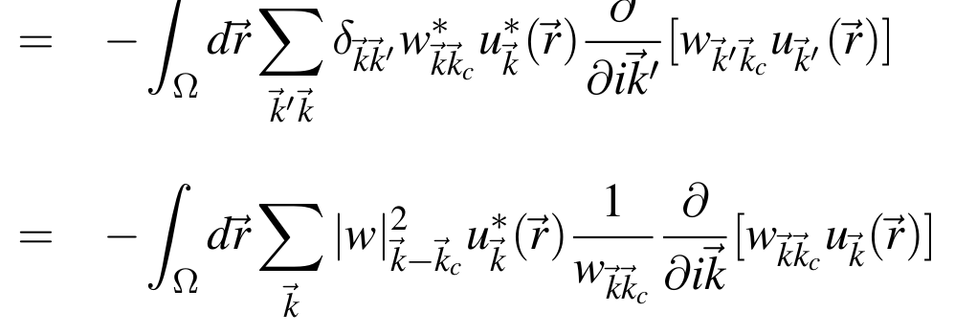
Check localization of wave packet -- continued:
Recall that:

Slide 11
Check localization of wave packet -- continued:
= 0

Slide 12
Dynamics of electron wave packet
Lagrangian:
Hamiltonian:
+ V(r)
Unperturbed Hamiltonian:

Slide 13
Dynamics of electron wave packet
After evaluating Lagrangian matrix elements (HW 21)
Lagrange equations of motion:

Slide 14
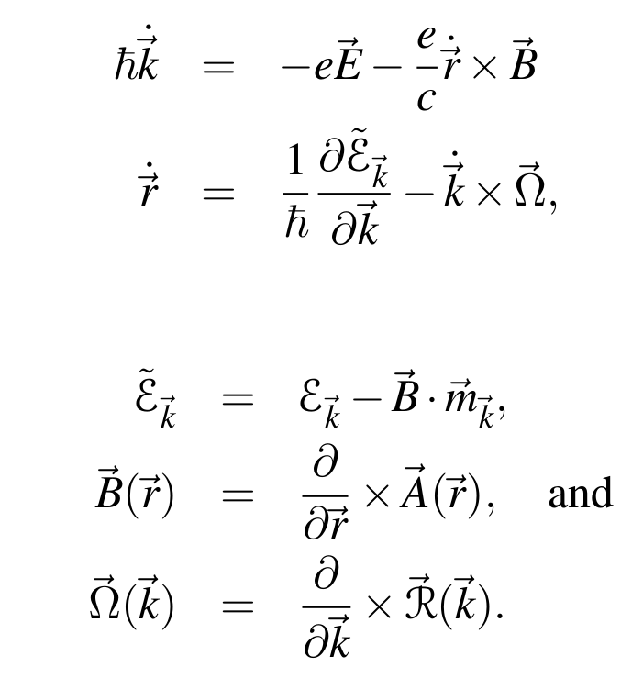
Semi classical equations of motion (dropping “c” subscript)
where:

Slide 15
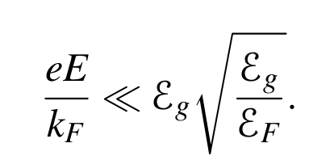
Restrictions of semi classical equations
Spatial scales of external potentials must be much larger than interatomic spacing (validity of wave packet)
Single band approximation restricts magnitude of electric and magnetic field strengths to avoid band gap transitions

Slide 16
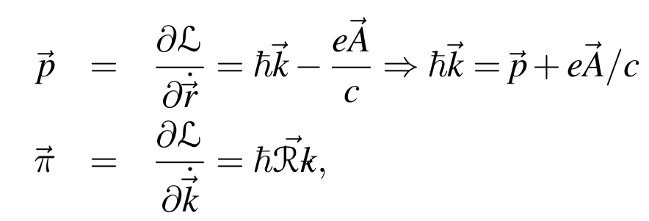
Semi-classical Hamiltonian

Slide 17
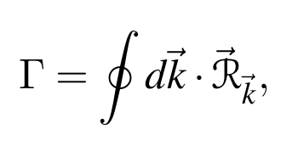
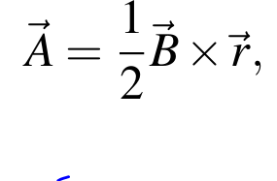
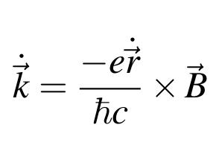
Example – de-Haas-van Alphen effect
Bohr-Summerfeld quantization
integer
½, but will be omitted

Slide 18
Example – de-Haas-van Alphen effect -- continued

Slide 19
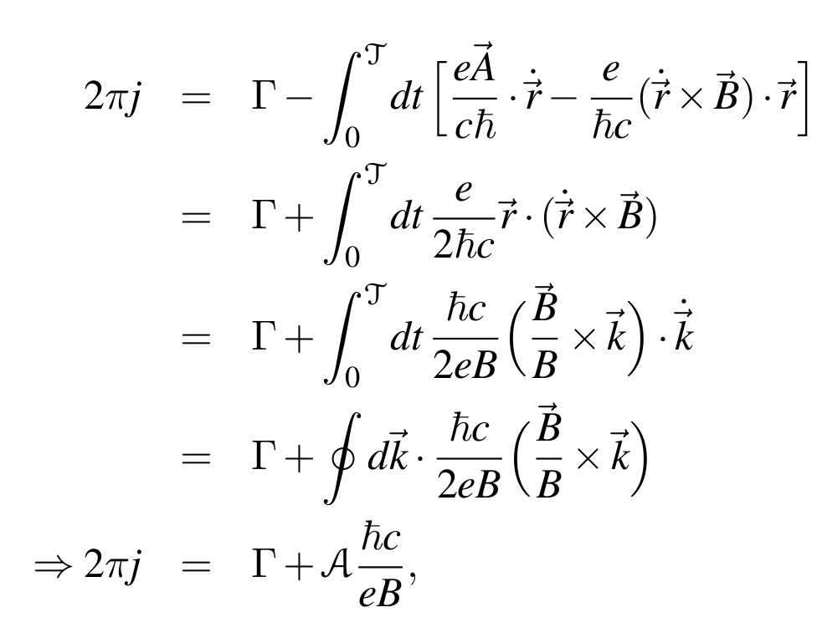
Example – de-Haas-van Alphen effect -- continued

Slide 20
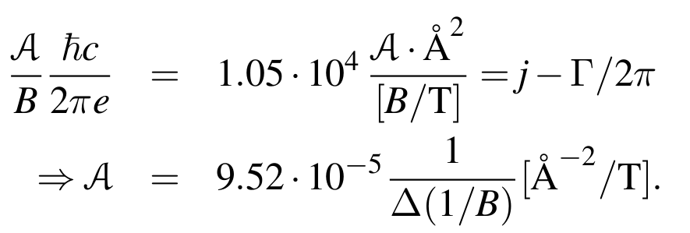
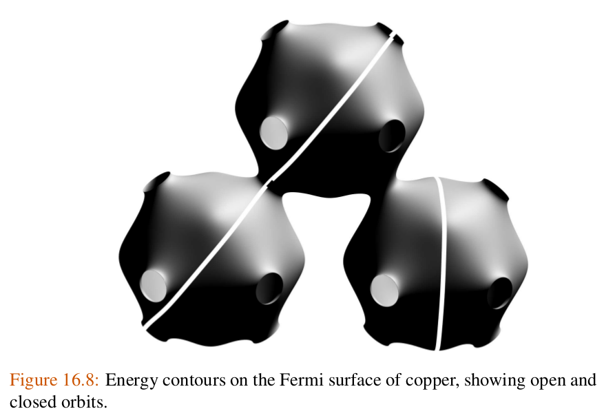
Example – de-Haas-van Alphen effect -- continued

Slide 21
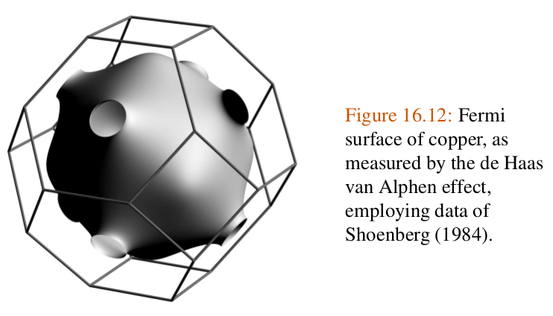
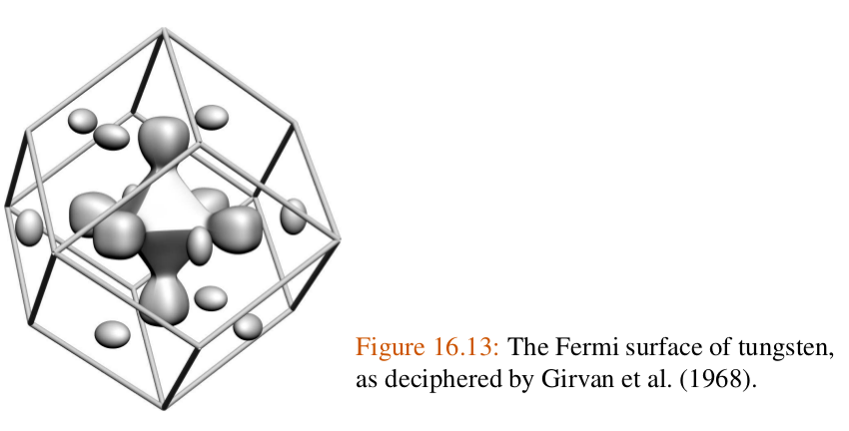
Example – de-Haas-van Alphen effect -- continued

Slide 22
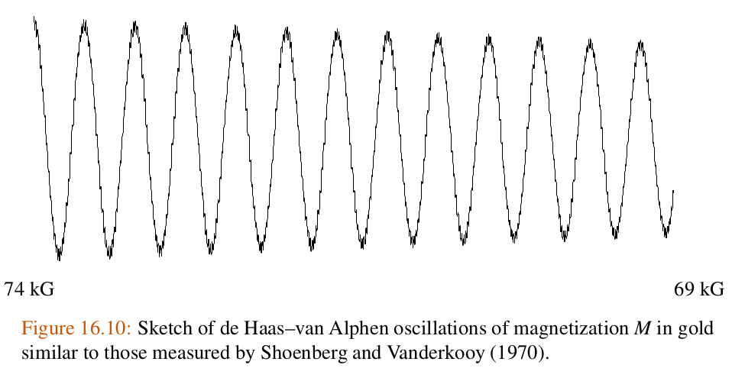
Example – de-Haas-van Alphen effect -- continued

