Slide 1
PHY 752 Solid State Physics
11-11:50 AM MWF Olin 107
Plan for Lecture 23:
Transport phenomena and Fermi liquid theory – Chap. 17 in Marder
Boltzmann equation
Thermoelectric phenomena
Hall effect
Contains materials from Marder’s lecture notes

Slide 2
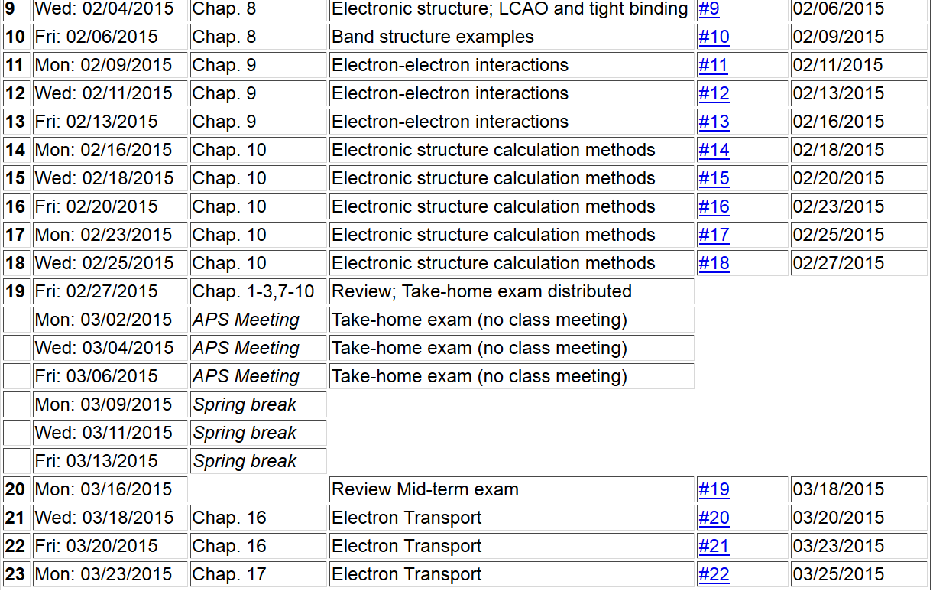

Slide 3
Using previous results based on wavepacket of Bloch waves with wavevectors near k_{c} →k and spatially centered at r_{c} → r.
Effective Hamitonian with electric and magnetic fields:
where
Equations of motion

Slide 4
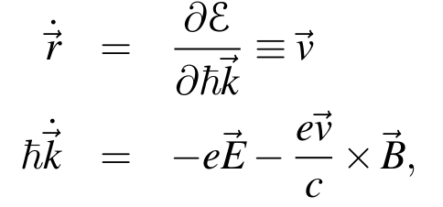
Equations of motion continued:
Marder’s notation for distribution function:
Number of electrons in volume
density of states

Slide 5
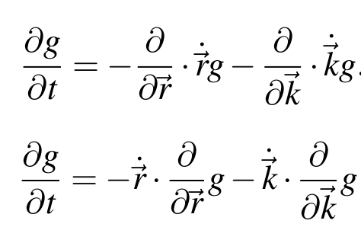
Properties of the distribution function:
Continuity equation:
additional term due to particle interactions
Boltzmann’s equation:

Slide 6
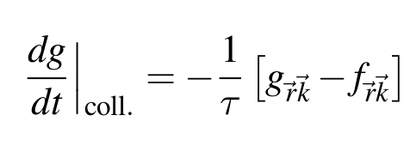
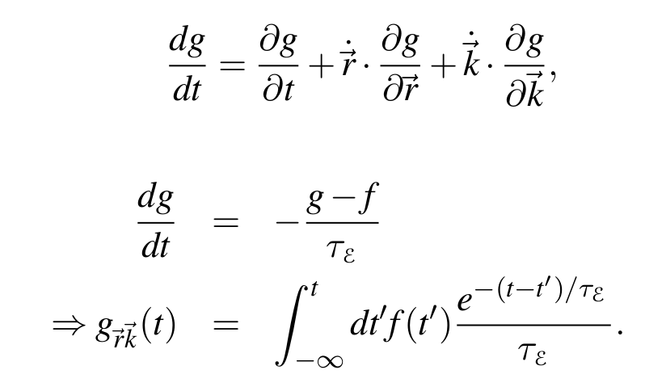
Relaxation time approximation to collision term
Fermi-Dirac distribution
Solution to Boltzmann equation in relaxation time approximation:

Slide 7
Finding distribution function in relaxation time approximation -- continued
Integrating by parts:

Slide 8
Finding distribution function in relaxation time approximation -- continued

Slide 9
Finding distribution function in relaxation time approximation -- continued
If the relaxation time τ_{E} is faster than the other variables, the integral can be approximated as:

Slide 10
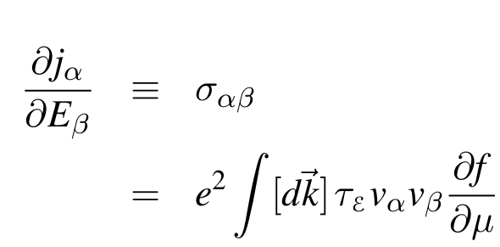
Application to electrical current in the presence of a uniform electric field

Slide 11
Application to electrical current in the presence of a uniform electric field -- continued
➔ Only the Fermi surface contributes to the conductivity

Slide 12
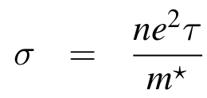
Application to electrical current in the presence of a uniform electric field -- continued
Alternate expression:
For isotropic system:
where:

Slide 13
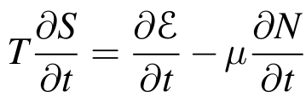
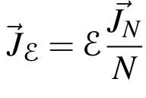
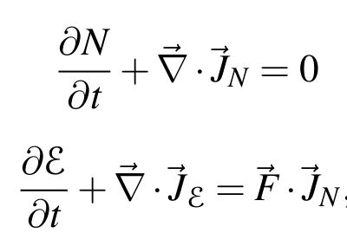
Effects of heat and temperature
For a constant volume process, the first law of thermo says
Define particle current:
Define energy current:
External force acting on system

Slide 14
Effects of heat and temperature – continued
Rate of entropy production:
Rate of heat production

Slide 15
Effects of heat and temperature – continued
Heat production per wavenumber and per volume:
Connection with Boltzmann distribution in relaxation approximation:

Slide 16
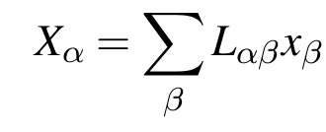
Calculation of response coefficients
General form of response coeffients:

Slide 17
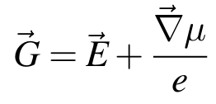
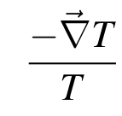
Responses involving thermal and electrical gradients
Electrochemical force:
Electrochemical flux:
Thermal force:
Thermal flux:

Slide 18
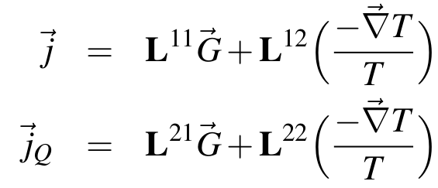
Responses involving thermal and electrical gradients – continued
Linear coefficients:
Note that these can be calculated from:
where

Slide 19
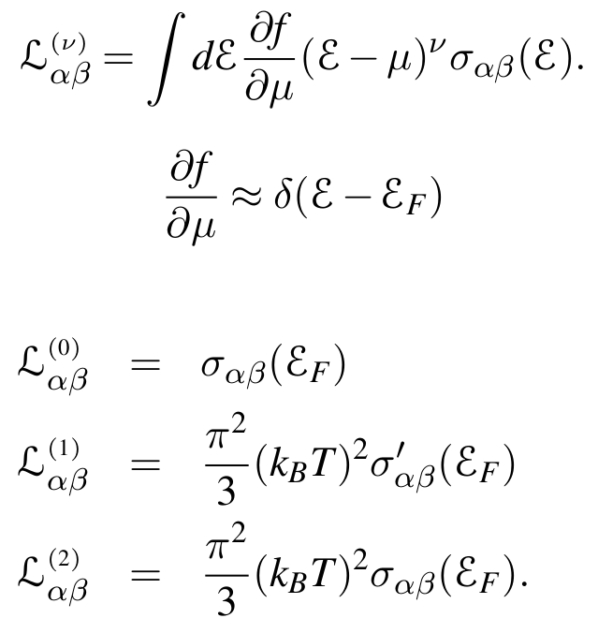
Responses involving thermal and electrical gradients – continued
Define:
Note that:

Slide 20
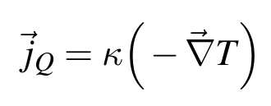
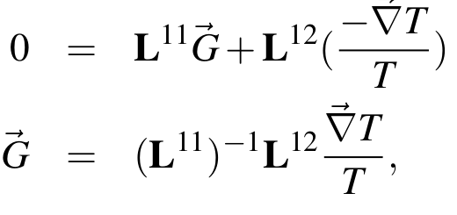
Example: Thermal conductivity
Consider the case where there is heat flow but no current:

Slide 21
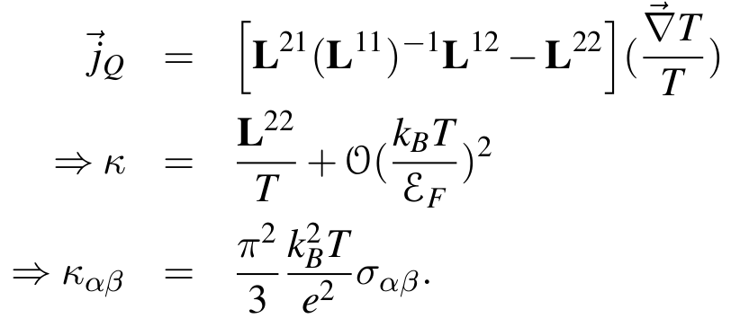
Example: Thermal conductivity -- continued

Slide 22
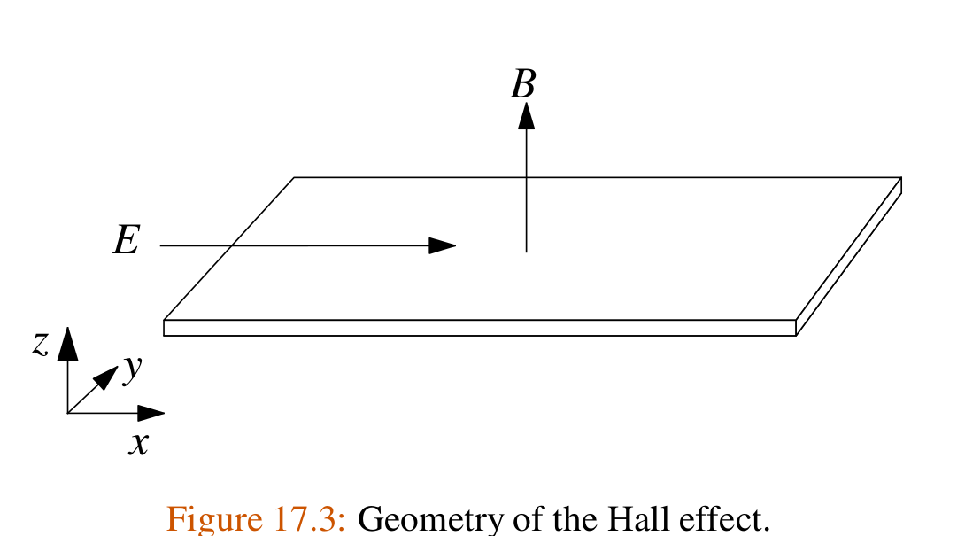
Example: Hall effect

Slide 23
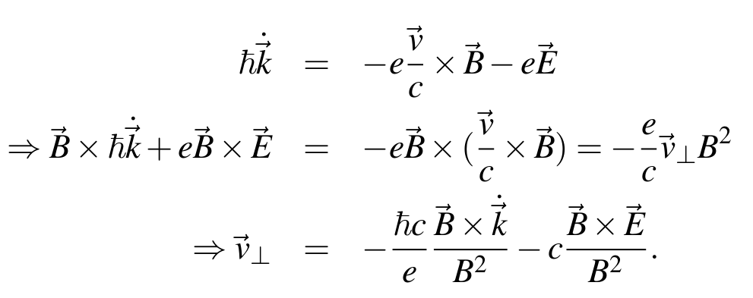
Example: Hall effect -- continued

Slide 24
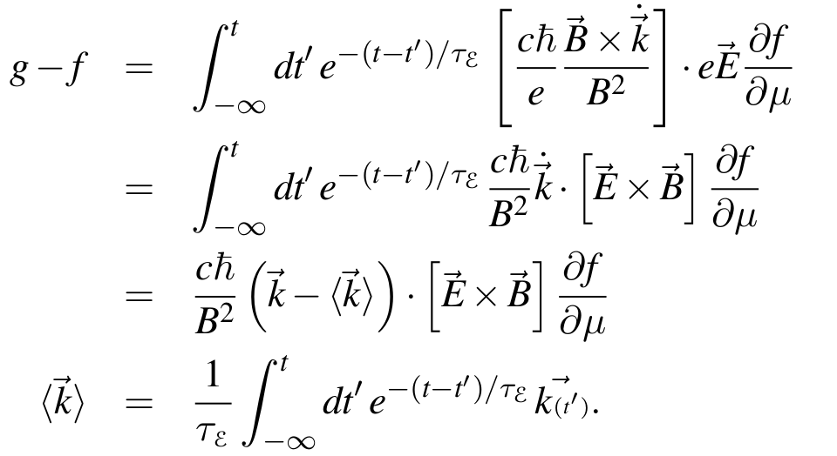
Example: Hall effect -- continued

Slide 25
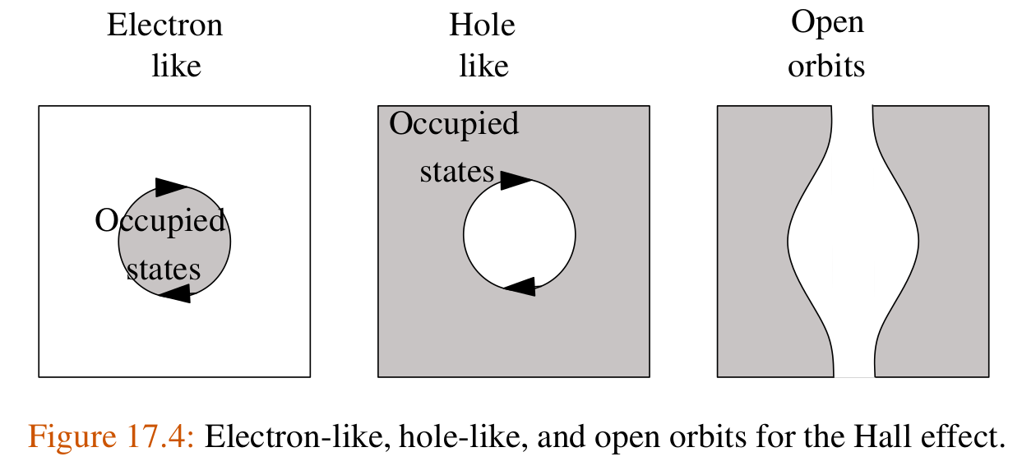
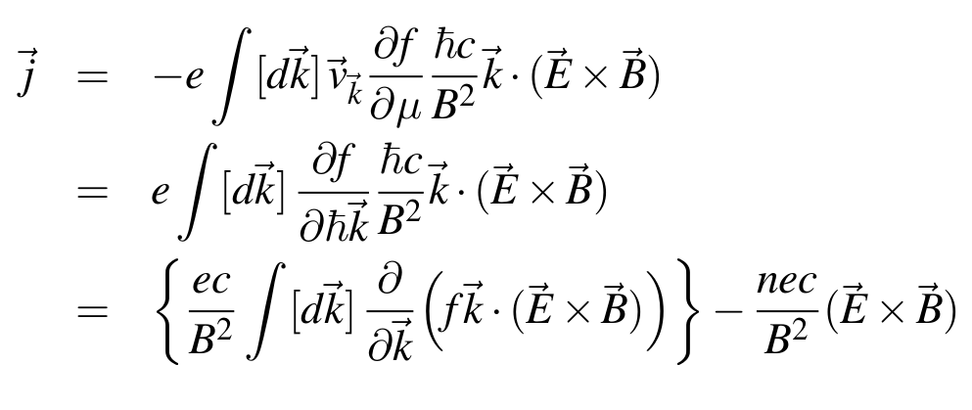
Example: Hall effect -- continued

Slide 26
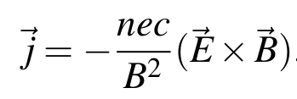
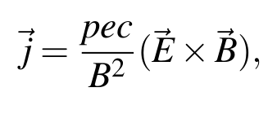
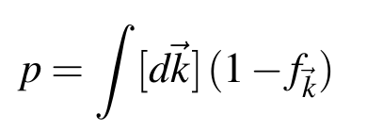
Example: Hall effect -- continued
where:

Slide 27
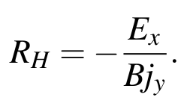
Example: Hall effect -- continued
Hall coefficient:

