Slide 1
PHY 752 Solid State Physics
11-11:50 AM MWF Olin 107
Plan for Lecture 23:
Transport phenomena – Chap. 17 & 18 in Marder
Hall effect
Magnetoresistance
Microscopic picture
Contains materials from Marder’s lecture notes

Slide 2
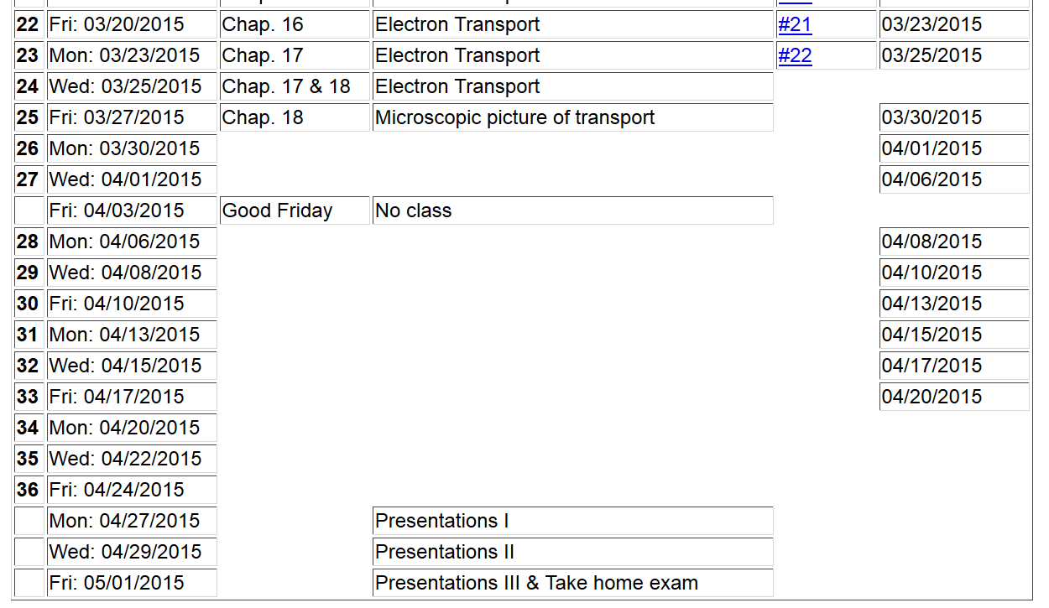

Slide 4
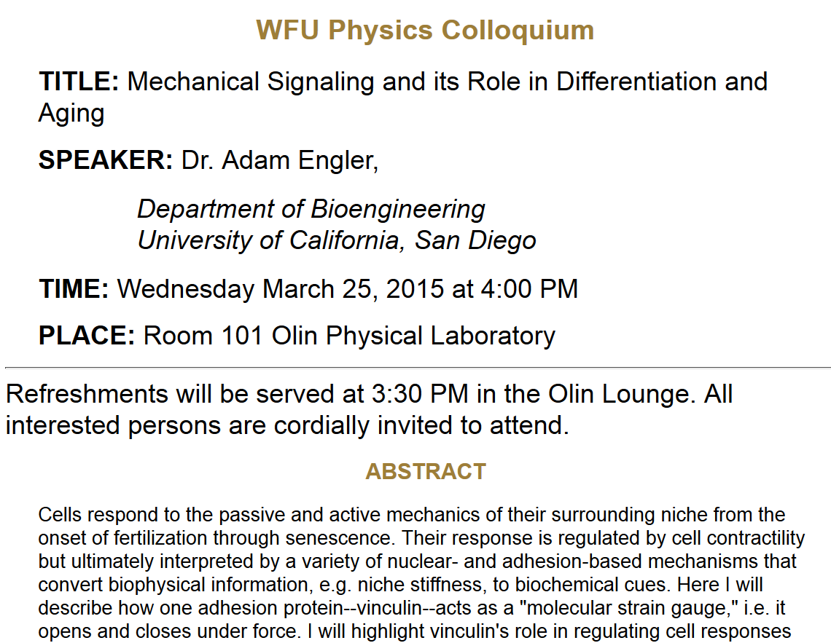

Slide 5
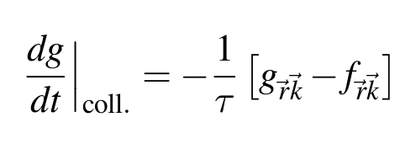
Transport theory in the relaxation time approximation
Boltzmann’s equation:
Relaxation time approximation to collision term
Fermi-Dirac distribution

Slide 6
Transport theory in the relaxation time approximation
General solution to linear order:
Estimation of resulting current:

Slide 7
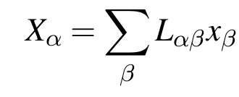
Calculation of response coefficients
General form of response coeffients:
where:

Slide 8
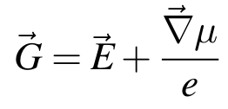
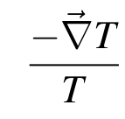
Responses involving thermal and electrical gradients
Electrochemical force:
Electrochemical flux:
Thermal force:
Thermal flux:

Slide 9
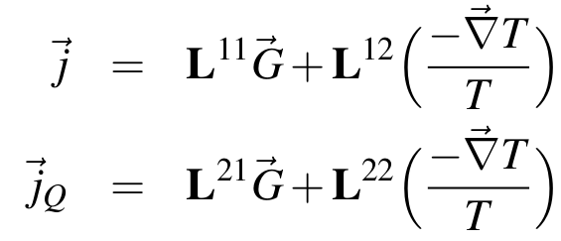
Responses involving thermal and electrical gradients – continued
Linear coefficients:
Note that these can be calculated from:
where

Slide 10
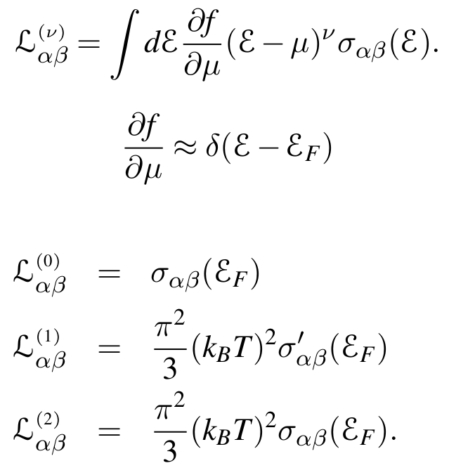
Responses involving thermal and electrical gradients – continued
Define:
Note that:

Slide 11
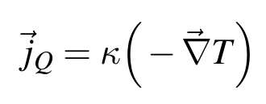
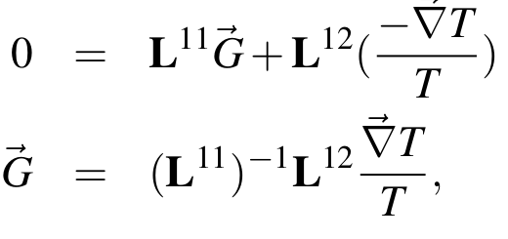
Example: Thermal conductivity
Consider the case where there is heat flow but no current:

Slide 12
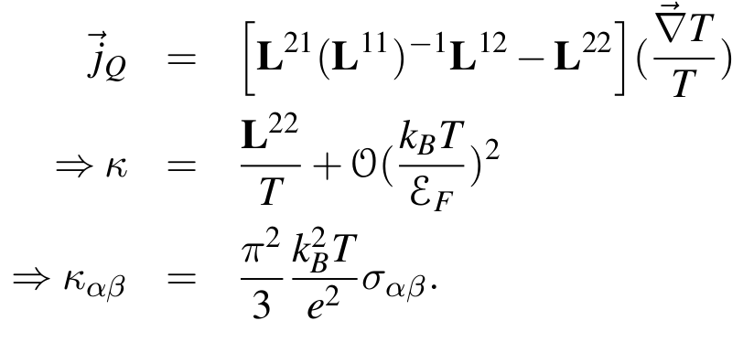
Example: Thermal conductivity -- continued

Slide 13
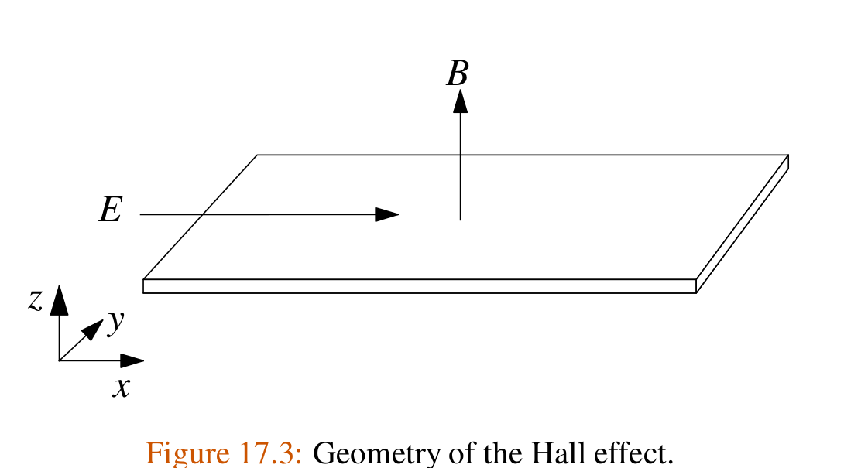
Example: Hall effect

Slide 14
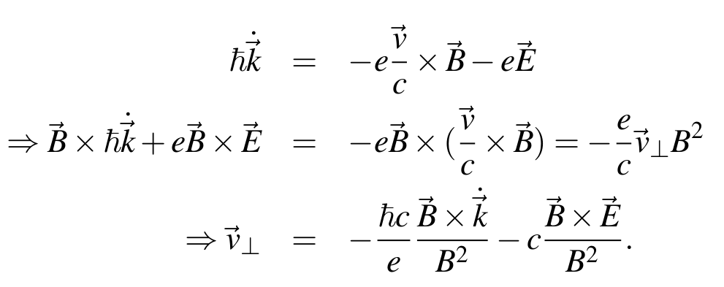
Example: Hall effect -- continued

Slide 15
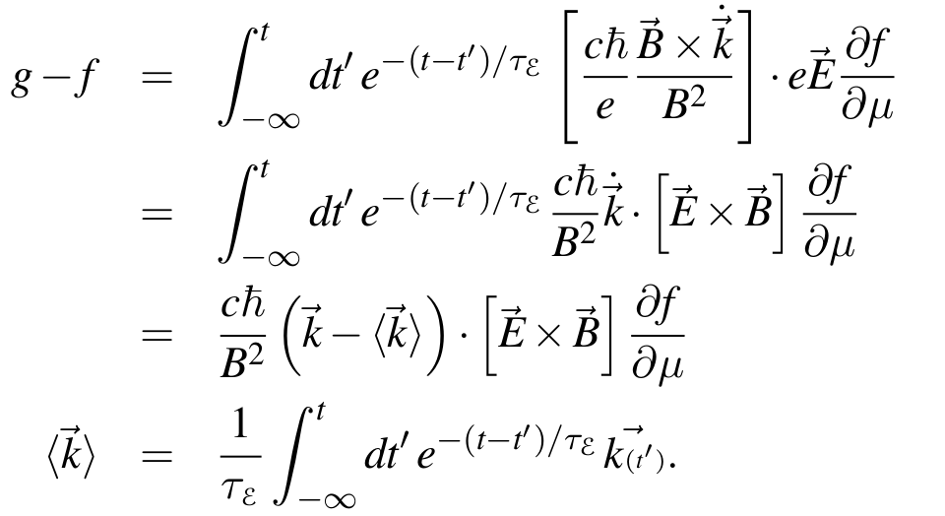
Example: Hall effect -- continued

Slide 16
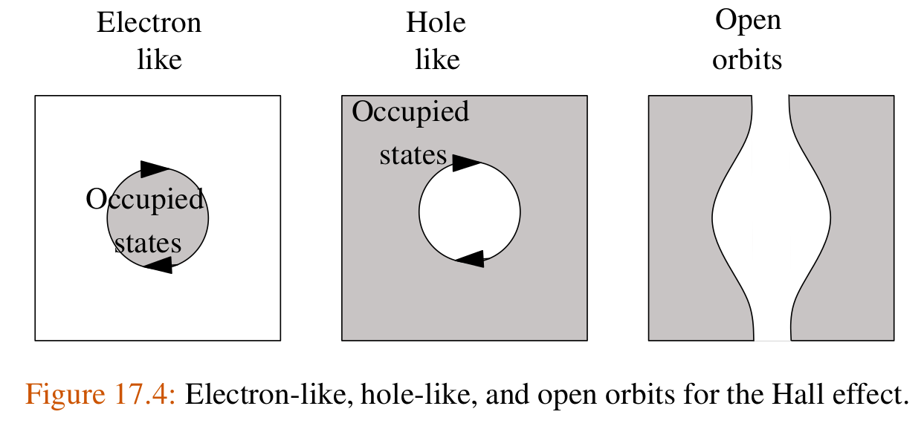
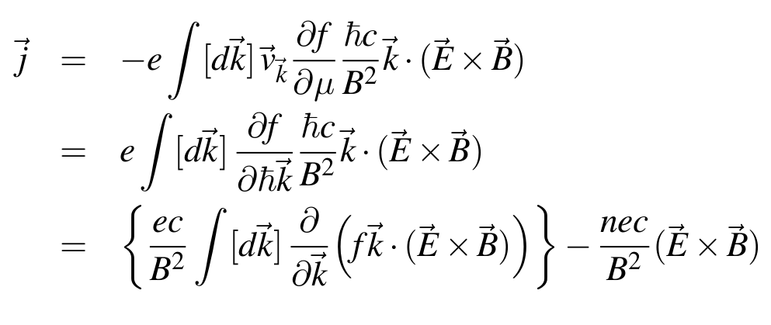
Example: Hall effect -- continued

Slide 17
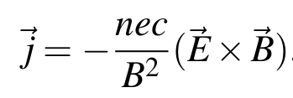
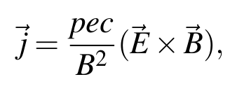
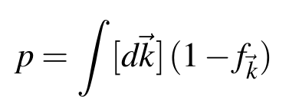
Example: Hall effect -- continued
where:

Slide 18
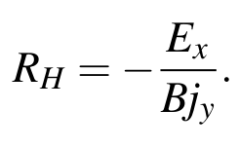
Example: Hall effect -- continued
Hall coefficient:

Slide 19
Microscopic models of conduction (Chap. 18 of Marder)
Probability of electron scattering event k → k’
distribution functions
transition probability

Slide 20
Microscopic models of conduction -- continued
Estimate transition rate using Fermi Golden rule:
Electron scattering potential
Number of scatters
Assume:

Slide 21
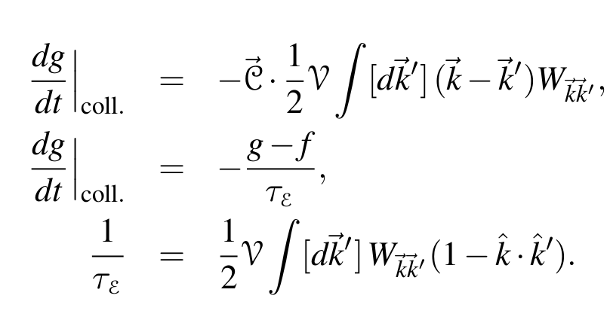
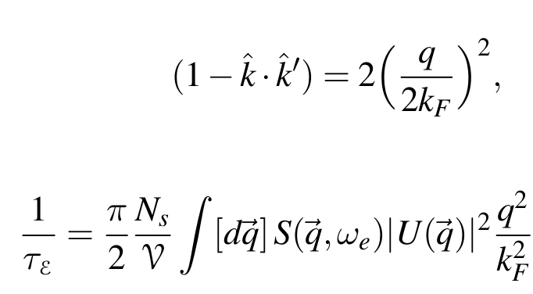
Microscopic models of conduction -- continued
Approximate evaluation of integral:

