Slide 1
PHY 752 Solid State Physics
11-11:50 AM MWF Olin 107
Plan for Lecture 25:
Chap. 18 & 19 in Marder
Impurity states
Properties of semiconductors
Some of the lecture materials are from slides prepared by Marder

Slide 2
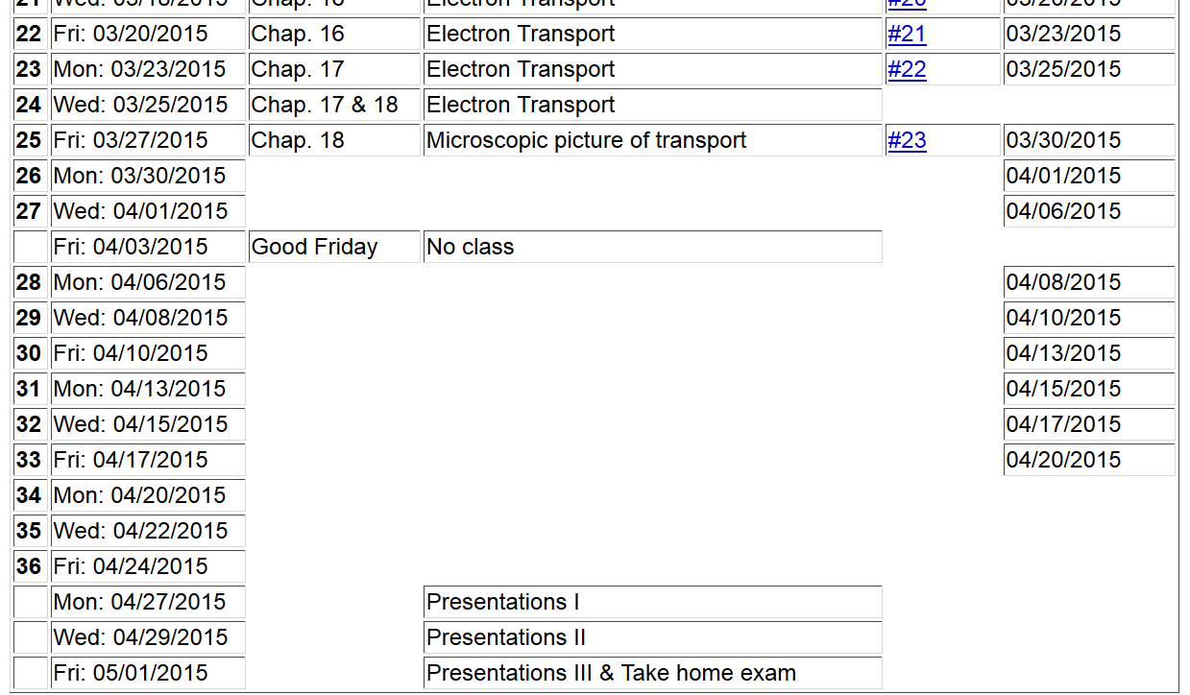

Slide 3
Impurity states due to point defects

Slide 4
Impurity states due to point defects -- continued

Slide 5
Impurity states due to point defects -- continued
valence charge of impurity relative to that of host lattice
Dielectric constant

Slide 6
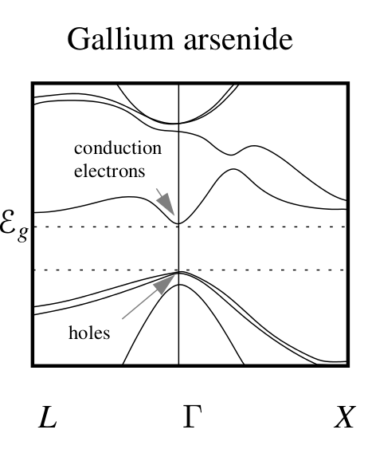
Impurity states due to point defects -- continued

Slide 7
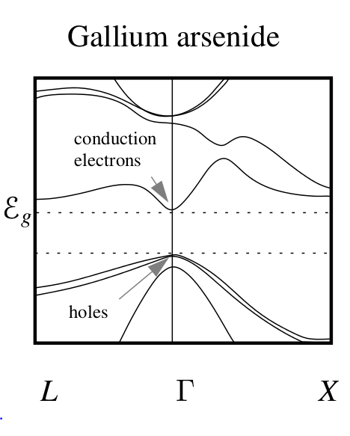
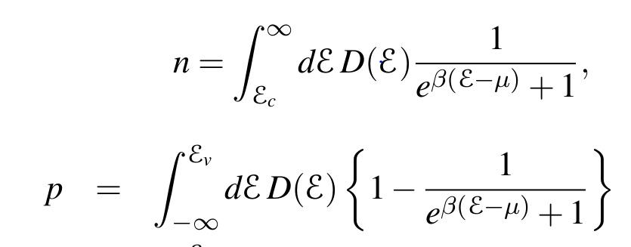
Semiconductor properties
Population of electrons (n) and holes (p) in a pure semiconductor
μ

Slide 8
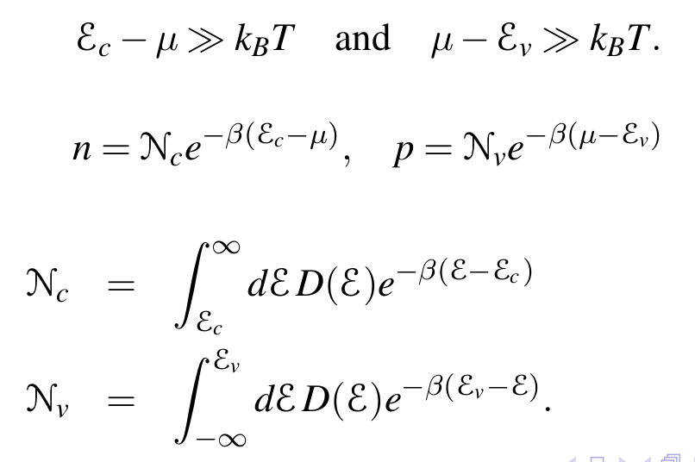
Semiconductor properties -- continued
For:

Slide 9
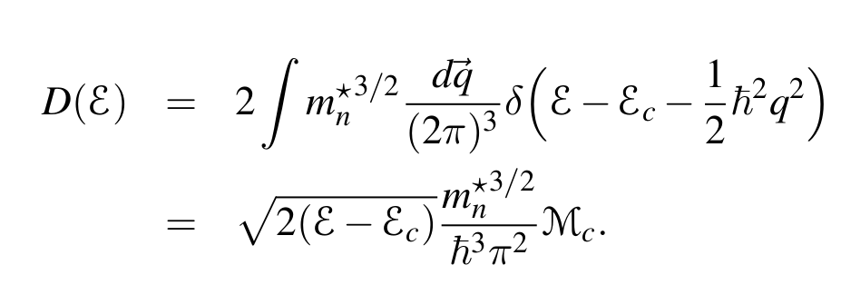
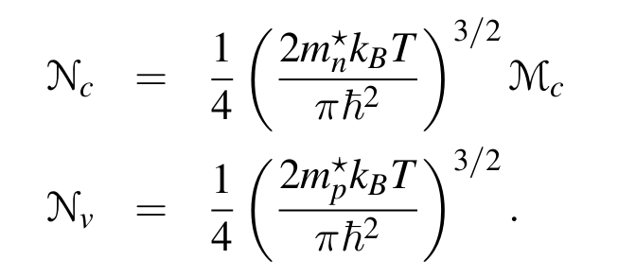
Semiconductor properties -- continued
multiplicity of conduction band minima

Slide 10
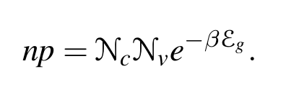
Semiconductor properties -- continued
For intrinsic semiconductor, n=p=n_{i}

Slide 11
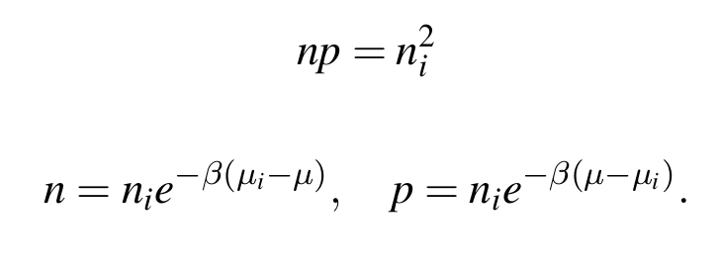
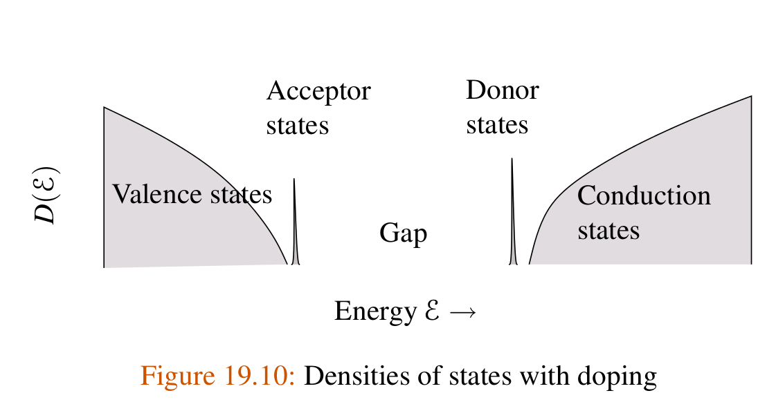
Semiconductor properties -- continued
Intrinsic carriers:
Effects of impurities:

Slide 12
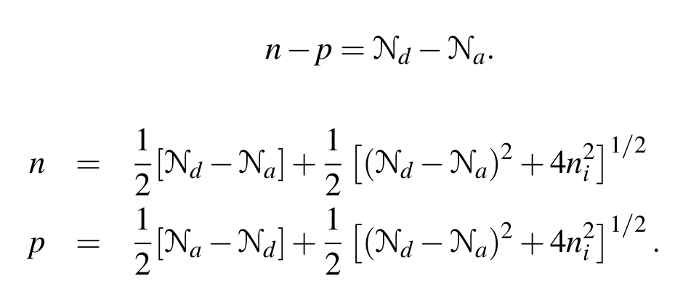
Semiconductor properties – continued
Typically, the ionized impurities dominate the carrier concentrations

Slide 13
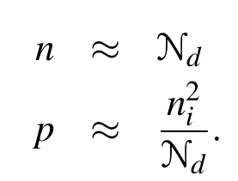
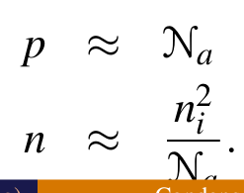
Semiconductor properties – continued
For primarily donor doping:
For primarily acceptor doping:

Slide 14
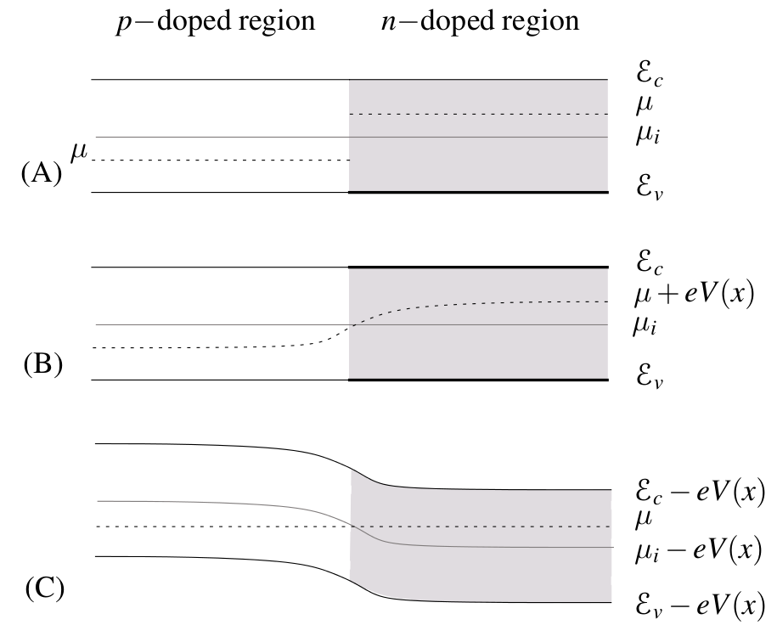
Semiconductor junction
Before equilibration
After equilibration
Junction potential

Slide 15
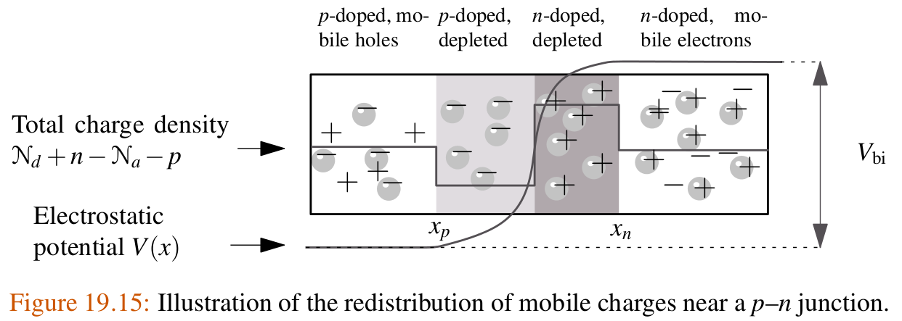
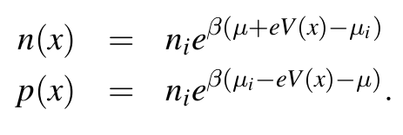
Semiconductor junction

Slide 16
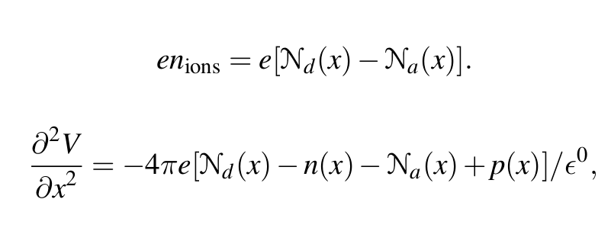
Semiconductor junction

Slide 17
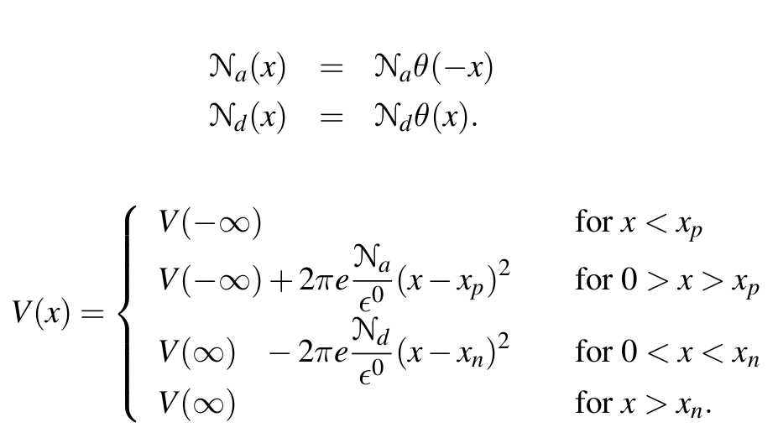
Semiconductor junction
Simplified model:

Slide 18
Semiconductor junction

Slide 19
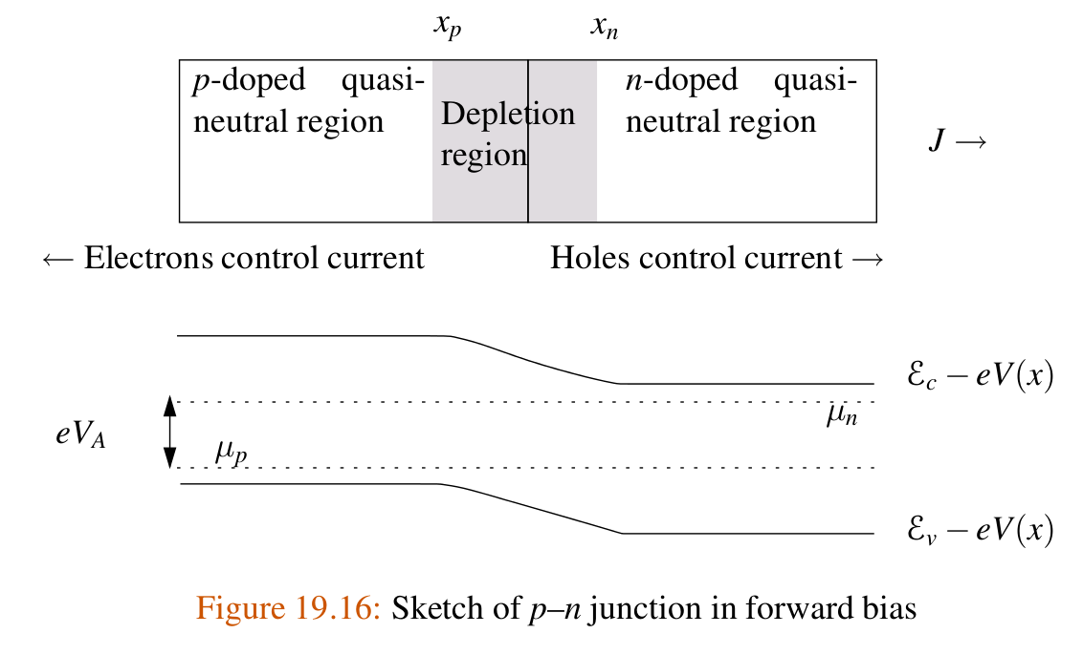
Behavior of ideal diode

Slide 20
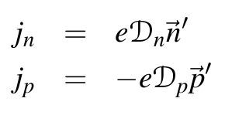
Behavior of ideal diode – continued
Diffusion of electrons and holes:

