Slide 1
PHY 752 Solid State Physics
11-11:50 AM MWF Olin 107
Plan for Lecture 26:
Chap. 19 in Marder
Properties of semiconductors
Diodes and other electronic devices
Some of the lecture materials are from slides prepared by Marder

Slide 2
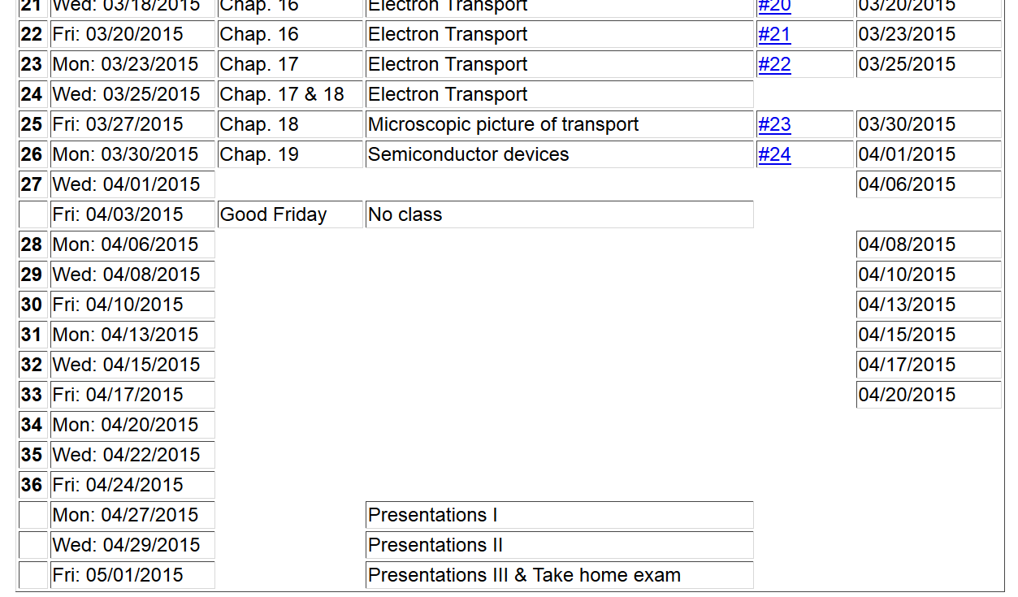

Slide 3
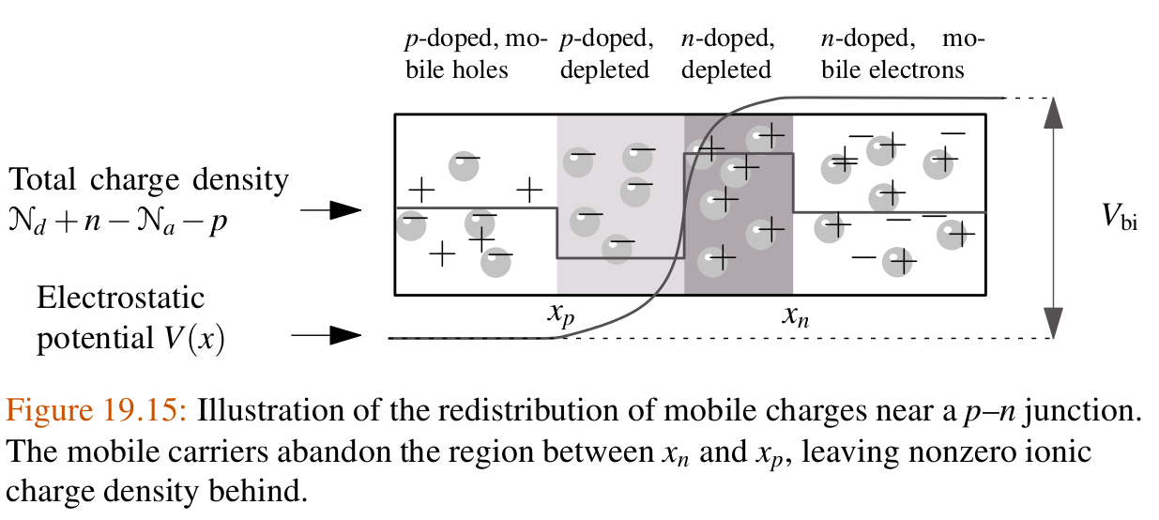
Charge and voltage profile near a semiconductor p-n junction
Equilibrium distributions

Slide 4
Charge and voltage profile near a semiconductor p-n junction
Internal voltage:

Slide 5
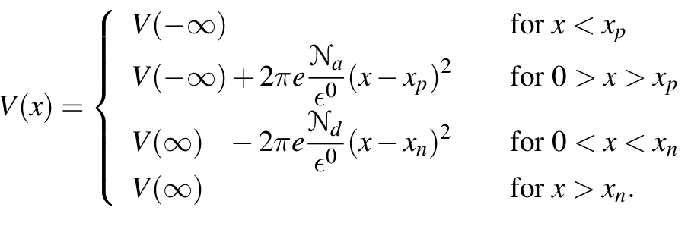
Charge and voltage profile near a semiconductor p-n junction
Simplified model:

Slide 6
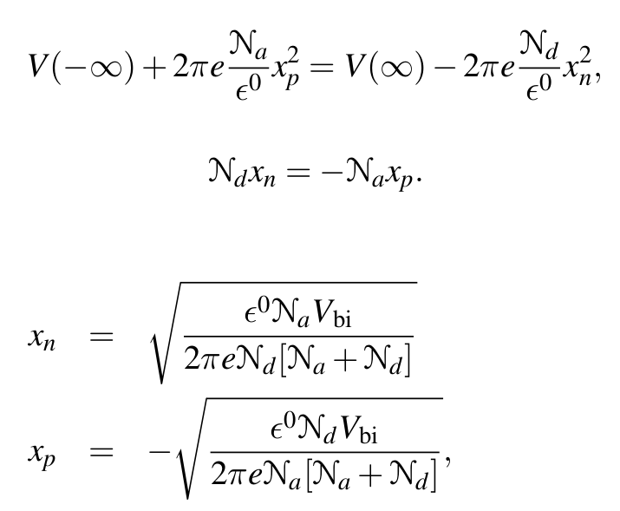
Charge and voltage profile near a semiconductor p-n junction
Simplified model – continued:

Slide 7
Charge and voltage profile near a semiconductor p-n junction
Effects of adding an applied voltage to junction

Slide 8
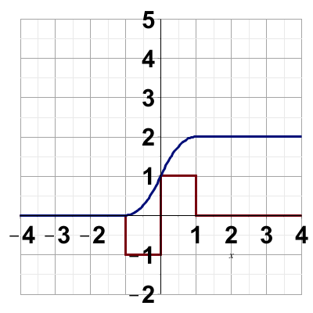
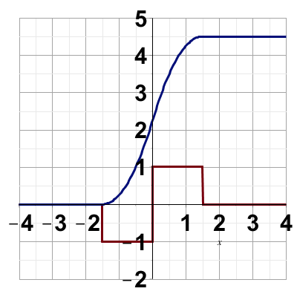
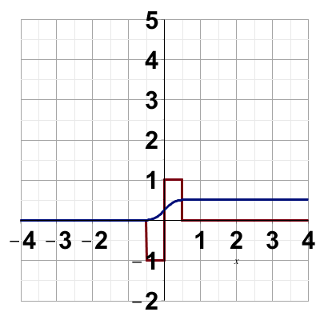
Charge and voltage profile near a semiconductor p-n junction
V_{A}=0
V_{A}<0
V_{A}>0
V(x)
ρ(x)

Slide 9
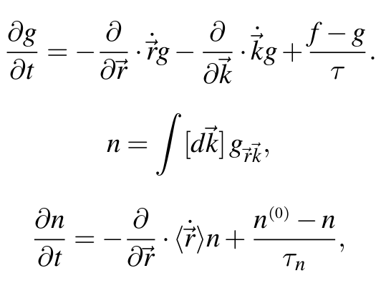
Boltzmann equation treatment of current response to diode
(relaxation time approximation)

Slide 10
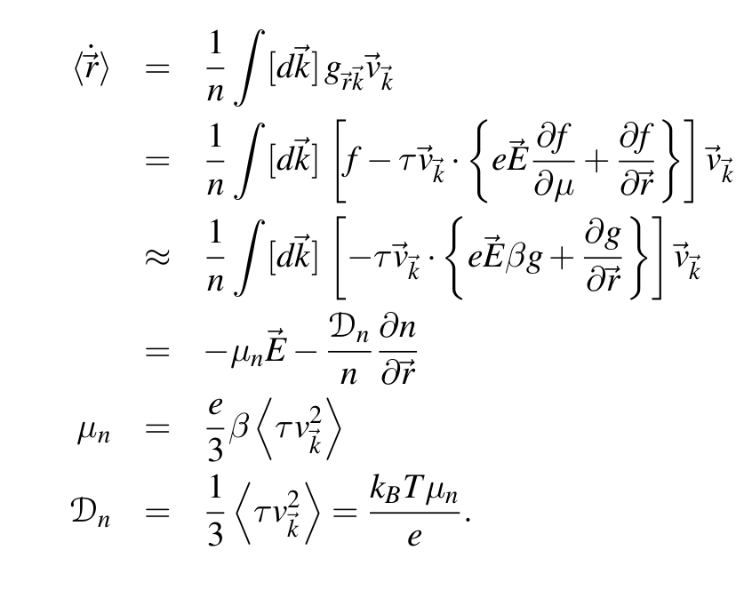
Boltzmann equation treatment of current response to diode
(relaxation time approximation)
electron mobility
electron diffusion coefficient; Einstein relation

Slide 11
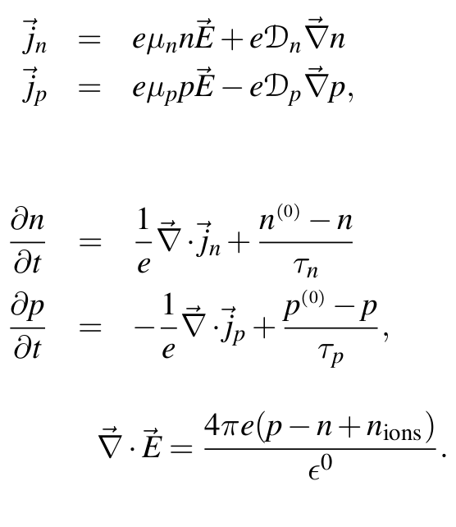
Boltzmann equation treatment of current response to diode
(relaxation time approximation)
Summary of equations:

Slide 12
Boltzmann equation treatment of current response to diode
Approximate solution ignoring “minority” carriers and assuming spatially constant currents j_{n} and j_{p}
For HW, you will show that the above solutions are consistent with the equations:

Slide 13
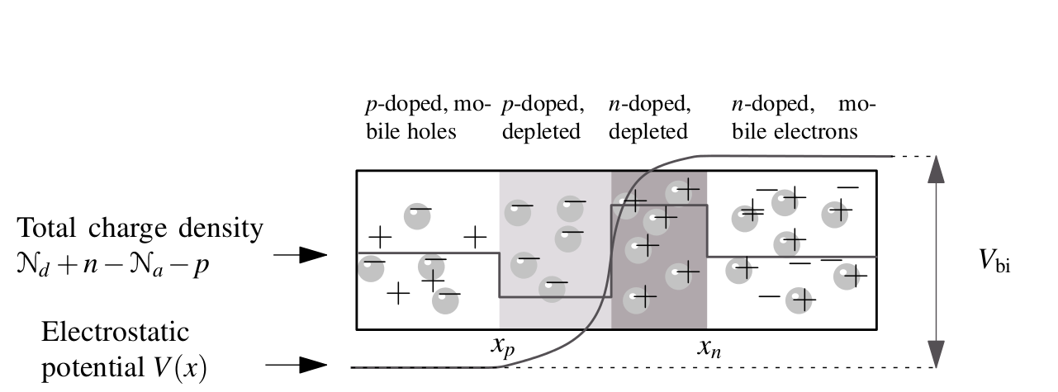
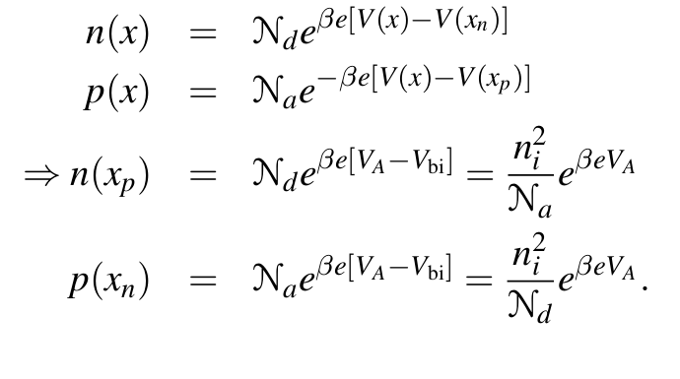
-V_{A}
p majority
n minority
n majority
p minority
Estimation of minority carriers

Slide 14
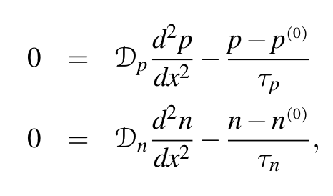
Boltzmann equation treatment of current response to diode
Approximate steady state solutions in presence of applied voltage V_{A}
= 0
≈ 0
➔

Slide 15
Boltzmann equation treatment of current response to diode
Approximate steady state solutions in presence of applied voltage V_{A}
Solution to diffusion equations:
for x>x_{n}
for x<x_{p}

Slide 16
Boltzmann equation treatment of current response to diode
Approximate steady state solutions in presence of applied voltage V_{A}

Slide 17
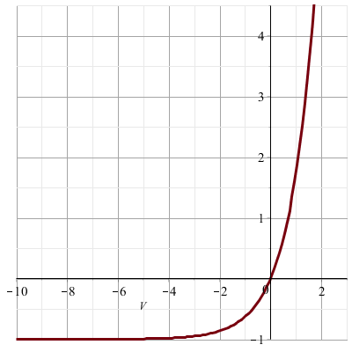
Behavior of diode:
j
V_{A}>0
V_{A}<0

