Slide 1
PHY 752 Solid State Physics
11-11:50 AM MWF Olin 107
Plan for Lecture 27:
Chap. 20 in Marder
Models of dielectric response of materials
Some of the lecture materials are from slides prepared by Marder

Slide 2
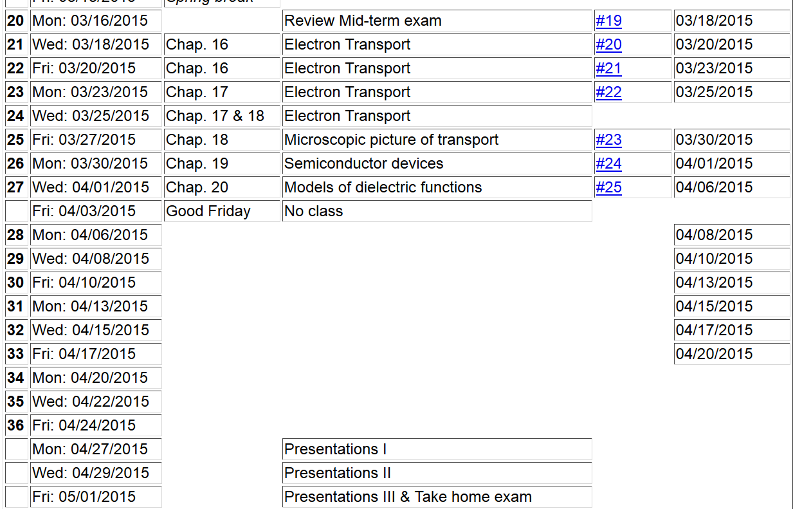

Slide 4
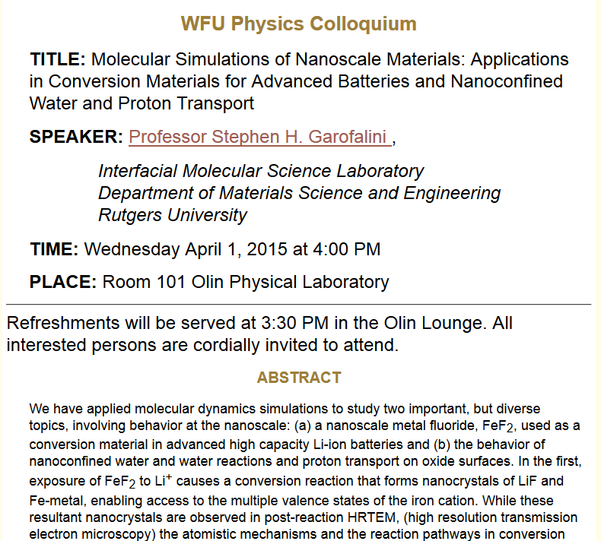

Slide 5
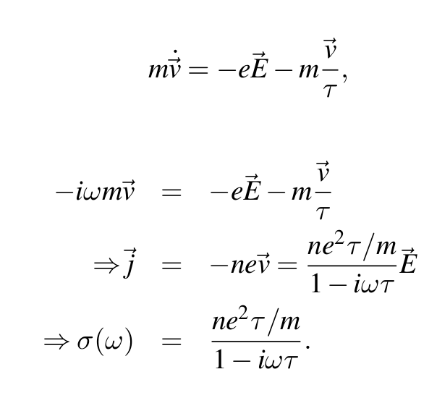
Drude model for unbound electrons in presence of electric field
having pure time harmonic frequency ω:

Slide 6
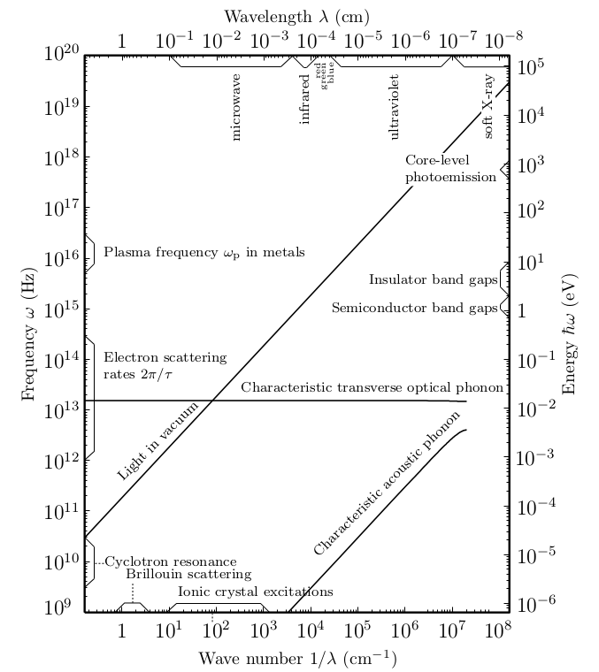

Slide 7
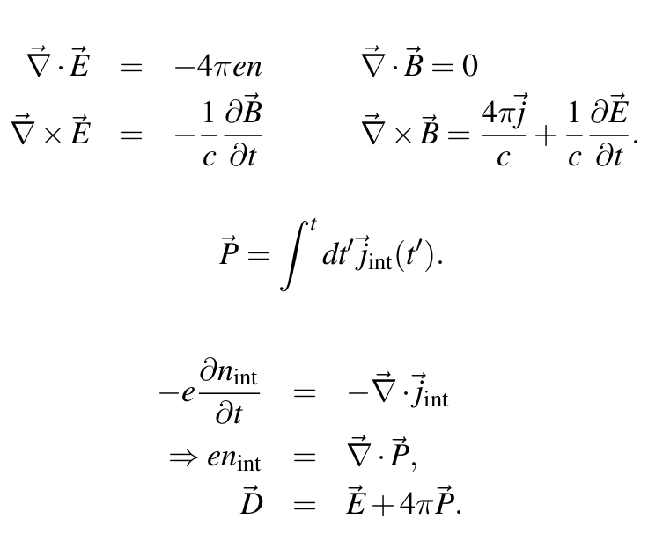
Maxwell’s equations including “internal” charges and currents

Slide 8
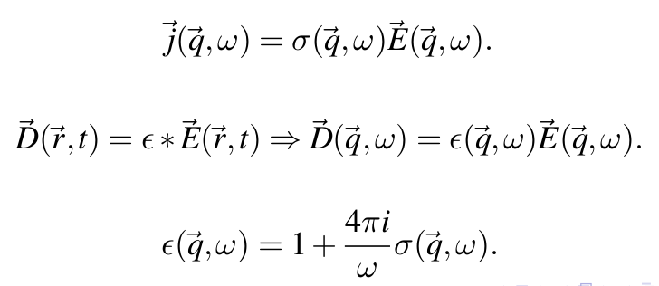
Maxwell’s equations including both internal and “external” charges and currents
Relationship between current, conductivity and electric field:
In Fourier space:

Slide 9
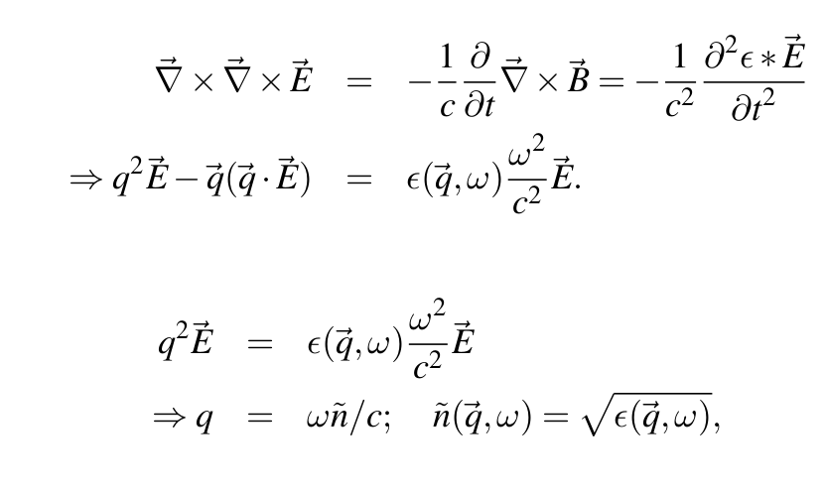
Electromagnetic waves within media
Transverse mode:

Slide 10
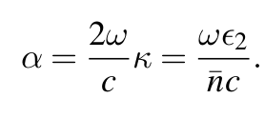
Real and imaginary parts of refractive index
Absorption coefficient

Slide 11
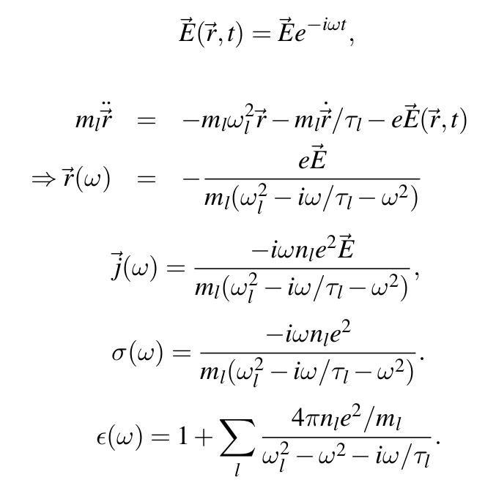
Drude model with bound oscillators

Slide 12
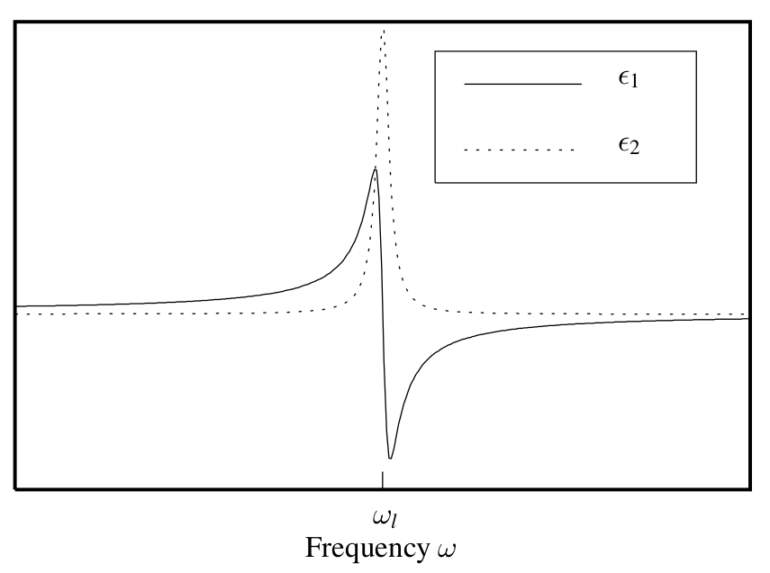
Real and imaginary parts of dielectric function for Drude model

Slide 13
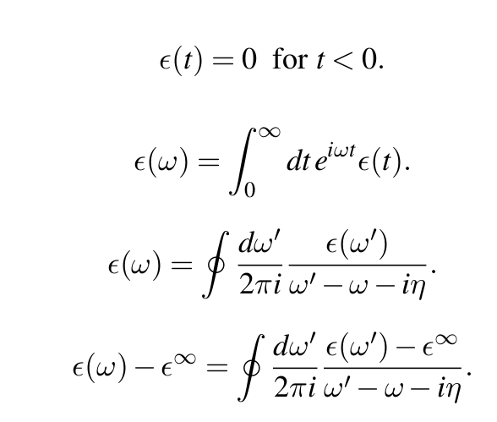
Analytic properties of dielectric function

Slide 14
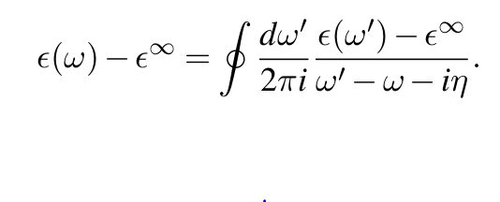
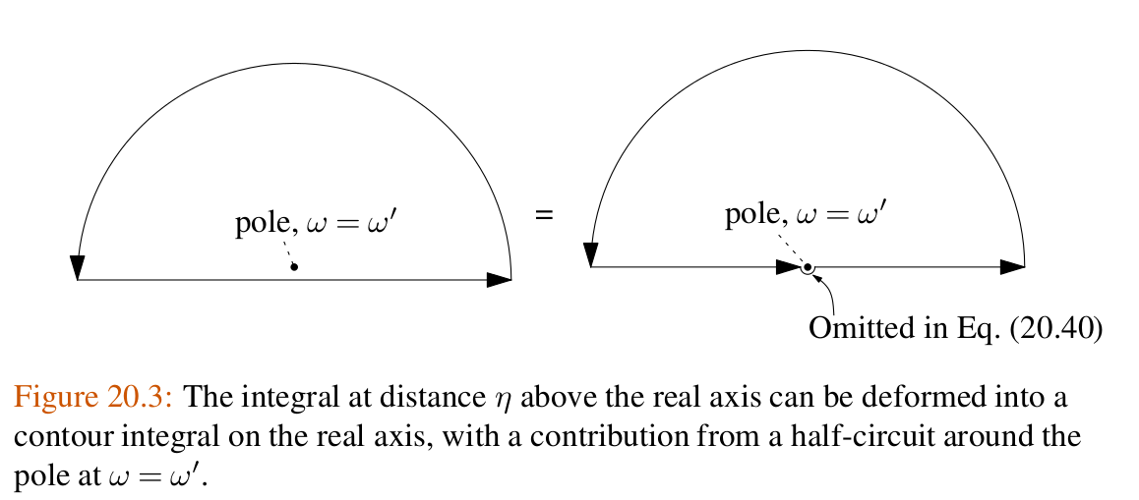

Slide 15
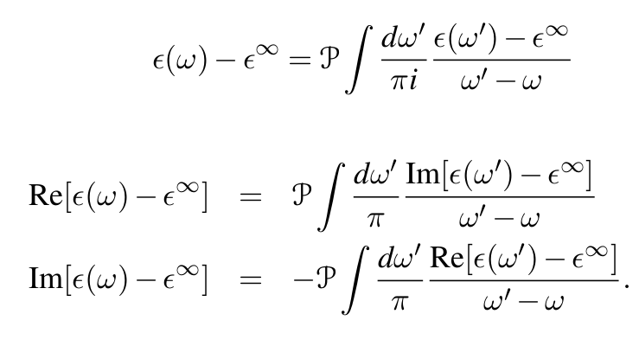
In terms of principle parts integral over negative and positive frequencies

Slide 16
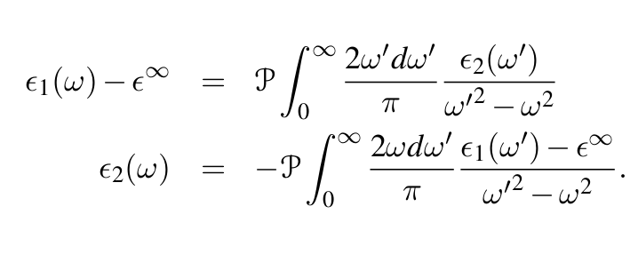
In terms of positive frequencies only

Slide 17
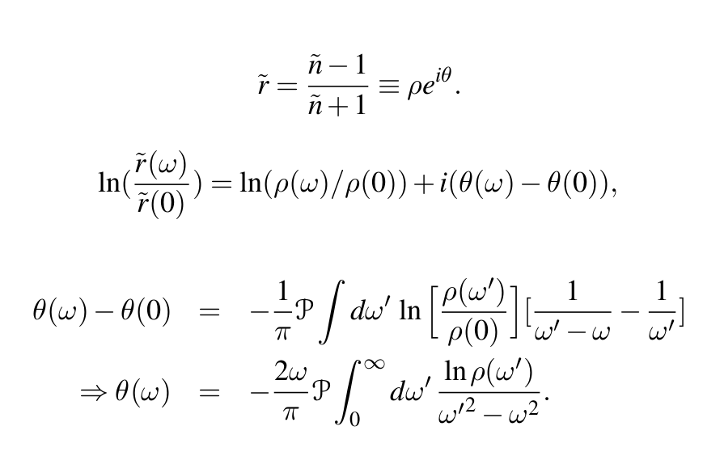
Analysis of reflectivity data

