Slide 1
PHY 752 Solid State Physics
11-11:50 AM MWF Olin 107
Plan for Lecture 28:
Chap. 21 in Marder & pdf file from Bassani’s text
Optical properties of solids
Interband transitions
Excitons

Slide 2
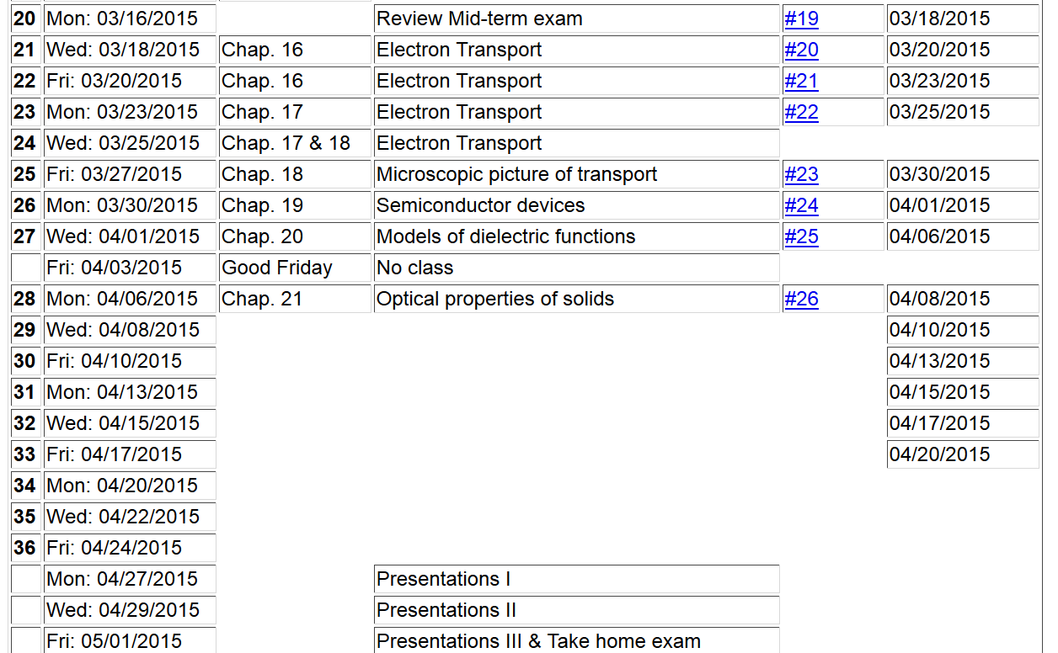

Slide 3
Treatment of electromagnetic fields in solids
periodic potential

Slide 4
Treatment of electromagnetic fields in solids

Slide 5
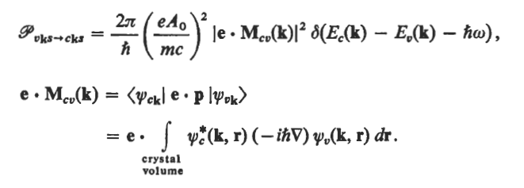
Treatment of electromagnetic fields in solids
using possibility #1 and following Bassani’s text
Fermi Golden Rule:
In this case:

Slide 6
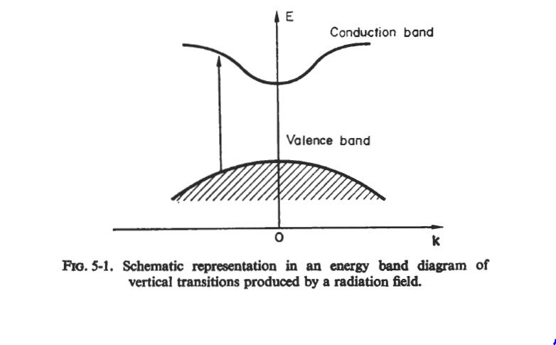
Treatment of electromagnetic fields in solids
using possibility #1 and following Bassani’s text

Slide 7
Treatment of electromagnetic fields in solids
using possibility #1 and following Bassani’s text
spin
Normalizing the result in terms of imaginary part of dielectric constant:

Slide 8
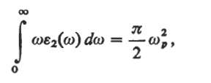
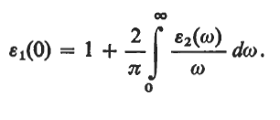
Treatment of electromagnetic fields in solids
using possibility #1 and following Bassani’s text
From Kramers-Kronig transform:
Special results:

Slide 9
Treatment of electromagnetic fields in solids
using possibility #1 and following Bassani’s text
Sometimes can use group theory to determine “forbidden” transitions
When matrix elements are constant; structure depends sensitively on joint density of states

Slide 10
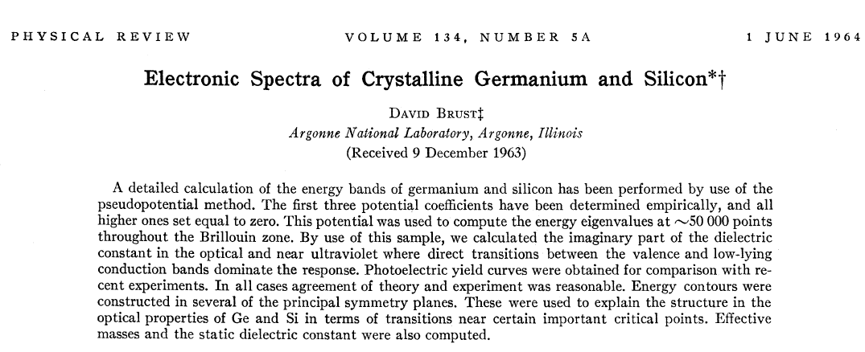

Slide 11
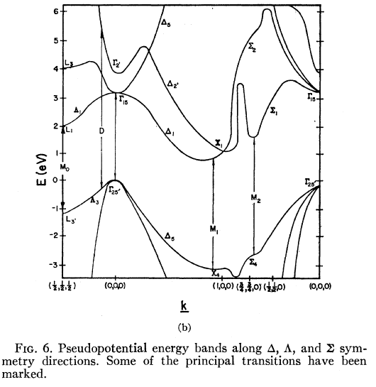
Band structure of Si (as calculated by Brust)

Slide 12
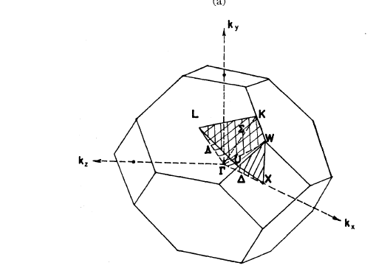
Integration region of Brillouin zone

Slide 13
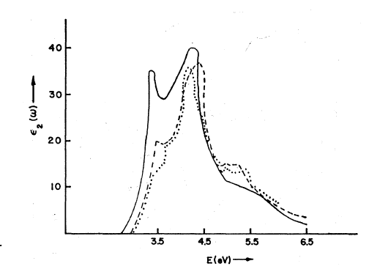
Experiment
Calculation with matrix elements

Slide 14
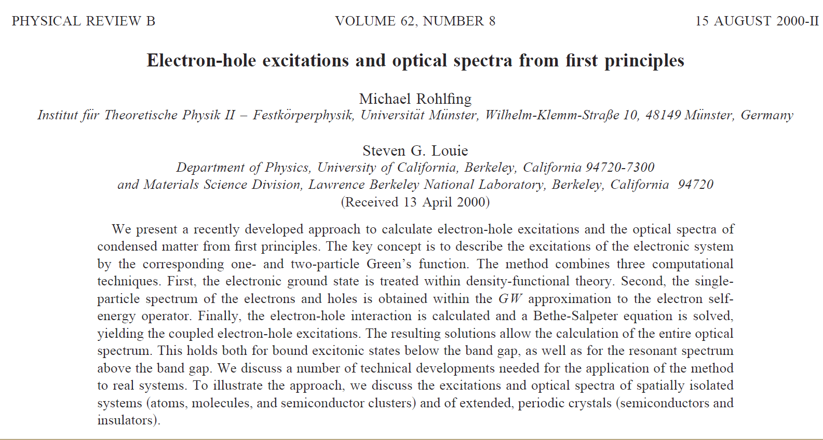
First principles calculation

Slide 15
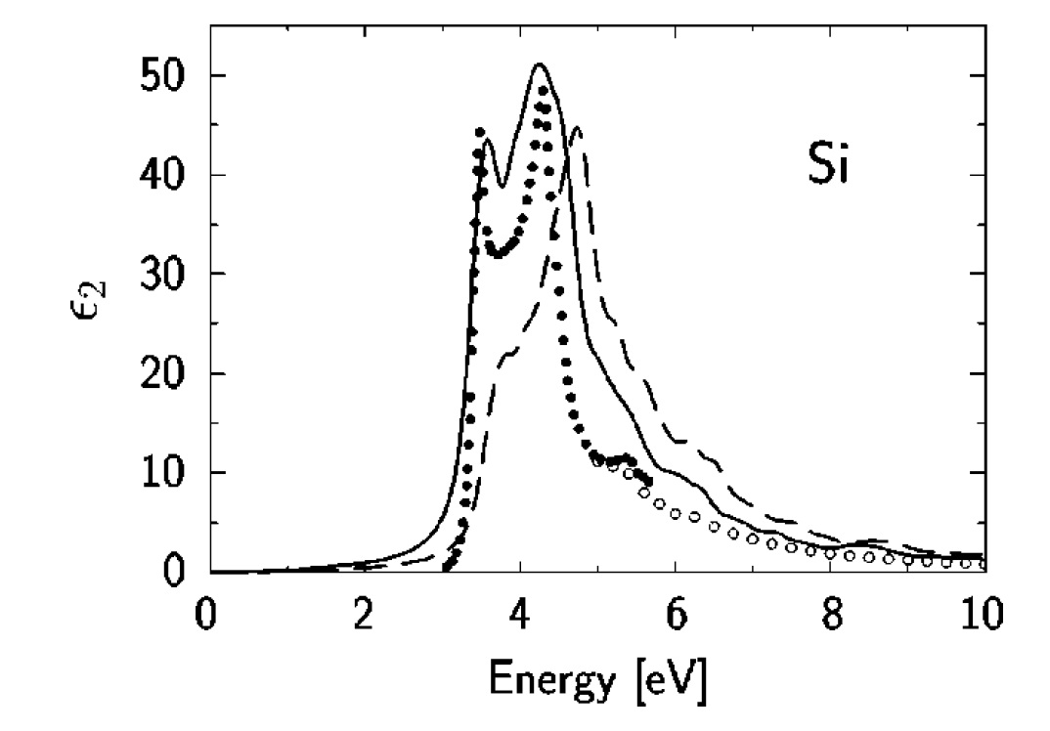
Experiment
Theory without exciton
Theory with exciton

Slide 16
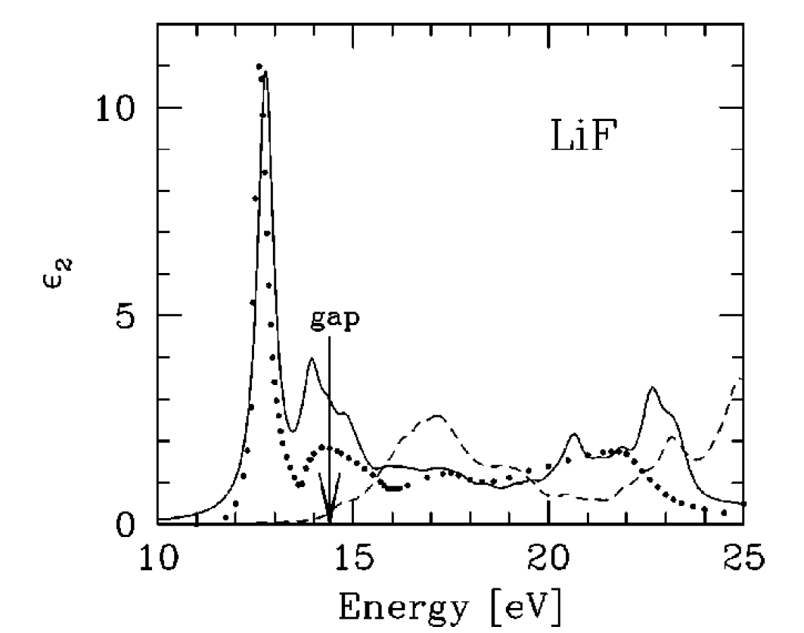

Slide 17
Exciton effects
-
r_{n}-r_{p}
+

Slide 18
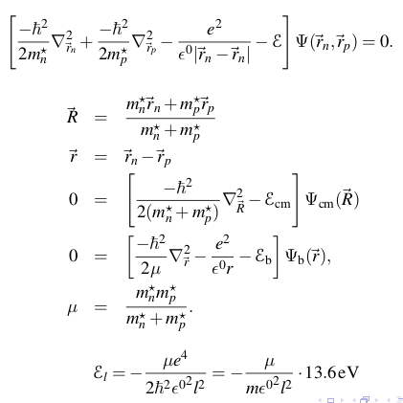
Exciton effects (using Marder’s materials)
Wannier approximation
p

Slide 19
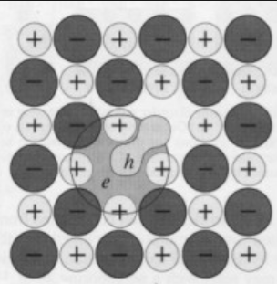
Self-trapped excitons (RT Williams)
NaCl

