Slide 1
PHY 752 Solid State Physics
11-11:50 AM MWF Olin 107
Plan for Lecture 29:
Chap. 22 in Marder & pdf file on “Maximally Localized Wannier Functions”
Electromagnetic properties of insulators
Modern theory of polarization

Slide 2
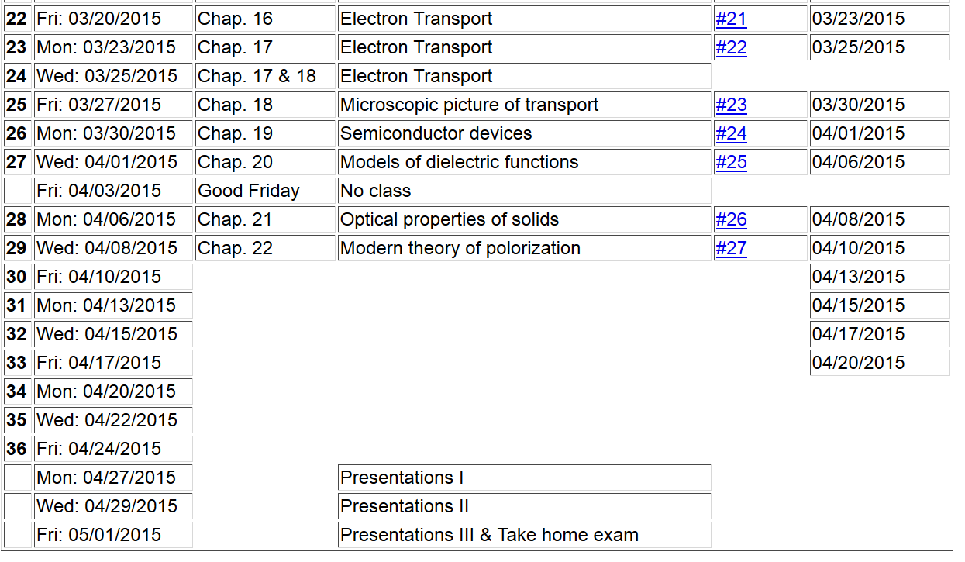

Slide 4
Electromagnetic properties of insulating materials
Some references:
“Maximally localized Wannier functions: Theory and applications”, Marzari et al., RMP 84, 1419 (2012)
“Macroscopic polarization in crystalline dielectrics: the geometric phase approach”, Resta, RMP 66, 899 (1994)
“Electric polarization as a bulk quantity and its relation to surface charge”, Vanderbilt and King-Smith, PRB 48, 4442 (1993)

Slide 6
Notion of an electric dipole moment
summing over eigenstates of the system
➔”Modern” theory of polarization can be formulated in terms of Wannier functions or in terms a Berry-phase expression. All of the formulations define the polarization modulo eR/V, where R is a lattice translation and V is the volume of the unit cell.

Slide 7
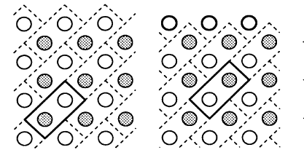
Ambiguity of polarization
P₁
P₂

Slide 8
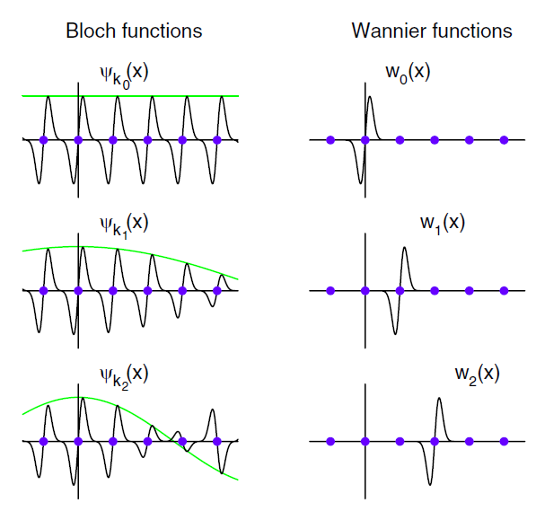
Notion of Wannier functions formed from
Bloch eigenstates:

Slide 9
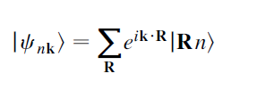
Construction of Wannier function from Bloch states
Inverse transform:
Non-uniqueness of Wannier functions; suppose a Bloch function is multiplied by an arbitrary phase:
➔ constructed Wannier function would change

Slide 10
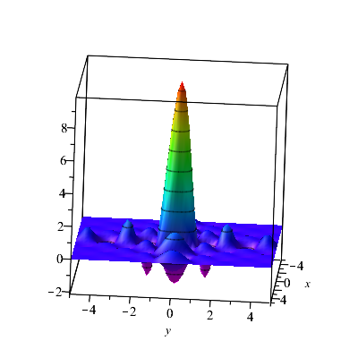
Simple example of Wannier function

Slide 11
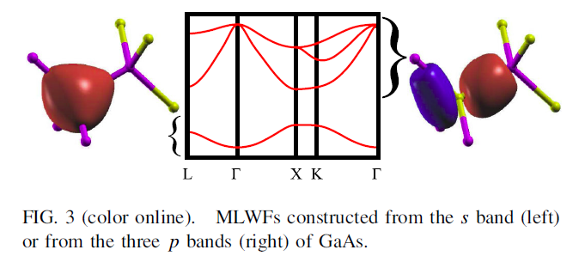
In addition to the arbitrary phase problem, it is often the case that there are multiple or entangled bands needed to form the Wannier states.
➔Turning problem into an advantage – notion of maximally localized Wannier functions

Slide 12
Some details:
Normalization of Bloch waves:
Orthogonality of Wannier functions:

Slide 13
Notion of maximally localized Wannier function is to use the non-uniqueness to choose the phase in order to maximize the localization of the Wannier function

Slide 14
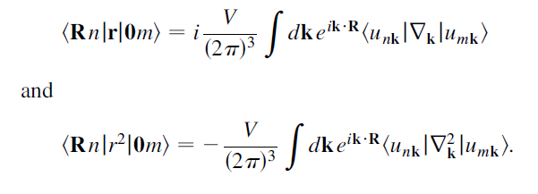
Practical calculation of localization function
Actually these expressions must be evaluated using finite differences in k. The localization function
is minimized by means of a unitary transformation on
the phase of the Bloch functions:

Slide 15
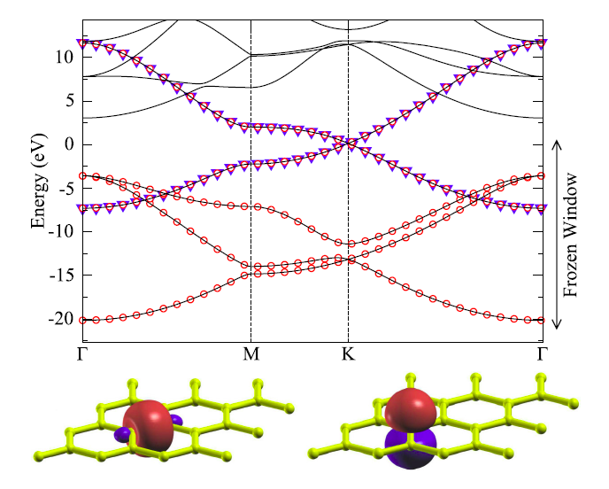
Some examples
Graphene

Slide 16
Wannier functions used to evaluate polarization
Wannier function in central cell:

Slide 17
Polarization of system depends on position weighted sum of both electronic charges and on ionic charges:

Slide 18
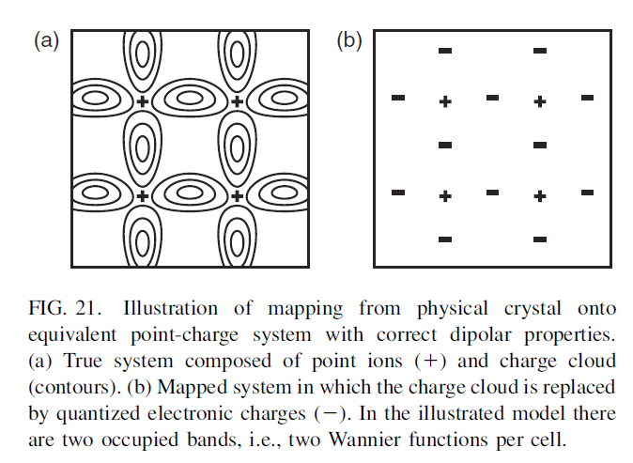

Slide 19
Note that we previously noticed that the Bloch functions and the corresponding Wannier functions are not unique, but we can shown that r_{n} is unique up to a lattice translation
(thanks to Vanderbilt and King-Smith)
We assume the Bloch waves have the symmetry:
Consider the transformed Bloch wave:

Slide 20
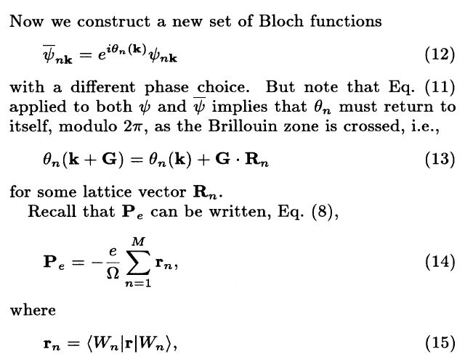

Slide 21
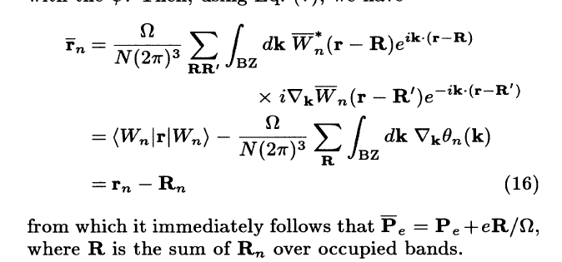
Vanderbilt and King-Smith note that with this definition of the polarization, the surface charge of a polar material is consistent with

