Slide 1
PHY 752 Solid State Physics
11-11:50 AM MWF Olin 107
Plan for Lecture 30:
Surface properties of solids (some material in Marder Chap. 4, 19, 23)
Geometric and electronic structures of surfaces
Work function
Photoemission

Slide 2
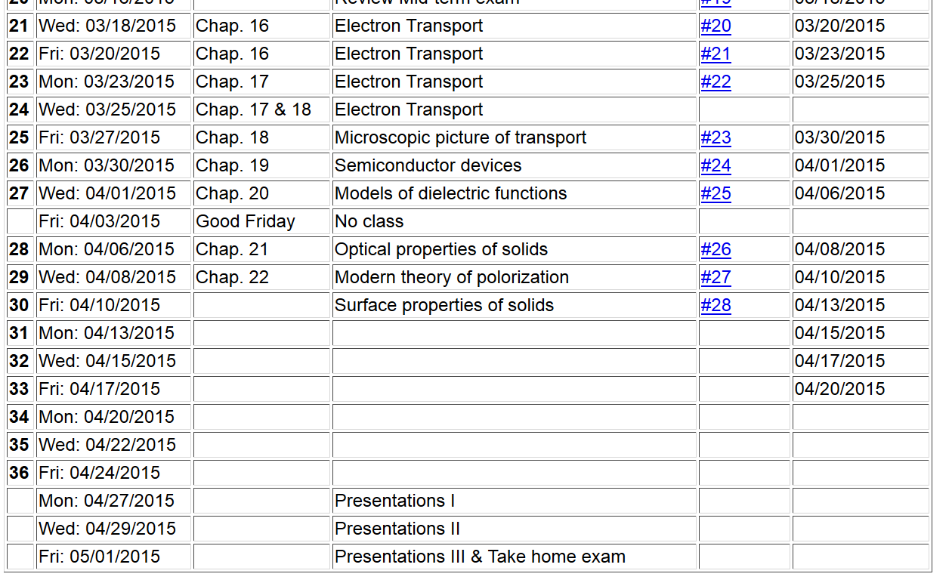

Slide 3
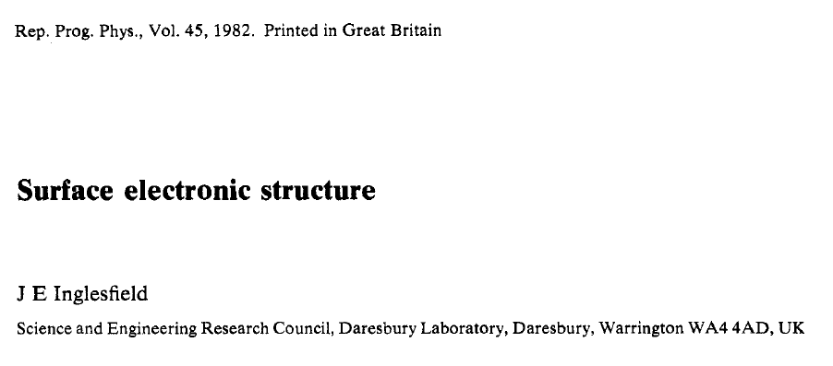
Surface effects in solids
Some material is taken from the review article:
pages 223-284

Slide 4
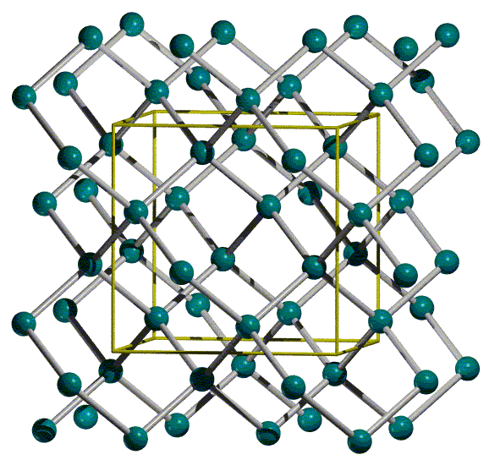

Slide 6
What happens when crystal is cleaved?
Potential barrier between inside of crystal and vacuum – work function
Crystal loses periodicity in cleavage direction (band smearing)
Possibility of surface states
Possibility of image potential states

Slide 7
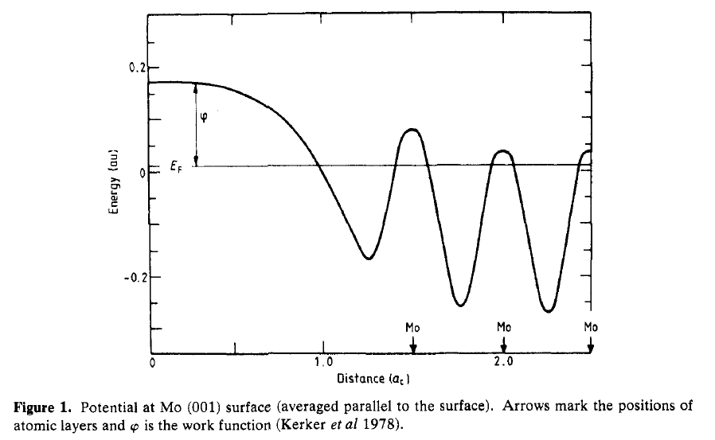
Projection of effective potential near surface
work function

Slide 8
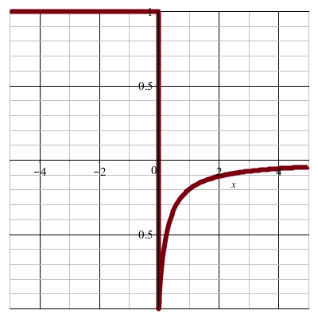
Model of interface:
φ
work
function
z
E_{F}
z=0 (surface plane)

Slide 9
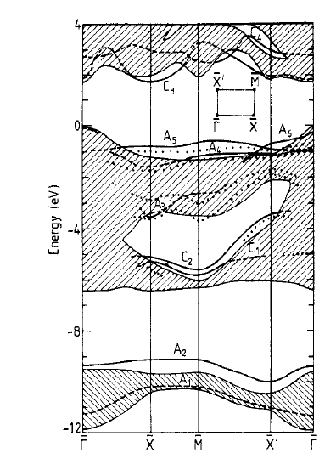
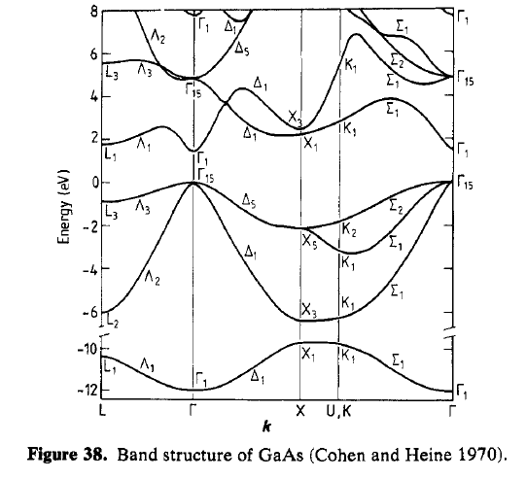
no longer periodic
surface bands
bulk bands

Slide 10
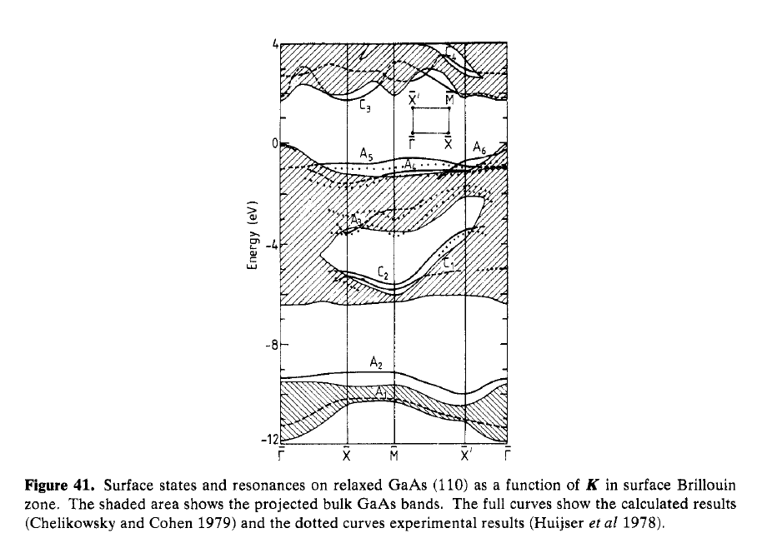
projected bulk states
surface induced gap
surface states

Slide 11
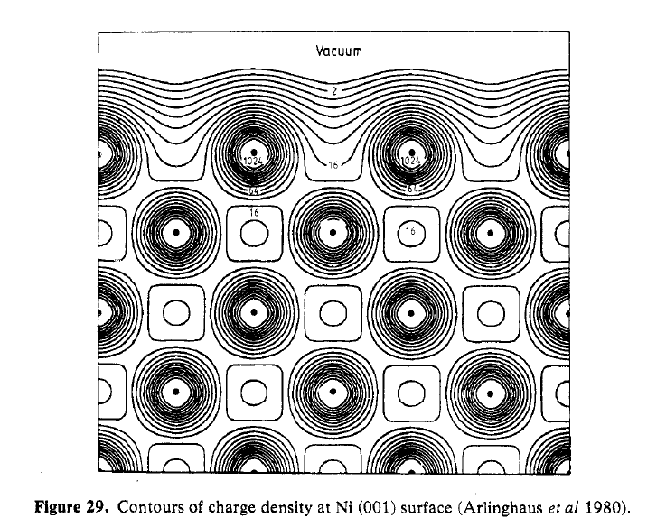
Relaxation of surface atoms – example Ni (001)

Slide 12
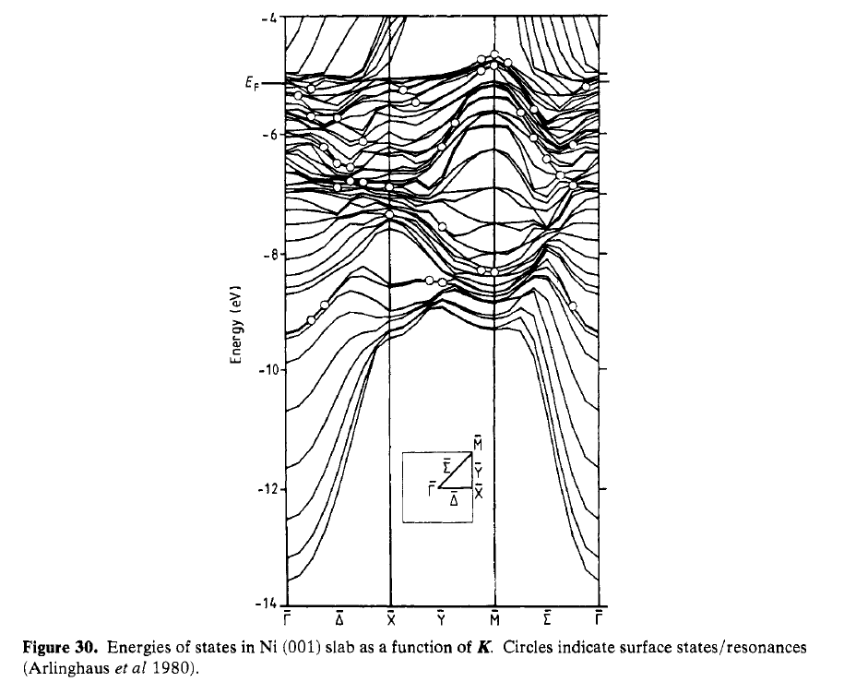
Electronic structure calculation for slab

Slide 13
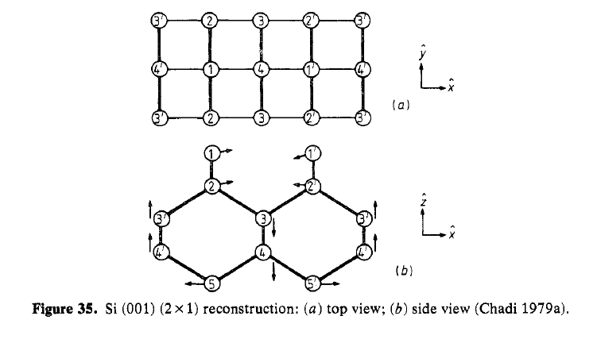
Surface reconstruction – Si (001)

Slide 14
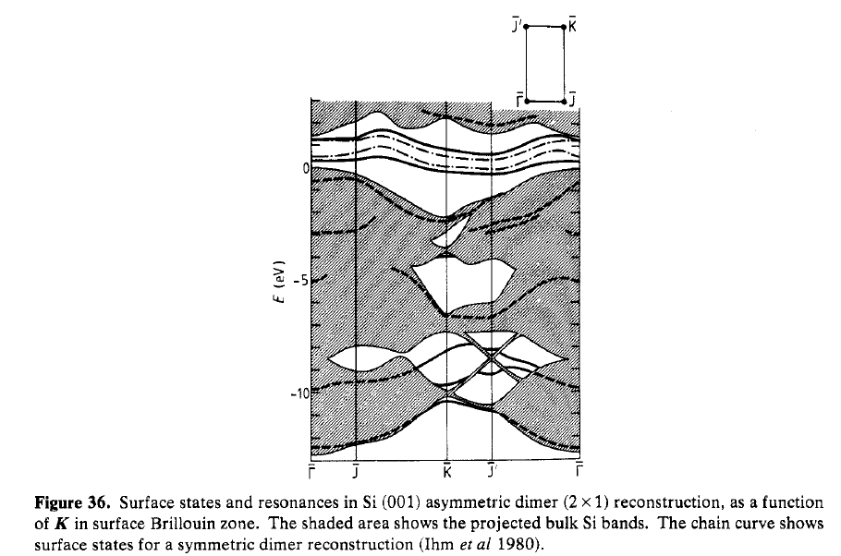

Slide 15
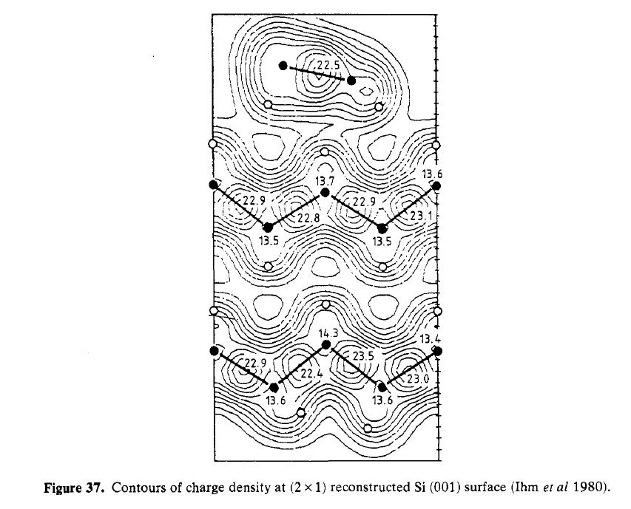

Slide 16
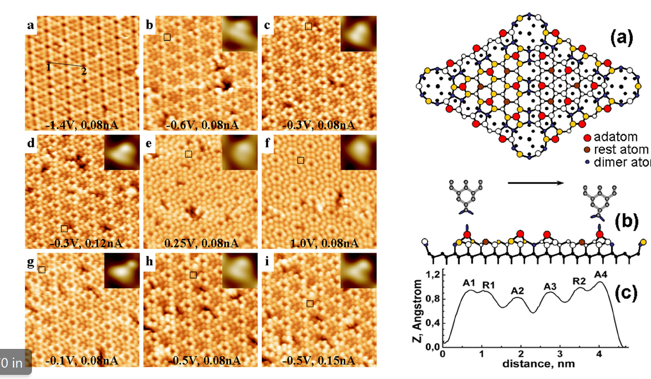

Slide 17
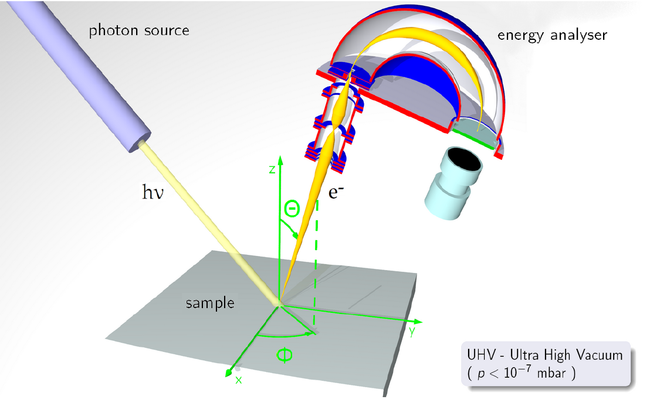
Photoemission measurements (materials from Matthias Kreier of Humbolt University)

Slide 18
Transition rate from Fermi Golden Rule
Energy and momentum conservation

Slide 19
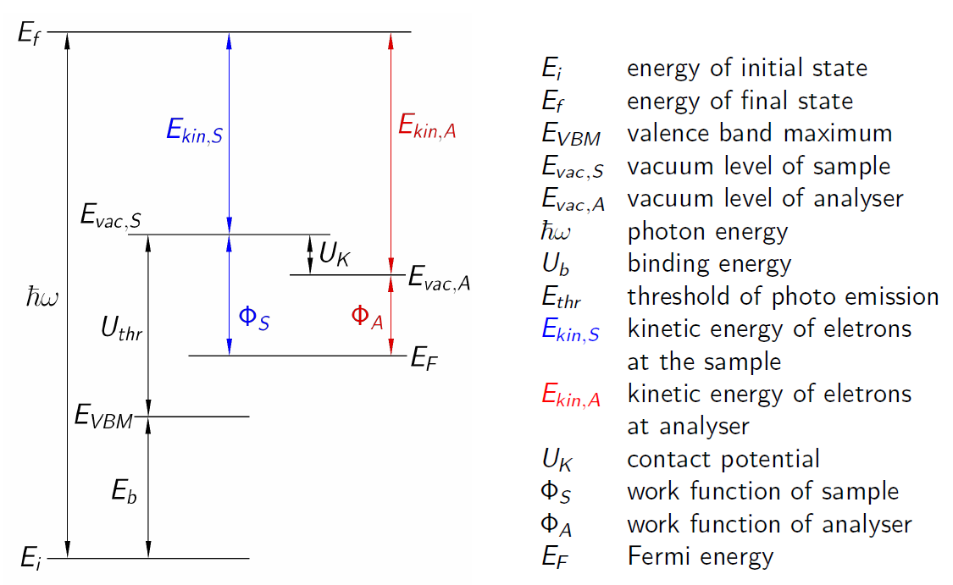

Slide 20
