Slide 1
PHY 752 Solid State Physics
11-11:50 AM MWF Olin 107
Plan for Lecture 31:
X-ray and neutron diffraction in solids (some material contained in Chap. 3 of Marder’s text)
Bragg law
Intensity relationships
Sensitivity to atomic parameters

Slide 2
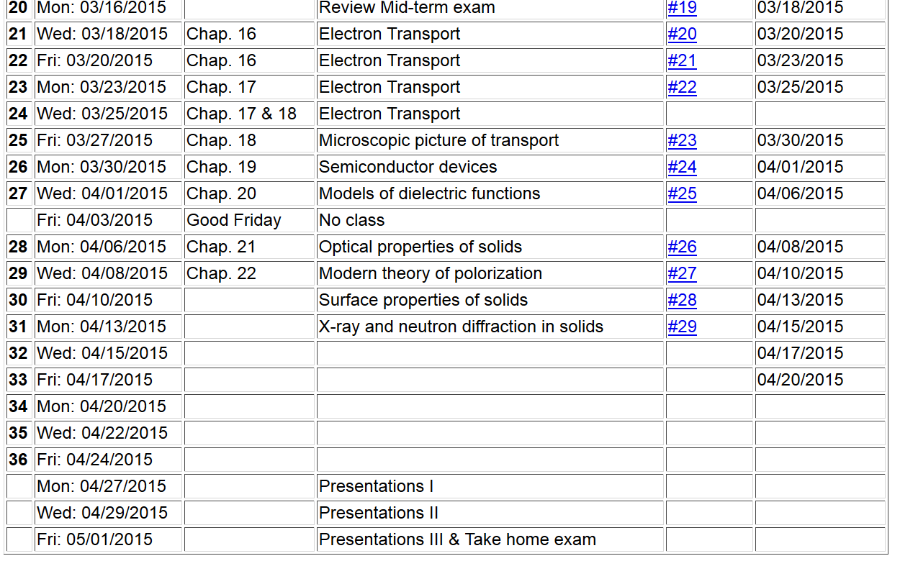

Slide 3
Comment on topics
X-ray and neutron diffraction in solids
Low energy electron diffraction in solids
Beyond independent electron picture -- Electron-electron interactions in the Hubbard model (Chapter 26 of your text)

Slide 4
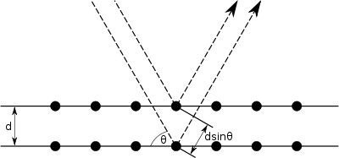
Bragg diffraction
incident beam
defracted beam
k_{scat}
In terms of wave vectors
k_{inc}
Δk
2θ

Slide 5
Relationship of normal distance between diffracting planes to Bravais lattice
a₃
a₁
a₂

Slide 6
Comes from Born approximation describing the interaction between scattering particle and material.
Intensity profile

Slide 7
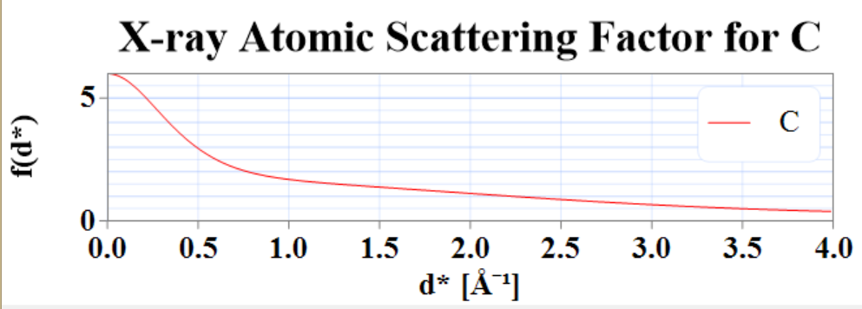
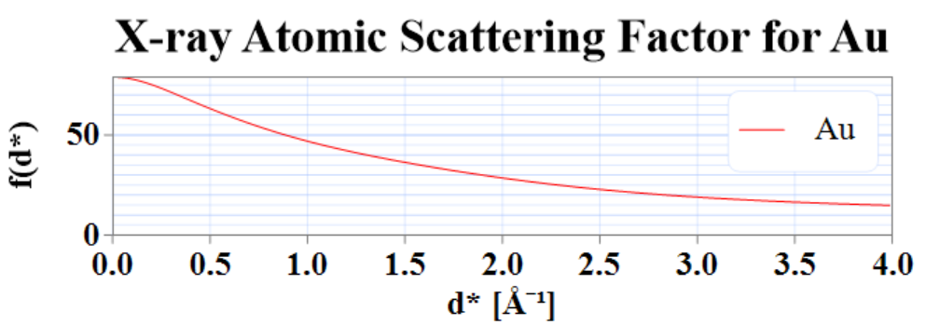
Atomic structure factors
For X-ray scattering; Fourier transform of electronic density
(these are from
crystaldiffract)

Slide 8
Atomic structure factors
http://www.ncnr.nist.gov/resources/n-lengths/

Slide 9
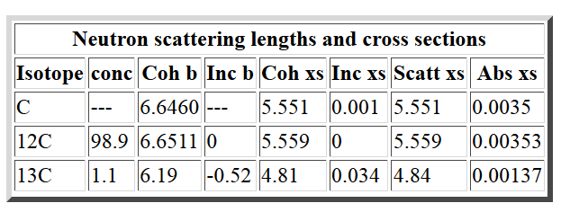
scattering length in 10⁻¹⁵ m

Slide 10
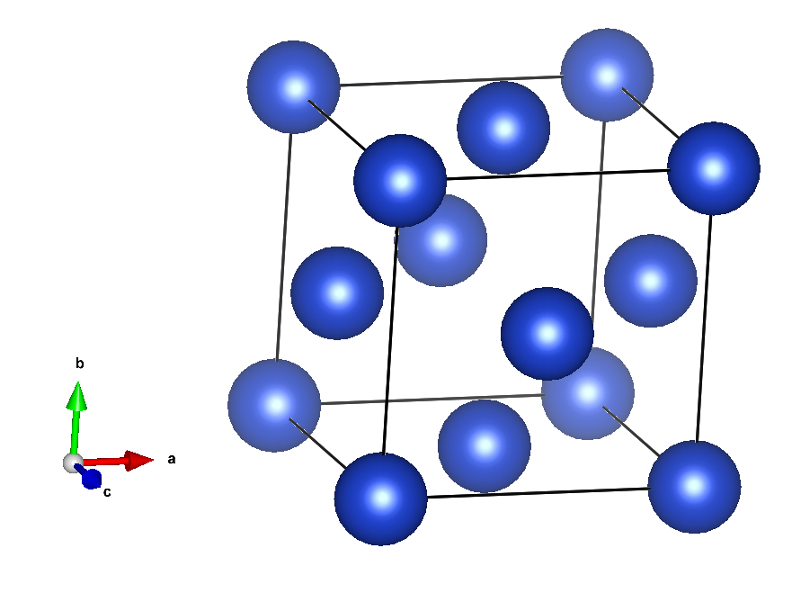
Cu (fcc)

Slide 11
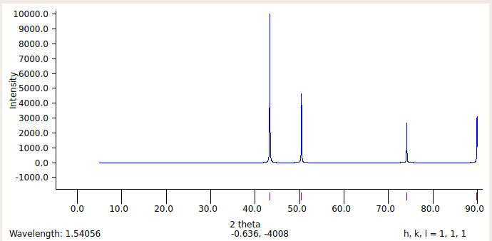
X-ray powder diffraction pattern for Cu (fcc)
what is lattice constant a?
3.615 Angstroms

Slide 12
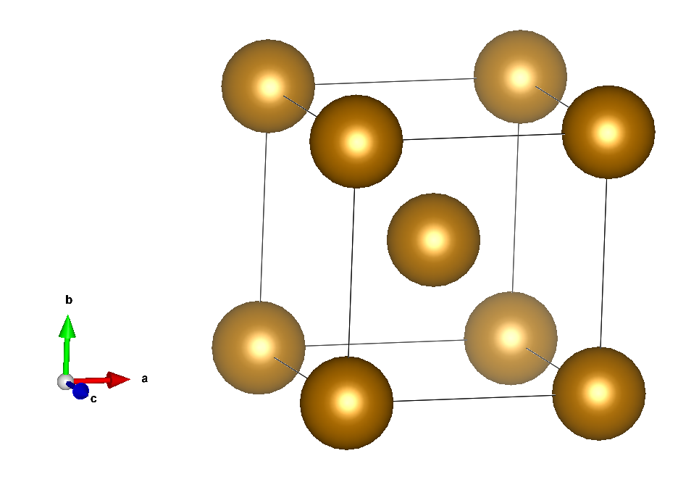
Fe (bcc)

Slide 13
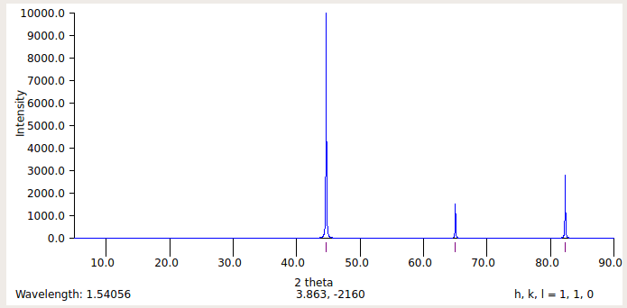
Fe (bcc)
2.8665 Angstroms
What is a ?

Slide 14
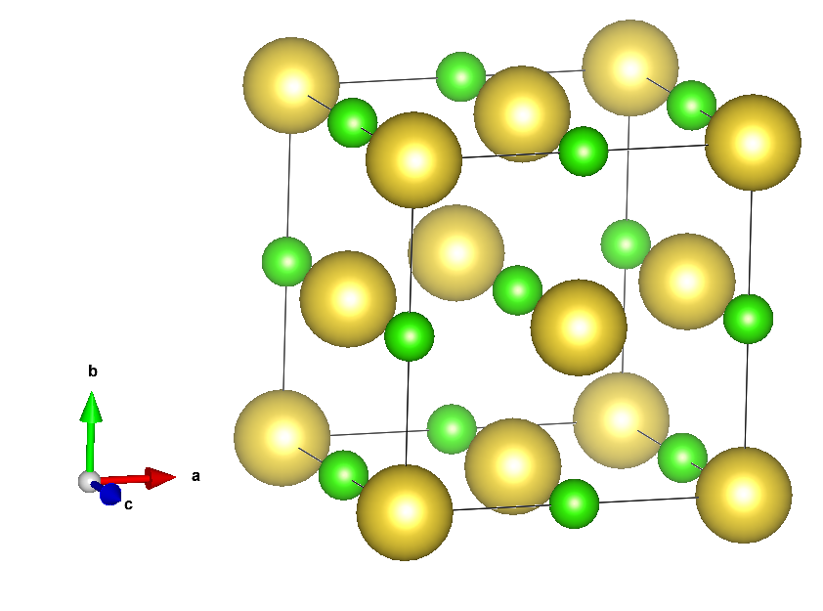
NaCl

Slide 15
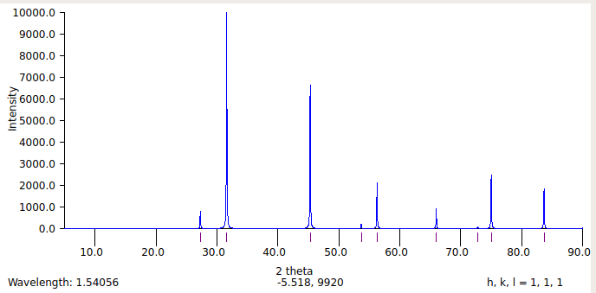
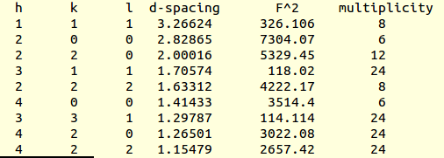
NaCl
a=5.6573 Angstroms

Slide 16
Comparison of X-ray and Neutron diffraction
time of flight
path length

Slide 17
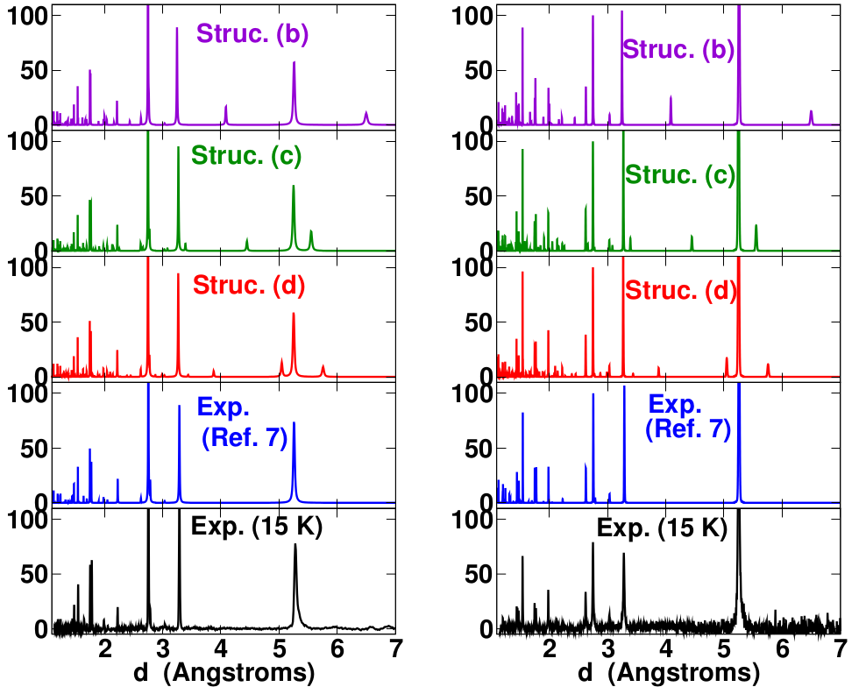
X-ray
Neutron

Slide 18
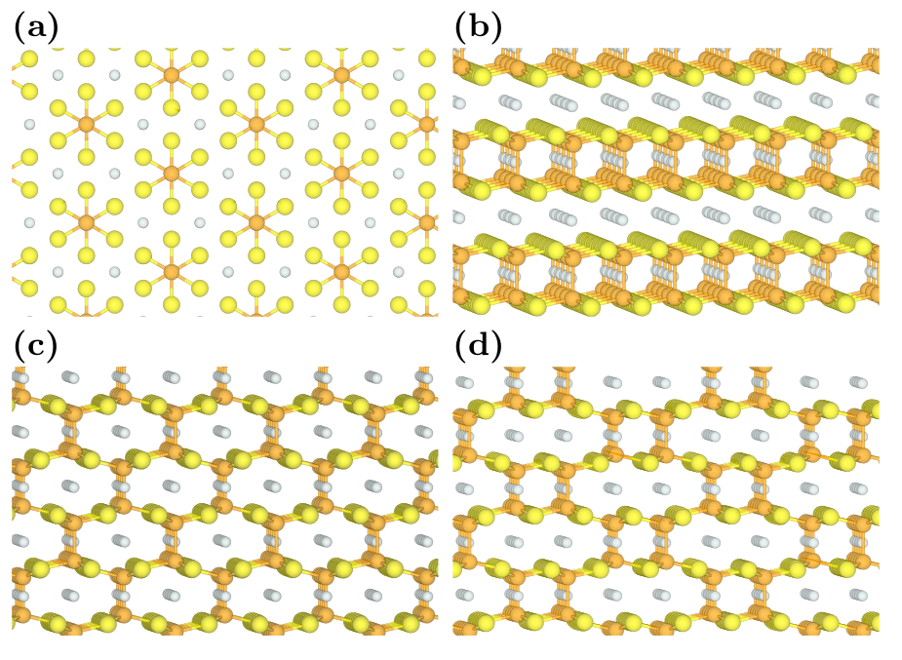

Slide 19
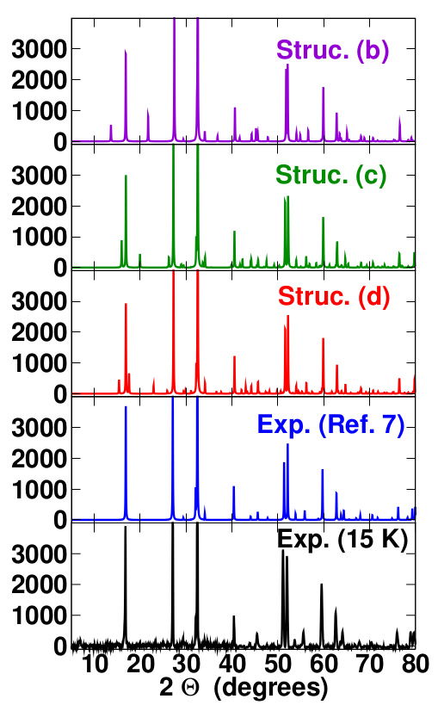
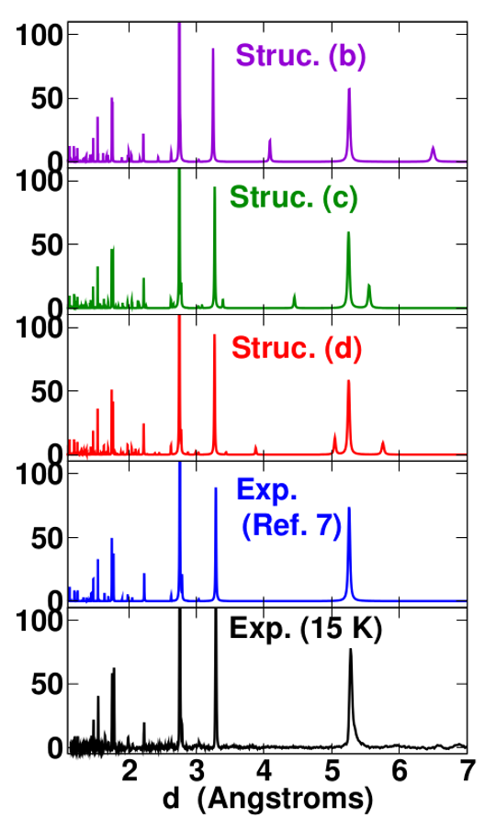
X-ray

Slide 20
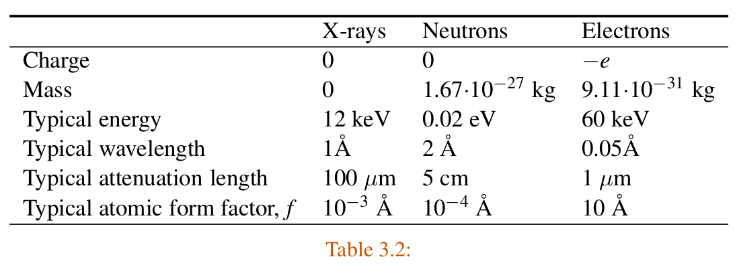
Properties of scattering particles
from pg. 61 of Marder’s text

