Slide 1
PHY 752 Solid State Physics
11-11:50 AM MWF Olin 107
Plan for Lecture 32:
The Hubbard model
Motivation for the model
Solution for a 2 site system
Hartree-Fock approximation
Comparison with exact solutions

Slide 2
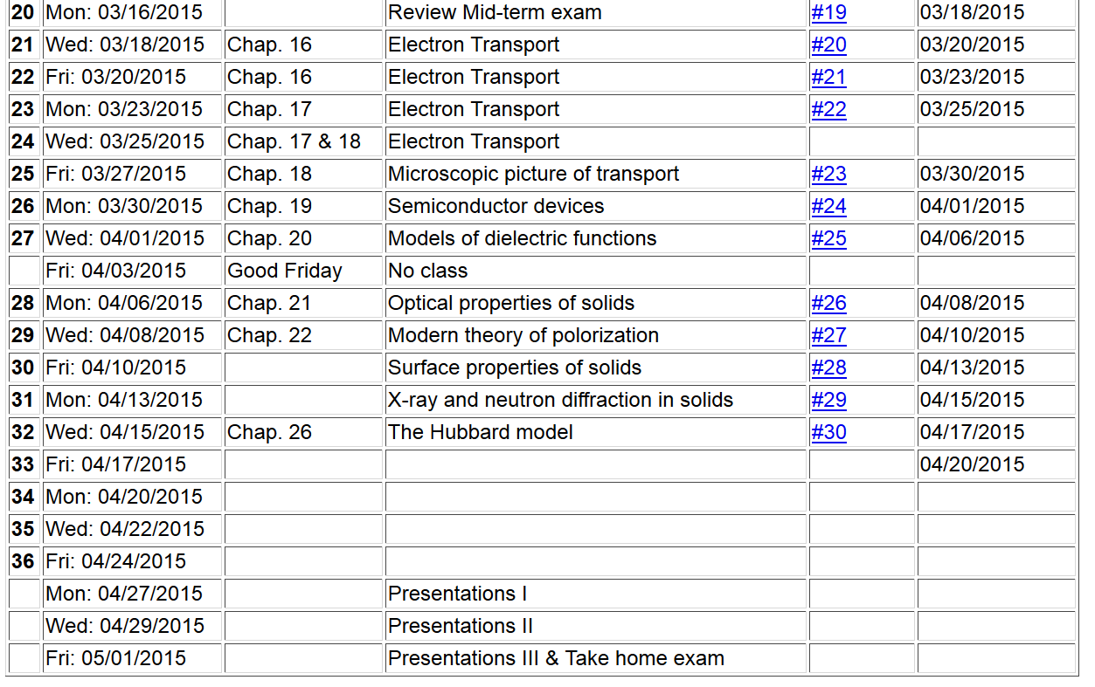

Slide 4
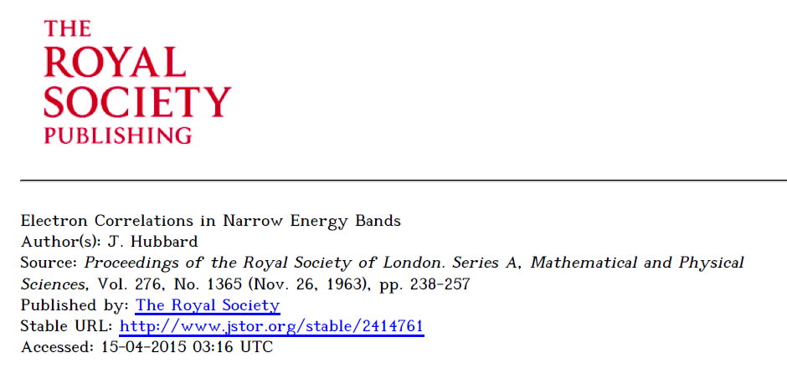
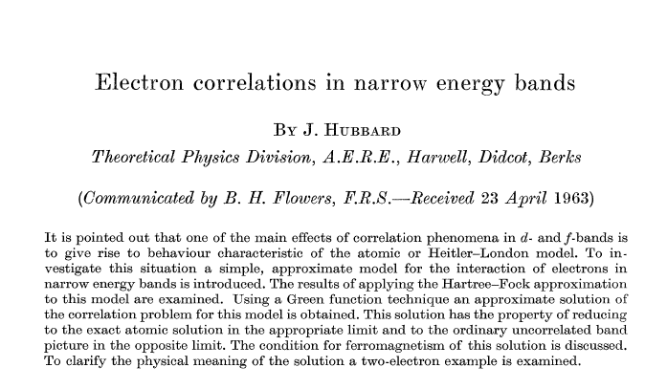

Slide 5
The Hubbard Hamiltonian:
single particle contribution
two particle contribution

Slide 6
l = 1 2 3 4
Possible configurations of a single site

Slide 7
Hubbard model -- continued
t represents electron “hopping” between sites, preserving spin
U represents electron repulsion on a single site

Slide 8
Two-site Hubbard model

Slide 9
Two-site Hubbard model

Slide 10
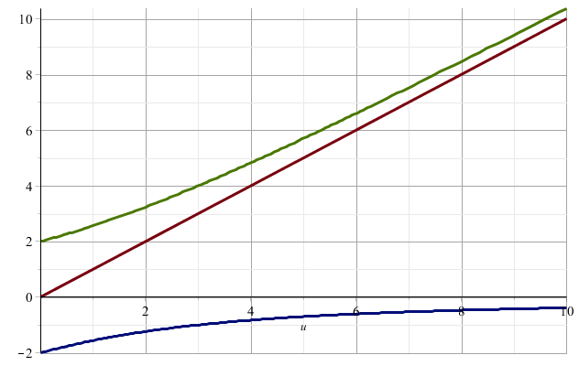
Eigenvalues of the Hubbard model

Slide 11
Two-site Hubbard model
Ground state of the two-site Hubbard model
Single particle limit (U →0)

