Slide 1
PHY 752 Solid State Physics
11-11:50 AM MWF Olin 107
Plan for Lecture 33:
The Hubbard model
Analysis of solution for a 2 site system
Hartree-Fock approximation
Extension to linear chain

Slide 2
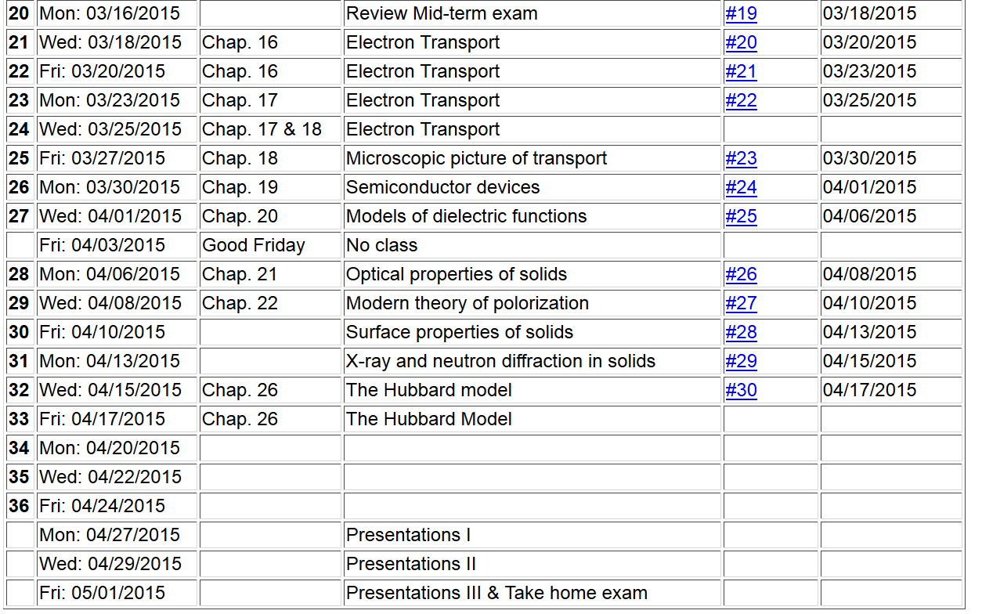

Slide 3
The Hubbard Hamiltonian:
single particle contribution
two particle contribution

Slide 4
l = 1 2 3 4
Possible configurations on a single site

Slide 5
Hubbard model -- continued
t represents electron “hopping” between sites, preserving spin
U represents electron repulsion on a single site

Slide 6
Two-site Hubbard model

Slide 7
Two-site Hubbard model

Slide 8
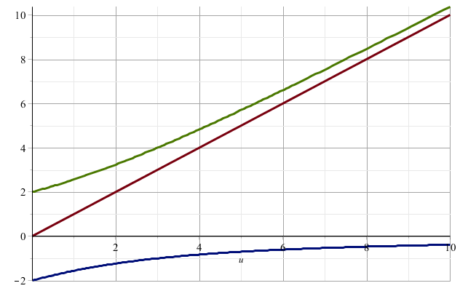
Eigenvalues of the Hubbard model
E₃
E₂
E₁

Slide 9
Two-site Hubbard model
Ground state of the two-site Hubbard model
Single particle limit (U →0)

Slide 10
Two-site Hubbard model
Single particle limit (U →0)
Full spectrum for spin 0 eigenstates
Single particle picture:
+t
E₁
E₂
E₃
-t

Slide 11
Two-site Hubbard model -- Hartree-Fock approximation

Slide 12
Two-site Hubbard model -- Hartree-Fock approximation
Variational search for lower energy solutions

Slide 13
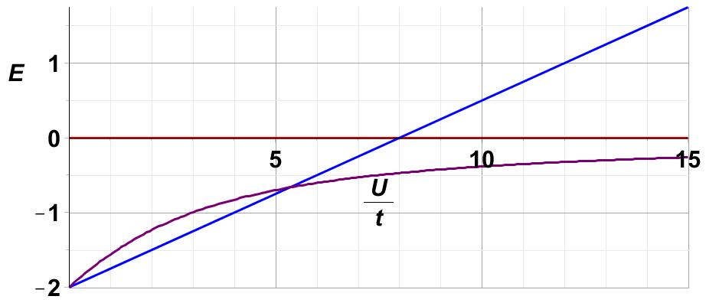
Ground state energy for 2-site Hubbard model
Hartree Fock
high spin
exact

Slide 14
Two-site Hubbard model -- continued
Ground state of the two-site Hubbard model
Isolated particle limit (t →0)

Slide 15
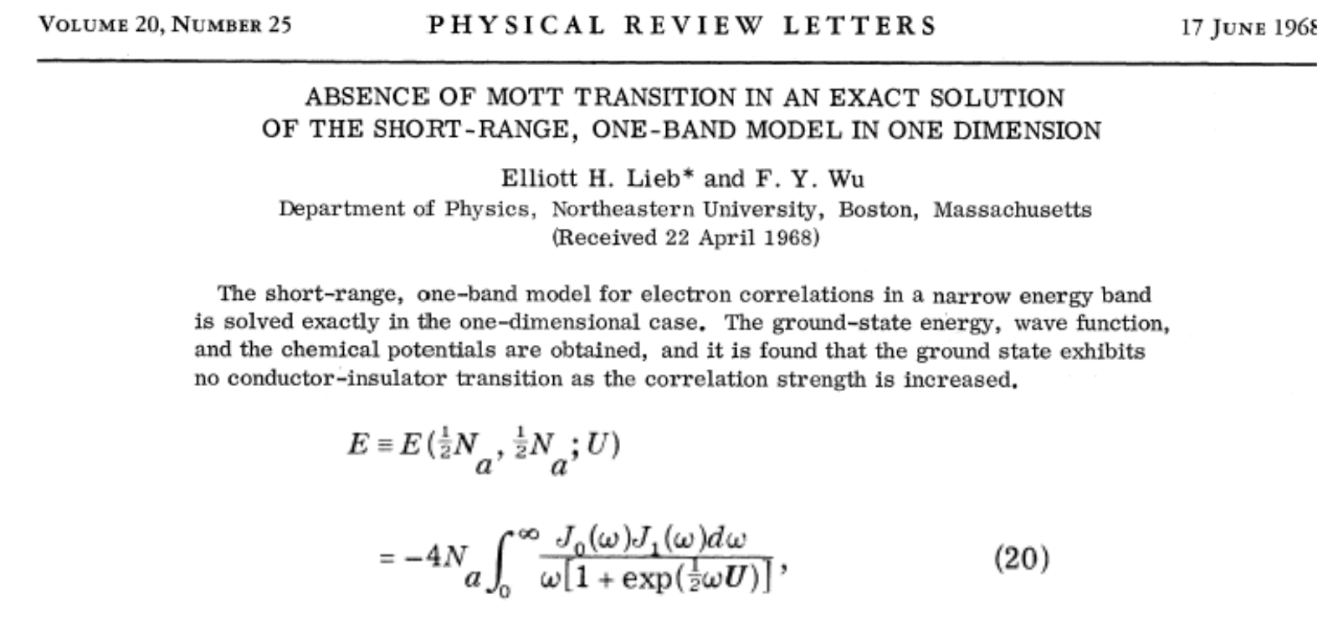
One-dimensional Hubbard chain

Slide 16
Approximate solutions in terms of single particle states; “broken symmetry” Hartree-Fock type solutions

Slide 17
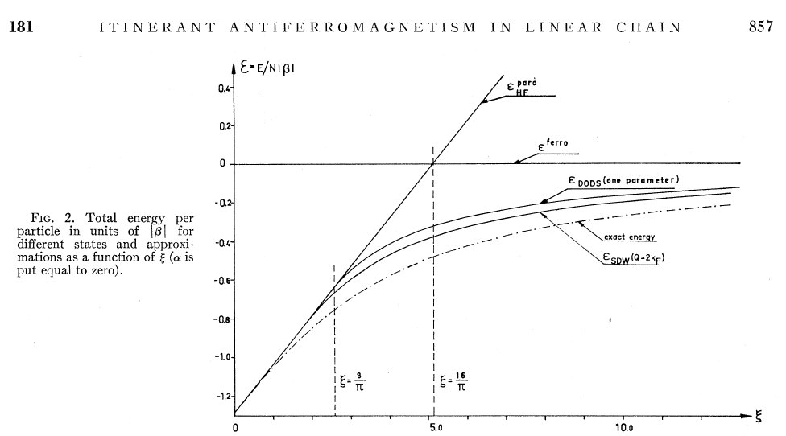

Slide 18
In the following slides, u represents U/t:

Slide 19
ε_{k} = -2 cos(ka)
ε_{k}
k
−π/a
-k_{F}
k_{F}
π/a

Slide 24
Antiferromagnetic form:
a
(x cos θ_{k})
For spin
(x sin θ_{k})
(x cos θ_{k})
For spin ↓
(x sin θ_{k})

Slide 26
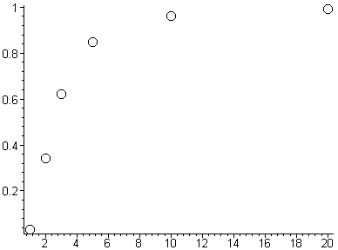
Solutions to AHF equation
for spin magnetization m as a function of u
m
u

Slide 28
SDW form:
a
For spin
(x cos θ_{k})
For spin ↓
(x sin θ_{k})

Slide 33
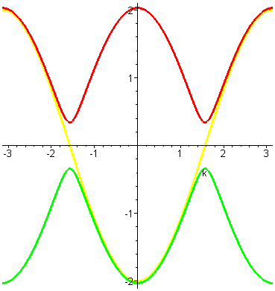
Single partical spectra

