Slide 1
PHY 752 Solid State Physics
11-11:50 AM MWF Olin 107
Plan for Lecture 34:
The Hubbard model
Linear chain
Hartree-Fock approximation
“Broken symmetry” solutions
LDA+U methods

Slide 2
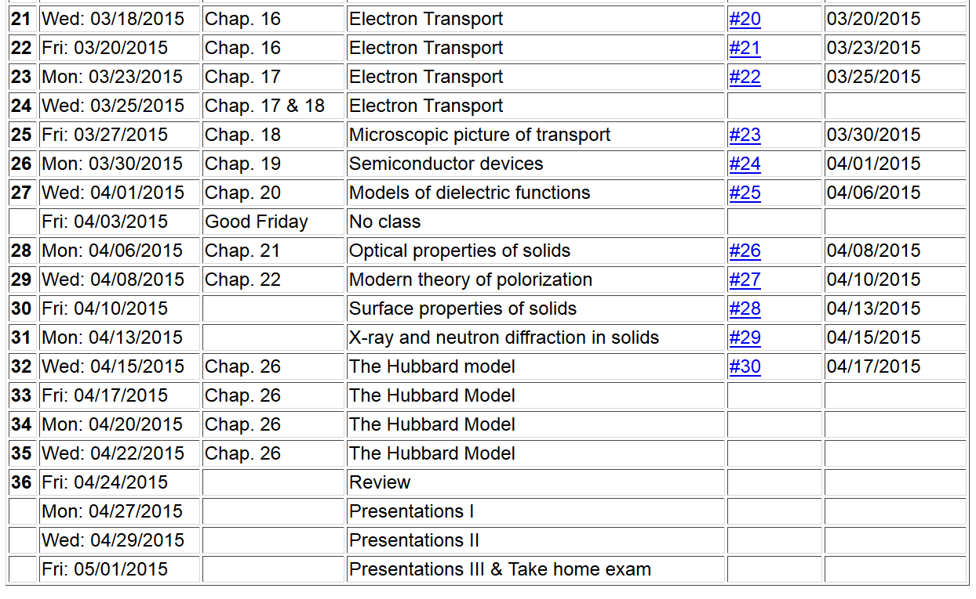

Slide 3
In the following slides, u represents U/t:

Slide 4
ε_{k} = -2 cos(ka)
ε_{k}
k
−π/a
-k_{F}
k_{F}
π/a

Slide 5
In the k-basis, the Hubbard model takes the form:

Slide 6
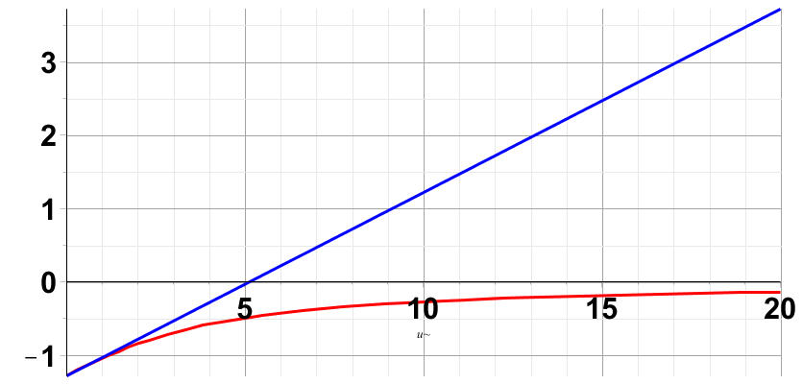
note that k_{F}=π/(2a)
Hartree-Fock
Exact

Slide 7
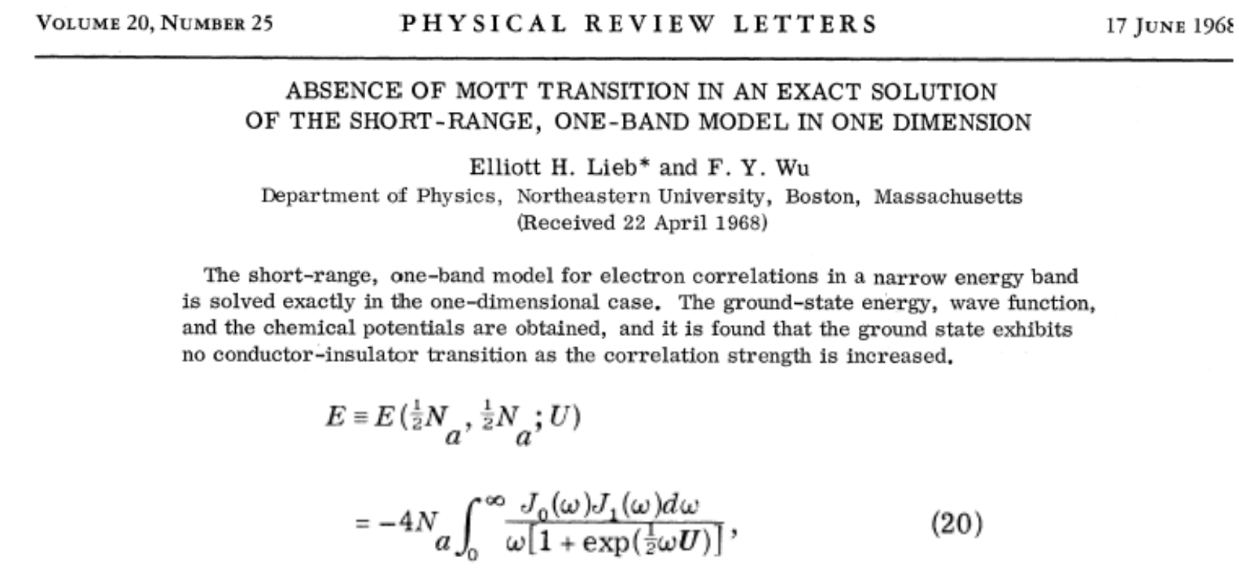
One-dimensional Hubbard chain

Slide 8
Approximate solutions in terms of single particle states; “broken symmetry” Hartree-Fock type solutions

Slide 9
Broken symmetry Hartree-Fock solution
m=0
m=1

Slide 11
Spin density wave solution -- continued

Slide 12
Spin density wave solution -- continued

Slide 13
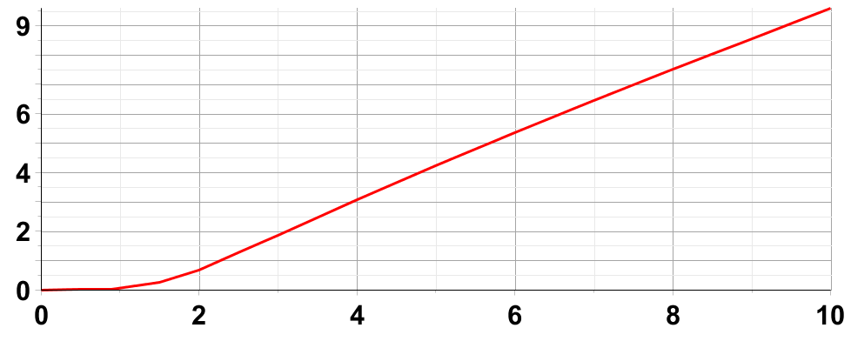
Spin density wave solution -- continued
Δ
u

Slide 14
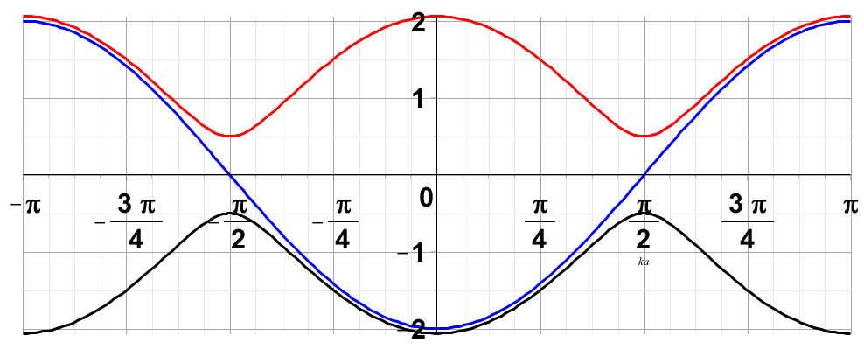
Spin density wave solution -- continued
Effects on single particle states

Slide 15
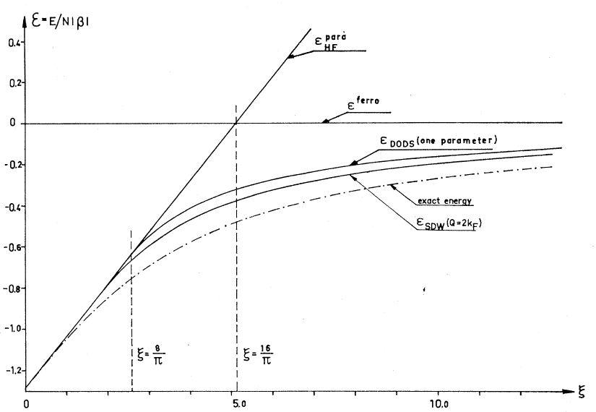
Spin density wave solution -- continued

Slide 16
SDW form:
a
For spin ↑
(x cos θ_{k})
For spin ↓
(x sin θ_{k})

