Slide 1
PHY 752 Solid State Physics
11-11:50 AM MWF Olin 107
Plan for Lecture 35:
The Hubbard model
LDA+U methods

Slide 2
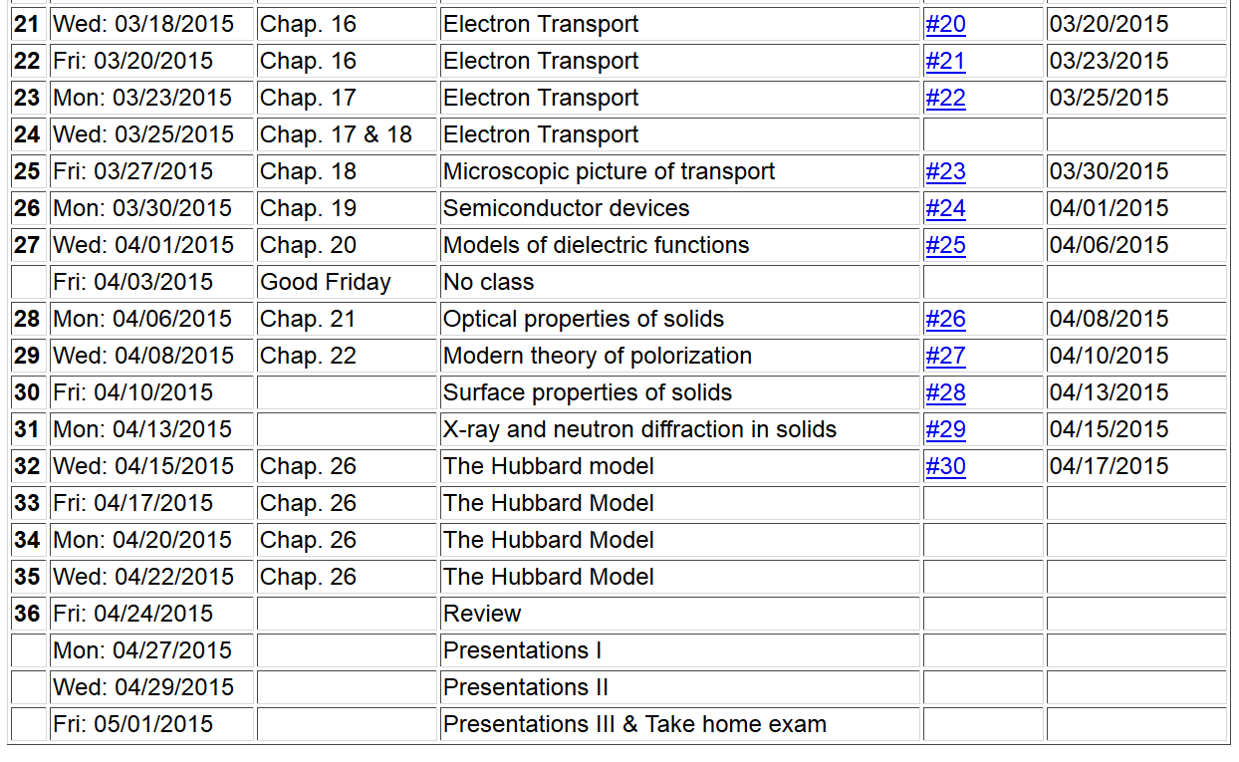

Slide 6
Motivation for the LDA+U approach

Slide 8
Details of the self-interaction problem
Hartree-Fock formalism removes self-interaction error
LDA+U approximately removes self-interaction error and can possibly add some additional physics

Slide 9
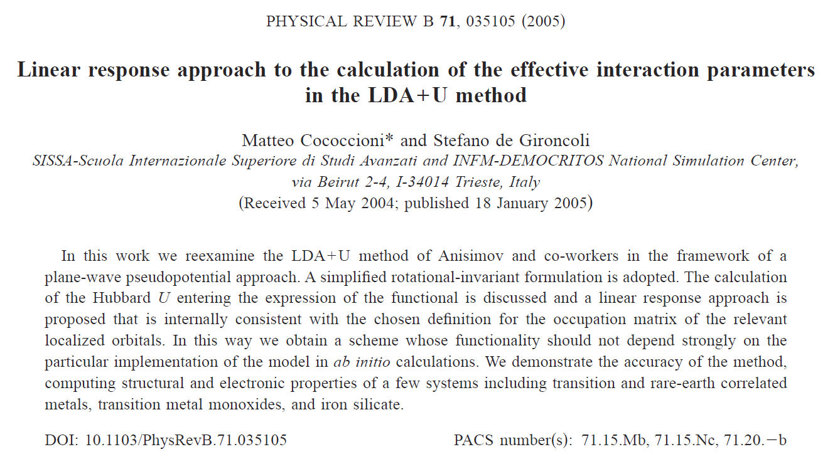

Slide 10
Total energy expression for LDA+U used by Cococcioni and de Gironcoli for all atomic sites I:
Coulomb and exchange interactions on atomic sites corrected for “double counting”
In principle the atomic site contributions could be calculated using atomic basis functions. Alternatively they can be introduced as model parameters or determined consistently from the modified equations.

Slide 11
LDA+U – continued
Approach is particularly important for describing d and f electrons where spin and orbital degeneracies also appear. Cococcioni and de Gironcoli use dominating spherically symmetric contribution and allow site occupancies n_{I} to vary consistently.

Slide 12
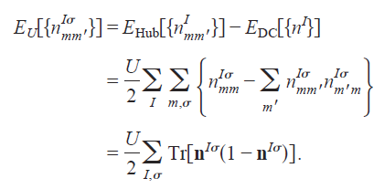
Simplified LDA+U Hamiltonian
Atomic site occupations n^{Iσ} depend on choice of basis functions, but net result should be robust.
Behavior of energy with expectation value.

Slide 13
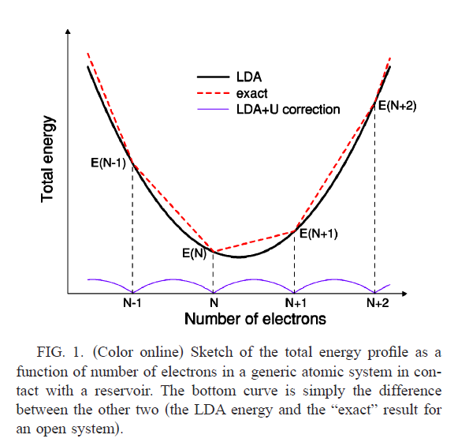
Needed correction to be provided by U term.

Slide 14
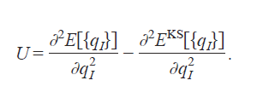
Cococcioni and de Girancoli proposal for calculating U:

Slide 15
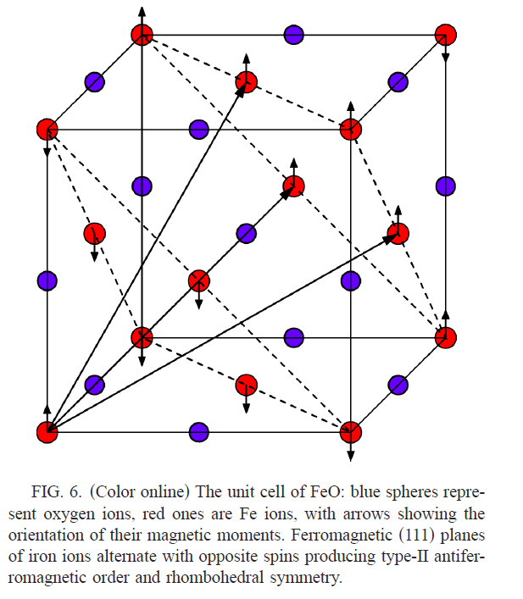
Cococioni & de Gironcoli
Example for FeO

Slide 16
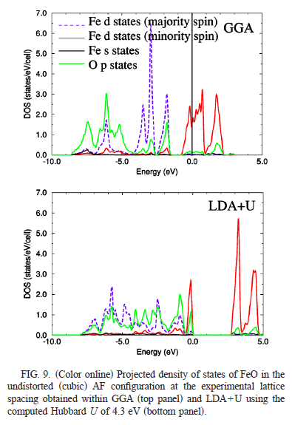
Cococioni & de Gironcoli

Slide 17
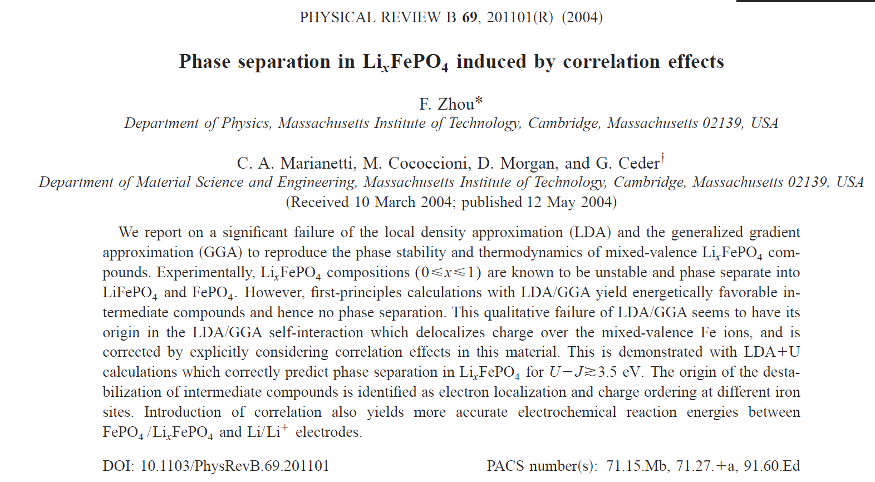
Application of LDA+U to phase stability of Li_{x}FeO₄

Slide 18
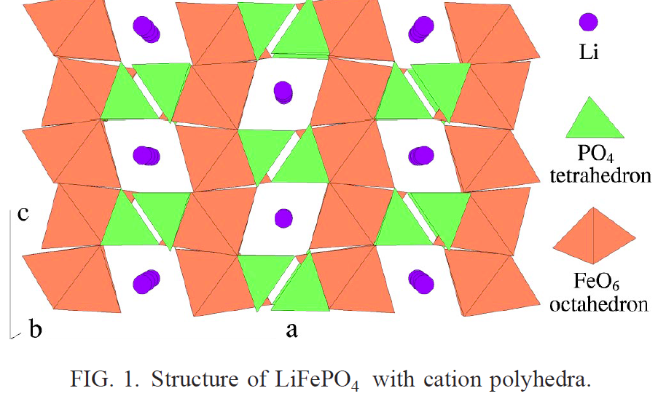
Experimentally, Li_{0.5}FePO₄ is unstable wrt to FePO₄ and LiFePO₄.

Slide 19
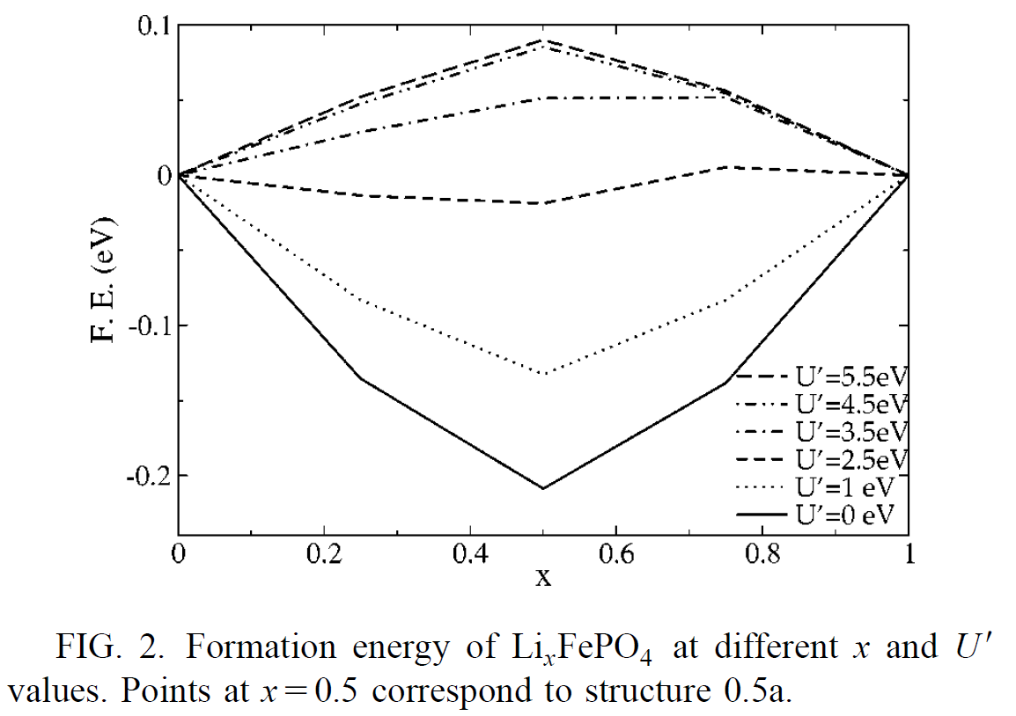
Simplified LDA+U

