Slide 1
PHY 752 Solid State Physics
11-11:50 AM MWF Olin 107
Plan for Lecture 36:
        Review
          Comment on Kramers-Kronig transforms
          Some equations worth knowing
          Course assessment forms

Slide 2
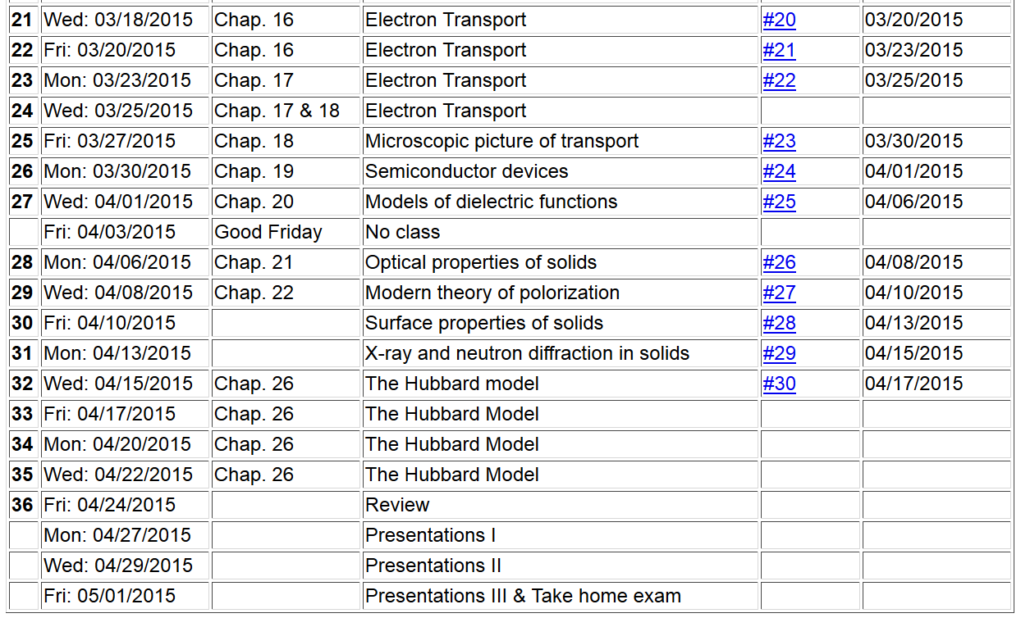

Slide 3
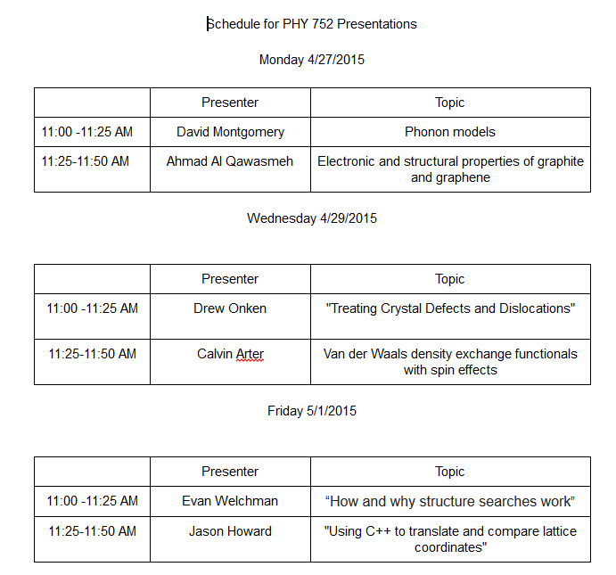

Slide 4
Review topic – analytic properties of dielectric function
Kramers-Kronig transform – for dielectric function:

Slide 5
Practical evaluation of Kramers-Kronig relation

Slide 6
Practical evaluation of Kramers-Kronig relation

Slide 7
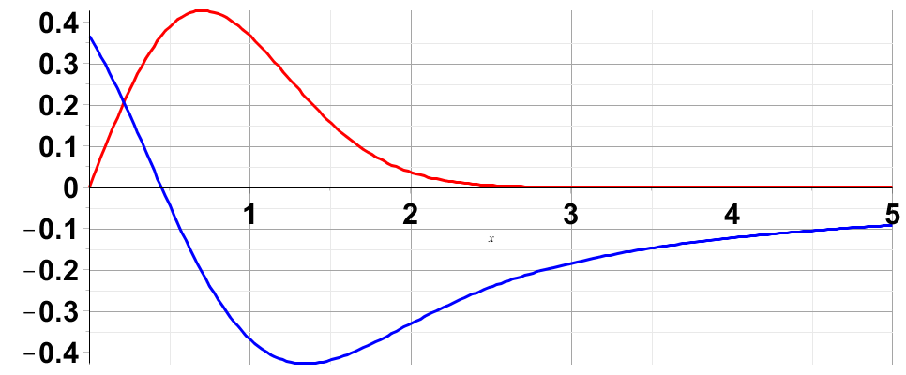
Evaluation of singular integral numerically:

Slide 8
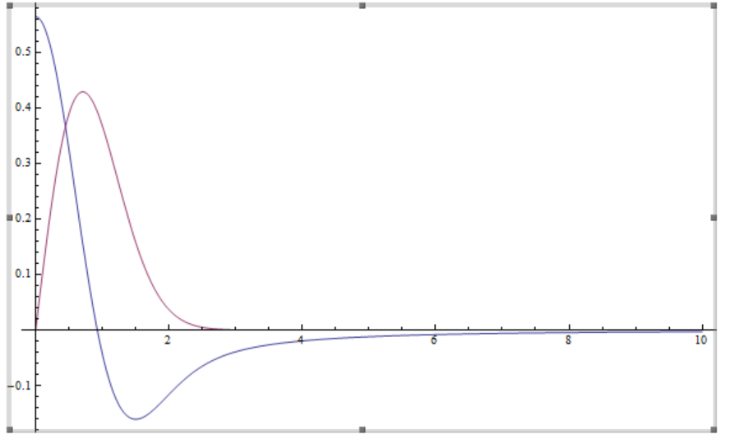
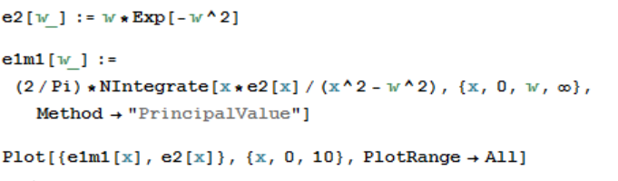
Evaluation of Kramer’s Kronig transform using Mathematica (with help from Professor Cook)

Slide 9
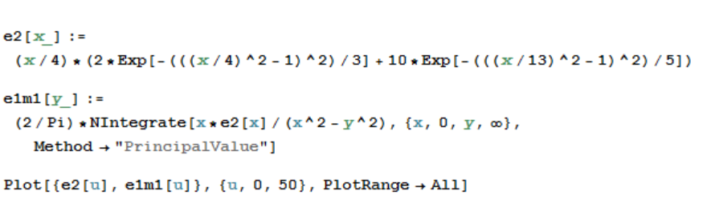
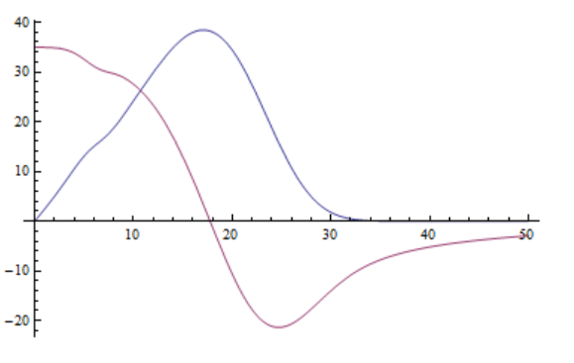
Another example

Slide 10
Some equations worth remembering --

Slide 11
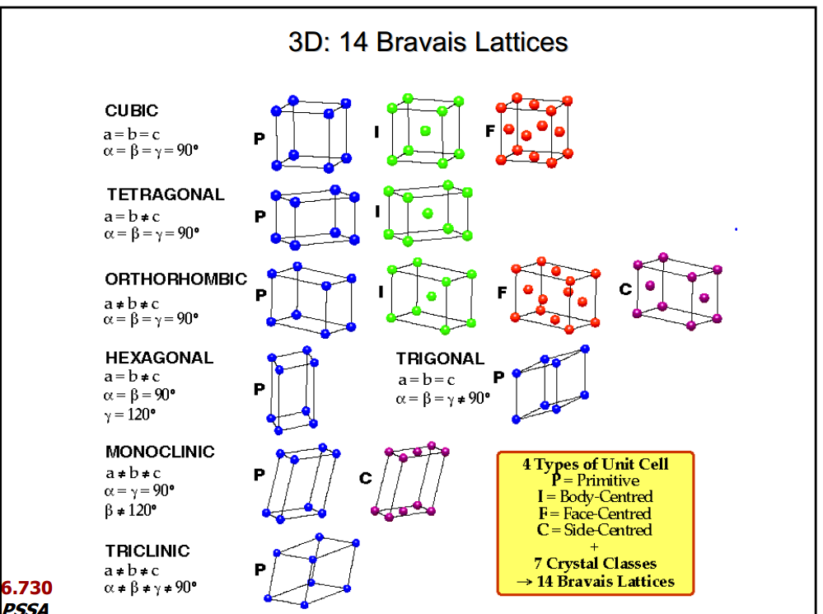

Slide 12
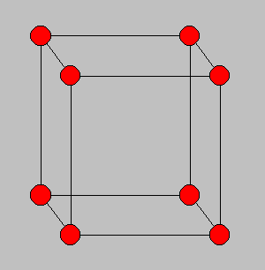
Bravais lattice vectors:
a₃
a₁
a₂
Distance between diffracting planes

Slide 13
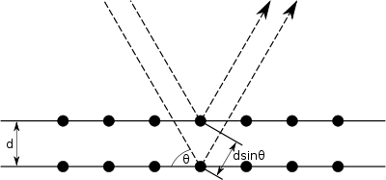
Bragg diffraction
incident beam
defracted beam
k_{scat}
In terms of wave vectors
k_{inc}
Δk
2θ

Slide 14
Single particle wavefunction in a periodic system
periodic function
Eigenfunctions of the periodic Hamiltonian are Bloch states with eigenvalues E_{nk} and
Wannier representation of electronic states -- continued
Comment: Wannier functions are not unique since the the Bloch function may be multiplied by a k-dependent phase, which may generate a different function W_{n}(r-T).

Slide 15
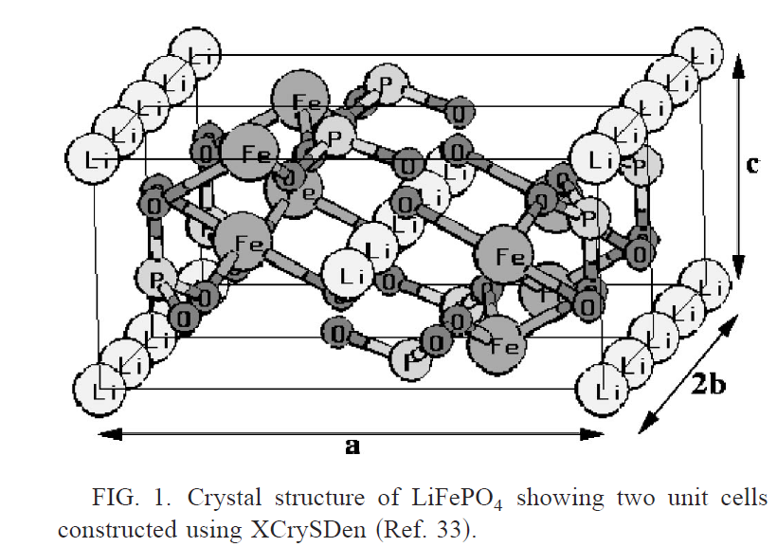
Understanding band structures
--- Example of LiFePO₄ and FePO₄
Electronic structures of FePO₄, LiFePO₄, and related materials
  Ping Tang and N. A. W. Holzwarth -- Phys. Rev. B 68, 165107 (2003)

Slide 16
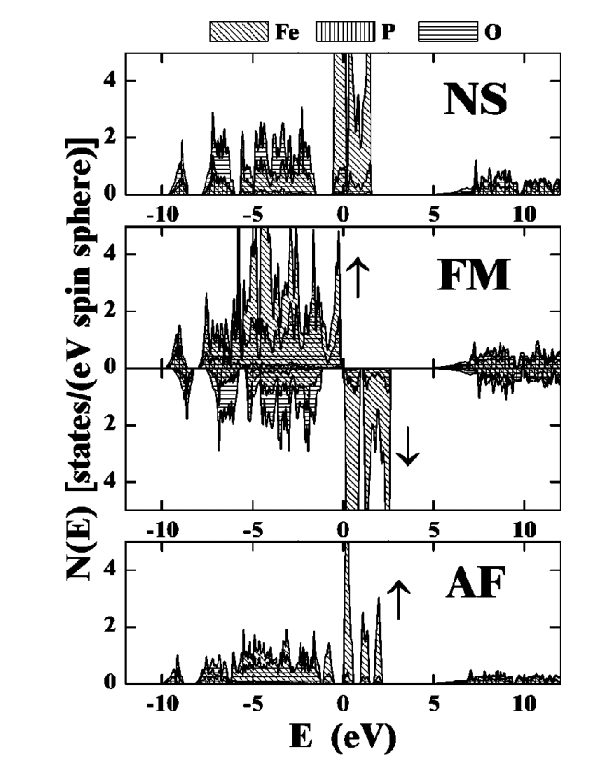
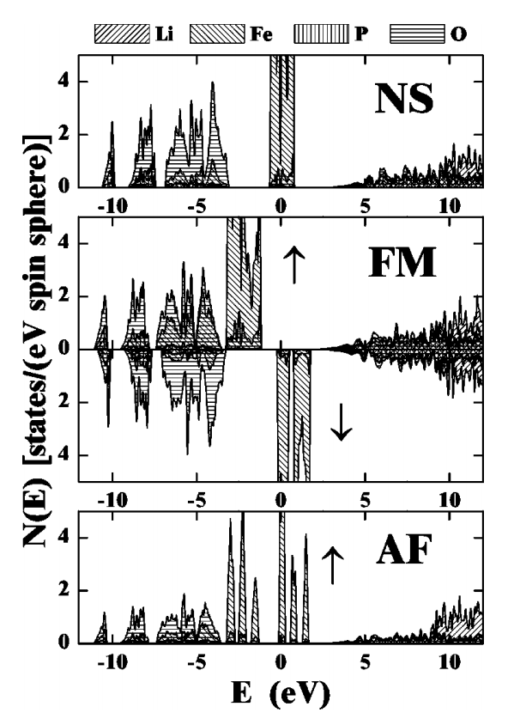
Partial densities of states
FePO₄
LiFePO₄

Slide 17
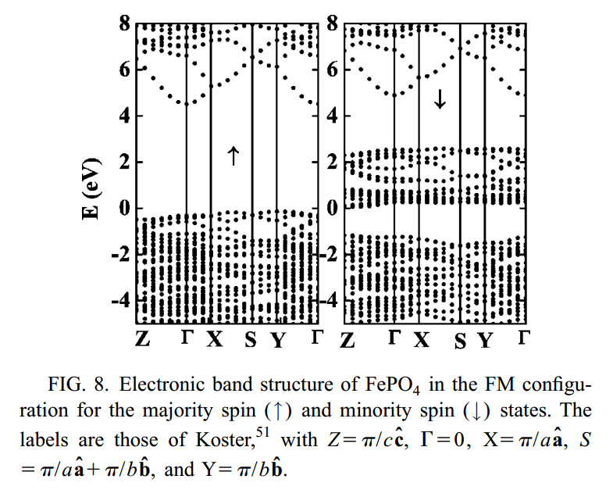

Slide 18
