Slide 1
PHY 752 Solid State Physics
11-11:50 AM MWF Olin 107
Plan for Lecture 4:
Reading: Chapter 1 & 2 in MPM;
Continued brief introduction to group theory
The “great” orthogonality theorem
Character tables
Examples

Slide 2
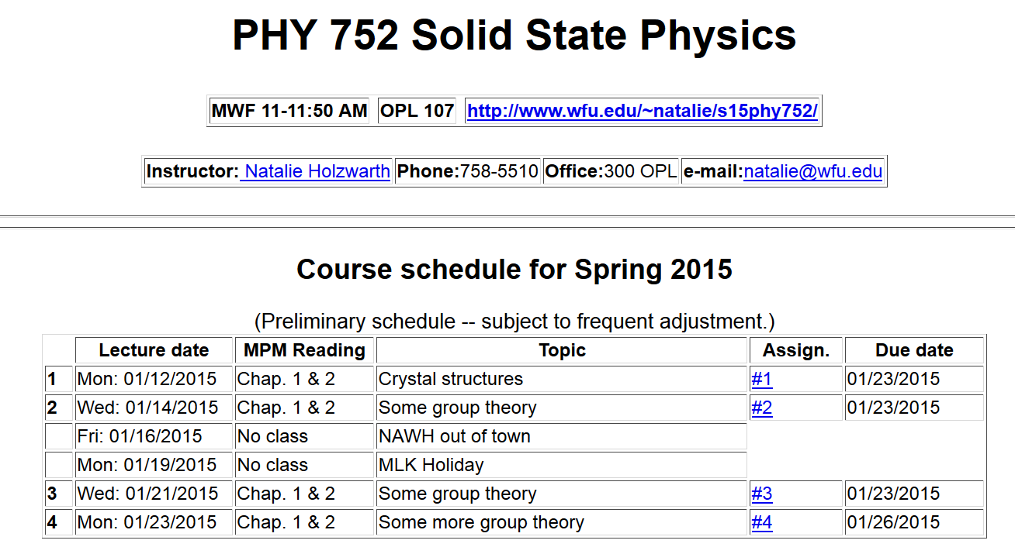

Slide 3
Results from last time --
The great orthogonality theorem

Slide 4
Results from last time -- continued
Character orthogonality theorem:

Slide 5
Example:

Slide 6
Character table for this group:
 | E | A,B,C | D,F
χ¹ | 1 | 1 | 1
χ² | 1 | -1 | 1
χ³ | 2 | 0 | -1
Use of character table for analyzing matrix elements:

Slide 7
Matrix element example -- continued
Initial
state
Operator
Final
state

Slide 8
Matrix element example -- continued
 | E | A,B,C | D,F
χ¹ | 1 | 1 | 1
χ² | 1 | -1 | 1
χ³ | 2 | 0 | -1

Slide 9
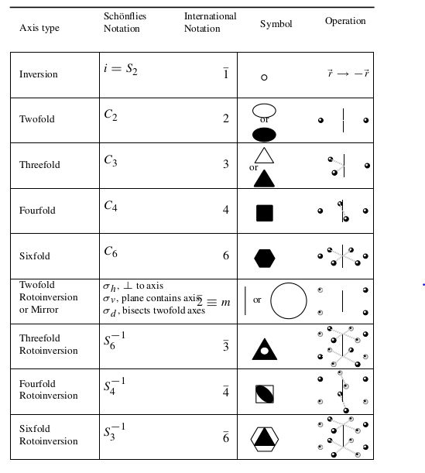
Some crystal symmetries

Slide 10
Some crystal symmetries -- cubic symmetry
Point groups -- 32 in all
Space groups (point groups + translations) – 230 in all

Slide 11
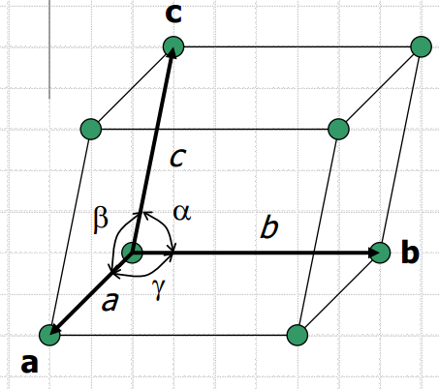
Bravais lattice ⬅➔ Reciprocal lattice

Slide 12
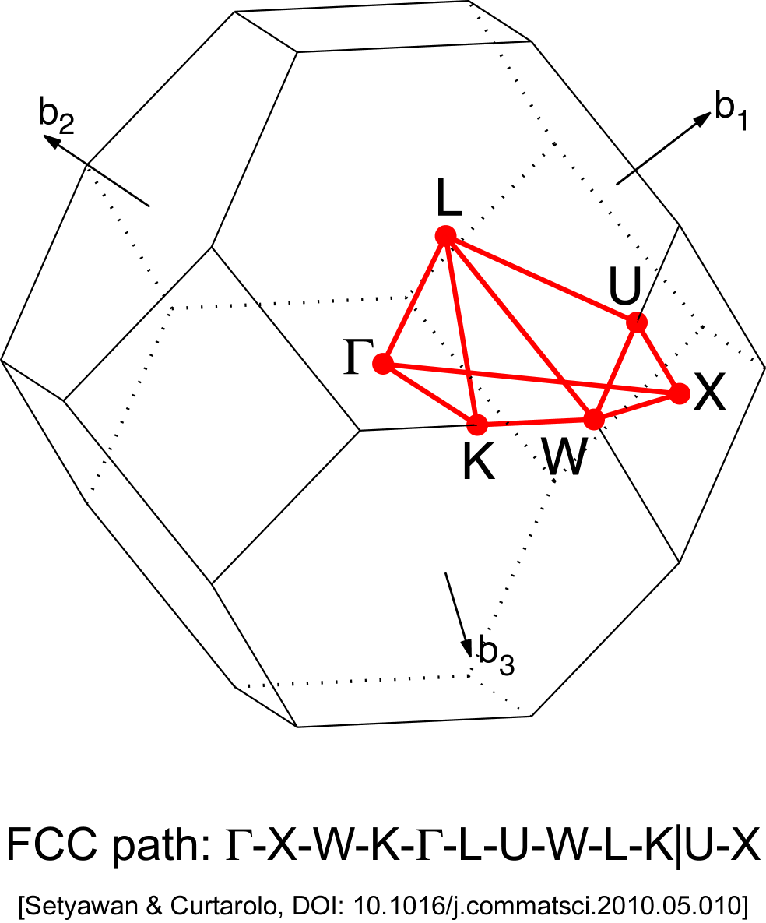
Symmetry associated with wavevector k
Wigner-Seitz cell of the reciprocal lattice exhibits the symmetry of the wavevectors k
Brillouin zone for fcc lattice

Slide 13
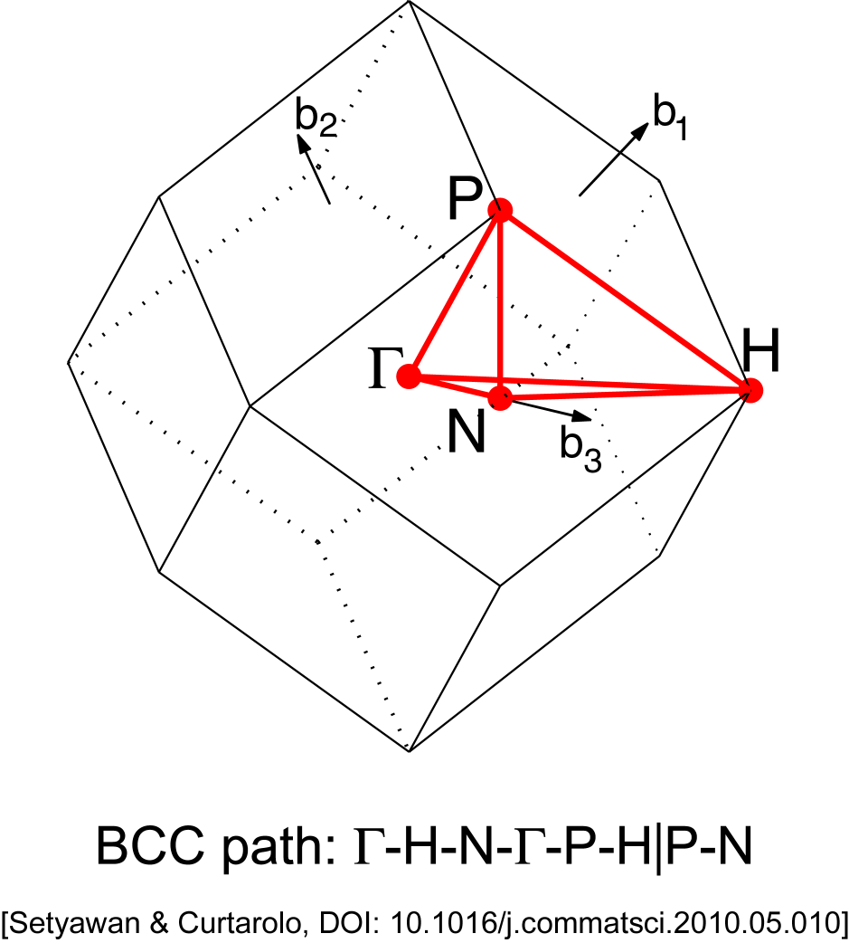

Slide 14
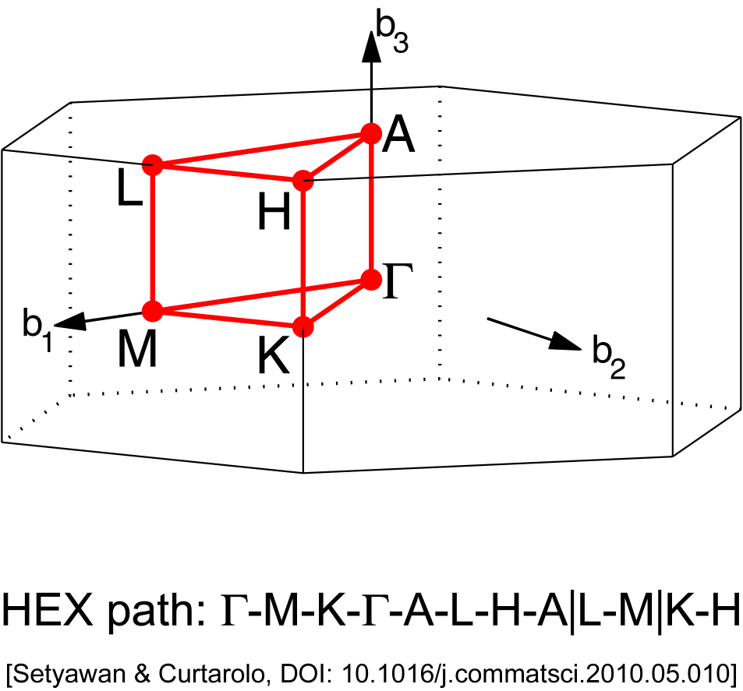
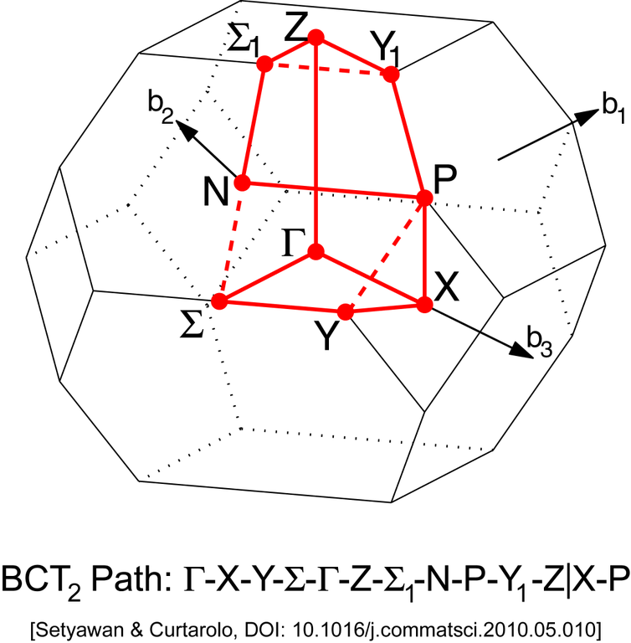

Slide 15
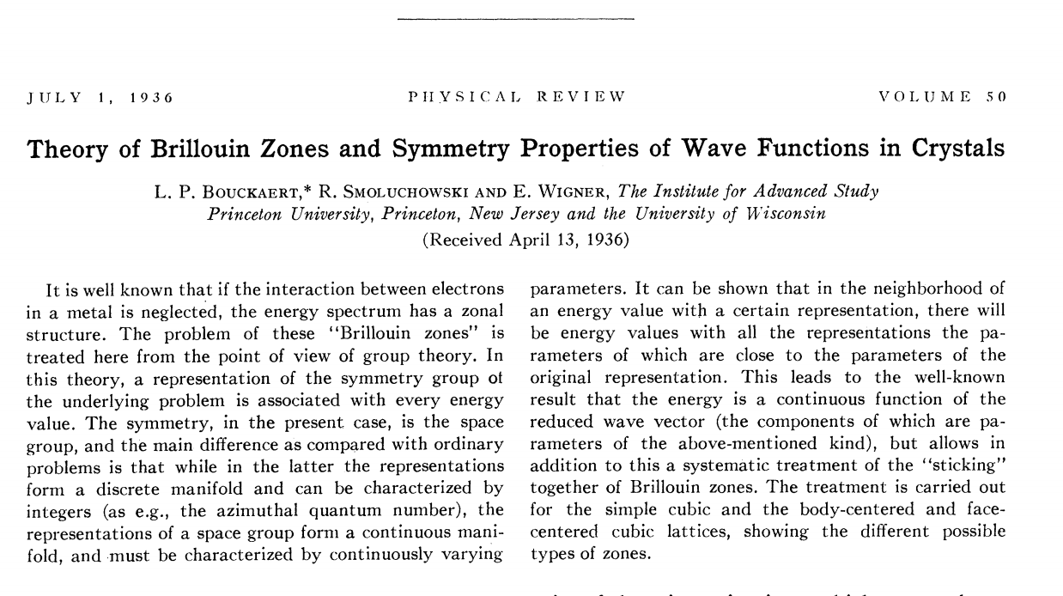

Slide 16
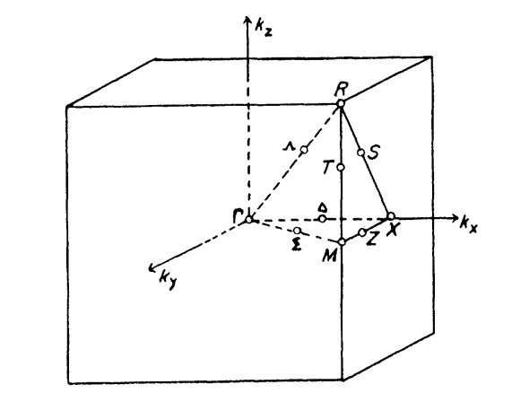
Brillouin zone for simple cubic lattice

Slide 17
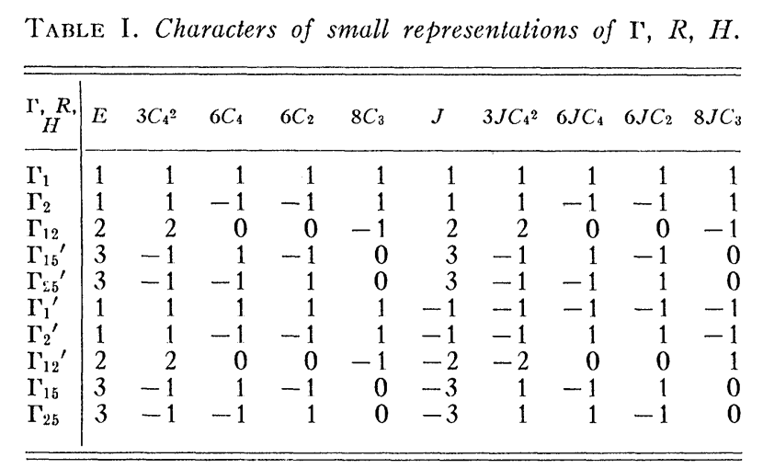
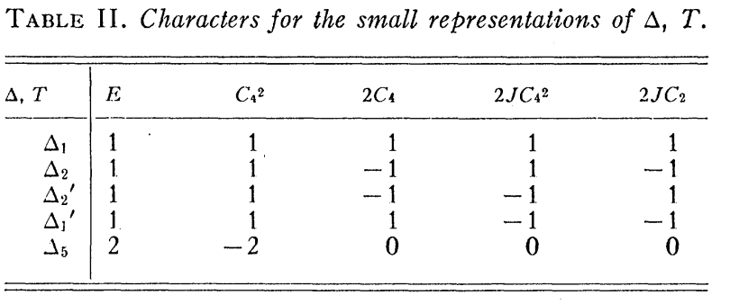

Slide 18
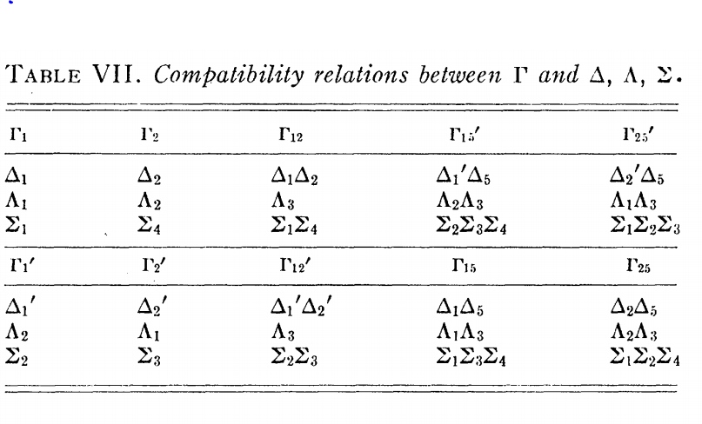

Slide 19
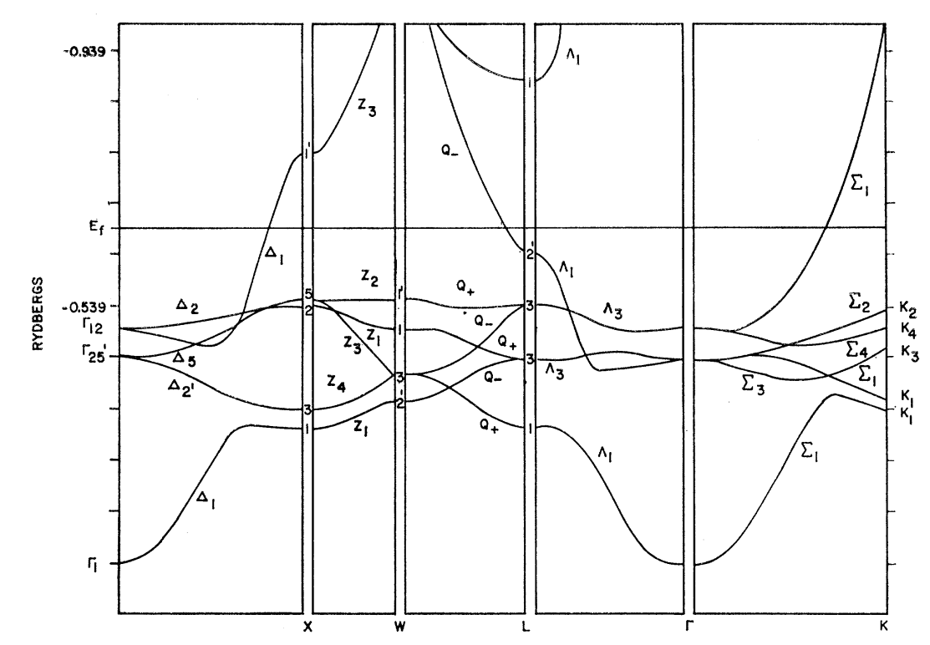
Band structure diagram for fcc Cu (Burdick, PR 129 138-159 (1963))

