Slide 1
PHY 752 Solid State Physics
11-11:50 AM MWF Olin 107
Plan for Lecture 6:
Reading: Chapter 6 in MPM; Electronic Structure
Independent electron models
Free electron gas
Densities of states
Statistical mechanics of non-interacting electrons

Slide 3
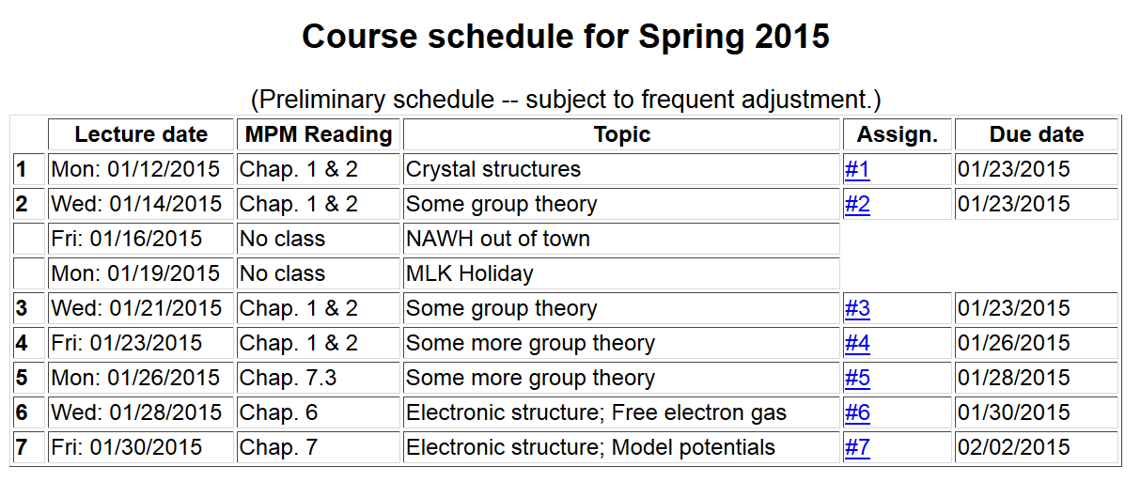

Slide 4
Quantum Theory of materials
Electronic coordinates
Atomic coordinates
Born-Oppenheimer approximation
Born & Huang, Dynamical Theory of Crystal Lattices, Oxford (1954)

Slide 5
Quantum Theory of materials -- continued
(Often treated classically)
Effective nuclear interaction provided by electrons

Slide 6
Terms neglected in Born-Oppenheimer approximation

Slide 7
First consider electronic Hamiltonian
Replace by “jellium”
Independent electron contributions

Slide 8
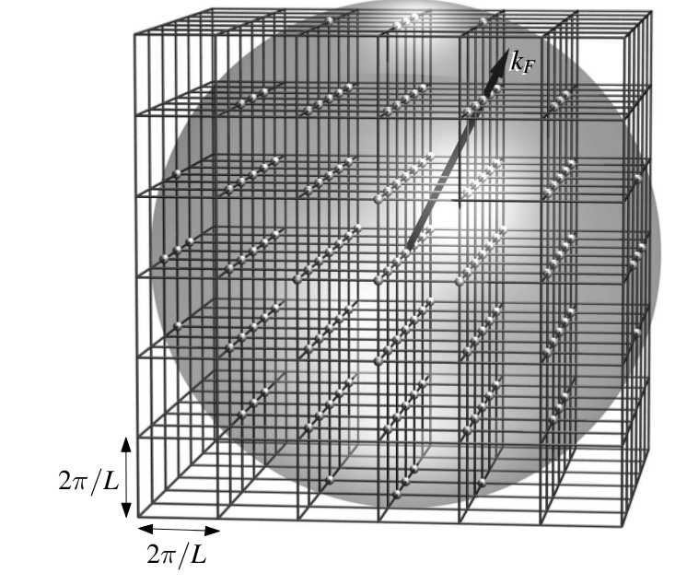
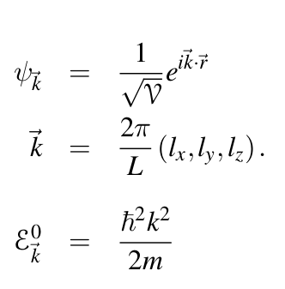
Treatment of each electron (Fermi particle) in the jellium model
Note: This and following slides taken from Marder’s text

Slide 9
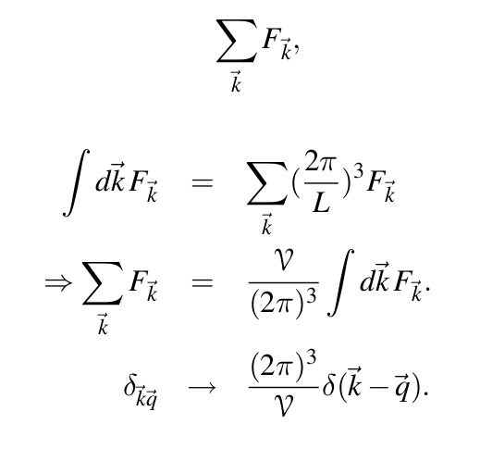
Enumerating the independent electron states by summing over k:

Slide 10
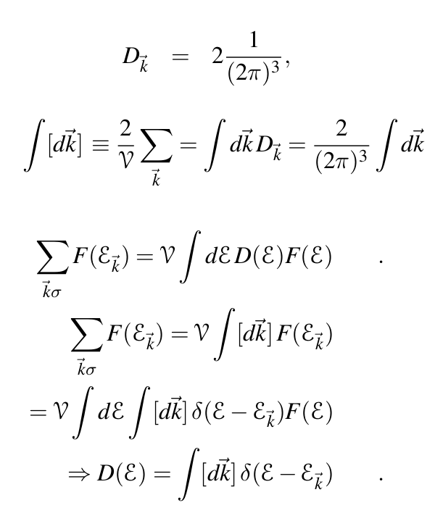
Enumerating the independent electron states by summing over k – continued:
Note: Each spatial state has a spin degeneracy of 2.

Slide 11
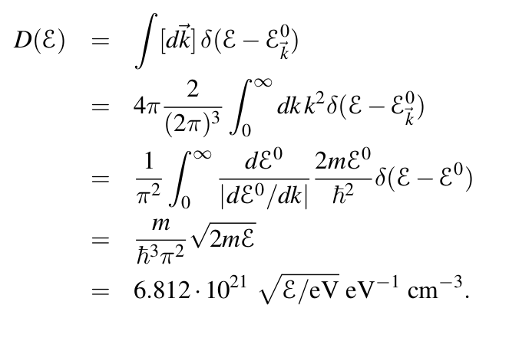
Enumerating the independent electron states by summing over k – continued for :

Slide 12
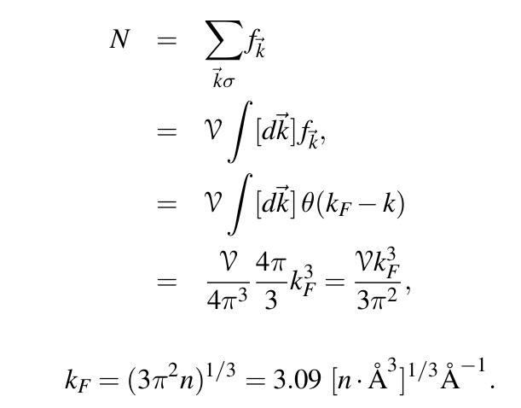
Enumerating the independent electron states by summing over k – continued for :

Slide 13
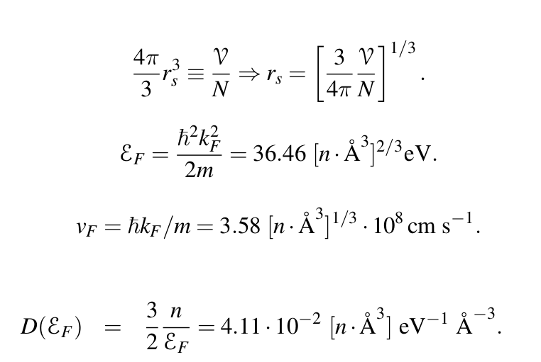
Enumerating the independent electron states by summing over k – continued for :

Slide 14
Note: Previous results are special to a 3-dimensional jellium system where the electronic states are related to the wavevectors according to
For your homework problem, you will consider a 2-dimensional jellium system with two different dispersions: E(k)=Xk² and E(k)=Xk.

Slide 15
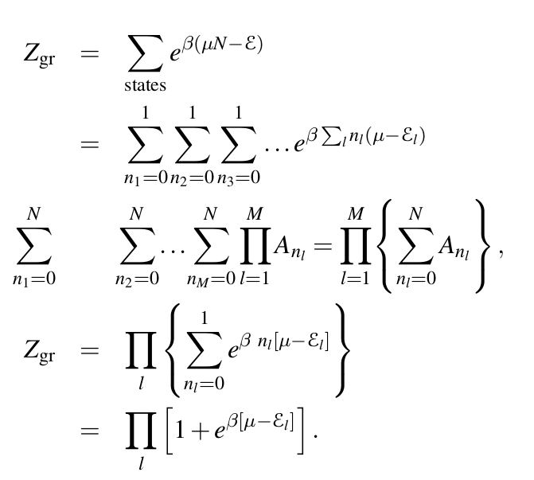
Statistical mechanics of free Fermi gas in terms of
“grand” partition function

Slide 16
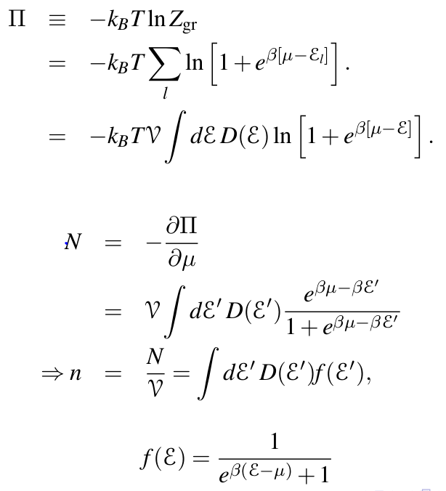
“Grand” potential

Slide 17
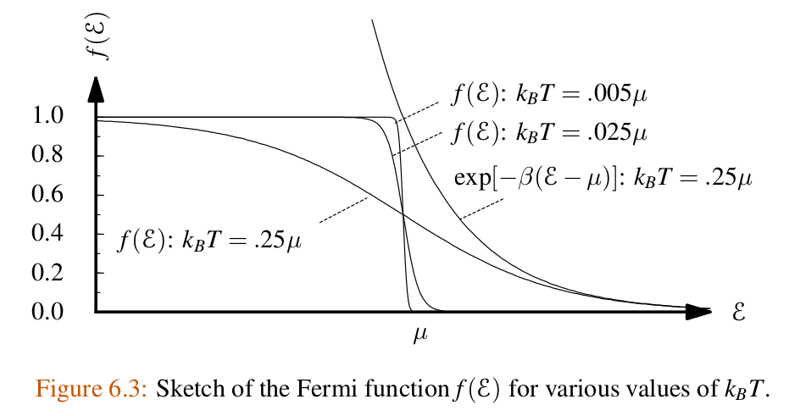

Slide 18
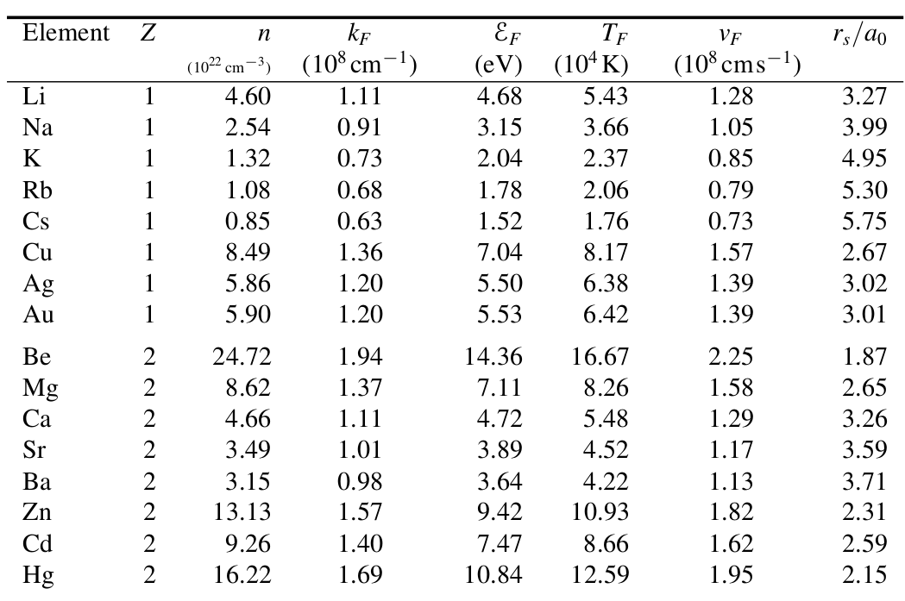

Slide 19
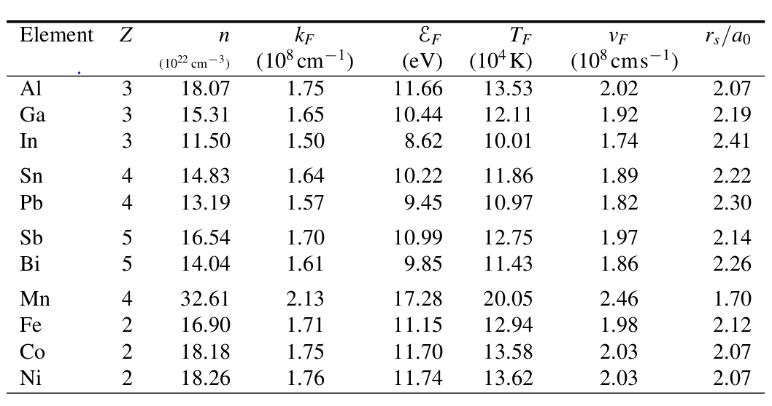
Jellium analysis of some metals

Slide 20
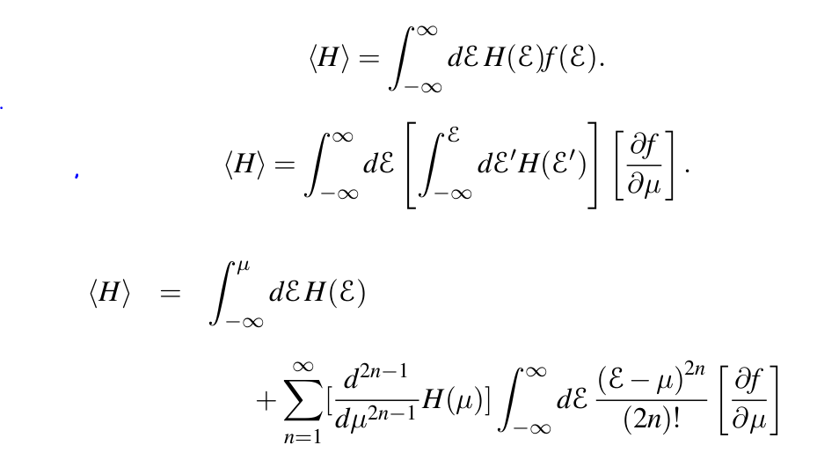
How well does the jellium model work – analysis of electronic contribution to specific heat
First consider the following trick:

Slide 21
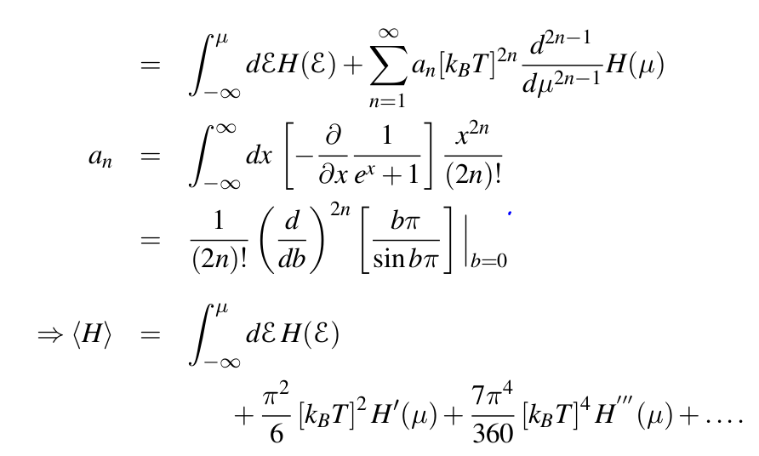

Slide 22
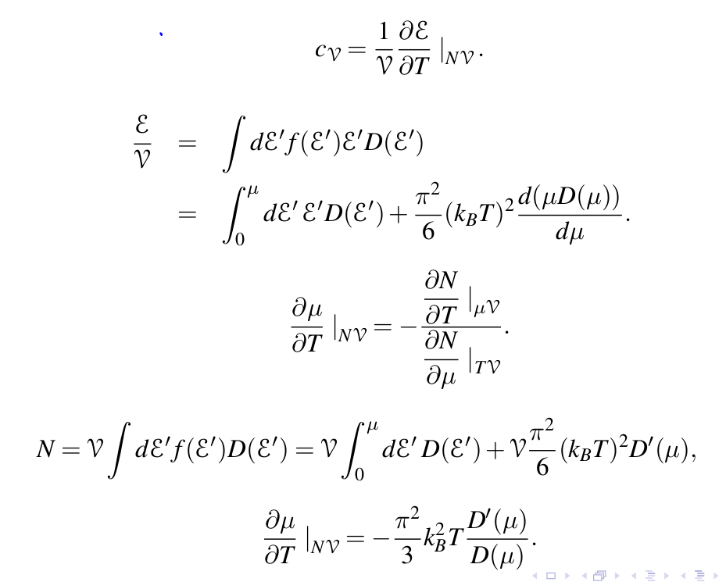

Slide 23
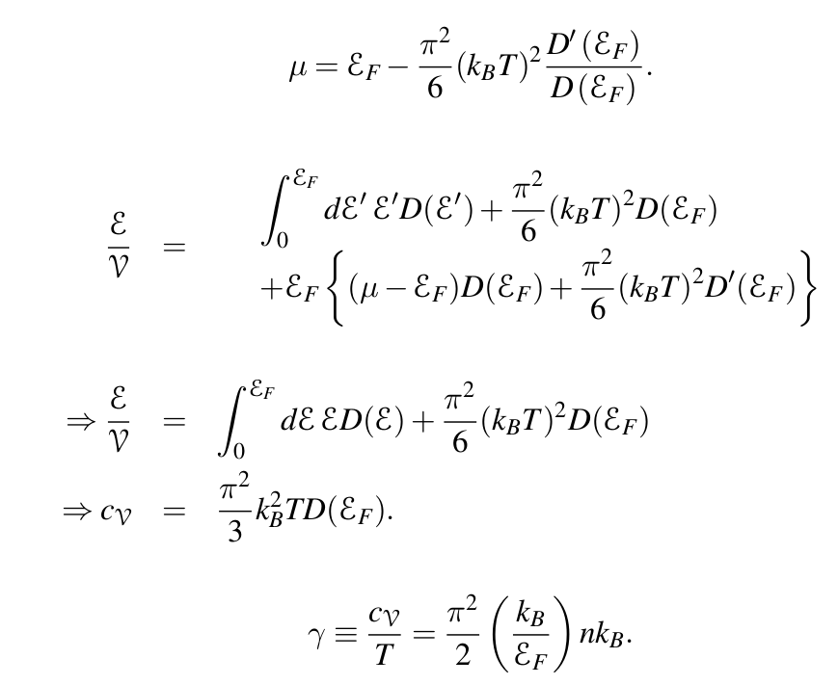

Slide 24
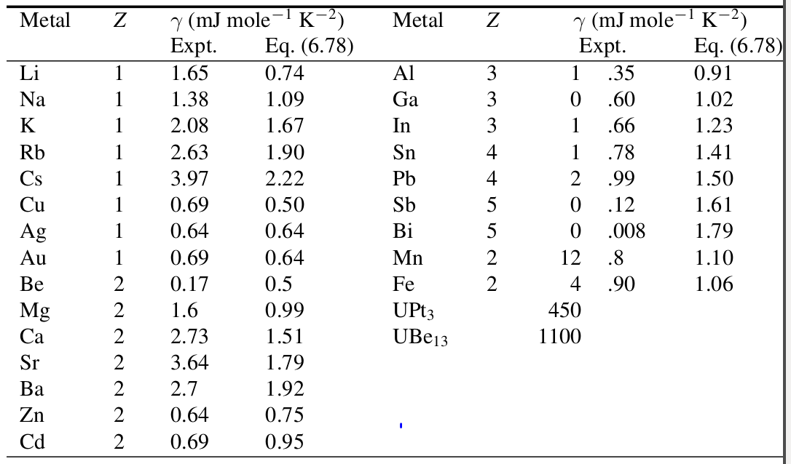
Specific heat table from Marder’s text:

