Slide 1
PHY 752 Solid State Physics
11-11:50 AM MWF Olin 107
Plan for Lecture 7:
Reading: Chapter 7 in MPM; Electronic Structure
Bloch’s Theorem
Eigenstates of a simple model potential

Slide 2
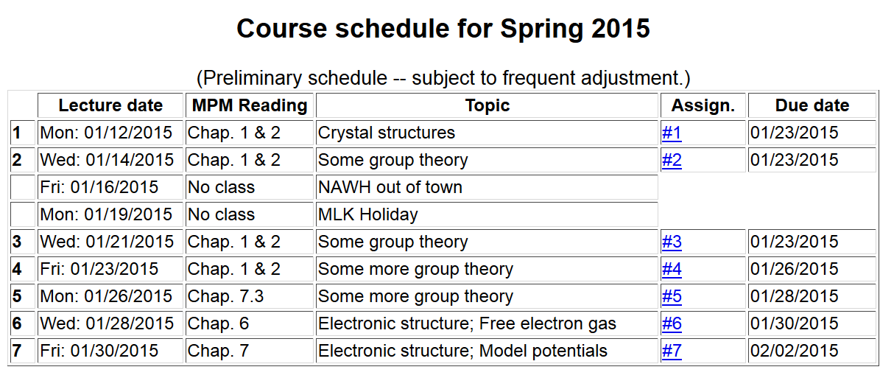

Slide 3
Consider an electron moving in a one-dimensional model potential (Kronig and Penney, Proc. Roy. Soc. (London) 130, 499 (1931)
a
V₀

Slide 4
a
V₀

Slide 5
a
V₀

Slide 6
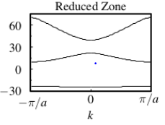
a
V₀
Band gap
E(k)

Slide 7
What causes band gaps in the electronic structure?
Consider a single potential well
Spectrum
E

Slide 8
a
V₀
b

Slide 9
a
V₀
b

Slide 10
a
V₀
b

Slide 11
v
Forbidden states
f
v
Forbidden states

Slide 12
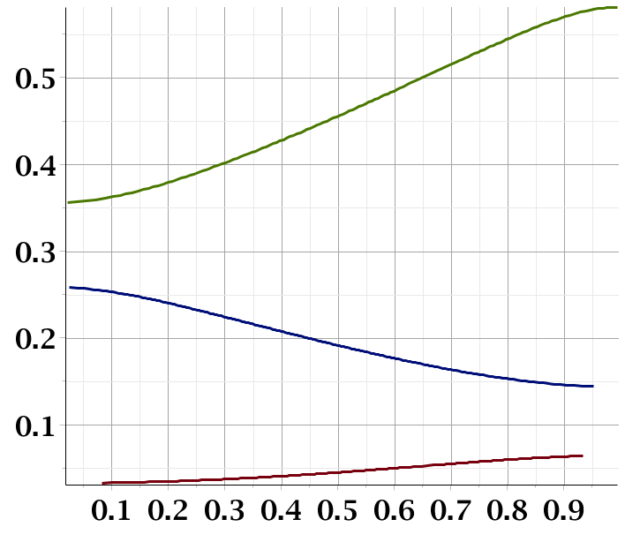
f
Band gap
Band gap
ka

Slide 13
Electrons in the presence of a weak periodic potential
V₀
x

Slide 15
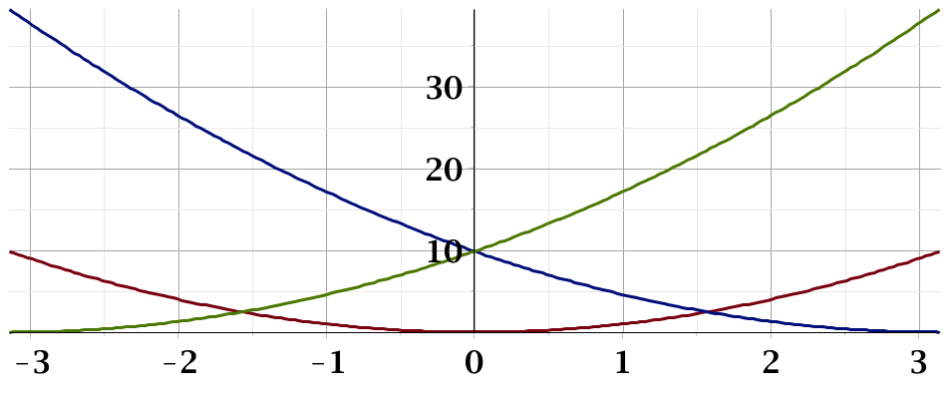
ka

