Slide 1
PHY 752 Solid State Physics
11-11:50 AM MWF Olin 107
Plan for Lecture 8:
Reading: Chapter 8 in MPM; Electronic Structure
Atom
Molecule
Solid
Linear combination of atomic orbital (LCAO) method

Slide 2
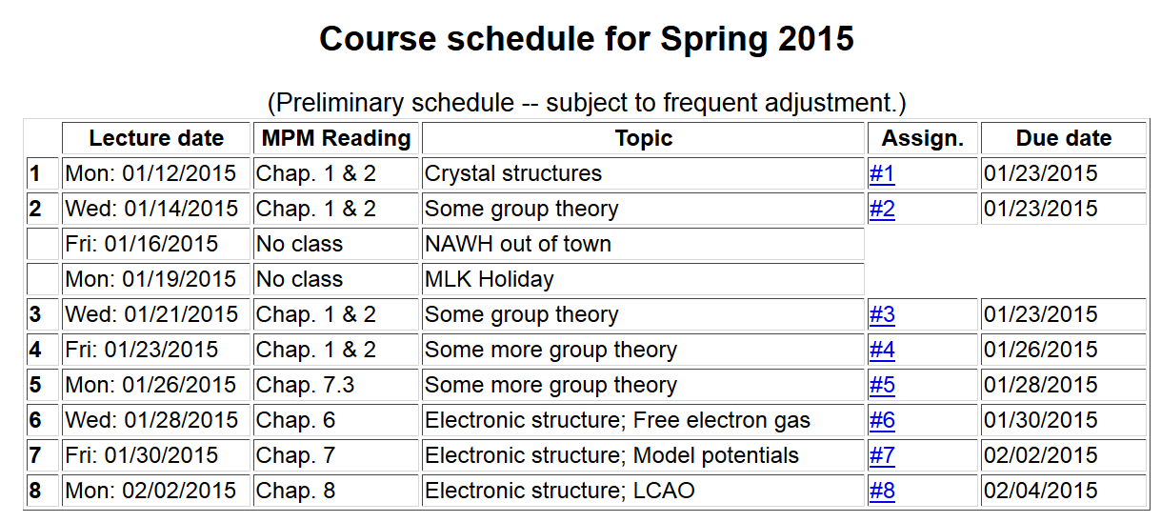

Slide 3
Electronic structure of an atom
For simplicity we will first consider a single electron system; a H-like ion with atomic charge Ze
E₁₀₀=-13. 60569253 Z² eV
a₀ = 0. 52917721092 Å

Slide 5
Electronic structure of H-like molecular ion
(within Born-Oppenheimer approximation)
-e
r_{B}
r_{A}
R_{AB}
Z_{A}e
Z_{B}e

Slide 6
Electronic structure of H-like molecular ion – continued
Ref. Pauling and Wilson, Introduction to Quantum Mechanics (1935) (now published by Dover)

Slide 7
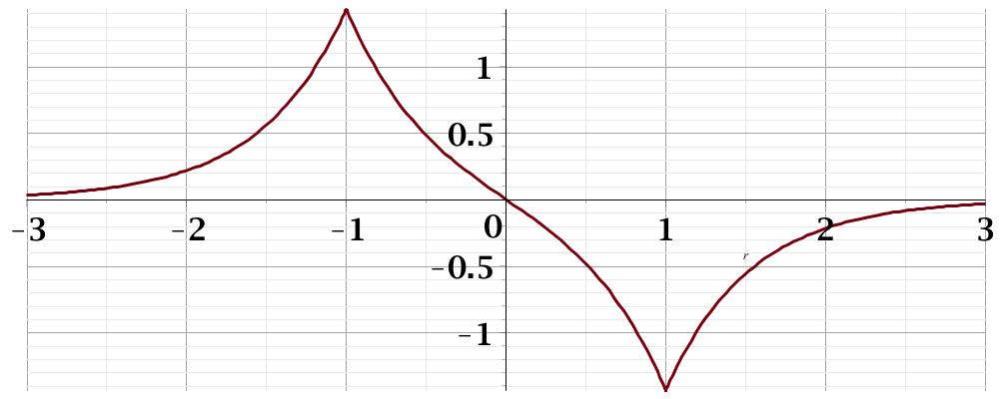
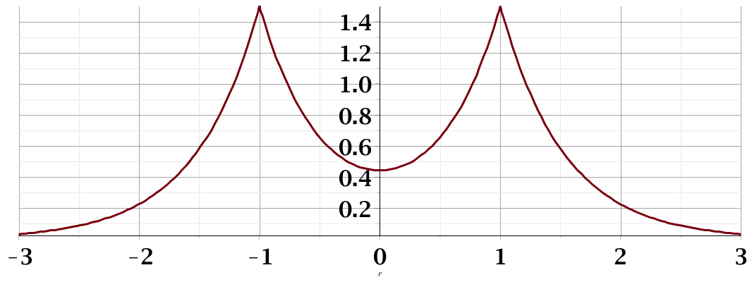
Electronic structure of H-like molecular ion – continued
E₋
Ψ₋
H_{AA}
H_{BB}
E₊
Ψ₊

Slide 8
Extension of approximate “linear combination of atomic orbital” idea to larger systems
N=2
N=3
N=4
4β
…………….

Slide 9
Extension of approximate “linear combination of atomic orbital” idea to larger systems – some details

Slide 10
Extension of approximate “linear combination of atomic orbital” idea to larger systems – more details

Slide 11
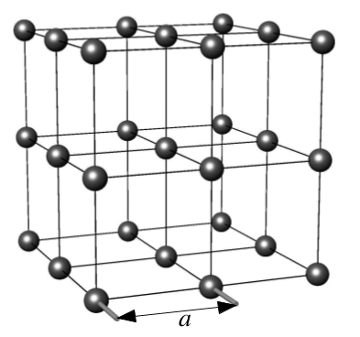
Extension of approximate “linear combination of atomic orbital” idea to larger systems – simple cubic lattice

Slide 12
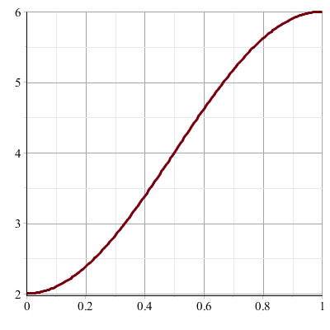
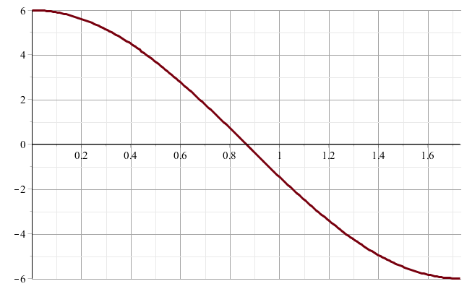
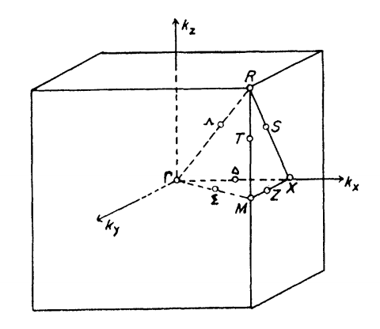
R
X
Γ

Slide 13
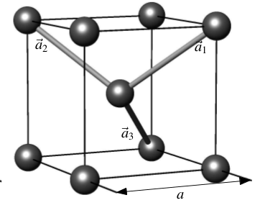
Extension of approximate “linear combination of atomic orbital” idea to larger systems – body centered cubic lattice

Slide 14
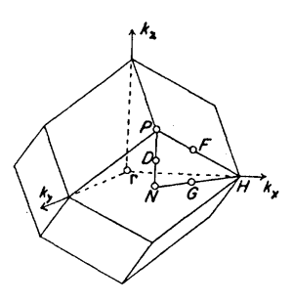
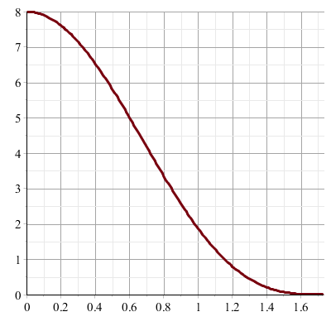
Γ
P

Slide 15
Honeycomb lattice (graphene sheet)
a

Slide 16
Tight binding electronic structure of graphite -- continued

Slide 17
