Slide 1
PHY 752 Solid State Physics
11-11:50 AM MWF Olin 107
Plan for Lecture 9:
Reading: Chapter 8 in MPM; Electronic Structure
Linear combination of atomic orbital (LCAO) method
Slater and Koster analysis
Wannier representation

Slide 2
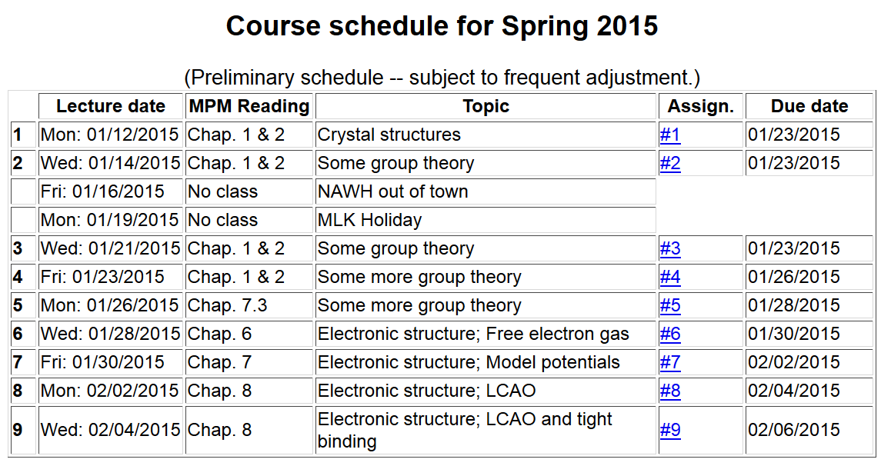

Slide 4
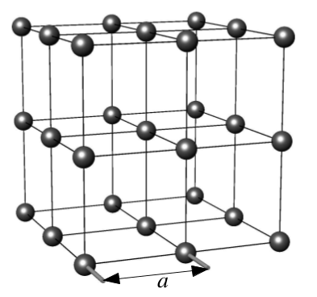
Linear combinations of atomic orbitals (LCAO) methods for analyzing electronic structure
Rª
periodic function
lattice translation
basis vector

Slide 5
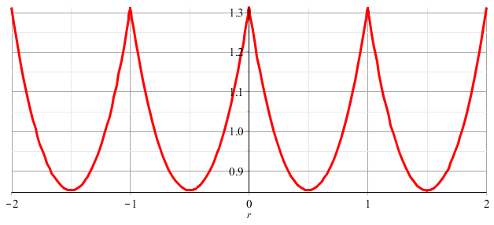
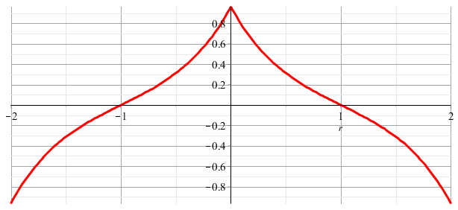
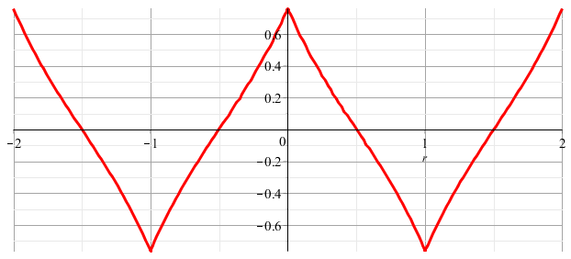
LCAO methods -- continued
k=0
k=π/2a
k=π/a

Slide 6
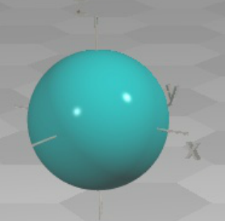
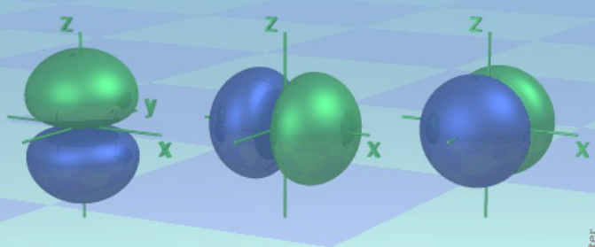
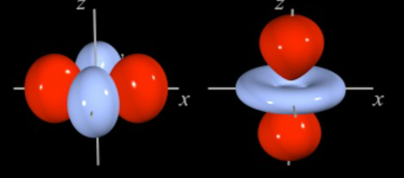
LCAO methods -- continued – angular variation
http://winter.group.shef.ac.uk/orbitron/
l=0
l=1
l=2

Slide 7
LCAO methods -- continued – angular variation
While, for atoms the “z” axis is an arbitrary direction, for diatomic molecules and for describing bonds, it is convenient to take the “z” axis as the bond direction.
Atom
symbol
l=0 m=0 s
l=1 m=0 p
m= ±1 p
l=2 m=0 d
m= ± 1 d
m= ± 2 d
Bond
symbol
l=0 λ=0 σ
l=1 λ=0 σ
λ=1 π
l=2 λ=0 σ
λ=1 π
λ= 2 δ

Slide 8
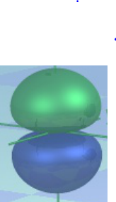
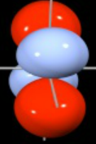
LCAO methods -- continued – bond types
ppσ
ssσ
ppπ
ddπ

Slide 9
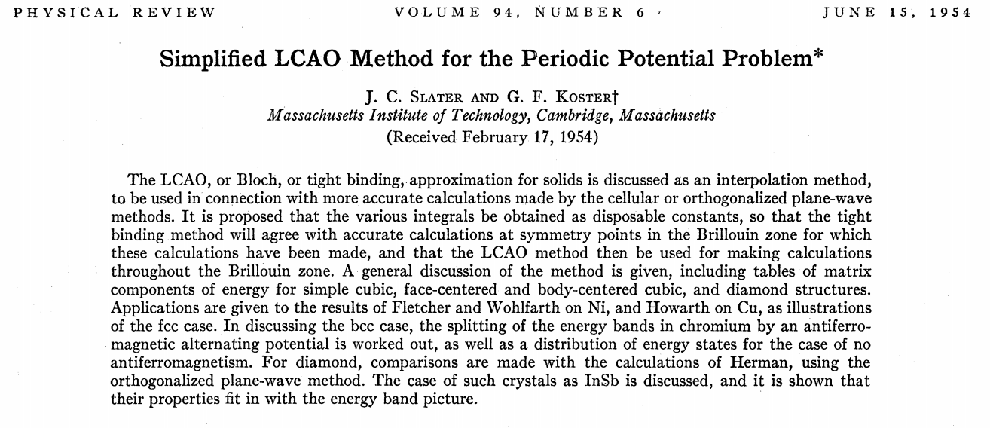

Slide 10
LCAO methods -- continued – Slater-Koster analysis

Slide 11
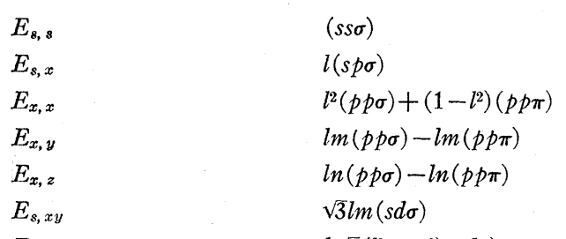
LCAO methods – Slater-Koster analysis -- continued
Notation in Slater-Koster paper

Slide 12
LCAO methods – Slater-Koster analysis -- continued
Simple cubic lattice
on site
NN
NNN

Slide 13
LCAO methods – summary

Slide 14
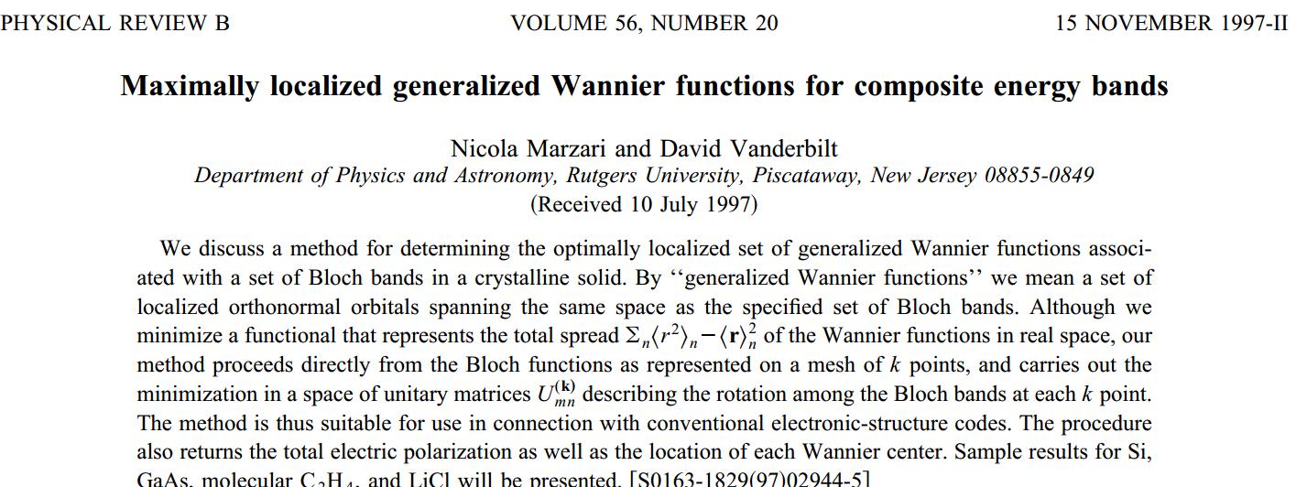
LCAO methods – summary
Is there a “best choice” for atom-centered functions?
Introduction to the Wannier representation

Slide 15
Wannier representation of electronic states
Note: This formulation is based on the relationship between the Bloch and Wannier representations and does not necessarily imply an independent computational method.

Slide 16
Wannier representation of electronic states -- continued
Comment: Wannier functions are not unique since the the Bloch function may be multiplied by a k-dependent phase, which may generate a different function W_{n}(r-T).

Slide 17
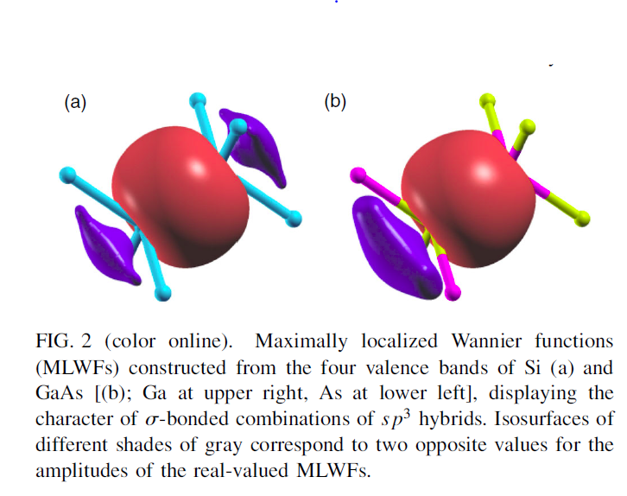
Example from RMP 84, 1419 (2012) by Mazari, Mostofi, Yates, Souza, and Vanderbilt

