Slide 1
PHY 712 Electrodynamics
9-9:50 AM MWF Olin 103
Plan for Lecture 7:
Start reading Chapter 3
Solution of Poisson equation in for special geometries –
Cylindrical
Spherical

Slide 2
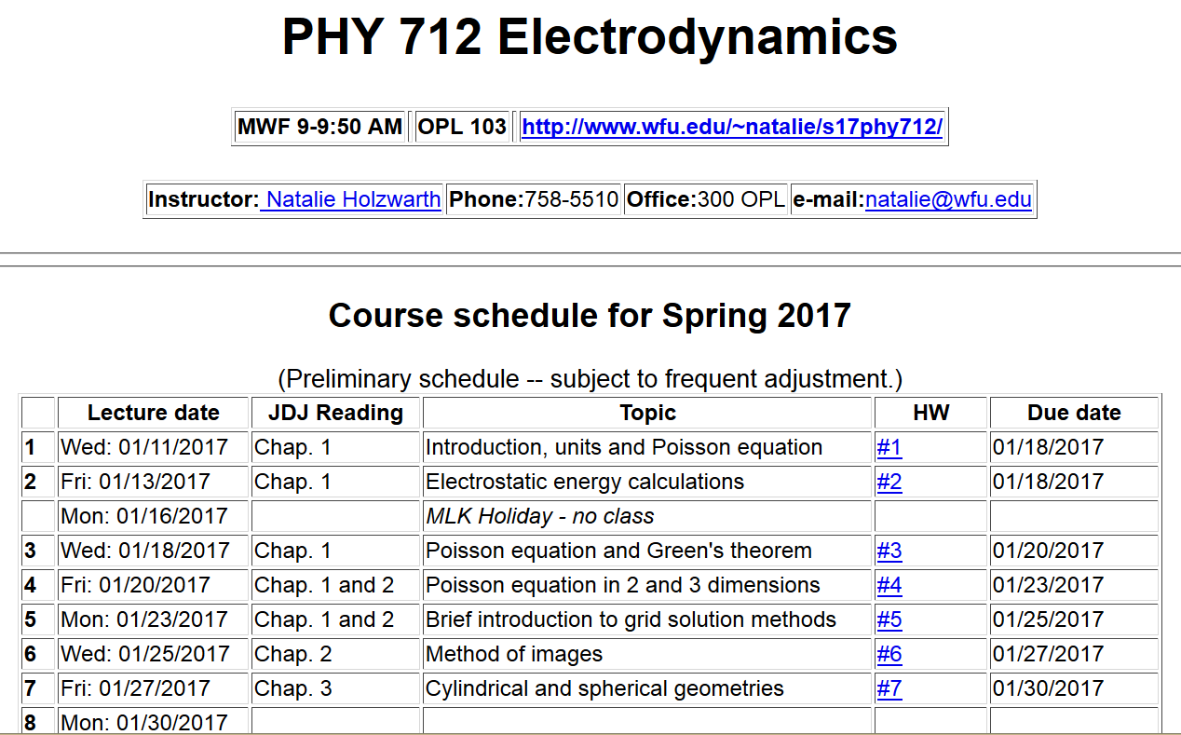

Slide 3
Solution of the Poisson/Laplace equation in various geometries -- cylindrical geometry with z-dependence
φ
ρ
z

Slide 4
Cylindrical geometry continued:
φ
ρ
z

Slide 5
Cylindrical geometry continued:
φ
ρ
z

Slide 6
Solutions of Laplace equation inside cylindrical shape
Example with non-trivial boundary value at z=L
m=0
m=1
m=2
kρ

Slide 7
Solutions of Laplace equation inside cylindrical shape
Example with non-trivial boundary value at z=L

Slide 8
Solutions of Laplace equation inside cylindrical shape
Example with non-trivial boundary value at ρ=a
m=0
m=1
m=2
kρ

Slide 9
Solutions of Laplace equation inside cylindrical shape
Example with non-trivial boundary value at ρ=a

Slide 10
Green’s function for Dirchelet boundary value inside cylindar:

Slide 11
Comments on cylindrical Bessel functions
m=0
K₀
I₀/50
J₀
N₀

Slide 12
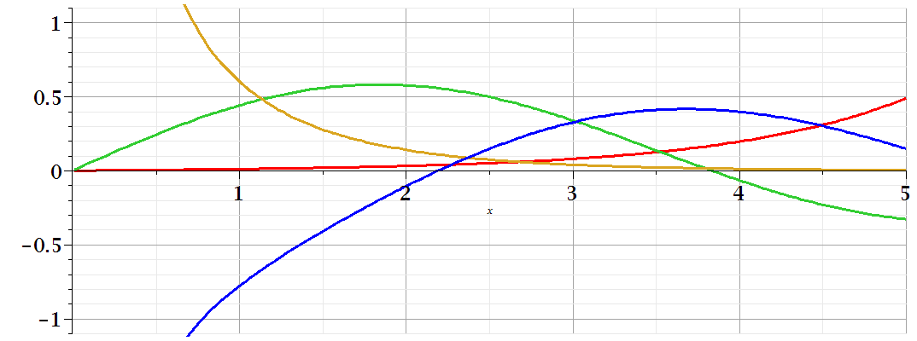
Comments on cylindrical Bessel functions
K₁
m=1
I₁/50
J₁
N₁

Slide 13
Some useful identities involving cylindrical Bessel functions

Slide 14
Poisson and Laplace equation in spherical polar coordinates
http://www.uic.edu/classes/eecs/eecs520/textbook/node32.html

Slide 15
Poisson and Laplace equation in spherical polar coordinates -- continued

Slide 16
Properties of spherical harmonic functions

Slide 17
Useful identity:

Slide 18
Example -- continued

Slide 19
Useful identity:

Slide 20
Useful identity:

Slide 21
Some spherical harmonic functions:

