Slide 1
PHY 712 Electrodynamics
9-9:50 AM Olin 103
Plan for Lecture 19:
Review Chapter 1-7 in Jackson
Brief review
Comments on some homework problems
Distribution of take home exam

Slide 2
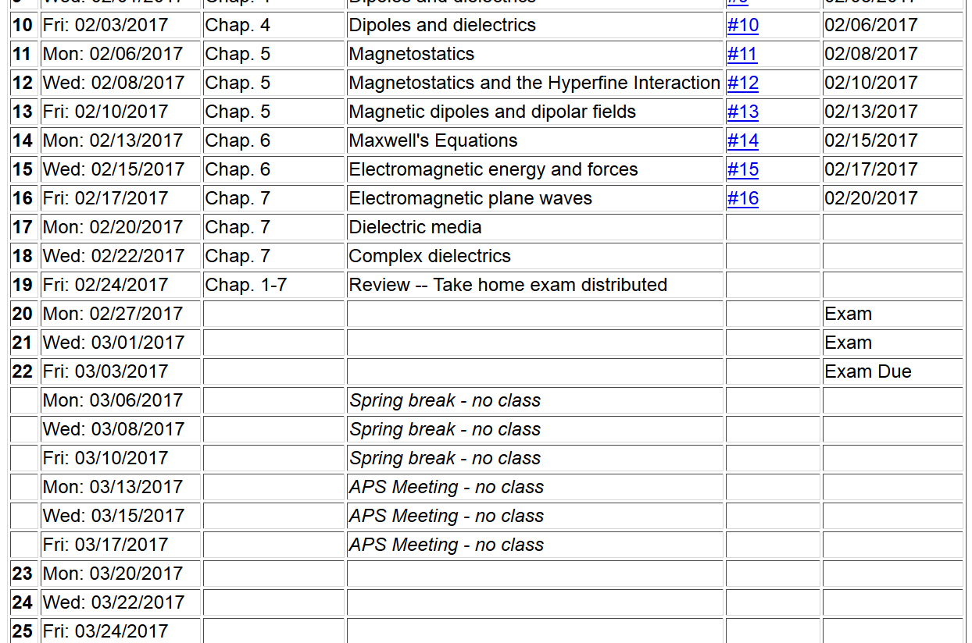

Slide 3
Review
Maxwell’s equations

Slide 4
Review -- continued
Maxwell’s equations

Slide 5
Review -- continued

Slide 6
Review -- continued

Slide 7
Review -- continued
When to solve equations using integral form
versus differential form?
Examples from electrostatic and magnetostatic cases:
Useful for spatially confined sources.

Slide 8
Review -- continued
Useful identity:

Slide 9
Review -- continued
Some spherical harmonic functions:

Slide 10
Review -- continued

Slide 11
Review -- continued
Hyperfine interaction energy:
Putting all of the terms together:
In this expression the brackets indicate evaluating the expectation value relative to the electronic state.

Slide 12
Review of HW problem:
4.9 in Jackson
A point charge q is located in free space a distance d from the center of a dielectric sphere of radius a (a<d) and dielectric constant ε/ε₀. Find the electrostatic potential.
a
q
d

Slide 13
Review of HW -- continued

Slide 14
a
q
d

Slide 16
Comment on HW #11
Consider an infinitely long wire with radius a, oriented along the z axis. There is a steady uniform current inside the wire. Specifically the current is along the z-axis with the magnitude of J₀ for ρ ≤ a and zero for ρ > a, where ρ denotes the radial parameter of the natural cylindrical coordinates of the system.
Find the vector potential (A) for all ρ.
Find the magnetic flux field (B) for all ρ.
Solution to problem using PHY 114 ideas
In this case, it is convenient to solve part b first.
Top view for ρ < a
Top view for ρ > a
J₀
B
B

Slide 17
Comment on HW #11 -- continued
Top view for ρ < a
Top view for ρ > a
B
B

Slide 18
Comment on HW #11 -- continued
J₀

Slide 19
Comment on HW #12
A sphere of radius a carries a uniform surface charge distribution σ. The sphere is rotated about a diameter with constant angular velocity ω. Find the vector potential A and magnetic field B both inside and outside the sphere.
ω
r

Slide 20
Comment on HW #12 -- continued

