Slide 1
PHY 712 Electrodynamics
9-9:50 AM Olin 103
Plan for Lecture 22:
Chap. 8 in Jackson – Wave Guides
Electromagnetic waves within an ideal rectangular wave guide
Electromagnetic waves within an ideal cylindrical wave guide
Energy considerations

Slide 2
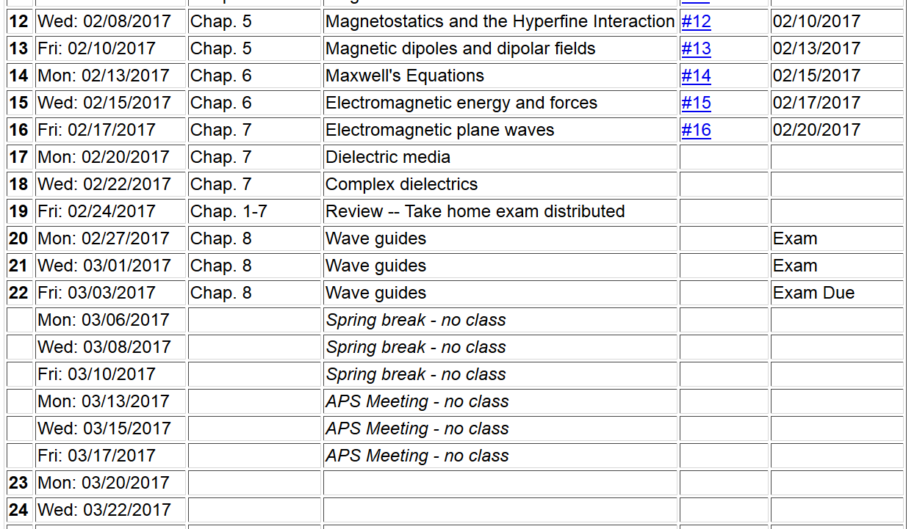

Slide 3
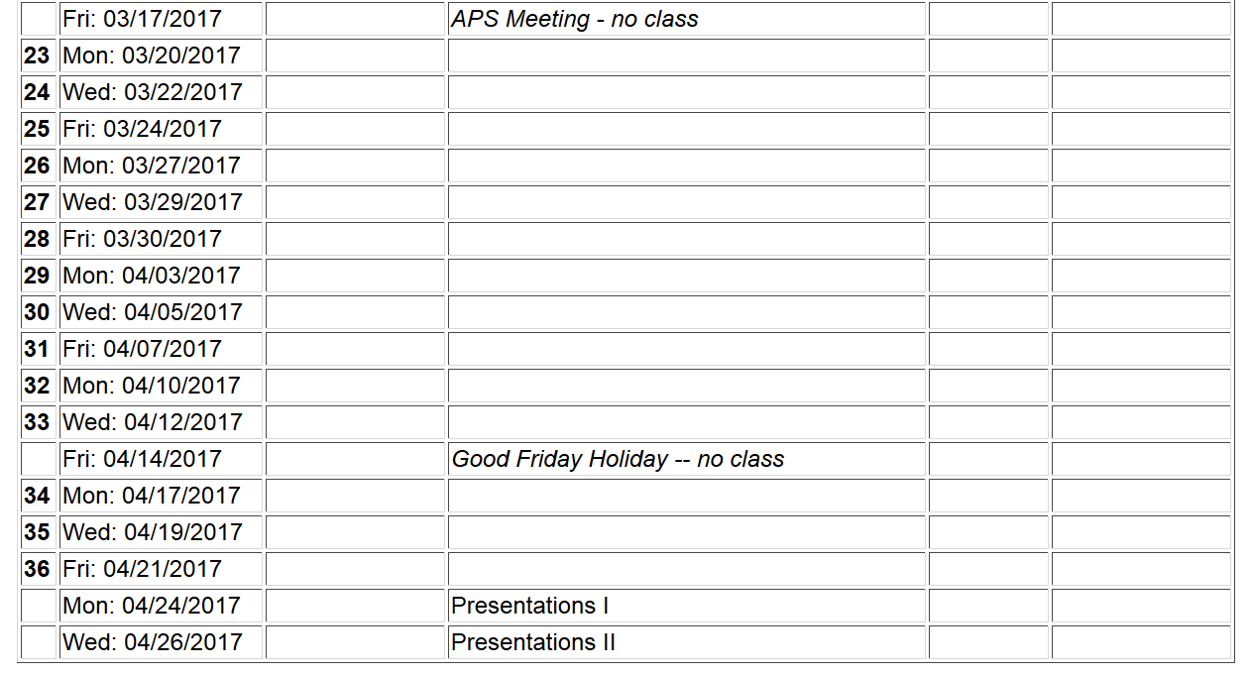
Comments:
Enjoy your spring break!
Please use part of the week of 3/13-17 to develop your presentation projects

Slide 4
Boundary conditions at surface of ideal metal

Slide 5
Analysis of rectangular waveguide
Boundary conditions at surface of waveguide:
y
x
z
Cross section view
b
a

Slide 6
Analysis of rectangular waveguide
y
x
z

Slide 7
Solution of Maxwell’s equations within the pipe:

Slide 8
Maxwell’s equations within the pipe in terms of all 6 components:
For TE mode
X
X
X

Slide 9
TE modes for retangular wave guide continued:

Slide 10
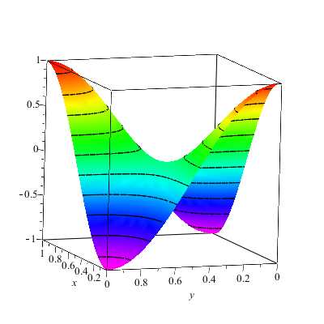
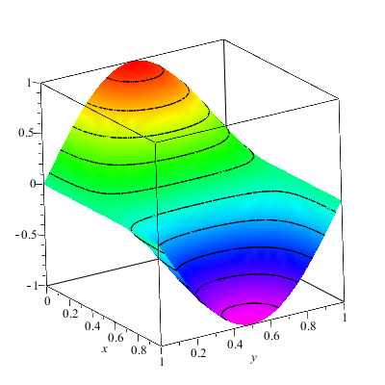
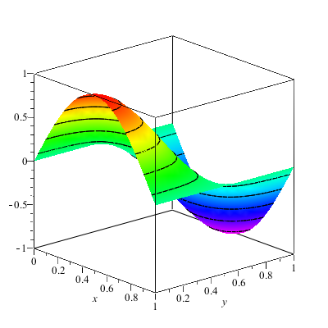
Solution for m=n=1

Slide 11
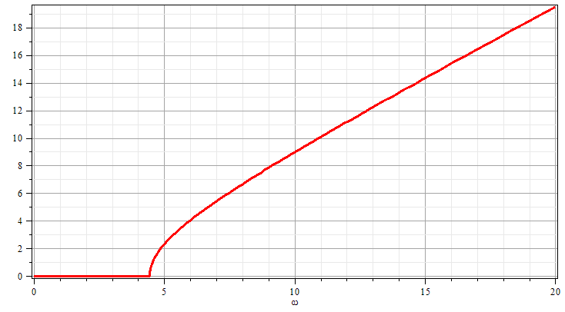
Solution for m=n=1
k
ω

Slide 12
Analysis of rectangular waveguide
y
x
z

Slide 15
Waveguides with rectangular cross section
b
a
Waveguides with circular cross section
a

Slide 16
Waveguides with circular cross section
a

Slide 17
Energy associated with wave guide modes
In practice, there are energy losses due conduction within the skin depth.

Slide 18
Comments:
Enjoy your spring break!
Please use part of the week of 3/13-17 to develop your presentation projects

