Slide 1
PHY 712 Electrodynamics
9-9:50 AM MWF Olin 103
Plan for Lecture 35:
Special Topics in Electrodynamics:
Electromagnetic aspects of superconductivity
Tunneling between two superconductors

Slide 2
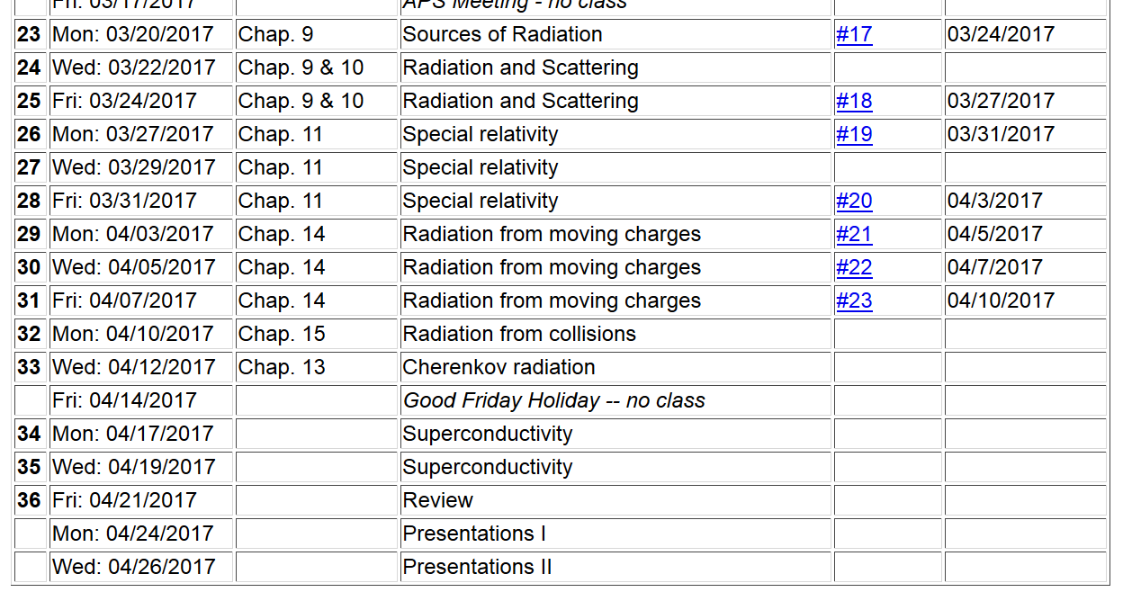

Slide 4
Review: London model of superconducting state

Slide 5
London model, continued

Slide 6
London model – continued

Slide 7
Behavior of superconducting material – exclusion of magnetic field according to the London model
λ_{L}
x

Slide 8
Quantization of current flux associated with the superconducting state (Ref: Ashcroft and Mermin, Solid State Physics)

Slide 9
Quantization of current flux associated with the superconducting state -- continued
Suppose a superconducting material has a cylindrical void. Evaluate the integral of the current in a closed path within the superconductor containing the void.
dl
Such “vortex” fields can exist within type II superconductors.

Slide 10
Josephson junction -- tunneling current between two superconductors (Ref. Teplitz, Electromagnetism (1982))
d
x
B_{z}

Slide 11
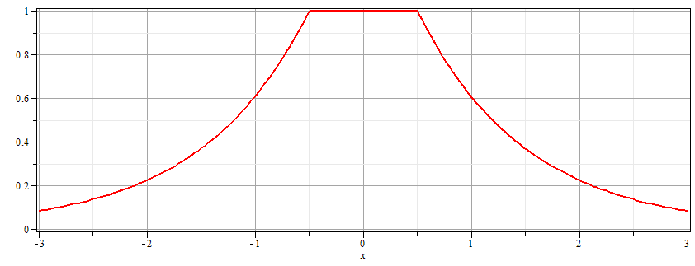
Josephson junction -- continued
Supercon left
Junction
Supercon right
B_{z}
d

Slide 12
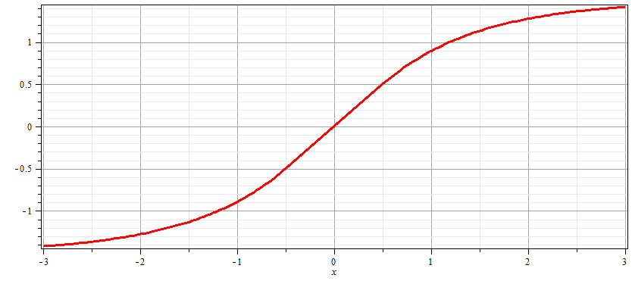
Josephson junction -- continued
Supercon left
Junction
Supercon right
A_{y}
d

Slide 13
Josephson junction -- continued
d
L
R
x
Coupling parameter

Slide 14
Josephson junction -- continued

Slide 15
Josephson junction -- continued
J_{L}
J_{R}
J_{T}
L
R
x

Slide 16
Josephson junction -- continued
J_{L}
J_{R}
J_{T}
L
R
x

Slide 17
Josephson junction -- continued
J_{L}
J_{R}
J_{T}
L
R
x

Slide 18
Josephson junction -- continued
J_{L}
J_{R}
J_{T}
L
R
x
B_{z}

Slide 19
Josephson junction -- continued
J_{L}
J_{R}
J_{T}
L
R
w
w
x

Slide 20
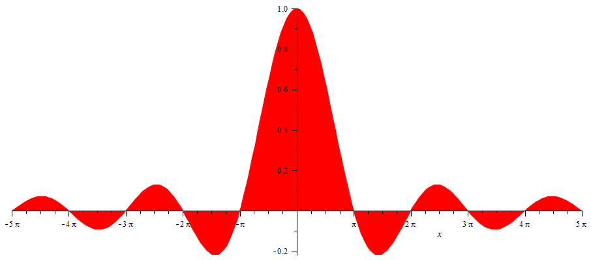
Josephson junction -- continued
SQUID =superconducting quantum interference device
I_{T}
Φ/Φ₀
Note: This very sensitive “SQUID” technology has been used in scanning probe techniques. See for example, J. R. Kirtley, Rep. Prog. Physics 73, 126501 (2010).

Slide 21
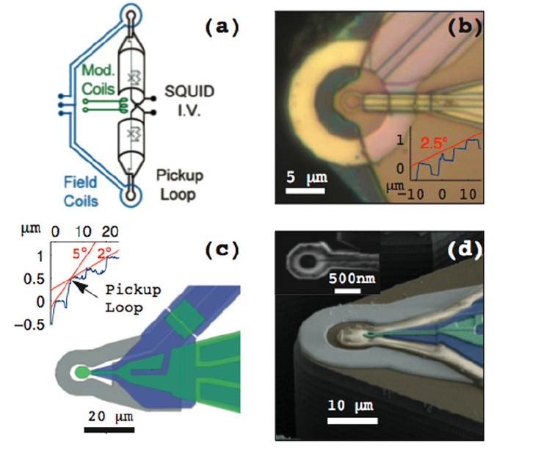
Scanning SQIUD microscopy
Ref. J. R. Kirtley, Rep. Prog. Phys. 73 126501 (2010)

Slide 22
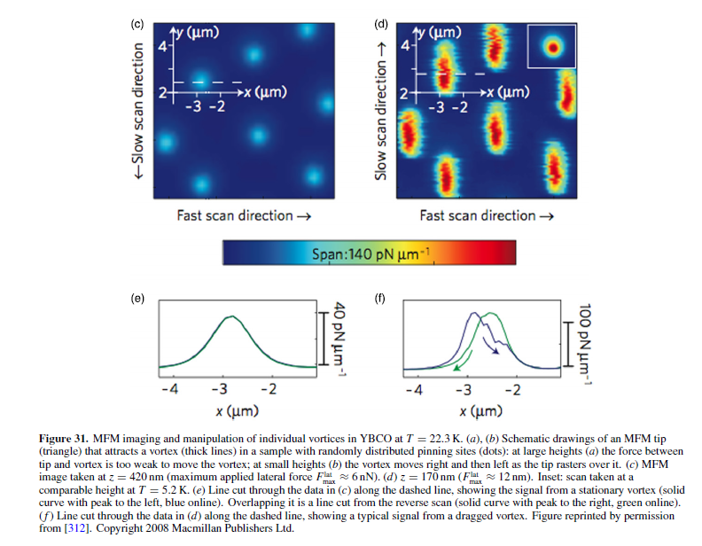

Slide 23
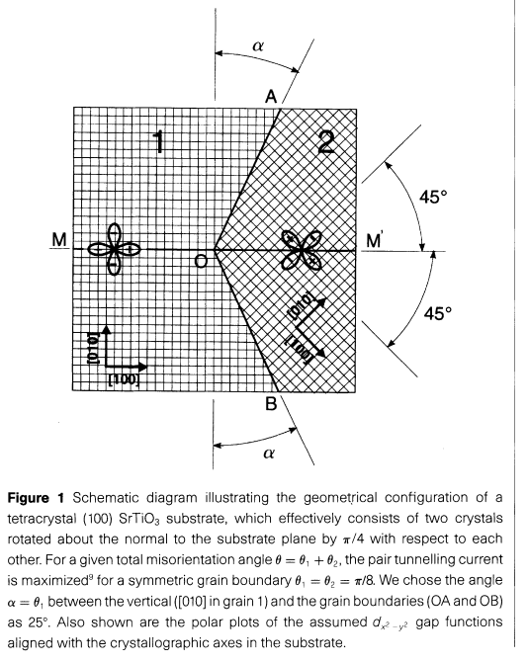
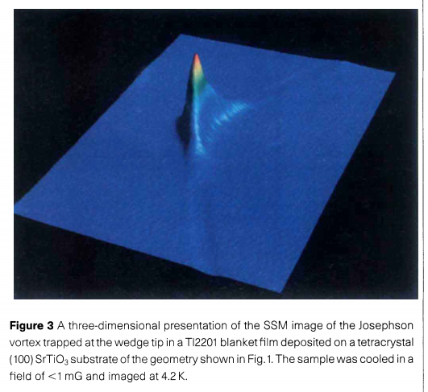
pg. 481

