Slide 1
PHY 712 Electrodynamics
9-9:50 AM MWF Olin 103
Plan for Lecture 36:
Review of Electrodynamics
Units
Problem solving strategies
Examples
Course evaluation forms

Slide 2
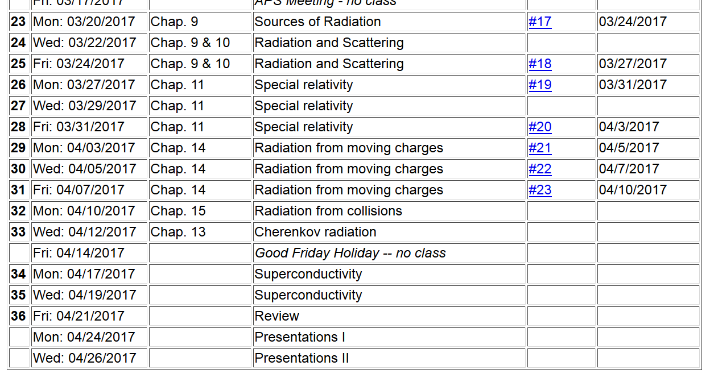

Slide 3
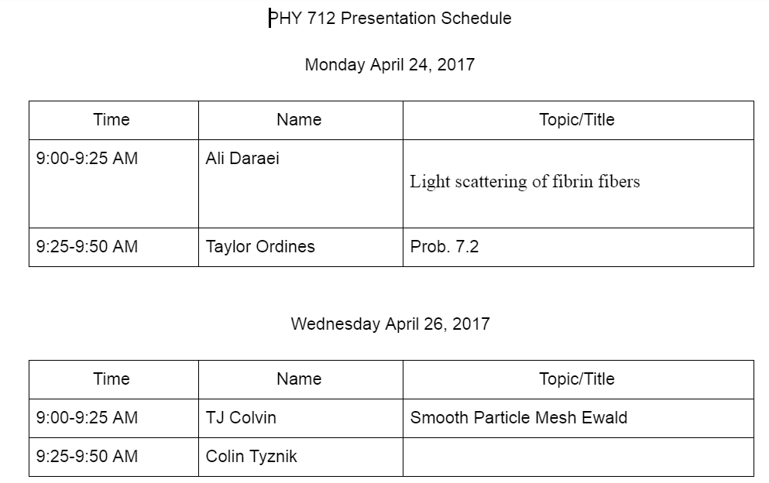

Slide 5
Example problems --

Slide 6
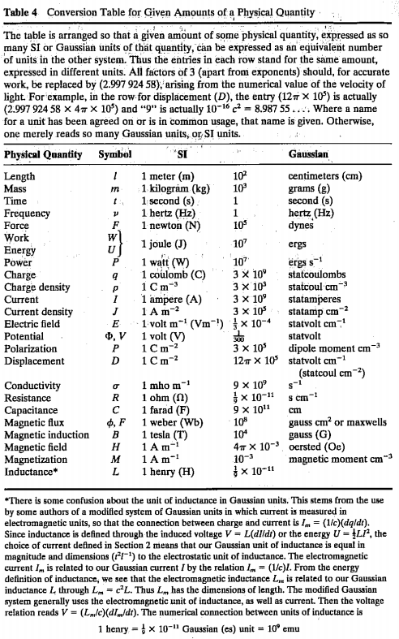
Jackson
pg. 783

Slide 7
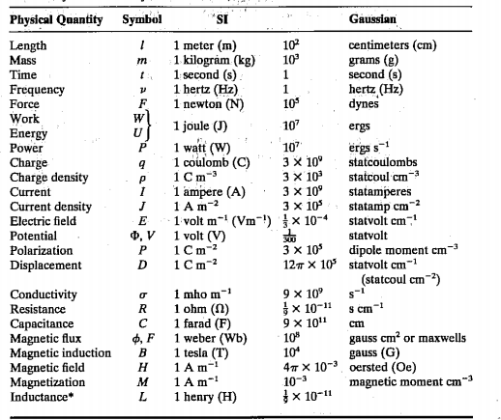

Slide 8
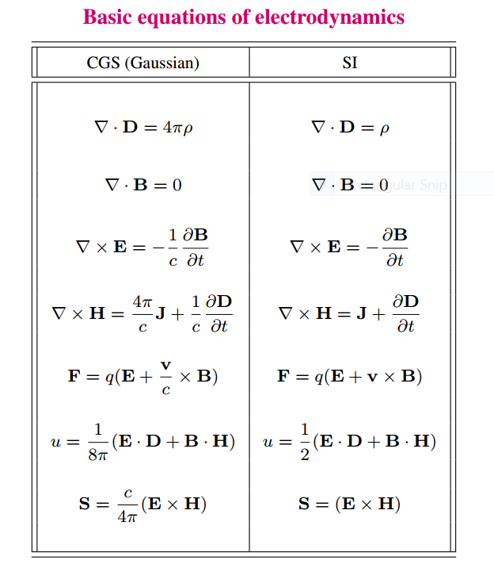

Slide 9
elementary charge: e=1.6021766208 x 10⁻¹⁹ C
=4.80320467299766 x 10⁻¹⁰ statC

Slide 10
Energy and power (SI units)

Slide 14
In your “bag” of tricks:
Direct (analytic or numerical) solution of differential equations
Solution by expanding in appropriate orthogonal functions
Green’s function techniques

Slide 15
How to choose most effective solution method --
In general, Green’s functions methods work well when source is contained in a finite region of space

Slide 17
Electromagnetic waves from time harmonic sources

Slide 18
Electromagnetic waves from time harmonic sources – continued:

Slide 19
Electromagnetic waves from time harmonic sources – continued:

Slide 20
Electromagnetic waves from time harmonic sources – continued:

Slide 21
Electromagnetic waves from time harmonic sources – continued:

Slide 22
Example of dipole radiation source

Slide 23
Example of dipole radiation source -- continued
Relationship to pure dipole approximation (exact when kR➔0)

Slide 24
Electromagnetic waves from time harmonic sources – for dipole radiation --:

Slide 25
Radiation from a moving charged particle
z
.
v
r-R_{q}(t_{r})=R
q
Θ
r
R_{q}(t)
y
x

Slide 26
Liènard-Wiechert potentials –(Gaussian units)

Slide 27
Electric and magnetic fields far from source:

Slide 28
Poynting vector:

