Slide 1
PHY 745 Group Theory
11-11:50 AM MWF Olin 102
Plan for Lecture 1:
    Reading: Chapters 1 in DDJ (Dresselhaus, Dresselhaus, and Jorio)
      Course structure and expectations
      Definition of a group
      Some examples

Slide 2
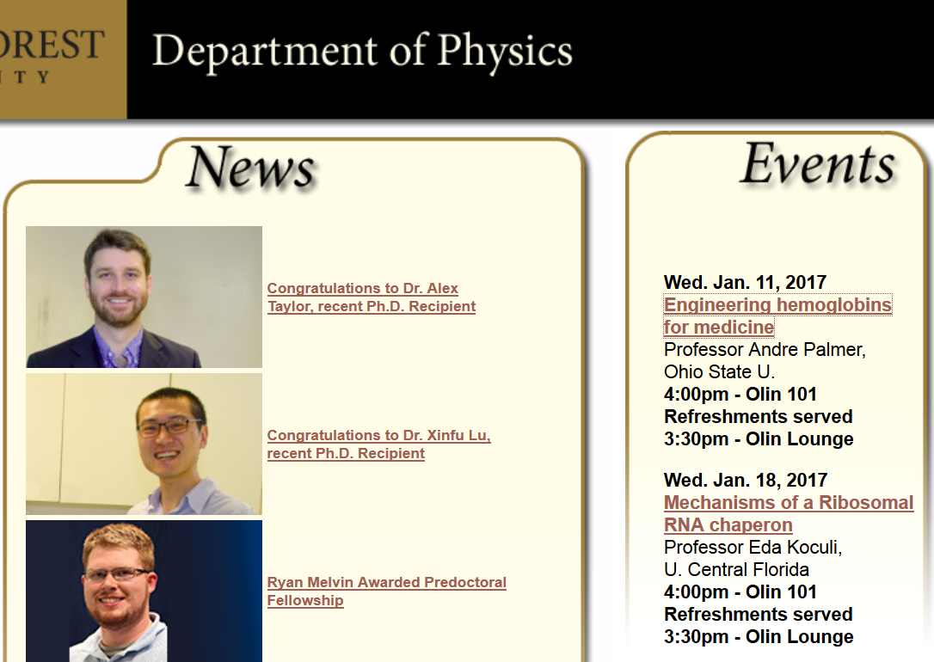

Slide 3
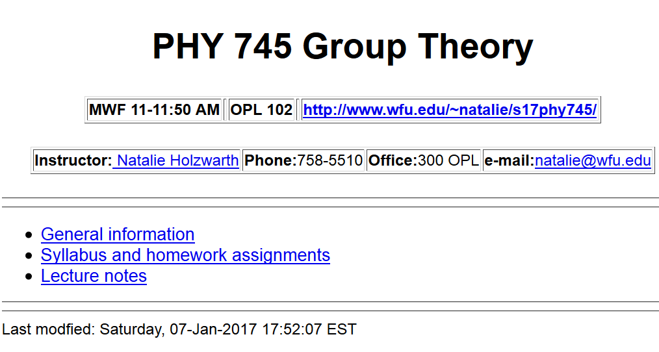
http://users.wfu.edu/natalie/s17phy745/

Slide 4
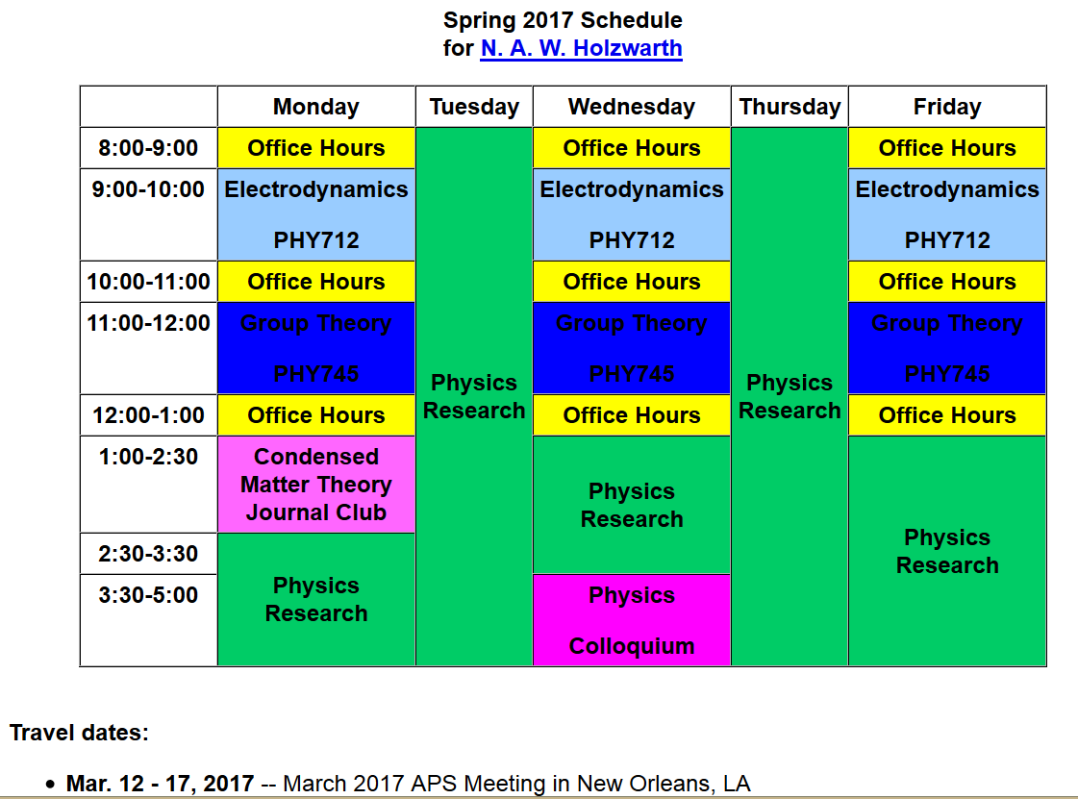

Slide 5
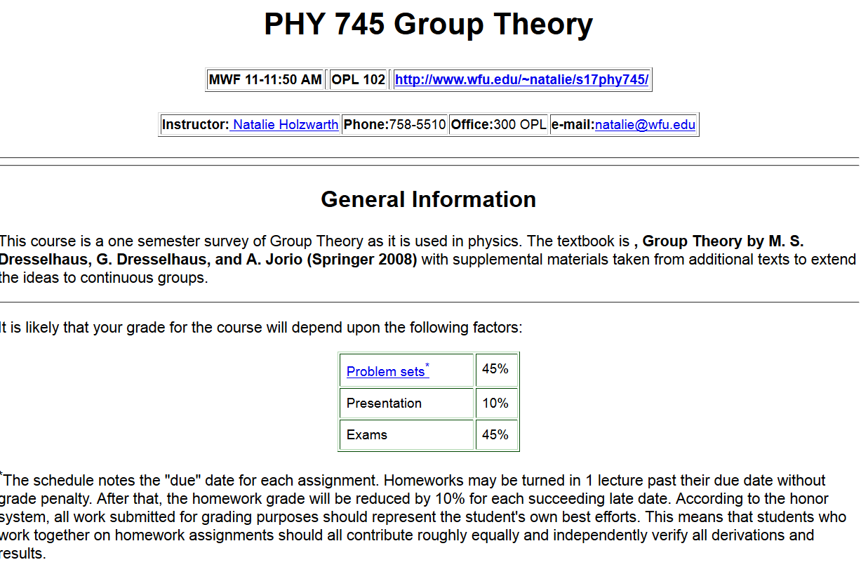

Slide 6
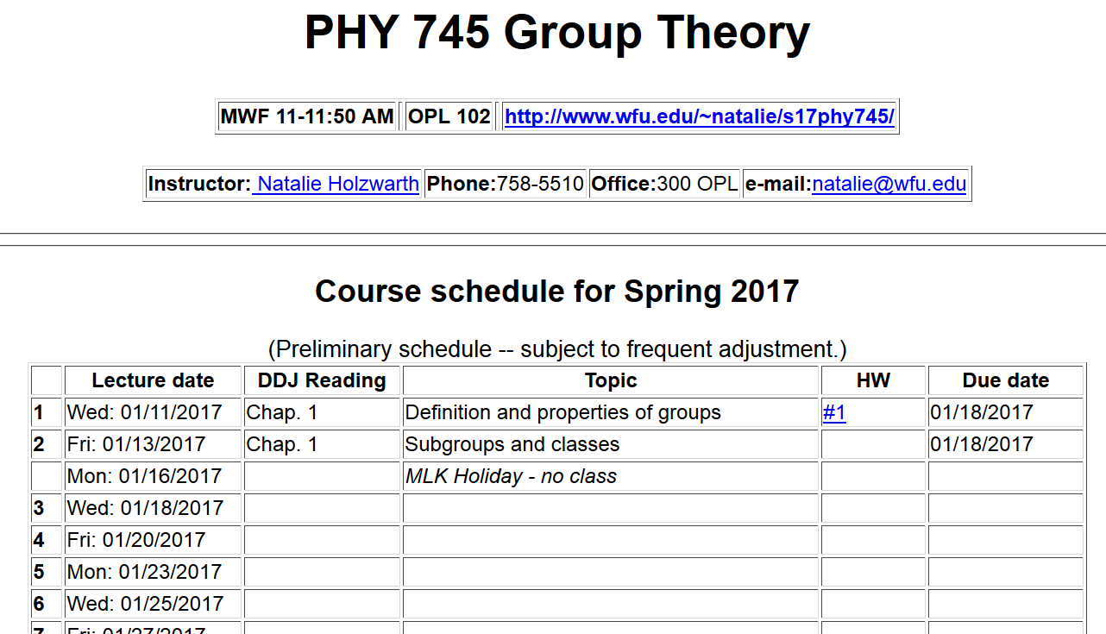

Slide 7
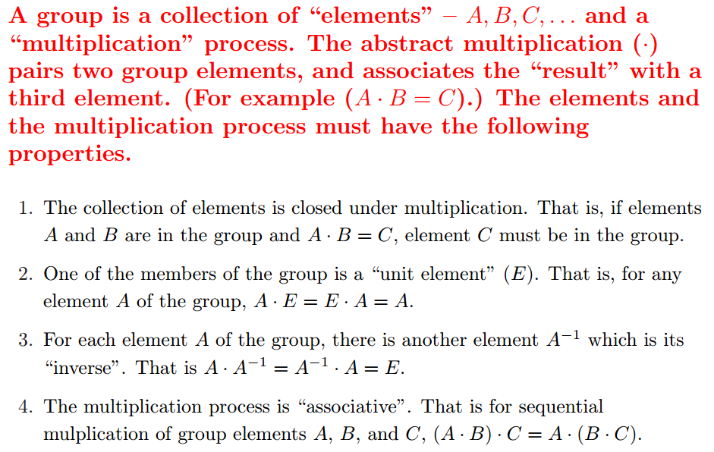
Group theory
  An abstract algebraic construction in mathematics
  Definition of a group:

Slide 8
Some definitions:
Order of the group ➔ number of elements (members) in the group (positive integer for finite group, ∞ for infinite group)
Subgroup ➔ collection of elements within a group which by themselves form a group
What does this have to do with physics?
  Provides valuable analysis tools for physical objects we know – crystals, molecules, etc.
  Provides framework for understanding physical processes we don’t yet understand – particle physics

Slide 9

Examples of group theory applied to crystals
http://www.cryst.ehu.es/

Slide 10
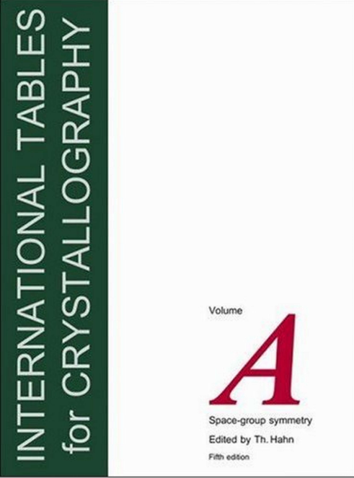
230 space groups
32 point groups

Slide 11
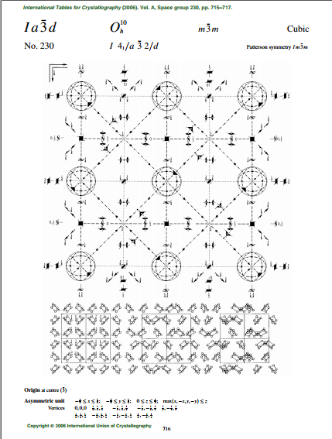
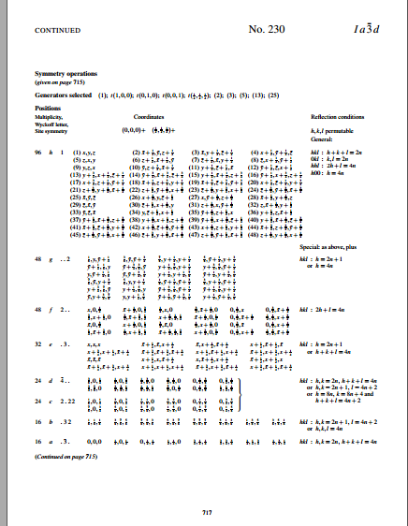
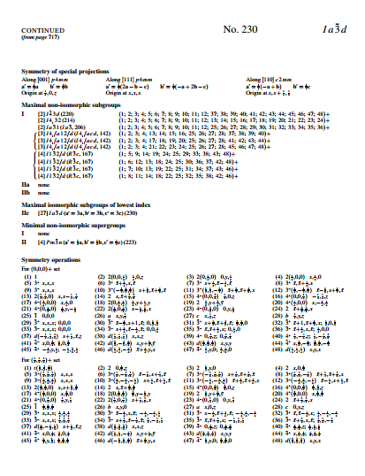

Slide 12
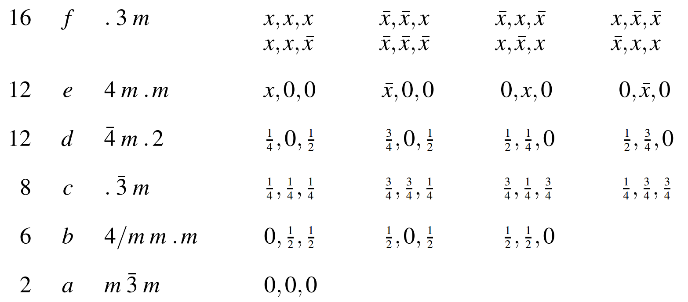
Some details from the International Tables of Crystallography
Wyckoff letter
Symmetry
Fractional coordinates of sites

Slide 13
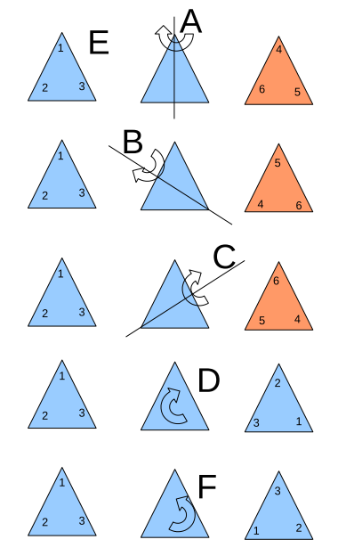
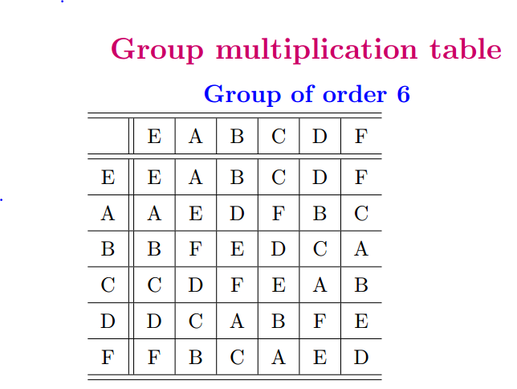
Example of a 6-member group E,A,B,C,D,F,G

Slide 14
Check on group properties:
Closed; multiplication table uniquely generates group members.
Unit element included.
Each element has inverse.
Multiplication process is associative.
Subgroup: members of larger group which have the property of a group
Note that the orders of the subgroups are 1, 2, 3 which are divisors of the order of the group (6).

Slide 15
Other details
Coset: Given a subgroup g_{i} of a group g a right coset can be formed by multiply an element of g with each element of g_{i}
Note that each pair of right cosets are either identical or completely distinct.

Slide 16
Notions of subgroups and their cosets result in the theorem: The order of a subgroup is a divisor of the order of the group.
Definition:
Definition:
A class is composed of members of a group which are generated by the conjugate construction:

Slide 17
For our example:

Slide 19
Other examples –
Groups of order 1: E (only possibility)
Groups of order 2: E, A with A²=E (only possibility)
Groups of order 3: E, A, B with A²=B and A³=E
Groups of order 4:
Possibility #1
Possibility #2
 | E | A | B | C
E | E | A | B | C
A | A | B | C | E
B | B | C | E | A
C | C | E | A | B
 | E | A | B | C
E | E | A | B | C
A | A | E | C | B
B | B | C | E | A
C | C | B | A | E
5. Groups of prime order are always cyclic and Abelian.

Slide 20
Special groups and terminologies
  A group is called Abelian if for every pair of elements A,B; AB=BA.
  A group is called cyclic if all the elements can be formed according to
  n is called the order of X (the period).
Recall for n=4 example:
 | E | A | A² | A³
E | E | A | A² | A³
A | A | A² | A³ | E
A² | A² | A³ | E | A
A³ | A³ | E | A | A²
 | E | A | B | C
E | E | A | B | C
A | A | B | C | E
B | B | C | E | A
C | C | E | A | B
➔

