Slide 1
PHY 745 Group Theory
11-11:50 AM MWF Olin 102
Plan for Lecture 10:
Introduction to groups having infinite dimension
Reading: Eric Carlson’s lecture notes
Example – 3-dimensional rotation group
Some properties of continuous groups

Slide 2
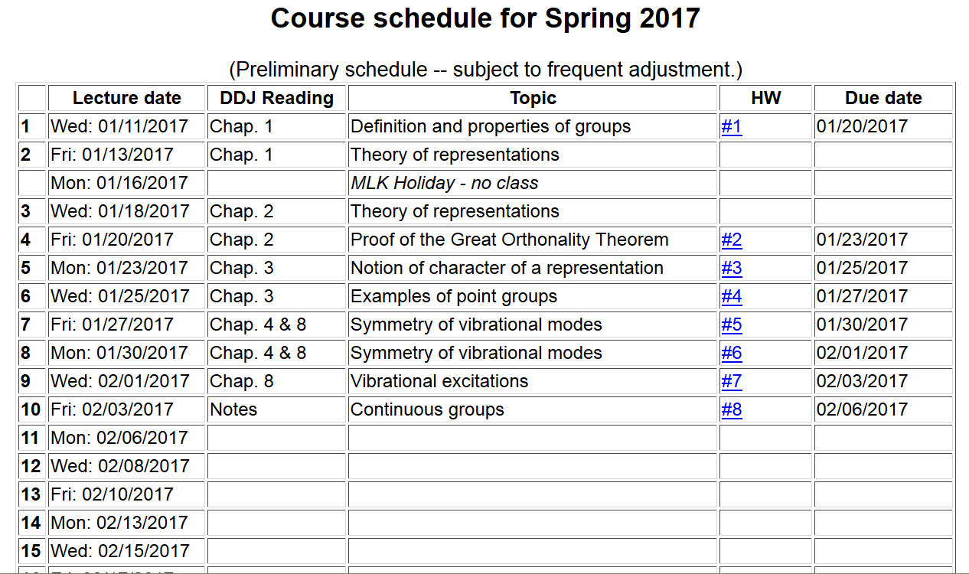

Slide 4
Evidently, the set of all rotations α about the z-axis form a group
Thanks to Euler, we can generalize the notion to say that all
three-dimensional rotations form a group

Slide 5
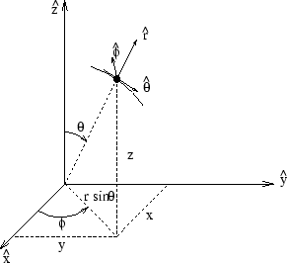
Spherical polar coordinates
http://www.uic.edu/classes/eecs/eecs520/textbook/node32.html

Slide 6
Spherical harmonic basis functions:

Slide 7
It can be shown that

Slide 8
Case for l=1 – continued --

Slide 10
Now consider the great orthogonality theorem:

Slide 11
Procedure for carrying out integration over group elements

Slide 12
Digression – “generators” of the three-dimensional rotation group
Consider rotation by an angle α about the z-axis
y
α
φ
x

