Slide 1
PHY 745 Group Theory
11-11:50 AM MWF Olin 102
Plan for Lecture 12:
Continuous groups, their representations, and the great orthogonality theorem
    Reading: Eric Carlson’s lecture notes
    Additional reference: Eugene Wigner, Group Theory
      Importance of commutation relations
      Integral relations

Slide 2
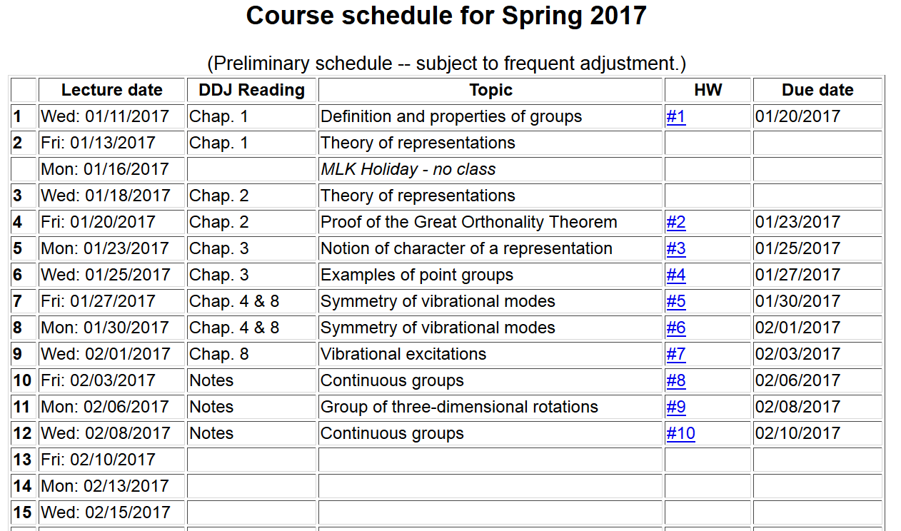

Slide 3
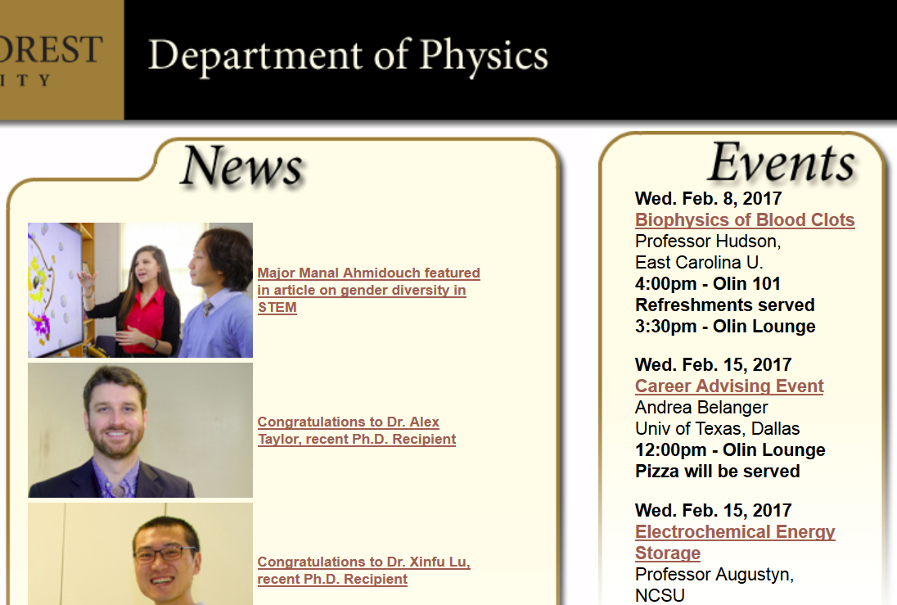

Slide 4
Group structure of SO(3) and SU(2)

Slide 5
Group structure of SO(3) and SU(2)

Slide 8
Now consider the great orthogonality theorem:

Slide 9
Procedure for carrying out integration over group elements

Slide 10
Analysis of continuum properties of continuous groups, following notes of Professor Eric Carlson.

Slide 11
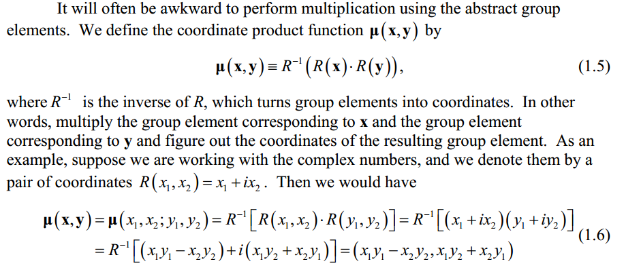
Some details from Professor Carlson’s Notes:

Slide 12
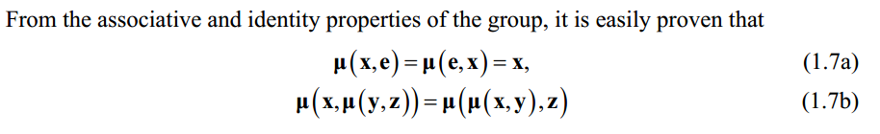
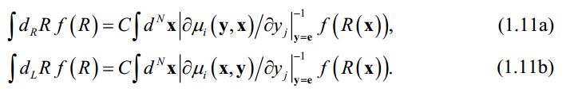
Use of measure function to perform needed integrals
Jacobian for left or right measures
Normalization constant

Slide 13

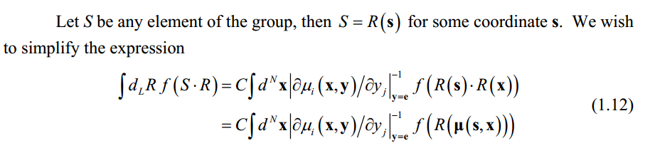
We are particularly interested in showing that the great orthogonality theorem holds for continuous groups which requires :
Proof from Professor Carlson’s notes:

Slide 14
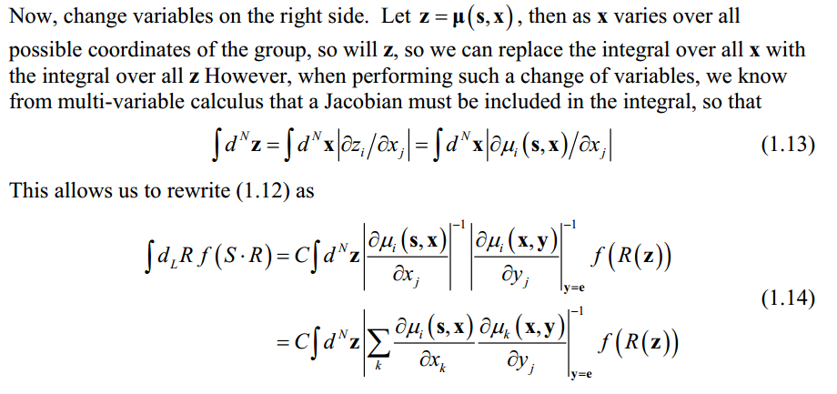
Changing variables --

Slide 15
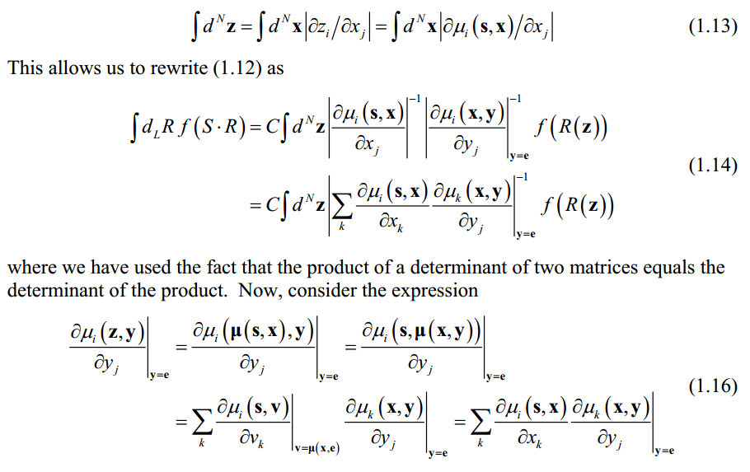
Using z varable:

Slide 16
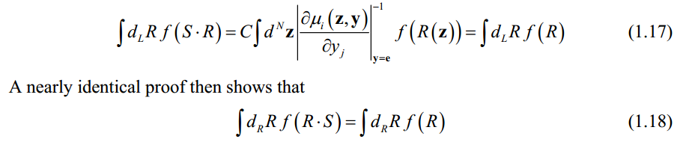
When the dust clears:
These arguments form the basis of the extension of the great orthogonality theorem to continuous groups. See Professor Carlson’s notes for more details.

